Slide 1
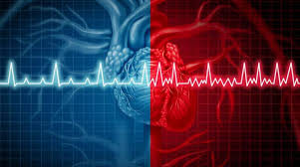
ATRIALL FIBRILLITION
Assist. Lec. Sura abbas
Medicine ward

Slide 2
Introduction
HF is increasingly recognized as a cause of AF; approximately 25% to 30% of patients with New York Heart Association (NYHA) class III HF
have AF.
and the arrhythmia is present in as many as 50% of patients with NYHA class IV HF.

Slide 3
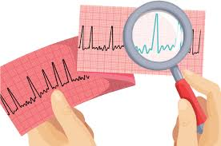
CLASSIFICATION OF AF

Slide 4
Classification of AF
AF is categorized into specific classifications.
Paroxysmal AF is defined as that which terminates spontaneously or with interventions within 7 days of onset. Patients with paroxysmal AF have episodes that begin suddenly and spontaneously, last minutes to hours, or sometimes as long as 7 days, and often terminate suddenly and spontaneously. Episodes may recur with variable frequency.
Persistent AF is defined as continued AF that lasts longer than 7 days.
Long-standing persistent AF is defined as continuous AF lasting 12 months or longer.
The term permanent AF is used when patient and clinician jointly decide to terminate further attempts to restore and/or maintain sinus rhythm.

Slide 5
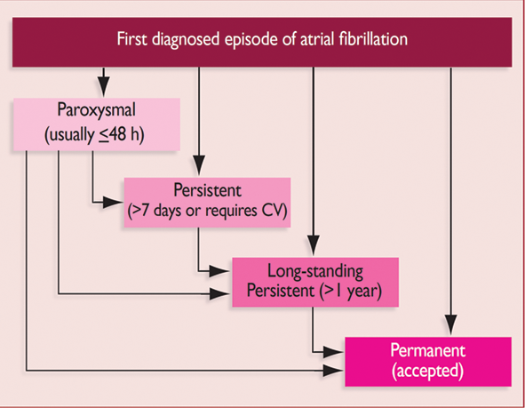

Slide 6
AF and stroke
AF is associated with substantial morbidity and mortality.
This arrhythmia is associated with a risk of ischemic stroke of approximately 5% per year.
AF is the cause of roughly one of every six
strokes.

Slide 7
During AF, atrial contraction is absent. Because atrial contraction is responsible for approximately 30% of LV filling, this blood that is not ejected from the left atrium to the left ventricle pools in the atrium, particularly in the left atrial appendage.
Blood pooling facilitates the formation of a thrombus, which subsequently may travel through the mitral valve into the left ventricle and may be ejected during ventricular contraction.
The thrombus then may travel through a carotid artery into the brain, resulting in an ischemic stroke. Patients with AF are also at increased risk for systemic thromboembolism.

Slide 8
Treatment
Desired Outcomes The goals of individualized therapy for AF are:
(a) ventricular rate control;
(b) termination of AF and restoration of sinus rhythm (commonly referred to as “cardioversion” or “conversion to sinus rhythm”);
(c) maintenance of sinus rhythm, or reduction in the frequency of episodes of paroxysmal AF;
(d) prevention of stroke and systemic thromboembolism.
These goals of therapy do not necessarily apply to all patients; the specific goal(s) that apply depend on the patient’s AF classification

Slide 10
Atrial Fibrillation (AF) or Flutter – Recent Onset
Hemodynamically Unstable AF For patients who present with an episode of AF that is Hemodynamically unstable, emergent conversion to sinus rhythm is necessary using direct current cardioversion (DCC).
Hemodynamic instability may be defined as the presence of any one of the following: (a) acutely altered mental status; (b) hypotension (systolic blood pressure less than 90 mm Hg) or other signs of shock; (c) ischemic chest discomfort; and/or (d) acute HF.

Slide 11
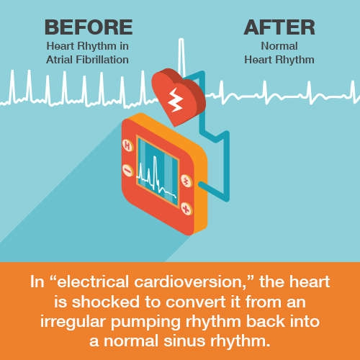

Slide 12
If the patient is hemodynamically stable (no reduced conscious level, systolic BP >90mmHg, no chest pain and no heart failure) and onset <48 hours, consider chemical cardioversion or DCC.

Slide 13
Decision algorithm for conversion of hemodynamically stable atrial fibrillation to normal sinus rhythm

Slide 14
Chemical cardioversion
Options include:
Amiodarone IV 300mg infused over 1 hour then 900mg over 24 hours through a central line (preferable) or large peripheral line or
Flecainide IV 2mg/kg, up to 150mg, over 30 minutes if no structural or coronary heart disease.

Slide 15
Ventricular rate control
Control ventricular rate with oral beta-blocker or rate-limiting calcium channel blocker (or digoxin if heart failure is present).
Remember – many cases of new onset AF or flutter will spontaneously revert to sinus rhythm – particularly if there is an obvious precipitating cause such as pneumonia, alcohol intoxication, hyperthyroidism or surgery.
Cardioversion is much less successful in established AF or flutter than in new onset, and, if being considered, should not be delayed. Anticoagulant cover required if onset >48 hours, so 4 – 6 week delay required.

Slide 16
Decision algorithm for selecting drug therapy for ventricular rate control

Slide 17
Maintenance of Sinus Rhythm
Decision algorithm for maintenance of sinus rhythm/reduction in the frequency of episodes of atrial fibrillation (AF) for patients with symptomatic paroxysmal or persistent AF despite rate control therapy

Slide 18
Maintenance of Sinus Rhythm
Options include beta-blocker, sotalol, flecainide and amiodarone depending upon circumstances and patient factors
Amiodarone loading regime is amiodarone oral 200mg three times daily for 1 week then 200mg twice daily for 1 week then 200mg daily.

Slide 19
Notes
N.B. Ideally, check baseline thyroid and liver function tests before starting. Interactions include digoxin and simvastatin (see BNF Appendix 1 for more details).
N.B. Deal with precipitants of AF: Infection, alcohol, hyperthyroidism, heart failure

Slide 20
Atrial Fibrillation (AF) – Persistent
Therapeutic Objectives:
1. Relieve symptoms – often only rate control required; diuretic may also be needed (often only on temporary basis).
2. Target ventricular (apex or ECG) rate <110bpm. If still symptomatic, aim for lower rate, <80bpm.
3. Assess thromboembolic risk and anticoagulate as appropriate (see flow chart further on).
4. In some cases, consider restoration of sinus rhythm by electrical or pharmacological cardioversion (only attempt chemical or electrical cardioversion after adequate anticoagulation with warfarin; risk of thromboembolism if not anticoagulated; limited long-term success).
5. Treat concomitant LV systolic dysfunction / heart failure.

Slide 21
Ventricular rate control in persistent AF
1. Target ventricular (apex or ECG) rate <110bpm. If still symptomatic then aim for lower rate, <80bpm.
2. Patients without heart failure should be started on either:
A beta-blocker – choice includes:
Bisoprolol oral 2.5mg daily and up-titrate to 5mg once daily if ventricular rate is still >110bpm or
Atenolol oral 25mg twice daily and up-titrate to 50mg twice daily if ventricular rate is still >110bpm. In frail or elderly patients consider starting dose of atenolol oral 25mg once daily.

Slide 22
Or
A rate-limiting calcium-channel blocker (CCB) i.e. verapamil or diltiazem (but avoid if LV systolic dysfunction)- Start with verapamil (slow release) oral 120mg once daily and titrate up to 240mg once daily if ventricular rate still >110bpm.

Slide 23
Digoxin has a limited role as first-line treatment for ventricular rate control. It can be used in combination with a beta-blocker / rate-limiting CCB when control of the ventricular rate is difficult.
3. Patients with heart failure should be started on digoxin and follow the NHSGGC Heart Failure guideline.
Heart failure / LV Systolic Dysfunction
ACE inhibitors and beta-blockers are strongly recommended. Beta-blockers must be initiated under direction of a hospital physician. Rate-limiting CCBs should be avoided

Slide 24

This Photo by Unknown Author is licensed under CC BY-NC-ND

Slide 25
Prevention of stroke / thromboembolism
Patients with both recurrent paroxysmal AF and sustained AF have a high risk of thromboembolism, particularly stroke.
This risk is greatest in patients with certain risk factors.
For primary prevention, anticoagulants can substantially reduce risk of thromboembolism.
Patients with AF and a previous stroke or transient ischemic attack (TIA) have an absolute risk of a further stroke of the order of 10–12% per annum and an absolute benefit of approximately 80 fewer strokes per 1000 patient years of treatment.
Advanced age is not a contraindication to anticoagulation.
In patients with 'lone' AF, i.e. AF in a structurally normal heart and no other risk factors for thromboembolic disease (CHA2DS2-VASC = 0), no anti-thrombotic or anticoagulant therapy is recommended.

Slide 26
Who should receive anticoagulant therapy
Patients with clinical risk factors or echocardiographic risk factors
Patients without contraindications to Anticoagulant therapy.

Slide 27
Cautions / contraindications to anticoagulant therapy
Absolute contraindications include: active bleeding, pregnancy, stroke <14 days.
Relative contraindications include: significant bleeding risk e.g. active peptic ulcer or recent head injury; bleeding in the last 6 months; previous cerebral hemorrhage.
Cautions include: recurrent falls, alcohol abuse.

Slide 28
Choice of agent: new oral anticoagulant agents (NOACs) vs warfarin
Pros of NOACs
More stable anticoagulation
No requirement for anticoagulant monitoring
Fewer food and drug interactions
Fewer intracranial bleeds
Cons of NOACs
No specific antidote
More gastrointestinal bleeding with dabigatran and rivaroxaban, especially in the elderly
Remember: NOACS are indicated only in those patients who have non-valvular AF; not those with mitral stenosis or a mechanical valve.

Slide 29
Combined anticoagulant and antiplatelet therapy
Adding aspirin to warfarin in AF does not reduce the risk of stroke (except with prosthetic heart valves) but substantially increases the risk of bleeding.
The combination is generally not indicated in stable coronary disease, but there are some circumstances, such as after an acute coronary event or PCI, when short-term combined double or triple therapy is used according to cardiologist advice.

Slide 31
Non-valvular Atrial fibrillation (paroxysmal, persistent or permanent)

Slide 32
New anticoagulants (direct thrombin and Factor Xa inhibitors)
New anticoagulants:
Apixaban oral 5mg twice daily
Dabigatran oral 150mg twice daily
Rivaroxaban oral 20mg once daily
Doses may need to be reduced in some patients who have either low body weight (≤60kg), renal impairment or age ≥80 years and another risk factor.

Slide 33
Digoxin
In frail elderly patient or patients with very low body weight, lower loading and maintenance doses than those advised below may be required.
Loading dose – normal renal function:
Digoxin oral (preferred route) 500micrograms followed 6 hours later by 500–1000micrograms in divided doses > 6 hours apart or
Digoxin IV 500micrograms followed 6 hours later by 250–500micrograms in divided doses 4–6 hours apart.
Loading dose – renal impairment (creatinine clearance <30ml/minute):
Digoxin oral (preferred route) 500micrograms followed 6 hours later by 250–375micrograms in divided doses >6 hours apart or
Digoxin IV 250–500micrograms
N.B. Digoxin injection: 25micrograms = 0.1ml. Additional loading doses may be required; give according to ventricular (heart rate) response.
Maintenance daily dose: The tables below outline digoxin daily maintenance dosing for patients <60kg (see table 2) and >60kg (see table 3).

Slide 34

This Photo by Unknown Author is licensed under CC BY

Slide 35
According to the HF case
The pt. complaining that he can feel his heart fluttering and pounding in his chest. He states that this started several hours ago, and he waited to see if it would stop, but it has not. He also complains of feeling light-headed and says that he “nearly passed out.” His pulse is irregular, with a rate of 145 beats/min.
Now how we can meet the goals in the patient in the previous case ?!!!!
Tx options for:
Ventricular rate control
Conversion to sinus rhythm
Maintenance sinus rhythm
Does he need anti-coagulant?

Slide 36
REFERENCE:
Pharmacotherapy principle and practice 2016

Slide 37


