Slide 1
Heart failure case presentation
Assist. Lec. Sura abbas
Medicine ward

Slide 2
Key points:
The most common causes of heart failure are coronary artery disease (CAD), hypertension, and dilated cardiomyopathy.
The sympathetic nervous system and the renin-angiotensin aldosterone system (RAAS) involved in disease progression.
Symptoms of left-sided heart failure include dyspnea, orthopnea, and paroxysmal nocturnal dyspnea (PND), whereas symptoms of right-sided heart failure include fluid retention, GI bloating, and fatigue.

Slide 3
Chief complaints
A 68-year-old man with a history of known CAD and type 2 diabetes mellitus presents for a belated follow-up clinic visit (his last visit was 2 years ago).
His most bothersome complaint is SOB at night when lying down flat; he has to sleep on three pillows to get adequate rest and sometimes even that does not help. Although he used to be able to walk a few blocks and two to three flights of stairs comfortably before getting breathless, he has had increasing symptoms after one flight of stairs. He also notes his ankles are always swollen and his shoes no longer fit; therefore he only wears slippers. Additionally, he has difficulty finishing his meals due to bloating and nausea, and overall his appetite is decreased.
What information is suggestive of a diagnosis of HF?
What additional information do you need to know before creating a treatment plan?

Slide 4
Medical History, Physical Examination, and Diagnostic Tests
PMH: Dyslipidemia × 20 years, type 2 diabetes mellitus × 15 years, coronary artery disease × 10 years (MIs in 1999 and 2002), history of alcohol abuse × 30 years,
history of migraines × 40 years
Allergies: No known drug allergies
Meds: Diltiazem CD 240 mg once daily, nitroglycerin 0.4 mg sublingual as needed (last use yesterday after showering), glipizide 10 mg twice daily for diabetes, metformin 1000 mg twice daily for diabetes, atorvastatin 40 mg once daily for dyslipidemia, naproxen 220 mg twice daily as needed for headaches, vitamin B12 once daily, multivitamin daily, aspirin 81 mg once daily
FH: Significant for early heart disease in mother (MI at age 63)
SH: He is disabled from a previous accident; he is married, has three children, and runs his own business; he drinks 10 to 12 beers nightly

Slide 5
Physical examination
BP 126/84 mm Hg, pulse 60 beats/min and regular, respiratory
rate 16/min, Ht 5′8″ (173 cm), Wt 251 lb (114 kg), body mass
index (BMI): 38.2 kg/m2
Lungs are clear to auscultation with a prolonged expiratory phase
CV: Regular rate and rhythm with normal S1 and S2; there is an S3 and a soft S4 present
Abd: Soft, nontender, and bowel sounds are present,
(+) hepatojugular reflux
Ext: 2+ pitting edema extending to below the knees is observed.
JVP 11 cm
Chest x-ray: Bilateral pleural effusions and cardiomegaly
Echocardiogram: EF = 25% (0.25)

Slide 6
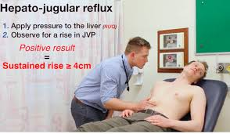
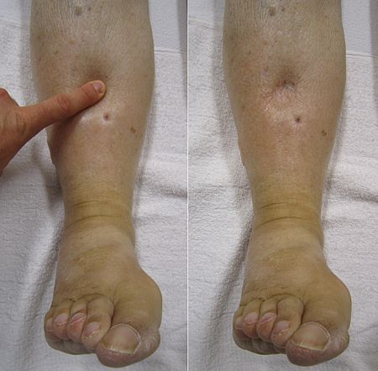

Slide 7
Laboratory Values
Hct: 41.1% (0.411)
WBC: 5.3 × 103/μL (5.3 × 109/L)
Sodium: 136 mEq/L (136 mmol/L)
Potassium: 3.2 mEq/L (3.2 mmol/L)
Bicarb: 30 mEq/L (30 mmol/L)
Chloride: 90 mEq/L (90 mmol/L)
Magnesium: 1.5 mEq/L (0.75 mmol/L)
Fasting blood glucose: 120 mg/dL (6.7 mmol/L)
Uric acid: 8 mg/dL (476 μmol/L)
BUN: 40 mg/dL (14.3 mmol/L)
SCr: 1.6 mg/dL (141 μmol/L)
Alk Phos: 120 IU/L (2.00 μKat/L)
Aspartate aminotransferase: 100 IU/L (1.67 μKat/L)

Slide 8
questions
What other laboratory or diagnostic tests are required for assessment of the patient’s condition?
How would you classify his NYHA FC and ACC/AHA HF stage?
Identify exacerbating or precipitating factors that may worsen his HF.
What are your treatment goals for the patient?

Slide 9
HINT
Based on the information presented and your problem-based assessment, create a care plan for the patient’s HF. Your plan should include:
Nonpharmacologic treatment options.
Acute and chronic treatment plans to address symptoms and
prevent disease deterioration.
Monitoring plan for acute and chronic treatments.

Slide 12
Desired Therapeutic Outcomes
There is no cure for HF. The general therapeutic management goals for chronic HF include:
preventing the onset of clinical symptoms or reducing symptoms by which one?
preventing or reducing hospitalizations, slowing progression of the disease, improving quality of life, and prolonging survival. ? How?

Slide 13
Non pharmacologic treatment
involves dietary modifications such as sodium and fluid restriction, risk factor reduction including smoking cessation, timely immunizations, and supervised regular physical activity.
Patient education (monitoring symptoms, dietary and medication adherence, exercise and physical fitness)
Home monitoring should include daily assessment of weight and exercise tolerance.

Slide 14
Pharmacological options
Diuretics
Type of diuretics?
Route of intake?
Diuretic resistance? How to tx it?
Diuretics se?

Slide 15
Pharmacological options to reduce hospitalization:
ACE.I (choice, se, monitoring, CI)
ARABS
BB
( carvedilol, bisoprolol, metoprolol succinate or tartrate)
Aldosterone antagonist
Hydralazine/ isosorbide dinitrate
Note: there are compensatory mechanisms in HF to increase CO, it will be helpful in the beginning but by passing time it will lead to worsening the condition which include( RAAS, SNS, cardiac hypertrophy and remodeling)

Slide 16
Other drugs:
CCB
Amlodipine, felodipine
Sacubitril( home work role in hf)
Digoxin ( added if pt remain symptomatic or in AF)(DOSE)
Antiplatelet and anticoagulant
Warfarin if AF or prosthetic heart valve

Slide 18
Acute heart failure (ADHF)
Acute heart failure syndromes (AHFS) may be defined as new-onset, gradual, or rapidly worsening chronic HF signs and symptoms that require urgent therapy.

Slide 19
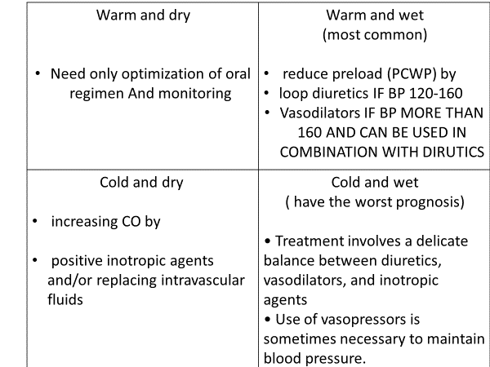

Slide 20
Acute heart failure (ADHF)
After 6 months, the patient returns to the clinic complaining of extreme SOB with any activity, as well as at rest. He sleeps sitting up due to severe orthopnea, can only eat a few bites of a meal and then feels full and nauseous, and states he has gained 22 lb (10 kg) from his baseline weight. He is also profoundly dizzy when standing up from a chair and bending over. He states that he does not feel his furosemide therapy is working. He is admitted to the cardiology unit.
SH: Admits to resuming previous alcohol intake; additionally, he has been eating out in restaurants more often in the past 2 weeks
Meds: Atorvastatin 40 mg once daily, lisinopril 10 mg once daily, furosemide 80 mg twice daily, glipizide 10 mg twice daily for diabetes, metformin 1000 mg twice daily for diabetes, nitroglycerin 0.4 mg sublingual as needed, multivitamin daily, aspirin 325 mg daily

Slide 21
Physical examination
VS: BP 96/54 mm Hg, pulse 102 beats/min and regular,
respiratory rate 22/minute, temperature 37°C (98.6°F),
Wt 273 lb (124 kg), BMI 41.5 kg/m2
Lungs: There are rales present bilaterally
CV: Regular rate and rhythm with normal S1 and S2; there is an S3 and an S4; a 4/6 systolic ejection murmur is present

Slide 22
jugular veins are distended, JVP is 11 cm above sternal angle
Abd: Hard, tender, and bowel sounds are present; 3+ pitting edema of extremities is observed
CXR: Bilateral pleural effusions and cardiomegaly
Echo: EF = 20% (0.20)
Pertinent labs: BNP 740 pg/mL (740 ng/L; 214 pmol/L),?

Slide 23
Lab data
K: 4.2 mEq/L (4.2 mmol/L), BUN 64 mg/dL (22.8 mmol/L),
SCr 2.4 mg/dL (212 μmol/L), Mg 1.8 mEq/L (0.9 mmol/L);
A pulmonary catheter is placed, revealing the following: PCWP
37 mm Hg (4.9 kPa); CI 2.5 L/min/m2
What NYHA functional class, ACC/AHA stage, and hemodynamic subset is the patient currently in?
What are your initial treatment goals?
What pharmacologic agents are appropriate to use at this time?
Identify a monitoring plan to assess for efficacy and toxicity of
the recommended drug therapy.
Once symptoms are improved, how would you optimize oral
medication therapy for this patient’s HF

Slide 24
Treatment of acute heart failure and Desired Therapeutic Outcomes
correct the underlying precipitating factor(s); (cardiac, metabolic or patient related)
relieve the patient’s symptoms and improve hemodynamics.
optimize a chronic oral medication regimen and educate the patient, reinforcing adherence to lifestyle modifications and the drug regimen (dose and SE).
Oral agents: β-blockers, ACE inhibitors or ARBs, and aldosterone antagonists should be initiated as soon as possible during the hospitalization(contribute to improvement in hemodynamics).

Slide 25
Pharmacologic Approaches to Treatment of AHF
Diuretics
Loop diuretics, including furosemide, bumetanide, and torsemide (DOC)
Diuretics decrease preload by functional venodilation within 5 to 15 minutes of administration and subsequently by an increase in sodium and water excretion. This provides rapid improvement in symptoms of pulmonary congestion.
Route
Bolus injection should be administered at a rate not exceeding 4 mg per minute to avoid ototoxicity

Slide 26
Vasodilators
IV vasodilators cause a rapid decrease in arterial tone (After load), resulting in a decrease in SVR and a subsequent increase in SV and CO.
Additionally, vasodilators reduce ventricular filling pressures (PCWP) (preload) within 24 to 48 hours, reduce myocardial oxygen consumption, and decrease ventricular workload.
Nitroglycerin, nitroprusside, and nesiritide

Slide 27
Inotropic agents
This class include dopamine, dobutamine and milrinone
Used in patients with decreased CO( COOL SUBSETS)
dopamine, dobutamine need beta receptors to act while milrinone is not

Slide 28
Reference:
Pharmacotherapy principle and practice 2016

