Slide 1
Common cold part (2)
Prepared by:
Assist. Lect. Noor Wafaa Hashim

Slide 2
Paracetamol
Indications :
Mild to moderate pain | Pyrexia
Pain | Pyrexia with discomfort
Post-immunisation pyrexia in infants
Acute migraine

Slide 3
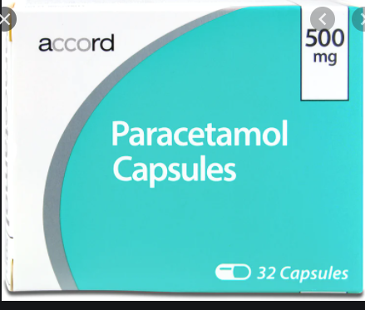
Paracetamol
Paracetamol (Acetaminophen)
INDICATIONS AND DOSE:
Mild to moderate pain | Pyrexia
▶ BY MOUTH
▶ Adult: 0.5–1 g every 4–6 hours; maximum 4 g per day
▶ BY INTRAVENOUS INFUSION
▶ Adult (body-weight up to 50 kg): 15 mg/kg every
4–6 hours, dose to be administered over 15 minutes;
maximum 60 mg/kg per day
▶ Adult (body-weight 50 kg and above): 1 g every
4–6 hours, dose to be administered over 15 minutes;
maximum 4 g per day
▶ BY RECTUM
▶ Adult: 0.5–1 g every 4–6 hours; maximum 4 g per da

Slide 4
Paracetamol
Mild to moderate pain in patients with risk factors for
hepatotoxicity | Pyrexia in patients with risk factors for
hepatotoxicity:
▶ BY INTRAVENOUS INFUSION
▶ Adult (body-weight up to 50 kg): 15 mg/kg every
4–6 hours, dose to be administered over 15 minutes;
maximum 60 mg/kg per day
▶ Adult (body-weight 50 kg and above): 1 g every
4–6 hours, dose to be administered over 15 minutes;
maximum 3 g per day

Slide 5
paracetamol
Pain | Pyrexia with discomfort:
▶ BY MOUTH
▶ Child 3–5 months: 60 mg every 4–6 hours; maximum 4 doses per dayChild 6–23 months: 120 mg every 4–6 hours; maximum
4 doses per day
▶ Child 2–3 years: 180 mg every 4–6 hours; maximum
4 doses per day
▶ Child 4–5 years: 240 mg every 4–6 hours; maximum
4 doses per day
▶ Child 6–7 years: 240–250 mg every 4–6 hours;
maximum 4 doses per day
▶ Child 8–9 years: 360–375 mg every 4–6 hours;
maximum 4 doses per day
▶ Child 10–11 years: 480–500 mg every 4–6 hours;
maximum 4 doses per day
▶ Child 12–15 years: 480–750 mg every 4–6 hours;
maximum 4 doses per day
▶ Child 16–17 years: 0.5–1 g every 4–6 hours; maximum
4 doses per day

Slide 6
Paracetamol
▶ BY RECTUM
▶ Child 3–11 months: 60–125 mg every 4–6 hours as
required; maximum 4 doses per day
▶ Child 1–4 years: 125–250 mg every 4–6 hours as
required; maximum 4 doses per day
▶ Child 5–11 years: 250–500 mg every 4–6 hours as
required; maximum 4 doses per day
▶ Child 12–17 years: 500 mg every 4–6 hours

Slide 7
Paracetamol
Post-immunisation pyrexia in infants:
▶ BY MOUTH
▶ Child 2–3 months: 60 mg for 1 dose, then 60 mg after
4–6 hours if required
▶ Child 4 months: 60 mg for 1 dose, then 60 mg after
4–6 hours; maximum 4 doses per day
Acute migraine:
▶ BY MOUTH
▶ Adult: 1 g for 1 dose, to be taken as soon as migraine
symptoms develop

Slide 8
Paracetamol
CAUTIONS :Before administering, check when paracetamol last administered and cumulative paracetamol dose over previous 24 hours . body-weight under 50 kg . Chronic alcohol consumption . chronic dehydration . Chronic malnutrition . hepatocellular insufficiency . long-term use (especially in those who are malnourished).

Slide 9
Paracetamol
Side effects:▶ Common or very common▶ With rectal use Anorectal erythema
PREGNANCY Not known to be harmful.
BREAST FEEDING Amount too small to be harmful.
HEPATIC IMPAIRMENT Dose-related toxicity—avoid large doses.
RENAL IMPAIRMENT
Dose adjustments ▶ In adults Increase infusion dose interval to every 6 hours if eGFR less than 30 mL/minute/1.73m2.

Slide 10
Paracetamol
MEDICINAL FORMS:
Tablet: CAUTIONARY AND ADVISORY LABELS (29, 30)
29:Do not take more than 2 tablets at any one time.Do not take more than 8 in 24 hours.
30:contain paracetamol. Do not take anything else containing paracetamol while taking this medicine. Talk to a doctor at once if you take too much of this medicine even if you feel well .
Paracetamol 500 mg
Paracetamol 1 gram

Slide 11
Paracetamol
Suppository:
CAUTIONARY AND ADVISORY LABELS 30
Paracetamol (80,120,125,240,250,500 )mg,1g.
Oral suspension
CAUTIONARY AND ADVISORY LABELS 30
Paracetamol 120mg/5ml
Paracetamol 250mg/5ml
Paracetamol 500mg/5ml

Slide 12
Paracetamol
Effervescent tablet
Solution for infusion
Oral solution
Powder
Capsule
Orodispersible tablet
Combinations available:
Cocodamol,Dihydrocodeine with paracetamol

Slide 13
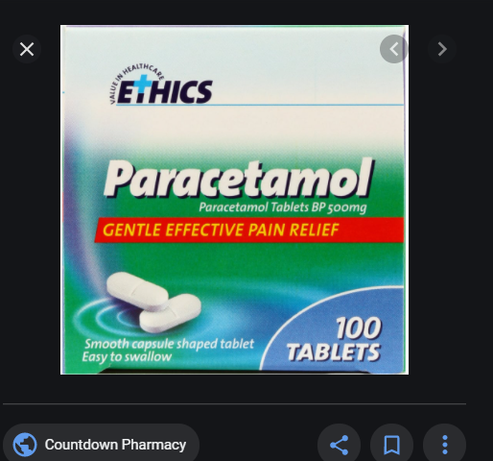
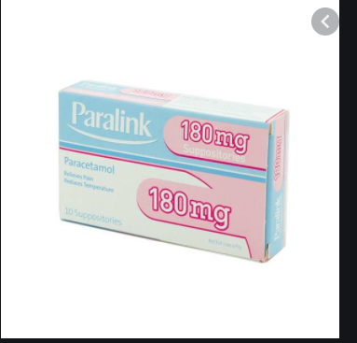
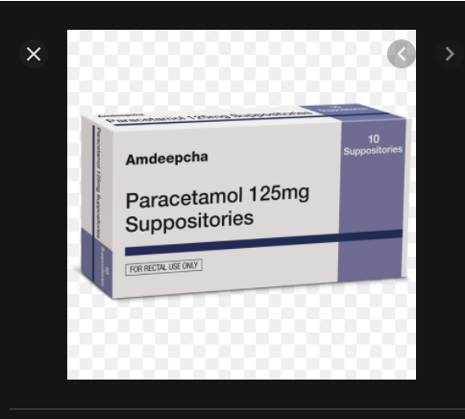
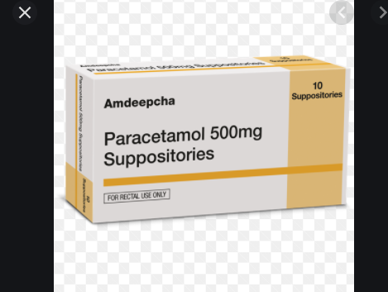

Slide 14
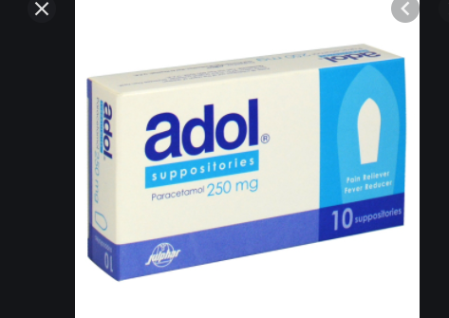
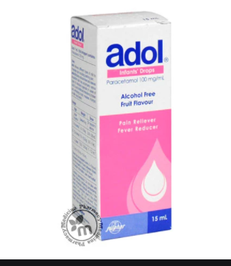
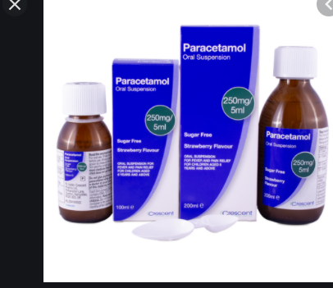
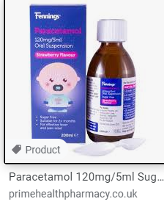

Slide 15
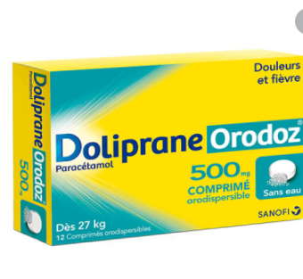
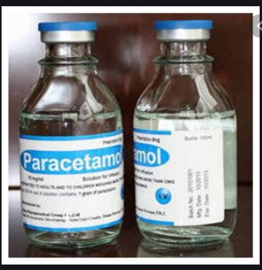
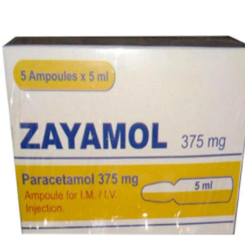

Slide 16
Loratadine
INDICATIONS AND DOSE:
Symptomatic relief of allergy such as hay fever, chronic idiopathic urticaria
▶ BY MOUTH
▶ Child 2–11 years (body-weight up to 31 kg): 5 mg once daily
▶ Child 2–11 years (body-weight 31 kg and above): 10 mg once daily
▶ Child 12–17 years: 10 mg once daily
▶ Adult: 10 mg once daily

Slide 17
Loratadine
SIDE-EFFECTS
▶ Common or very common: Drowsiness . nervousness (in children)
SIDE-EFFECTS, FURTHER INFORMATION :
Non-sedating antihistamines such as loratadine cause less sedation and psychomotor impairment than the older antihistamines, but can still occur; sedation is generally minimal. This is because non-sedating antihistamines penetrate the blood
brain barrier to a much lesser extent.

Slide 18
Loratadine
PREGNANCY Most manufacturers of antihistamines advise
avoiding their use during pregnancy; however, there is no
evidence of teratogenicity.
BREAST FEEDING Most antihistamines are present in
breast milk in varying amounts; although not known to be
harmful, most manufacturers advise avoiding their use in
mothers who are breast-feeding.
HEPATIC IMPAIRMENT Manufacturer advises caution in
severe impairment (Dose adjustments).

Slide 19
Loratadine
Driving and skilled tasks Although drowsiness is rare,nevertheless patients and their carers should be advised that it can occur and may affect performance of skilled tasks (e.g. cycling or driving); alcohol should be avoided.

Slide 20
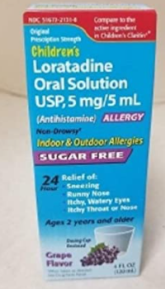
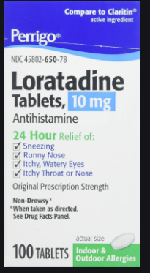
Loratadine
MEDICINAL FORMS
Oral solution 5 mg/5ml
Tablet 10 mg

Slide 21
Chlorphenamine maleate
INDICATIONS AND DOSE
Symptomatic relief of allergy such as hay fever, urticaria, food allergy, drug reactions | Relief of itch associated with chickenpox
Adult: 4 mg every 4–6 hours; maximum 24 mg per day
Emergency treatment of anaphylactic reactions▶ BY INTRAMUSCULAR INJECTION, OR BY INTRAVENOUS INJECTION.

Slide 22
Chlorphenamine maleate
IMPORTANT SAFETY INFORMATION
MHRA/CHM ADVICE (MARCH 2008 AND FEBRUARY 2009) OVERTHE- COUNTER COUGH AND COLD MEDICINES FOR CHILDREN
Children under 6 years should not be given over-thecounter cough and cold medicines containing chlorphenamine.

Slide 23
Chlorphenamine maleate
▶ Side effects: Common or very common Drowsiness, Concentration impaired . coordination abnormal . dizziness . dry mouth . fatigue .headache . nausea . vision blurred.
CAUTIONS :Epilepsy . prostatic hypertrophy (in adults) .pyloroduodenal obstruction . susceptibility to angle closure glaucoma . urinary retention.
Children and elderly patients are more susceptible to side-effects.

Slide 24
Chlorphenamine maleate
PREGNANCY Most manufacturers of antihistamines advise
avoiding their use during pregnancy; however, there is no
evidence of teratogenicity. Use in the latter part of the
third trimester may cause adverse effects in neonates such
as irritability, paradoxical excitability, and tremor.
BREAST FEEDING Most antihistamines are present in
breastmilk in varying amounts; although not known to be
harmful, most manufacturers advise avoiding their use in
mothers who are breast-feeding.
HEPATIC IMPAIRMENT Manufacturer advises caution.

Slide 25
Chlorphenamine maleate
MEDICINAL FORMS:
Solution for injection(10mg/1ml)
Oral solution(2mg/5ml ) : CAUTIONARY AND ADVISORY LABELS 2
2: THIS MEDICINE MAKE YOU SLEEPY.IF THIS HAPPENS DO NOT DRIVE OR USE TOOLS OR MACHINES .DO NOT DRINK ALCOHOL .
Tablet
CAUTIONARY AND ADVISORY LABELS 2
▶ Chlorphenamine maleate (Non-proprietary)
Chlorphenamine maleate 4 mg .

Slide 26

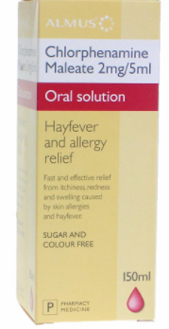
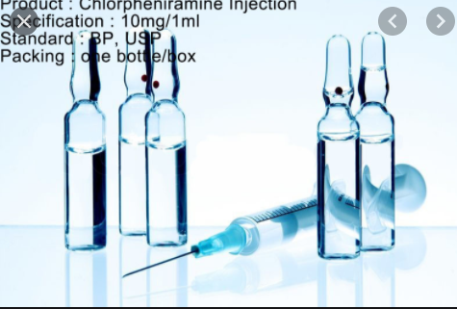

Slide 27
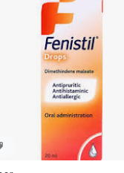

Fenistil®
Fenistil drops
Fenistil gels
Contain: Dimethindene maleate

Slide 28
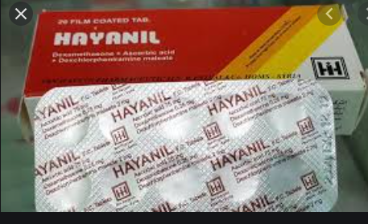
Hayanil®
Dexamethasone 0.25 mg
Dexchlorphenramine 2 mg
Ascorbic acid (Vitamin C) 75 mg

Slide 29
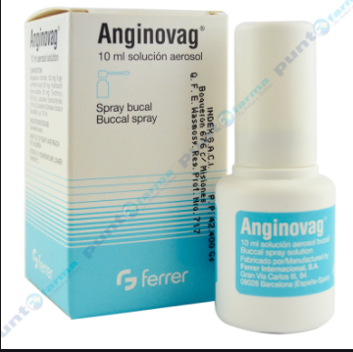
Anginovag®
Composition : H.C, Dequalinium(antiseptic), tyrothricin,glycerrhtinic,lidocaine.

Slide 30

Thank you for listening

