Slide 1

Class Reference book
English Language
For 3rd Year Students
College Pharmacy Al-Mustansiriyah University
Chapter One

Slide 2
Classes of verbs in English
The auxiliary verbs do, be, and have
Modal auxiliary verbs must, can, should, might, will, and would
Full verbs play, run, help, go, and etc...

Slide 3
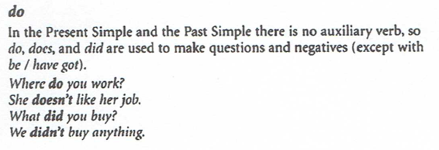
1.Tenses and auxiliary verbs

Slide 4
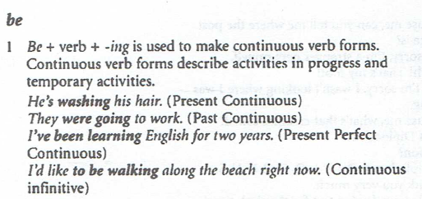
1.Tenses and auxiliary verbs

Slide 5
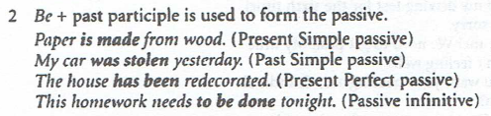
1.Tenses and auxiliary verbs

Slide 6
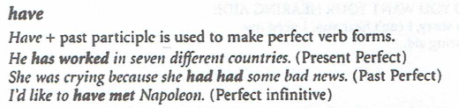
1.Tenses and auxiliary verbs

Slide 7
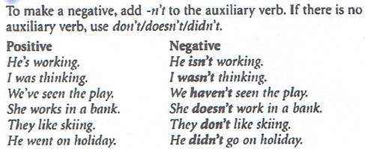
2. Negative and auxiliary verbs

Slide 8
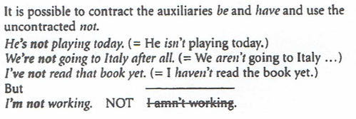
2. Negative and auxiliary verbs

Slide 9
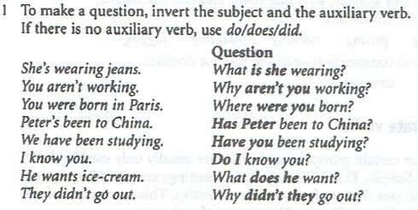
3. Questions and auxiliary verbs

Slide 10
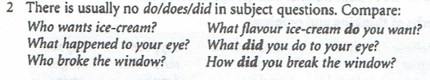
3. Questions and auxiliary verbs

Slide 11
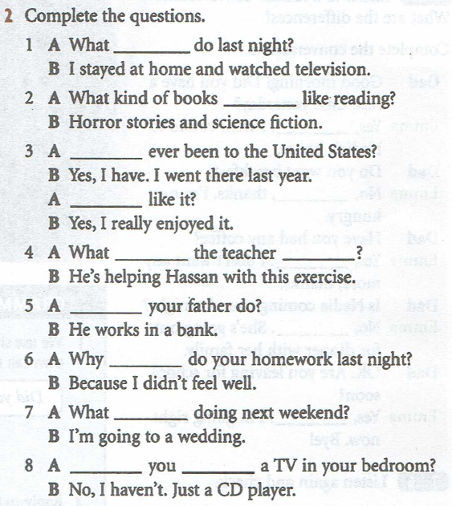
Practice

Slide 12
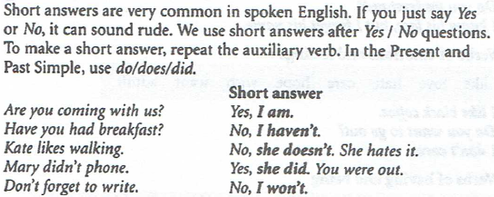
4. Short answers and auxiliary verbs

Slide 13
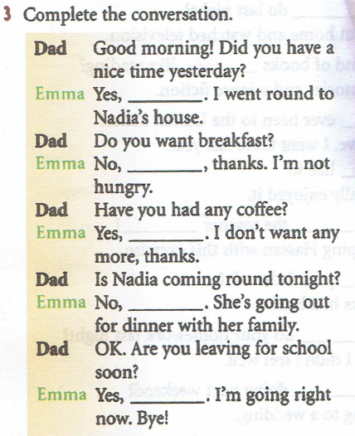
Practice

Slide 14
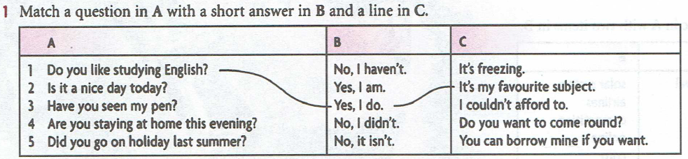
Practice

