Slide 1
Thermometer
A thermometer is a device that measure temperature.
Types of thermometers:
Glass-liquid thermometer
This type has two main parts: 1. the sensor part which is the bulb of mercury-in-glass. 2. the visible scale to read temperature.
Infrared thermometer which measure the temperature of infrared radiation that is radiated from body.

Slide 2
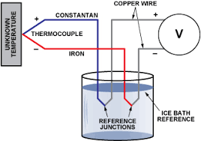
Thermocouple thermometer: A thermocouple is an electrical device consisting of two dissimilar electrical conductors forming electrical junctions at different temperatures. A thermocouple produces a temperature-dependent voltage, and this variation in voltage can be interpreted to measure temperature.

Slide 3
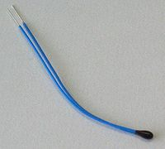
Thermister: A thermistor is a type of resistor whose resistance is dependent on temperature. There are two types of thermistor, those with a resistance that increase with temperature (Positive Temperature Coefficient – PTC) and those with a resistance that falls with temperature (Negative Temperature Coefficient – NTC).
The most common type of thermistors are those in which resistance decreases as the temperature increases (NTC).
jjjjjhhhhh

