Slide 1
Stem cells
A stem cell is
1- a non-specialized,
2- generic cell which can make exact copies of
itself indefinitely and
3- can differentiate and produce specialized cells for the various tissues of the body.
3- Stem cells are cells found in most, if not all, multi-cellular organisms.

Slide 2
Classification of stem cells on the basis of potency
Stem cells can be classified by the extent to which they can differentiate into
different cell types. These four main classifications are totipotent, pluripotent,
multipotent, or unipotent.
Totipotent
The ability to differentiate into all possible cell types. Examples are the
zygote formed at egg fertilization and the first few cells that result from the division of the zygote.

Slide 3
pluripotent
Pluripotent
The ability to differentiate into almost all cell types. Examples include
embryonic stem cells and cells that are derived from the mesoderm, endoderm ectoderm germ layers that are formed in the beginning stages of embryonic stem cell
differentiation.

Slide 4
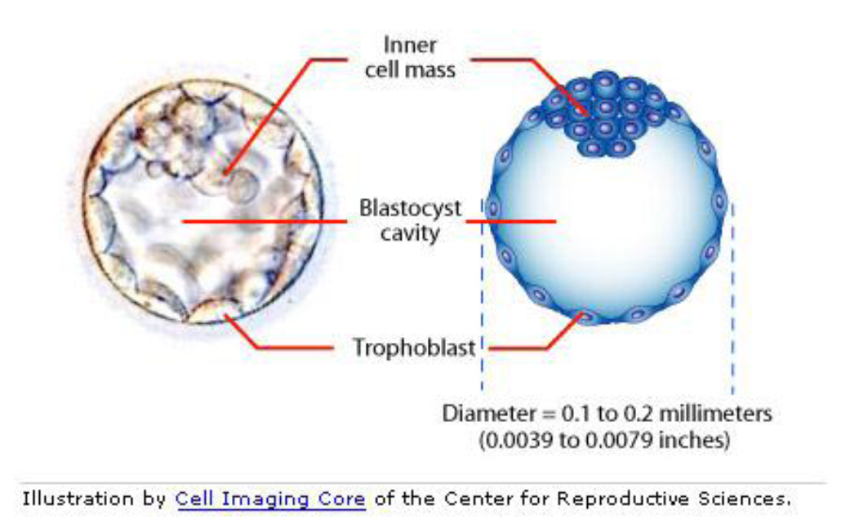

Slide 5
Multipotent and Multipotent
Multipotent
The ability to differentiate into a closely related family of cells. Examples
include hematopoietic (adult) stem cells that can become red and white blood cells or
platelets.
Oligopotent
The ability to differentiate into a few cells. Examples include (adult) lymphoid or
myeloid stem cells.

Slide 6
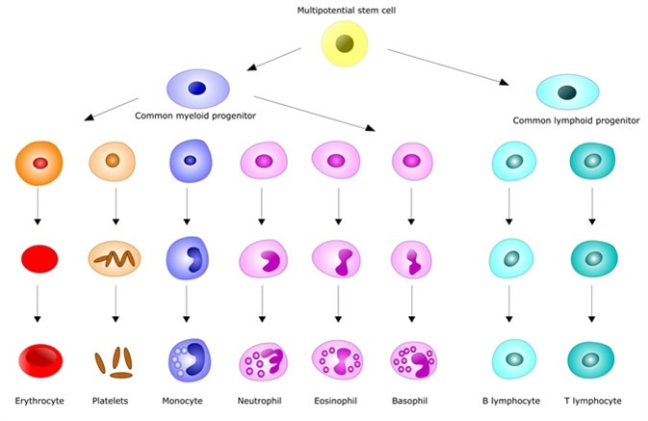

Slide 7
Unipotent
The ability to only produce cells of their own type, but have the property of selfrenewal required to be labeled a stem cell. Examples include (adult) muscle stem
cells.

Slide 8
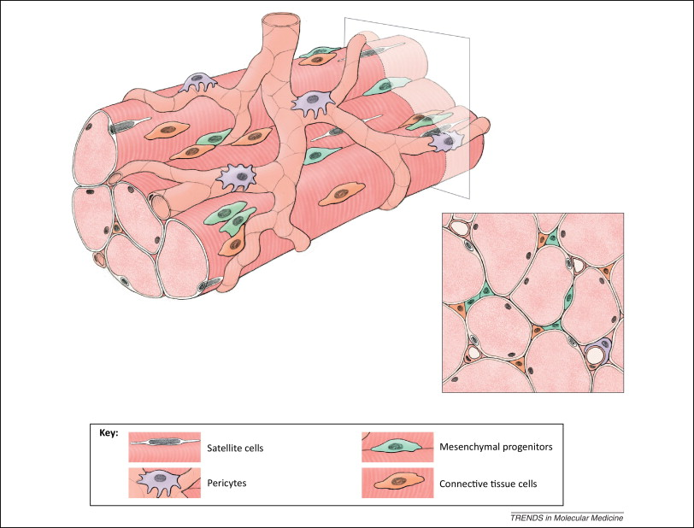

Slide 9
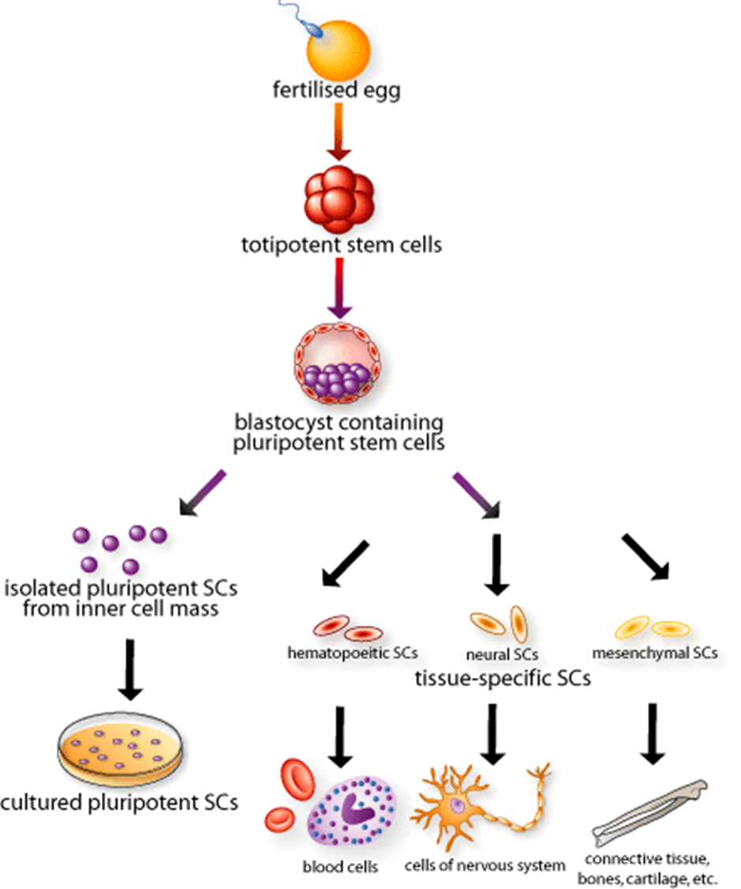

Slide 10
Stem cells sources
Embryonic stem cells are derived from very early embryos and can in theory give rise to all cell types in the body.
Many adult tissues contain stem cells that can replace cells that die or restore tissue after injury.
Skin, muscle, intestine and bone marrow, for example, each contain their own stem cells. In the bone marrow, billions of new blood cells are made every day from blood-forming stem cells

Slide 11
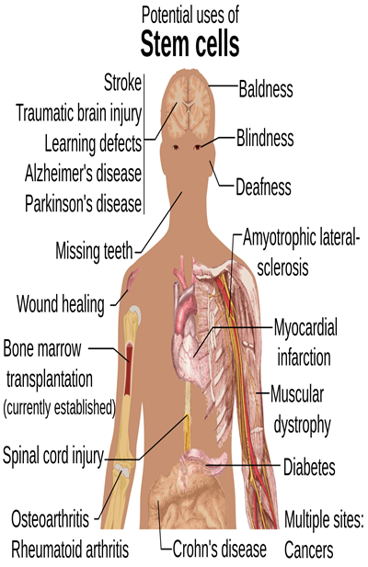
Potential uses of Stem cells

