Slide 1
TDM of Cyclosporine
REFERENCE: APPLIED CLINICAL PHARMACOKINETICS
by: lecturer HADEEL DELMAN

Slide 2
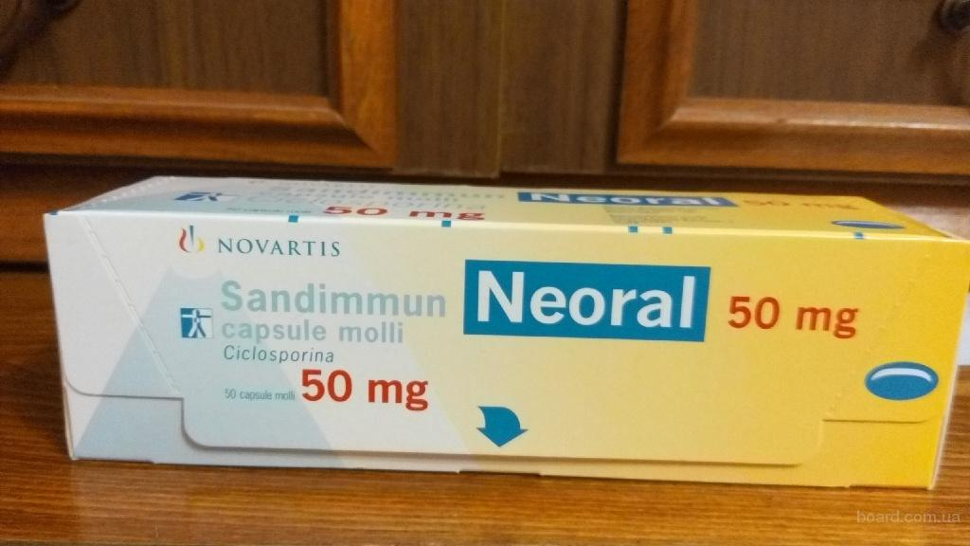
Cyclosporine…

Slide 3
Therapeutic and Toxic Concentrations
The therapeutic range of cyclosporine depend on:
The type of assay used to measure the concentration.
A blood or serum concentrations are determined.
Because cyclosporine is bound to RBCs, blood concentrations are higher than simultaneously measured serum or plasma concentrations.

Slide 5
Desired cyclosporine concentrations and time of administration differ between the various types of organ transplants:
In renal transplant patients:
Delay cyclosporine therapy for a few days or until the kidney begins functioning to avoid unwanted effects on the newly transplanted organ. {cyclosporine can cause nephrotoxicity}.
Use lower cyclosporine concentrations to avoid toxicity in the new renal graft.
For patients with poor kidney function:
Held until after transplantation to avoid nephrotoxicity.
For other solid organ transplant patients:
Therapy may be started several hours (4–12 hours) before surgery.

Slide 6
Basic Clinical Pharmacokinetic Parameters
Cyclosporine is almost completely (>99%) eliminated by hepatic metabolism.
Cyclosporine is a low-to-moderate (~30%) hepatic extraction ratio drug.
Its hepatic clearance is influenced by unbound fraction in the blood (fB), intrinsic clearance (Cl′int), and liver blood flow (LBF).

Slide 7
variability of cyclosporine conc.
There is a large amount of intrasubject variability in cyclosporine concentrations obtained on a day-to-day basis, even when the patient should be at steady state. There are many reasons for this variability:
Cyclosporine has low water solubility,
Its gastrointestinal absorption can be influenced by many variables.

Slide 8
Versions of cyclosporine
1- Original dosage form (Sandimmune, Novartis),
2- The modified formulations, microemulsion (Neoral, Novartis)
- Absorbed faster (shorter tmax),
- Greater extent (higher AUC and Cmax) and
- More consistently (decreased intrapatient and interpatient variability).
They are not considered bioequivalent formulations and therefore should not be used interchangeably.

Slide 9
Original version vs. microemulsion version
Microemulsion version of the drug (Neoral) was marketed to improve bioavailability via reducing absorption variability (10–30% for Neoral versus 16–38% for Sandimmune).
Cyclosporine available as capsules and solution in regular (25-mg, 50-mg, and 100-mg capsules; 100-mg/mL solution) and micro emulsion (25-mg and 100-mg capsules; 100-mg/mL solution) form. As well as for intravenous administration 50 mg/mL.

Slide 10
Clearance and half-life
Clearance for adults……… 6 mL/min/kg
Half-life = 10 hours
Clearance for children (≤16 years old)………. 10 mL/min/kg
Half-life = 6 hours
Clearance for Patients with liver failure…………..3 mL/min/kg
Half-life = 20 hours.

Slide 11
Volume of Distribution
Vd = 5 L/kg
Obesity does not influence cyclosporine pharmacokinetics, so doses should be based on ideal body weight for these individuals.
Renal failure does not change cyclosporine pharmacokinetics, and the drug is not significantly removed by hemodialysis or peritoneal dialysis.

Slide 12
Initial Dosage Determination Methods
1- Pharmacokinetic Dosing Method
2- Literature-Based Recommended Dosing

Slide 13
Pharmacokinetic Dosing Method
1-Clearance estimate
Clearance for adult…… ……….. 6 mL/min/kg.
Children (≤16 years old) .……. 10 mL/min/kg.
Patients with liver failure ……. 3 mL/min/kg.
Clearance should be converted to L/hr.
Clearance × Kg × 60 /1000

Slide 14
2-Selection of pharmacokinetic equations:
Css = [F (D/τ)] / CL or D = (Css ⋅ CL ⋅ τ) / F
D = (Css ⋅ CL ⋅ τ)…… for I.V intermittent infusion
K0= Css. CL ……. for contiueous I.V infusion
Css in ng/mL=μ/L
τ= 12 hr…. for adult and I.V injection
F= 0.3 (bioavailability fraction for the oral dosage form 30% for most patient populations and oral dosage forms).
K0=D/τ

Slide 15
Example 1 HO is a 50-year-old, 75-kg (5 ft 10 in) male renal transplant patient 2 days post transplant surgery. The patient’s liver function tests are normal. Suggest an initial oral cyclosporine dose designed to achieve a steady-state cyclosporine trough blood concentration equal to 250 ng/mL.
Clearance for adult…………….. 6 mL/min/kg.
Cl = 6 mL/min/kg ⋅ 75 kg (60 min/h / 1000 mL/L) = 27 L/h
D = (Css ⋅ Cl ⋅ τ) / F = (250 μg/L ⋅ 27 L/h ⋅ 12 h) / (0.3 ⋅ 1000 μg/mg) D = 270 mg, rounded to 300 mg every 12 hours.
ملاحظة: في هذه المسئلة تم اعطاء التركيز المطلوب

Slide 16
Same patient as in example 1, now compute an initial dose using intravenous cyclosporine.
D = Css ⋅ Cl ⋅ τ ….. For I.V intermittent infusion
= (250 μg/L ⋅ 27 L/h ⋅ 12 h) / (1000 μg/mg)
= 81 mg, rounded to 75 mg every 12 hours.
ko = Css ⋅ Cl ….. for contiueous I.V infusion
= (250 μg/L ⋅ 27 L/h) / (1000 μg/mg)
= 6.8 mg/h, rounded to 7 mg/h.

Slide 17
Literature-Based Recommended Dosing
Oral doses of 8–18 mg/kg/d
Intravenous doses of 3–6 mg/kg/d
For obese individuals (>30% over ideal body weight) use ideal body weight.

Slide 18
Example 3 HO is a 50-year-old, 75-kg (5 ft 10 in) male renal transplant patient 2 days post transplant surgery. The patient’s liver function tests are normal. Suggest an initial oral cyclosporine dose designed to achieve a steady-state cyclosporine trough blood concentration within the therapeutic range.
For oral doses of 8–18 mg/kg/d
Dose = 8 mg/kg/d ⋅ 75 kg = 600 mg/d or 300 mg every 12 hours.
For intravenous doses of 3–6 mg/kg/d
Dose = 3 mg/kg/d ⋅ 75 kg = 225 mg/d,
rounded to 200 mg/d or 100 mg every 12 hours.
ملاحظة: في هذه المسئلة لم يعطى التركيز

Slide 19
Use of cyclosporine concentrations to alter doses
1-Linear Pharmacokinetics Method
2-Pharmacokinetic Parameter Method

Slide 20
Linear Pharmacokinetics Method
Dnew/Css,new = Dold/Css,old
Dnew = (Css,new/Css,old)Dold

Slide 21
Example 5A LK is a 50-year-old, 75-kg (5 ft 10 in) male renal transplant recipient who is receiving 400 mg every 12 hours of oral cyclosporine capsules. He has normal liver function. The current steady-state cyclosporine blood concentration equals 375 ng/mL. Compute a cyclosporine dose that will provide a steady-state concentration of 200 ng/mL.
Dnew = (Css,new/Css,old)Dold
= (200 ng/mL / 375 ng/mL) 800 mg/d
= 427 mg/d, rounded to 400 mg/d
The new suggested dose would be 400 mg/d or 200 mg every 12 hours of cyclosporine

Slide 22
Pharmacokinetic Parameter Method
It allows the computation of an individual’s own, unique pharmacokinetic constants (actual CL) and uses those to calculate a dose that achieves desired cyclosporine concentrations.
Cl = [F (D/τ)] / Css or Cl = (D/τ) / Css
Cl = ko/Css
Then calculate the new dose using initial dose determination equations.

Slide 23
Example 7 LK is a 50-year-old, 75-kg (5 ft 10 in) male renal transplant recipient who is receiving 400 mg every 12 hours of oral cyclosporine capsules. He has normal liver function. The current steady-state cyclosporine blood concentration equals 375 ng/mL. Compute a cyclosporine dose that will provide a steady-state concentration of 200 ng/mL.
Cl = [F(D/τ)] / Css
= [0.3 ⋅ (400 mg/12 h) ⋅ 1000 μg/mg] / (375 μg/L)
= 26.7 L/h.
D = (Css ⋅ Cl ⋅ τ) / F
= (200 μg/L ⋅ 26.7 L/h ⋅ 12h) / (0.3 ⋅ 1000 μg/mg)
= 214 mg, rounded to 200 mg every 12 hours.

Slide 24
Example 8 FD is a 60-year-old, 85-kg (6 ft 1 in) male liver transplant patient who is receiving 75 mg every 12 hours of intravenous cyclosporine. The current steady-state cyclosporine concentration equals 215 ng/mL. Compute a cyclosporine dose that will provide a steady-state concentration of 350 ng/mL.
Cl = (D/τ) / Css
= [(75 mg/12 h) ⋅ 1000 μg/mg] / (215 μg/L)
= 29.1 L/h.
D = Css ⋅ Cl ⋅ τ
= (350 μg/L ⋅ 29.1 L/h ⋅ 12h) / 1000 μg/mg
= 122 mg, rounded to 125 mg every 12 hours.
For unit conversion

Slide 25
If the patient in example 8 received cyclosporine as a continuous infusion at a rate of 6 mg/h, the equivalent clearance and dosage adjustment computations would be:
Cl = ko/Css
= (6 mg/h ⋅ 1000 μg/mg) / (215 μg/L)
= 27.9 L/h
ko = Css ⋅ Cl
= (350 μg/L ⋅ 27.9 L/h) / (1000 μg/mg)
= 9.8 mg/h, rounded to 10 mg/h

Slide 26
Thank you

