Slide 1
Aminoglycosides
Assistant lecturer :
Noor Wafaa Hashim

Slide 2
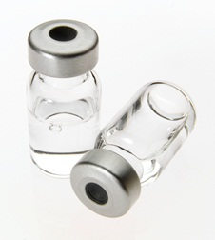
Aminoglycoside

Slide 3
Aminoglycosides
These include amikacin , gentamicin , neomycin sulfate, streptomycin , and tobramycin .
All are bactericidal and active against some Gram-positive and many Gram-negative organisms.
Amikacin, gentamicin, and tobramycin are also active against Pseudomonas aeruginosa ; streptomycin is active against Mycobacterium tuberculosis and is now almost entirely reserved for tuberculosis.

Slide 4
Aminoglycosides
The aminoglycosides are not absorbed from the gut(although there is a risk of absorption in inflammatory bowel disease and liver failure) and must therefore be given by injection for systemic infections.
Gentamicin is the aminoglycoside of choice in the UK and is used widely for the treatment of serious infections.

Slide 5
Aminoglycosides
It has a broad spectrum but is inactive against anaerobes and has poor activity against haemolytic streptococci and pneumococci. When used for the ‘blind’ therapy of undiagnosed serious infections it is usually given in conjunction with a penicillin or metronidazole or both.

Slide 6
Aminoglycosides
Gentamicin is used together with another antibiotic
for the treatment of endocarditis. Streptomycin may be used as an alternative in gentamicin-
resistant enterococcal endocarditis.
Loading and maintenance doses of gentamicin may be
calculated on the basis of the patient’s weight and renal
function (e.g. using a nomogram); adjustments are then
made according to serum-gentamicin concentrations

Slide 7
Aminoglycosides
High doses are occasionally indicated for serious infections, especially in the neonate, in the patient with cystic fibrosis, or in the immunocompromised patient. Whenever possible treatment should not exceed 7 days.
Amikacin is more stable than gentamicin to enzyme inactivation. Amikacin is used in the treatment of serious infections caused by gentamicin-resistant Gram-negative bacilli.

Slide 8
Aminoglycosides
Tobramycin has similar activity to gentamicin. It is slightly more active against Ps. aeruginosa but shows less activity against certain other Gram-negative bacteria. Tobramycin can be administered by nebuliser or by inhalation of powder on a cyclical basis (28 days of tobramycin followed by a 28-day tobramycin-free interval) for the treatment of chronic pulmonary Ps. aeruginosa infection in cystic fibrosis; however, resistance may develop and some patients do not respond to treatment.

Slide 9
Aminoglycosides
Neomycin sulfate is too toxic for parenteral administration and can only be used for infections of the skin or mucous membranes or to reduce the bacterial population of the colon prior to bowel surgery or in hepatic failure. Oral administration may lead to malabsorption . Small amounts of neomycin sulfate may be absorbed from the gut in patients with hepatic failure and, as these patients may also be uremic , cumulation may occur with resultant ototoxicity.

Slide 10
Once daily dosage
Once daily administration of aminoglycosides is more convenient, provides adequate serum concentrations, and in many cases has largely superseded multiple daily dose regimens (given in 2–3 divided doses during the 24 hours). Local guidelines on dosage and serum concentrations should be consulted

Slide 11
Aminoglycosides
A once-daily, high-dose regimen of an aminoglycoside should be avoided in patients with endocarditis due to Gram-positive bacteria, HACEK endocarditis, burns of more than 20% of the total body surface area, or creatinine clearance less than 20 mL/minute. There is insufficient evidence to recommend a once daily, high-dose regimen of an aminoglycoside in pregnancy.
HACEK:(Hemophilus,Aggregatibacter,Cardiobacterium,Eikenella,Kingella )species

Slide 12
Serum concentrations of Aminoglycosides
Serum concentration monitoring avoids both excessive and subtherapeutic concentrations thus preventing toxicity and ensuring efficacy. Serum-aminoglycoside concentrations should be monitored in: patients receiving parenteral aminoglycosides and must be determined in the elderly, in obesity, and in cystic fibrosis, or if high doses are being given, or if there is renal impairment.

Slide 13
Aminoglycosides
CONTRA-INDICATIONS: Myasthenia gravis (aminoglycosides may impair neuromuscular transmission).
CAUTIONS: Care must be taken with dosage (the main side effects of the aminoglycosides are dose-related).Conditions characterised by muscular weakness (aminoglycosides may impair neuromuscular transmission) . if possible, dehydration should be corrected before starting an aminoglycoside . whenever possible, parenteral treatment should not exceed 7 days.

Slide 14
Aminoglycosides
SIDE-EFFECTS ▶ Common or very common: Hearing impairment.
Nephrotoxicity: occurs most commonly in patients with renal impairment, who require reduced doses; monitoring is particularly important in the elderly.

Slide 15
Aminoglycosides
PREGNANCY: There is a risk of auditory or vestibular nerve damage in the infant when aminoglycosides are used in the second and third trimesters of pregnancy. The risk is greatest with streptomycin. The risk is probably very small with gentamicin and tobramycin, but their use should be avoided unless essential .Serum aminoglycoside concentration monitoring is essential during pregnancy .

Slide 16
Aminoglycosides
RENAL IMPAIRMENT: Excretion of aminoglycosides is principally via the kidney and accumulation occurs in renal impairment. Ototoxicity and nephrotoxicity occur commonly in patients with renal failure.
INTERACTIONS → Appendix 1: aminoglycosides

Slide 17
Amikacin
INDICATIONS AND DOSE : Serious Gram-negative infections resistant to gentamicin (multiple daily dose regimen)
BY I.M injection or by slow I.V injection or by I.V infusion 15 mg /kg in 2 divided doses increased to 22.5 mg/kg daily in 3 divided doses for up to 10 days, higher dose to be used in severe infections;maximum 1.5 g per day; maximum 15 g per course.
Serious Gram-negative infections resistant to gentamicin (once daily dose regimen) by I.V infusion ▶ Adult: Initially 15 mg/kg (max. per dose 1.5 g once daily), dose to be adjusted according to serum amikacin concentration; maximum 15 g per course.

Slide 18
Amikacin
DOSES AT EXTREMES OF BODY-WEIGH:
▶ To avoid excessive dosage in obese patients, use ideal weight for height to calculate dose and monitor serum amikacin concentration closely

Slide 19
Amikacin
DIRECTIONS FOR ADMINISTRATION :For intravenous infusion (Amikin ®); intermittent in Glucose 5% or Sodium chloride 0.9%. To be given over 30 minutes.
MEDICINAL FORMS:
Solution for injection:
Amikacin sulfate 250 mg per 1 ml
Amikacin 500mg/2ml solution for injection vials
▶ Amikacin sulfate 50 mg per 1 ml
Amikin 100mg/2ml solution for injection vials

Slide 20
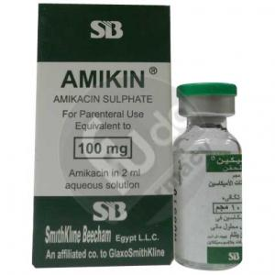

Slide 21
Gentamicin indications
Septicaemia | Meningitis and other CNS infections | Biliary tract infection | Acute pyelonephritis | Endocarditis |Pneumonia in hospital patients | Adjunct in listerial meningitis | Prostatitis.

Slide 22
Gentamicin indications
Gram-positive bacterial endocarditis(in combination with other antibacterials)
▶by I.M injection,or by slow I.V injection, or by I.V. infusion ▶ Adult: 1 mg/kg every 12 hours, intravenous injection to be administered over at least 3 minutes, to be given in a multiple daily dose regimen

Slide 23
Gentamicin indications
CNS infections (administered on expert advice)
Surgical prophylaxis
Surgical prophylaxis in joint replacement surgery
DOSES AT EXTREMES OF BODY-WEIGHT:
▶ With intramuscular use or intravenous use:To avoid excessive dosage in obese patients, use ideal weight for height to calculate parenteral dose and monitor serum-gentamicin concentration closely.

Slide 24
Gentamicin
IMPORTANT SAFETY INFORMATION:MHRA/CHM ADVICE: POTENTIAL FOR HISTAMINE-RELATED ADVERSE DRUG REACTIONS WITH SOME BATCHES (NOVEMBER 2017)
Following reports that some batches of gentamicin sulphate active pharmaceutical ingredient (API) used to manufacture gentamicin may contain higher than expected levels of histamine, which is a residual from the manufacturing process, the MHRA advise to monitor patients for signs of histamine-related adverse reactions; particular caution is required in patients taking concomitant drugs known to cause histamine release, in children, and in patients with severe renal impairment.

Slide 25
Gentamicin
DIRECTIONS FOR ADMINISTRATION:
▶ With intrathecal use For intrathecal injection, use preservative-free intrathecal preparations only.
▶ With intravenous use For intravenous infusion (Cidomycin ®); Gentamicin paediatric injection, Beacon; Gentamicin injection Hospira), give intermittently or via drip tubing in Glucose 5% or Sodium Chloride 0.9%. Suggested volume for intermittent infusion 50–100 ml given over20–30 minutes (given over 60 minutes for once daily dose regimen).
PRESCRIBING AND DISPENSING INFORMATION:
▶ With intravenous use Local guidelines may vary in the dosing
advice provided for once daily administration.
▶ With intrathecal use Only preservative-free intrathecal preparation should be used.

Slide 26
Gentamicin
MEDICINAL FORMS:
Solution for injection:
▶ Gentamicin (as Gentamicin sulfate) 5 mg per 1 ml
Gentamicin Intrathecal 5mg/1ml solution for injection ampoules | (Hospital only)
Gentamicin(as Gentamicin sulfate) 10 mg per 1ml
Gentamicin 20mg/2ml solution for injection ampoules

Slide 27
Gentamicin
Gentamicin Paediatric 20mg/2ml solution for injection vials
Gentamicin 80mg/2ml solution for injection vials
Gentamicin 80mg/2ml solution for injection ampoules
Infusion:
Gentamicin 80mg/80ml infusion bags
Gentamicin 240mg/80ml infusion bags
Gentamicin 360mg/120ml infusion bags

Slide 28
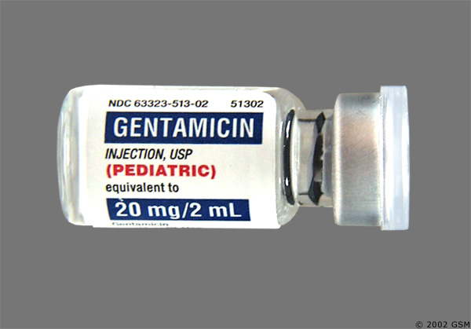
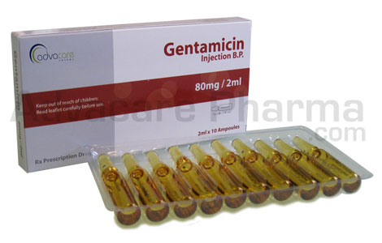

Slide 29
Neomycin
INDICATIONS AND DOSE:
Bowel sterilisation before surgery▶ BY MOUTH ▶ Adult: 1 g every 1 hour for 4 hours, then 1 g every 4 hours for 2–3 days
Hepatic coma▶ BY MOUTH ▶ Adult: Up to 4 g daily in divided doses usually for 5–7 days

Slide 30
Neomycin
CONTRA-INDICATIONS: Intestinal obstruction . Myasthenia gravis (aminoglycosides may impair neuromuscular transmission)
CAUTIONS: Avoid prolonged use.
It is too toxic for systemic use.

Slide 31
Neomycin
SIDE-EFFECTS :the same side effects as other
aminoglycosides, but, it is poorly absorbed after oral administration.
PREGNANCY There is a risk of auditory or vestibular nerve damage in the infant when aminoglycosides are used in the second and third trimesters of pregnancy.
HEPATIC IMPAIRMENT Absorbed from gastro-intestinal tract in liver disease—increased risk of ototoxicity.

Slide 32
Neomycin
RENAL IMPAIRMENT: Avoid–risk of ototoxicity and nephrotoxicity.
MONITORING REQUIREMENTS:
▶ Renal function should be assessed before starting an aminoglycoside and during treatment.
▶ Auditory and vestibular function should also be monitored during treatment.
MEDICINAL FORMS: Tablet Neomycin sulfate 500 mg.

Slide 33
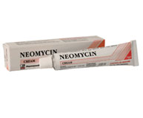
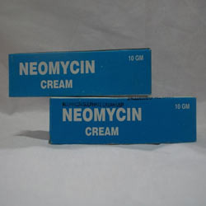

Slide 34
STREPTOMYCIN INDICATIONS AND DOSE
Tuberculosis, resistant to other treatment, in combination with other drugs ▶ by deep I.M
▶ Adult: 15 mg/kg daily (max. per dose 1 g), reduce dose in those under 50 kg and those over 40 years
Adjunct to doxycycline in brucellosis (administered on expert advice):▶by deep I.M
▶ Adult: (consult local protocol)
Enterococcal endocarditis
▶ Adult: (consult local protocol)

Slide 35
Streptomycin
IMPORTANT SAFETY INFORMATION Side-effects increase after a cumulative dose of 100 g, which should only be exceeded in exceptional circumstances.
SIDE-EFFECTS: Hypersensitivity . oral paraesthesia
RENAL IMPAIRMENT:Should preferably be avoided. If essential, use with great care and consider dose reduction.
MONITORING REQUIREMENTS:▶ One-hour (‘peak’) concentration should be 15–40 mg/litre; pre-dose (‘trough’) concentration should be less than 5 mg/litre (less than 1 mg/litre in renal impairment or in those over 50 years).
MEDICINAL FORMS: powder for solution for injection.

Slide 37
Tobramycin
INDICATIONS AND DOSE:
Septicaemia | Meningitis and other CNS infections | Biliary tract infection | Acute pyelonephritis or prostatitis | Pneumonia in hospital patients
▶ BY INTRAMUSCULAR INJECTION, OR BY SLOW INTRAVENOUS INJECTION, OR BY INTRAVENOUS INFUSION
▶ Adult: 3 mg/kg daily in 3 divided doses; increased if necessary up to 5 mg/kg daily in 3–4 divided doses, increased dose used in severe infection; dose to be reduced back to 3 mg/kg daily as soon as clinically indicated.

Slide 38
Tobramycin
Chronic Pseudomonas aeruginosa infection in patients with cystic fibrosis
▶ BY INHALATION OF NEBULISED SOLUTION
▶ Adult: 300 mg every 12 hours for 28 days, subsequent courses repeated after 28-day interval without tobramycin nebuliser solution
▶ BY INHALATION OF POWDER
▶ Adult: 112 mg every 12 hours for 28 days, subsequent courses repeated after 28-day interval without tobramycin inhalation powder

Slide 39
Tobramycin
Urinary-tract infection:
▶ BY INTRAMUSCULAR INJECTION
▶ Adult: 2–3 mg/kg for 1 dose
DOSES AT EXTREMES OF BODY-WEIGHT:
▶ To avoid excessive dosage in obese patients, use ideal weight for height to calculate parenteral dose and monitor serum-tobramycin concentration closely.

Slide 40
Tobramycin
CAUTIONS:
▶ When used by inhalation Conditions characterised bymuscular weakness—may impair neuromuscular transmission . history of prolonged previous or concomitant intravenous aminoglycosides—increased risk of ototoxicity . renal impairment—limited information available . severe haemoptysis—risk of further haemorrhage

Slide 41
Tobramycin
SIDE-EFFECTS ▶ Common or very common
▶ When used by inhalation: Dysphonia . increased risk of infection . malaise . respiratory disorder . Sputum discolouration
▶ Frequency not known
▶ When used by inhalation: Aphonia . oropharyngeal pain . Taste altered
▶ With parenteral use: Diarrhoea . disorientation . dizziness . exfoliative dermatitis . granulocytopenia . leucocytosis . leucopenia . nerve disorders . thrombocytopenia . Urine abnormalities . Vertigo.

Slide 42
MONITORING REQUIREMENTS of Tobramycin
▶ With intramuscular use or intravenous use One-hour (‘peak’) serum concentration should not exceed 10 mg/litre; predose(‘trough’) concentration should be less than 2 mg/litre.
▶ When used by inhalation Measure lung function before and after initial dose of tobramycin and monitor for bronchospasm; if bronchospasm occurs in a patient not using a bronchodilator, repeat test using bronchodilator .Manufacturer advises monitor renal function beforetreatment and then annually

Slide 43
DIRECTIONS FOR ADMINISTRATION of Tobramycin
▶ With intravenous use For intravenous infusion (Nebcin ®); intermittent or via drip tubing in Glucose 5% or Sodium chloride 0.9%. For adult intermittent infusion suggested volume 50–100mL given over 20–60 minutes.
▶ When used by inhalation Other inhaled drugs should be administered before tobramycin.
PATIENT AND CARER ADVICE:
▶ When used by inhalation Patient counselling is advised for Tobramycin dry powder for inhalation (administration).
VANTOBRA ® NEBULISER SOLUTION Manufacturer advises
if a dose is more than 6 hours late, the missed dose should
not be taken and the next dose should be taken at the normal time.

Slide 44
Tobramycin
RENAL IMPAIRMENT▶ When used by inhalation Manufacturer advises monitor serum-tobramycin concentration.
MEDICINAL FORMS:
Solution for injection ▶ Tobramycin (as Tobramycin sulfate) 40 mg per 1 ml solution for injection vials

Slide 45
Tobramycin
Inhalation powder :Tobramycin 28mg inhalation powder capsules with device.
Nebuliser liquid:
Tobramycin 60 mg per 1 ml ampoule
Tobramycin 75 mg per 1 ml ampoule
Tobramycin 100 mg per 1 ml ampoule

Slide 48
Thank you

