Slide 1

Physical pharmacy
Lab No. 6
Adsorption
Done by :
Assistant Lecturer
Zeina Dawood Sura Zuhair Hiba Sabah

Slide 2
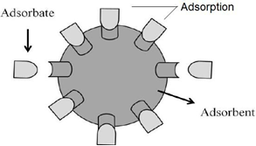
Adsorption
Adsorption is a process of free moving of solutes or gaseous molecules of a solution come close and attach themselves onto the surface of solid. The adsorption can be strong or weak depends on the nature of forces between solid surface (adsorbent) and the gas or dissolves solute (adsorbate), as shown below:

Slide 3
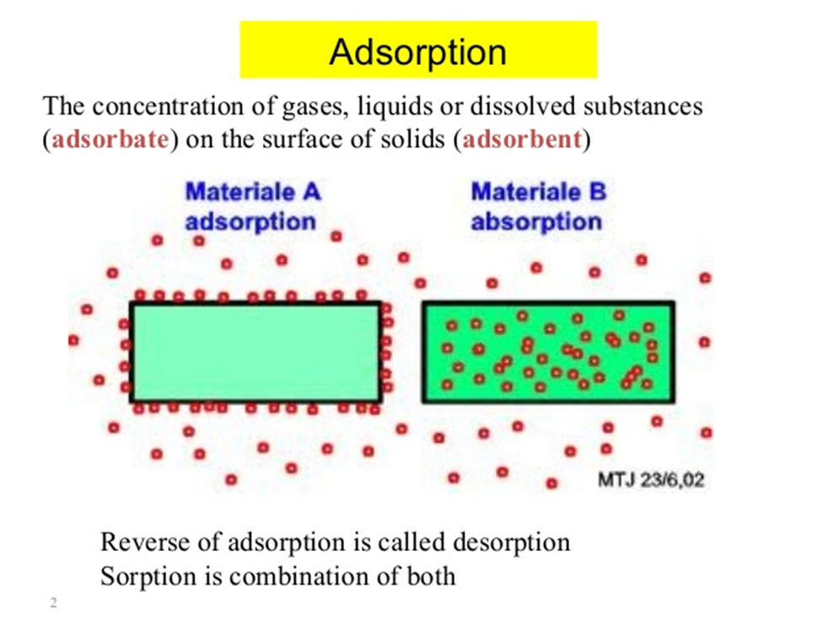

Slide 4
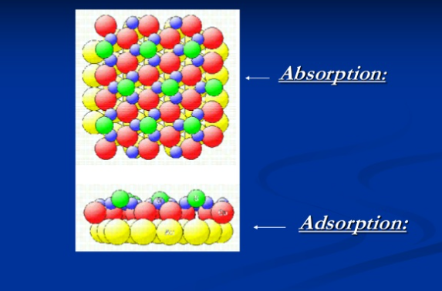


Slide 5
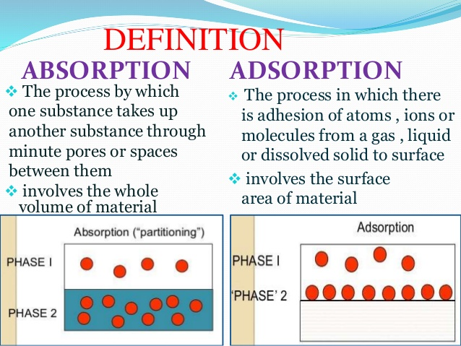

Slide 6

Adsorption
adsorption:- is the process which is involve the concentration or accumulation of gas ,liquid and solid on the surface of the liquid or solid which is in contact .
adsorbate:- is the substance being adsorbed.
adsorption isotherm:- is the relationship between the amount of substance being adsorbed and the amount existing in the bulk of the solution at constant temperature.
solid has the property of holding molecules at their surface and this property occur in the case of porous and finely divided material.
adsorbent:- is the material used to adsorb gas ,liquid and solid e.g. charcoal & kaolin

Slide 7
Types of adsorption:-
1- physical or vanderwaals adsorption
2- chemical or chemisorptions
associated with vanderwaals force and it is reversible .
the removal of adsorbate from adsorbent known as desorption ,
as physically adsorbed gas can be desorbed from solid by increasing temperature and decreasing pressure.
in which adsorbate is attached to adsorbent by primary chemical bond and is irreversible

Slide 8
Type of adsorption

Slide 9
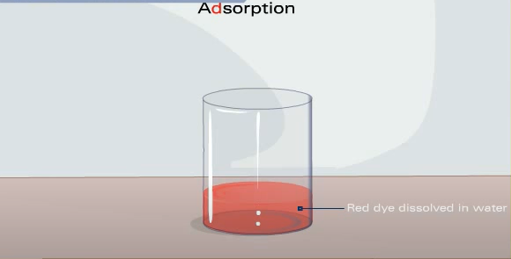
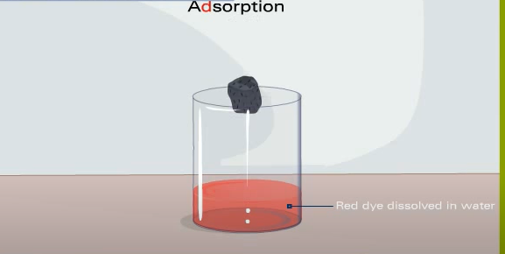
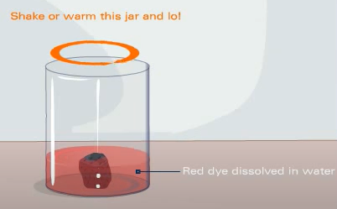
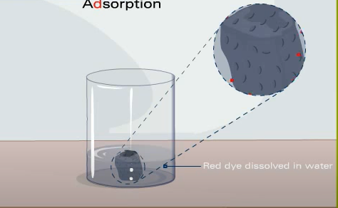
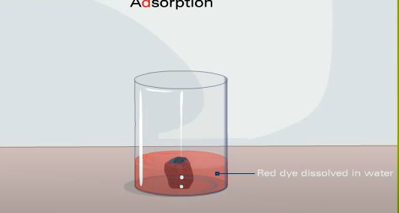
Add
charcoal
heat

Slide 10
Application of adsorption:
the removable of objectionable odor from room & food.
the operation of gas mask and measurement of particle dimension.
decoloring of solution ,detergent and wetting .
adsorption chromatography.

Slide 11
factors affecting on adsorption process
Adsorption on a solid is influenced by a number of factors such as,
• Surface area
• Nature of the adsorbate
• Hydrogen ion concentration (pH) of the solution
• Temperature
• Nature of adsorbent

Slide 12
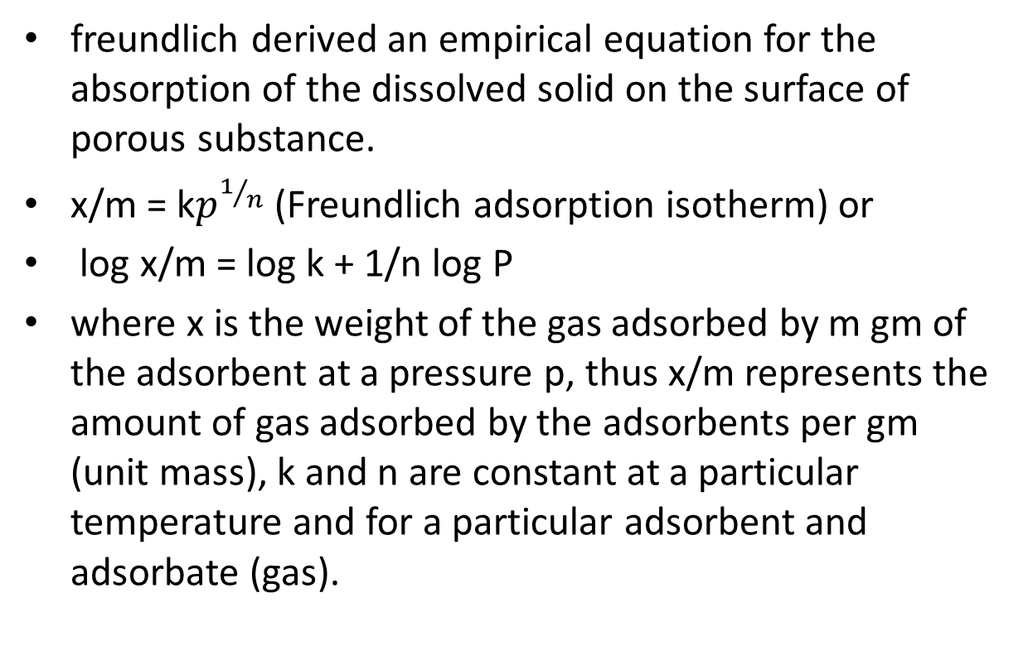
Freundlich adsorption isotherm
freundlich derived an empirical equation for the absorption of the dissolved solid on the surface of porous substance.
x/m = k$p_{}^{1/n}$(Freundlich adsorption isotherm) or
log x/m = log k + 1/n log P
where x is the weight of the gas adsorbed by m gm of the adsorbent at a pressure p, thus x/m represents the amount of gas adsorbed by the adsorbents per gm (unit mass), k and n are constant at a particular temperature and for a particular adsorbent and adsorbate (gas).

Slide 13
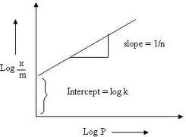
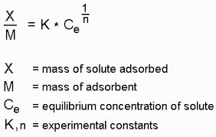
according to freundlich equation a plot of log x/m versus log p a straight line obtained and the constant k and 1/n determined ( intercept = log k, slop = 1/n )
Log C or

Slide 14
Experimental work
Aim of the experiment is to study the adsorption of oxalic acid on kaolin and see the effect of increasing the concentration of oxalic acid on adsorption.
Materials and equipments:-
-oxalic acid, D.W., NaOH, kaolin
-solutions:- 1 N oxalic acid,0.5 N NaOH, ph.ph indicator
-volumetric flask (50 cc)conical flask , pipette (20 cc), filter paper ,funnel, burette.

Slide 15
Procedure :-
1- prepare 50ml of the following concentration of oxalic acid ( 0.2 , 0.4 , 0.6 , 0.8 N ) from stock solution of 1N oxalic acid.
2- put 50 ml of each concentration and stock solution in 5 conical flasks.
3-introduce 2gm kaolin into each flask.
4- shake for 15 min. ,set aside for another 15 min to achieve equilibrium.
5-filter, reject the first portion of the filtrate after washing the receiver with it .
6- pipette 20 ml of the filtrate containing the non-adsorbed oxalic acid (free) and titrate them with 0.5 N NaOH using phenolphthalein indicator ( End point change in color from colorless to pink)
7- calculate the amount adsorbed in each flask and plot freundlich adsorption isotherm , find the values of K and 1/n.

Slide 16
First step prepare the dilutions
*To prepare 50 ml of 0.2 N oxalic acid solution from 1N (stock solution)
C1V1= C2V2
1N ×?=0.2N × 50
X=10 ml of stock solution complete the volume up to 50 ml by DW.
Other concentrations calculated by the same way.

Slide 17
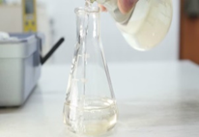
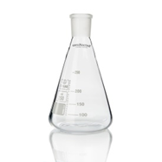
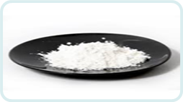
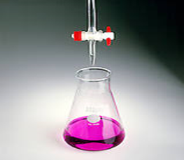
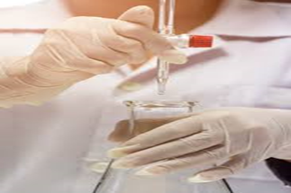
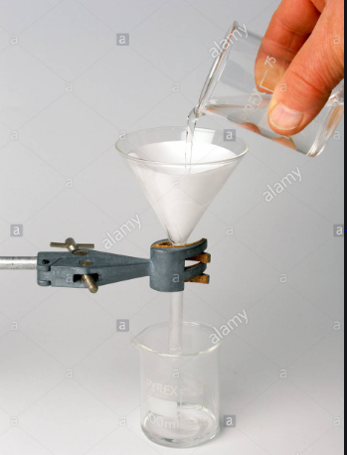
Steps of the experiment
Put 50ml of 0.2N of oxalic acid in conical flask
Weigh 1 g of kaolin & add to oxalic acid solution
shake for 15 min ,set aside for another 15 min
Change Color from
Colorless to pink
Take 20ml of filtrate ,2drops of phenolphthalein, titrate with(0.5N)NaOH
Filtration

Slide 19
Calculate the amount of total oxalic acid in each flask as follows:-
flask no.1:- if there is no kaolin present and we take 20 ml of solution and titrate it with 0.5 N NaOH theoretically it take 40 ml NaOH
1mole oxalic acid = 2 mole NaOH
1 M * V ox.A = 2 M * V NaOH
2N * V ox.A = 2 N * V NaOH
1 * 20 = 0.5 * V
V= 40 ml NaOH we need if there is no kaolin present in the flask
40* 0.0315 = 1.26 gm oxalic acid /20 ml (total)
= 3.15 gm ox.A /50 ml ...............................in flask no.1
x=amount adsorbed = 3.15 -[ (E.P1 * 0.0315)*50/20]= gm/50ml adsorbed of oxalic acid (X)

Slide 20
repeat the calculation for the other 4 flasks to find amount of oxalic acid /50ml that is adsorbed
- C% can be calculated as follows:-
for flask no. 1 ( concentration = 1 N)
1 = wt*1000 / 63*100
c%= 6.3 gm of oxalic acid /100ml
repeat the calculation for the other flasks to find C%

Slide 21
Tabulate the result as follow

Slide 22
To plot freundlich adsorption isotherm & find the values of K and 1/n. according to freundlich equation we plot log x/m versus log C a straight line obtained and the constant k and 1/n determined ( intercept = log k, slop = 1/n )
Log C

Slide 23


