Slide 1
Oral hypoglycemic drugs
Assist. Lec sura abbas

Slide 3
Type 2 DM
It is commonly associated with obesity, physical inactivity,
raised blood pressure, dyslipidaemia and a tendency to
develop thrombosis; therefore it increases cardiovascular
risk.
It is associated with long-term microvascular and
macrovascular complications, together with reduced quality
of life and life expectancy.

Slide 4
Pregnant
All oral antidiabetic drugs, except metformin
hydrochloride, should be discontinued before
pregnancy (or as soon as an unplanned pregnancy is
identified) and substituted with insulin therapy.

Slide 5
breast feeding
Metformin hydrochloride can be continued, or glibenclamide resumed, immediately after birth and during breastfeeding for those with pre-existing Type 2 diabetes.
All other antidiabetic drugs should be avoided while breastfeeding

Slide 7
Classes of OHD
Dipeptidyl Peptidase-4 Inhibitors (Gliptins)
Selective Sodium-Dependent Glucose Cotransporter-2 (SGLT-2) Inhibitors
Glucagon-Like Peptide 1 Agonists

Slide 8
sulphonylureas
The sulfonylureas act mainly by augmenting insulin secretion and consequently are effective only when some residual pancreatic beta-cell activity is present; during long-term administration they also have an extra-pancreatic action (all OHD need some functioning pancreas to act)

Slide 9
Cont.
These drugs are classified as being either first- or second-generation agents. Both classes of SU are equally effective when given at equipotent doses. Today, the vast majority of patients receiving a sulfonylurea are prescribed a second-generation agent.

Slide 11
Cont.
All sulfonylureas undergo hepatic biotransformation.
The first-generation sulfonylureas are more likely to cause drug interactions than second-generation agents.
All sulfonylureas, except tolbutamide, require a dosage adjustment or are not recommended in renal impairment
In elderly patients or those with compromised renal or hepatic function, lower starting dosages are necessary.

Slide 12
Side effects of SU
Common adverse effects include hypoglycemia and weight gain. There may be some cross-sensitivity in patients with sulfa allergy.

Slide 13
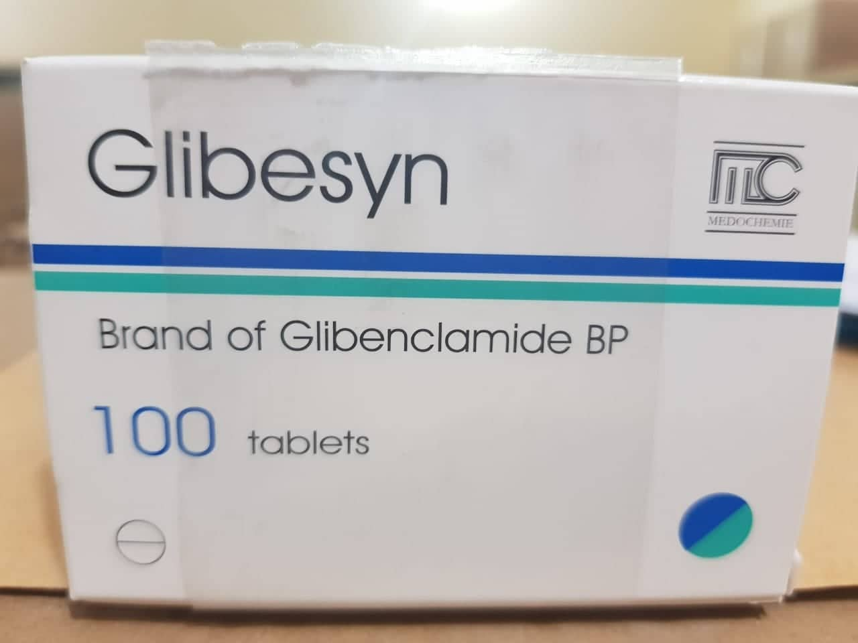
Initially 5 mg daily, adjusted according to response, dose to be taken with or immediately after
breakfast; maximum 15 mg per day

Slide 14
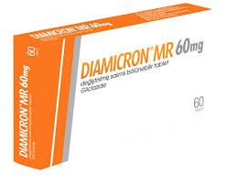
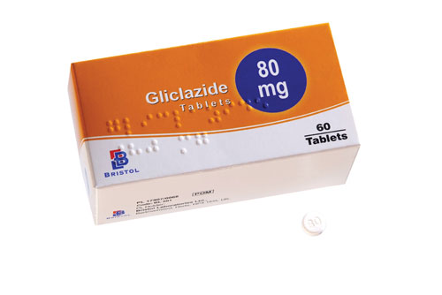
DOSE EQUIVALENCE AND CONVERSION
▶ Gliclazide modified release 30mg may be considered to be approximately equivalent in therapeutic effect to standard formulation gliclazide 80 mg.
dose to be taken with breakfast

Slide 15
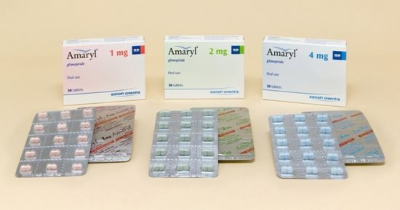
dose to be taken shortly before or with first main meal

Slide 16
meglinitides
REPAGLINIDES AND NATEGLINIDES stimulates insulin secretion. The primary benefit of nonsulfonylurea secretagogues is in reducing postmeal glucose levels
(should not be used in combination with other insulin secretagogues)
Risk of hypoglycemia but less than SU
Because they have a rapid onset and short duration of action(2-6 hr), they are to be taken 15 to 30 minutes before a meal

Slide 18
biguanides
Metformin exerts its effect mainly by decreasing gluconeogenesis and by increasing peripheral utilization of glucose; since it acts only in the presence of endogenous insulin it is effective only if there are some residual functioning pancreatic islet cells. . It does not stimulate insulin secretion and therefore, when given alone, does not cause hypoglycemia

Slide 19
SIDE-EFFECTS
▶ Common or very common Abdominal pain . Appetite decreased . diarrhoea (usually transient) . Gastrointestinal disorder . nausea . taste altered . vomiting
▶ Rare or very rare Hepatitis . lactic acidosis (discontinue) . skin reactions . vitamin B12 absorption decreased

Slide 20
Dose for DM
Adult: Initially 500 mg once daily for at least 1 week, dose to be taken with breakfast, then 500 mg twice daily for at least 1 week, dose to be taken with breakfast and evening meal, then 500 mg 3 times a day, dose to be taken with breakfast, lunch and evening meal; maximum 2 g per day

Slide 21
BY MOUTH USING MODIFIED-RELEASE MEDICINES
▶ Adult: Initially 500 mg once daily, then increased if necessary up to 2 g once daily, dose increased gradually, every 10–15 days, dose to be taken with evening meal, alternatively increased to 1 g twice daily, dose to be taken with meals, alternative dose only to be used if control not achieved with once daily dose regimen. If control still not achieved then change to standard release tablets

Slide 22
Polycystic ovary syndrome and metformin
Metformin hydrochloride (initiated by a specialist) is prescribed as an insulin sensitising drug in women with polycystic ovary syndrome who are not planning pregnancy [unlicensed indication].
Metformin hydrochloride may improve short-term insulin sensitivity and reduce androgen concentrations, but there is insufficient supporting evidence that metformin improves weight gain, hirsutism, acne or regulation of the menstrual cycle

Slide 23
Dose for PCOS
▶ BY MOUTH USING IMMEDIATE-RELEASE MEDICINES
▶ Adult: Initially 500 mg once daily for 1 week, dose to be taken with breakfast, then 500 mg twice daily for 1 week, dose to be taken with breakfast and evening meal, then 1.5–1.7 g daily in 2–3 divided doses

Slide 24
SIDE-EFFECTS, FURTHER INFORMATION
Gastro-intestinal side-effects are initially common with metformin, and may persist in some patients, particularly when very high doses are given. A slow increase in dose may improve tolerability.
PREGNANCY Can be used in pregnancy for both preexisting and gestational diabetes. Women with gestational diabetes should discontinue treatment after giving birth.
BREAST FEEDING May be used during breast-feeding in women with pre-existing diabetes.

Slide 25
HEPATIC IMPAIRMENT Withdraw if tissue hypoxia likely
CONTRA-INDICATIONS Acute metabolic acidosis (including lactic acidosis and diabetic ketoacidosis)
CAUTIONS Risk factors for lactic acidosis
CAUTIONS, FURTHER INFORMATION
▶ Risk factors for lactic acidosis Manufacturer advises caution in chronic stable heart failure (monitor cardiac function), and concomitant use of drugs that can acutely impair renal function; interrupt treatment if dehydration occurs, and avoid in conditions that can acutely worsen renal function, or cause tissue hypoxia.

Slide 26
MONITORING REQUIREMENTS
Determine renal function before treatment and at least annually (at least twice a year in patients with additional risk factors for renal impairment, or if deterioration suspected).

Slide 27
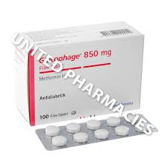
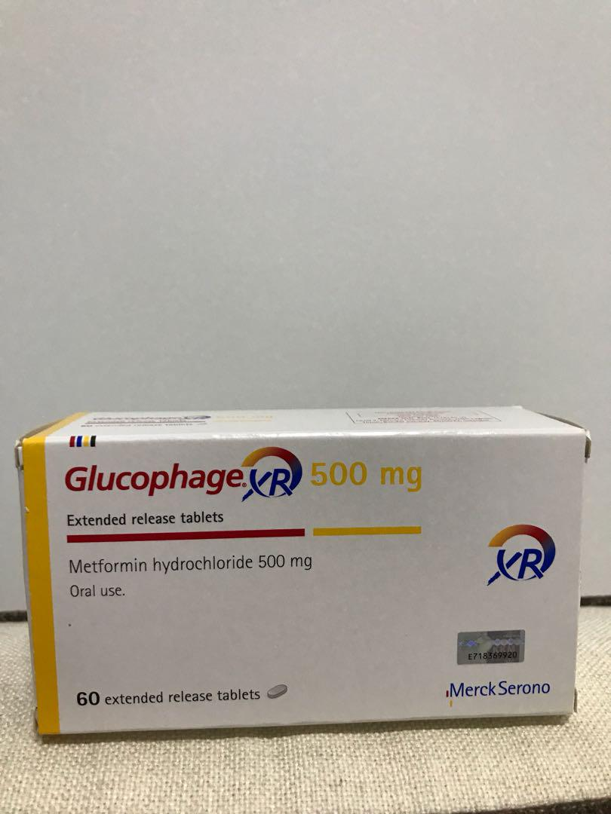

Slide 28
thiazolidinediones
Rosiglitazone and pioglitazone, reduces peripheral insulin resistance, leading to a reduction of blood-glucose concentration.
The onset of action for TZDs is delayed for several weeks and may require up to 12 weeks before maximum effects are observed.

Slide 29
Pioglitazone and heart failure
Incidence of heart failure is increased when pioglitazone is combined with insulin especially in patients with predisposing factors e.g. previous myocardial infarction.
Patients who take pioglitazone should be closely monitored for signs of heart failure; treatment should be discontinued if any deterioration in cardiac status occurs.
Pioglitazone should not be used in patients with heart failure or a history of heart failure

Slide 30
PIOGLITAZONE: RISK OF BLADDER CANCER
The European Medicines Agency has advised that there is a small increased risk of bladder cancer associated with pioglitazone use. However, in patients who respond adequately to treatment, the benefits of pioglitazone continue to outweigh the risks.
Pioglitazone should not be used in patients with active bladder cancer or a past history of bladder cancer, or in those who have uninvestigated macroscopic haematuria.
Pioglitazone should be used with caution in elderly patients as the risk of bladder cancer increases with age.

Slide 31
Before initiating treatment with pioglitazone, patients should be assessed for risk factors of bladder cancer (including age, smoking status, exposure to certain occupational or chemotherapy agents, or previous radiation therapy to the pelvic region) and any macroscopic haematuria should be investigated.
The safety and efficacy of pioglitazone should be reviewed after 3–6 months and pioglitazone should be stopped in patients who do not respond adequately to treatment.
Patients should be advised to report promptly any haematuria, dysuria

Slide 32
CONTRA-INDICATIONS and caution
CI: History of heart failure . previous or active bladder cancer . uninvestigated macroscopichaematuria
CAUTIONS Cardiovascular disease or in combination with insulin (risk of heart failure) . elderly (increased risk of heart failure, fractures, and bladder cancer) . increased risk of bone fractures, particularly in women. risk factors for bladder cancer

Slide 34
Intestinal alpha glcusidase inhibitors
Acarbose and miglitol are inhibitors of intestinal alpha glucosidases, delays the digestion and absorption of starch and sucrose; it has a small but significant effect in lowering blood glucose.

Slide 35
SIDE EFFECTS
High incidences of GI side effects, including flatulence, abdominal discomfort, and diarrhea
The α-glucosidase inhibitors are contraindicated in patients with chronic intestinal diseases including inflammatory bowel disease. In addition, neither drug in this class is recommended for patients with a serum creatinine greater than 2 mg/dL

Slide 36
CAUTIONS
May enhance hypoglycaemic effects of insulin and sulfonylureas (hypoglycaemic episodes may be treated with oral glucose but not with sucrose)

Slide 37
SIDE-EFFECTS, FURTHER INFORMATION
Antacids containing magnesium and aluminium salts unlikely to be beneficial for treating side effects.
PATIENT AND CARER ADVICE:
Antacids unlikely to be beneficial for treating side-effects.
To counteract possible hypoglycaemia, patients receiving insulin or a sulfonylurea as well as acarbose need to carry glucose (not sucrose—acarbose interferes with sucrose absorption).
Patients should be given advice on how to administer acarbose tablets.

Slide 38
DOSE
Adult: Initially 50 mg daily, then increased to 50 mg 3 times a day for 6–8 weeks, then increased if necessary to 100 mg 3 times a day (max. per dose 200 mg 3 times a day)
DIRECTIONS FOR ADMINISTRATION Tablets should be chewed with first mouthful of food or swallowed whole with a little liquid immediately before food.

Slide 39
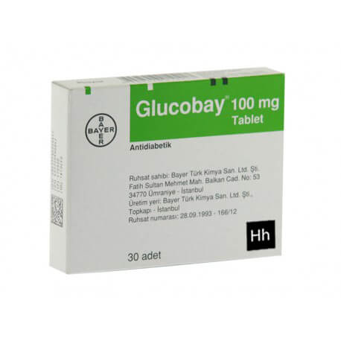

Slide 40
Dipeptidyl Peptidase-4 Inhibitors (Gliptins)
The dipeptidyl peptidase-4 (DPP-4) inhibitors (sitagliptin, saxagliptin, linagliptin, and alogliptin) are approved as adjunct to diet and exercise to improve glycemic control in adults with T2DM.
They lower blood glucose concentrations by inhibiting DPP-4, the enzyme that degrades endogenous GLP-1, thereby increasing the amount of endogenous GLP-1

Slide 41
SE
Common adverse effects include headache and nasopharyngitis. Hypoglycemia is not a common adverse effect with these agents because insulin secretion results from GLP-1 activation caused by meal-related glucose detection and not from direct pancreatic β-cell stimulation.
Acute pancreatitis, including hemorrhagic and necrotizing pancreatitis, has been reported in patients taking glipitins.

Slide 42
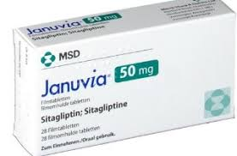
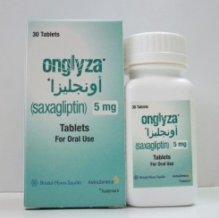
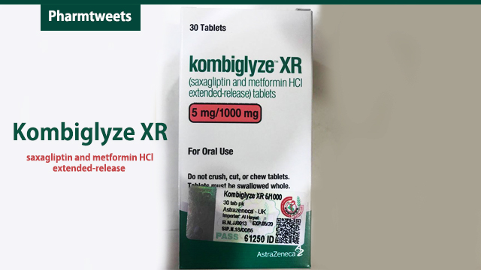

Slide 43
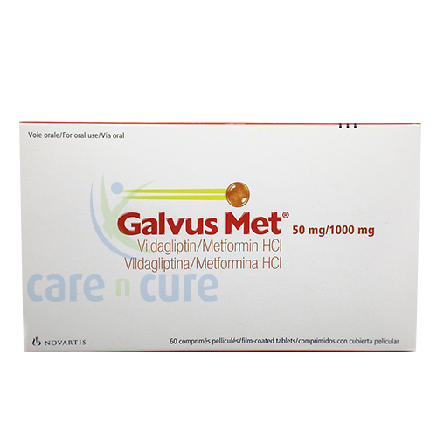

Slide 44
Selective Sodium-Dependent Glucose Cotransporter-2 (SGLT-2) Inhibitors
Canagliflozin, dapagliflozin, and empagliflozin, SGLT-2 inhibitors, are approved as adjunct to diet and exercise to improveglycemic control in adults with T2DM.
The SGLT-2 receptor is responsible for 90% of the active glucose reabsorption of the kidney’s proximal tubule.
By inhibiting this receptor, glucose reabsorption is decreased. Glucose passes into the urine, serum glucose is lowered and modest weight loss is promoted

Slide 45
SE
Possible adverse reactions include urinary tract infections, genital mycotic infections, increased urination, hypotension, and increased serum creatinine.

Slide 46
IMPORTANT SAFETY INFORMATION
A review by the European Medicines Agency has concluded that serious, life-threatening, and fatal cases of diabetic ketoacidosis (DKA) have been reported rarely in patients taking an SGLT2 inhibitor.
In several cases, the presentation of DKA was atypical with patients having only moderately elevated blood glucose levels, and some of them occurred during off-label use.

Slide 47
IMPORTANT SAFETY INFORMATION
Canagliflozin may increase the risk of lower-limb amputation (mainly toes) in patients with type 2 DM

Slide 48
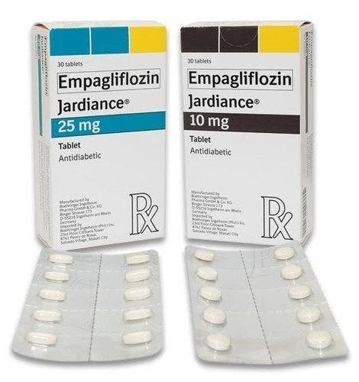
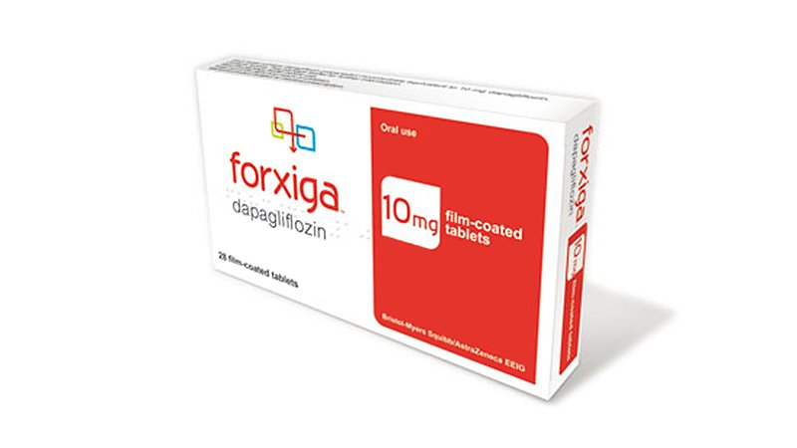

Slide 49
Glucagon-Like Peptide 1 Agonists
Exenatide, liraglutide, albiglutide, and dulaglutide are indicated for the treatment of T2DM to improve glycemic control. These agents are part of the group of drugs known as incretins
Binds to, and activates, the GLP-1 (glucagon-like peptide-1) receptor to increase insulin secretion, suppresses glucagon secretion, and slows gastric emptying.

Slide 50
Side effects
GLP-1 agonists typically produce moderate weight loss of around 1 to 3 kg
The main side effects of GLP-1 agonist therapy include nausea, vomiting, and diarrhea.
These GI adverse effects tend to lessen over time.
GLP-1 agonists have been associated with cases of acute pancreatitis. Any patient presenting with symptoms of acute pancreatitis, including abdominal pain, nausea, and vomiting, should have GLP-1 agonist therapy discontinued until pancreatitis can be ruled out.

Slide 51
Albiglutide, liraglutide, exenatide extended-release, and dulaglutide packaging's contain a black-box warning about thyroid C-cell tumors.22 They are contraindicated in patients with a personal or family history of medullary thyroid cancer and in those with a history of multiple endocrine tumors.
CONTRA-INDICATIONS Diabetic gastroparesis . inflammatory bowel disease . severe congestive heart failure—no information available
SAXENDA ® Concomitant use with other products for weight management . elderly 75 years or over (limited information) . obesity secondary to endocrinological or eating disorders
VICTOZA ® Diabetic ketoacidosis
CAUTIONS Thyroid disease

Slide 52
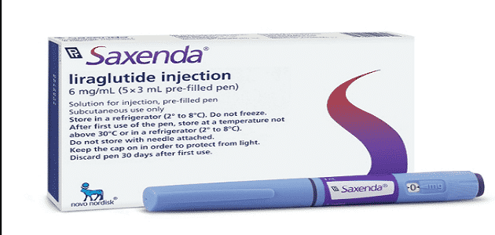
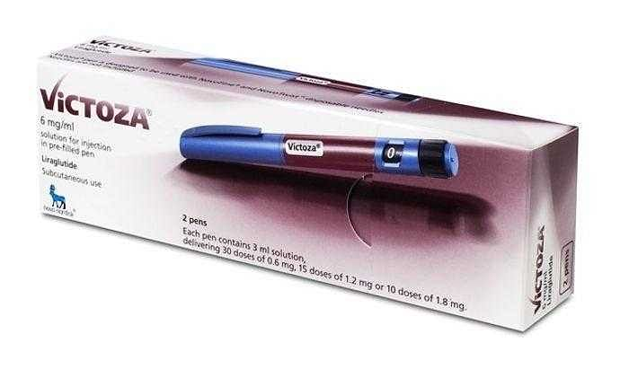

Slide 53
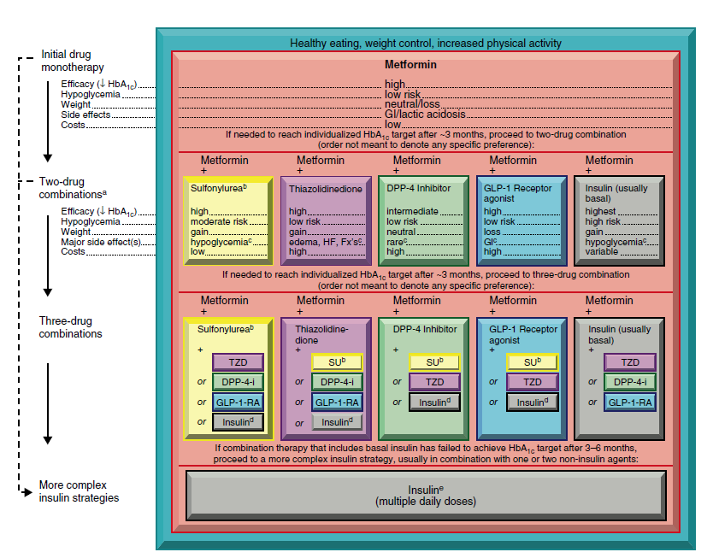
للأطلاع فقط

