Slide 1
Chronic heart failure

Slide 2
Definition
Inefficiency of the heart as a pump where the delivery of blood, and therefore oxygen and nutrients, becomes inadequate for the needs of the tissues.
Also is a complex clinical syndrome that result from any functional or structural cardiac disorder that impairs the ability of the ventricle to fill with or eject blood.

Slide 3
Types of heart failure
Heart failure with reduced(HFrEF)or systolic dysfunction :LVEF of 40% or less
Dilated ventricle(pumping problem)
Two third of cases are attributable to chronic heart disease
One third of cases are attributable to non ischemic cardiomyopathy
i.HTN
ii.Thyroid disease
iii.Obesity
iv.Stress
V. Cardiotoxins
Vi. Myocarditis
vii.Idiopathic
viii.Tachycardia
ix.Peripartum

Slide 4
Heart failure with preserved EF (HFpEF)or diastolic dysfunction
LVEF of 50% or greater ;borderline HFpEF is LVEF 41%–49%
Account for about 30% of patients with HF.
Impaired ventricular relaxation and filling
Most cause is HTN (60%–89%).

Slide 6
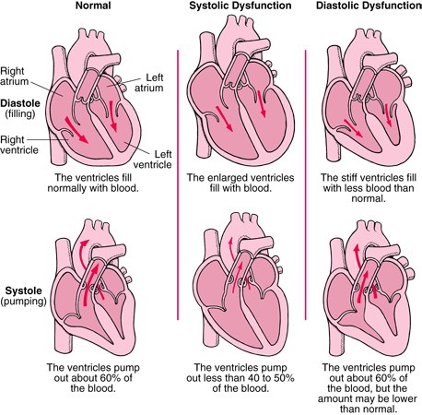

Slide 7
Stages of HF
Stage I : No symptoms with ordinary physical activity(such as walking or climbing stairs)
Stage II : Slight limitation With dyspnoea on moderate to sever exertion (climbing stairs or walking uphill.
Stage III : marked limitation of activity, activity causes dyspnea,fatigue or palpitation
Stage IV: sever disability,dyspnea at rest( unable to carry out any physical activity without discomfort)

Slide 9
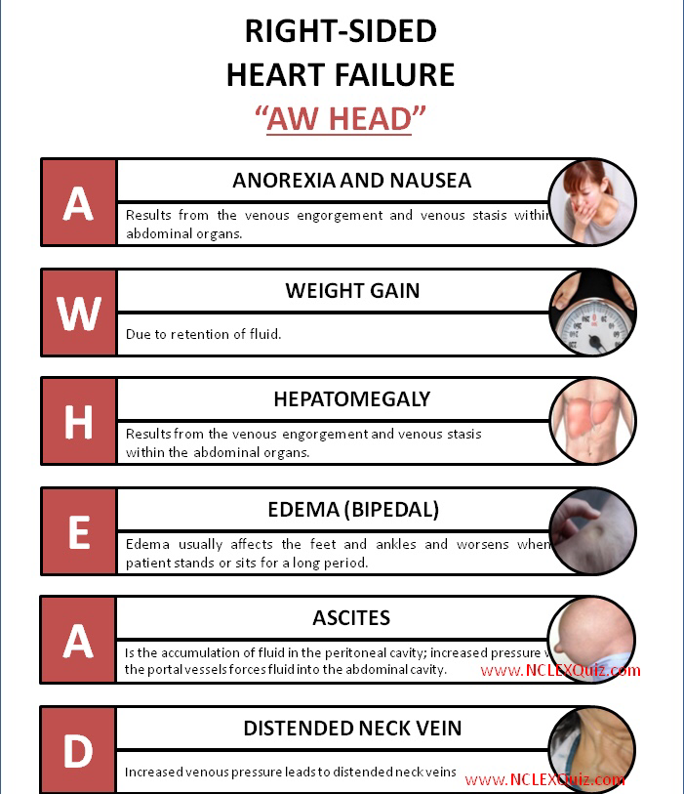

Slide 10
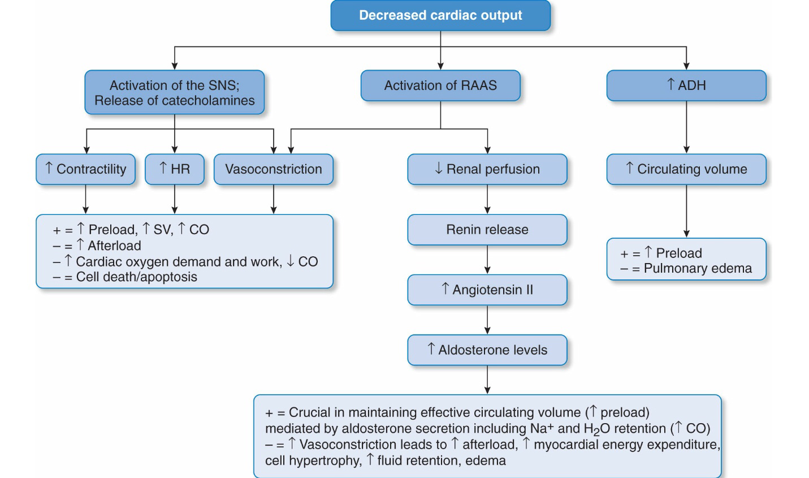

Slide 12
Goals of treatment
1.Modify or control risk factors (e.g.,HTN,obesity,DM)
2.Manage structural heart disease
3. Reduce morbidity and mortality
4. Prevent or minimize Na and water retention
5. Eliminate or minimize HF symptoms
6. Block compensatory neurohormonal activation caused by reduced cardiac output
7. Slow progression of worsening cardiac function

Slide 13
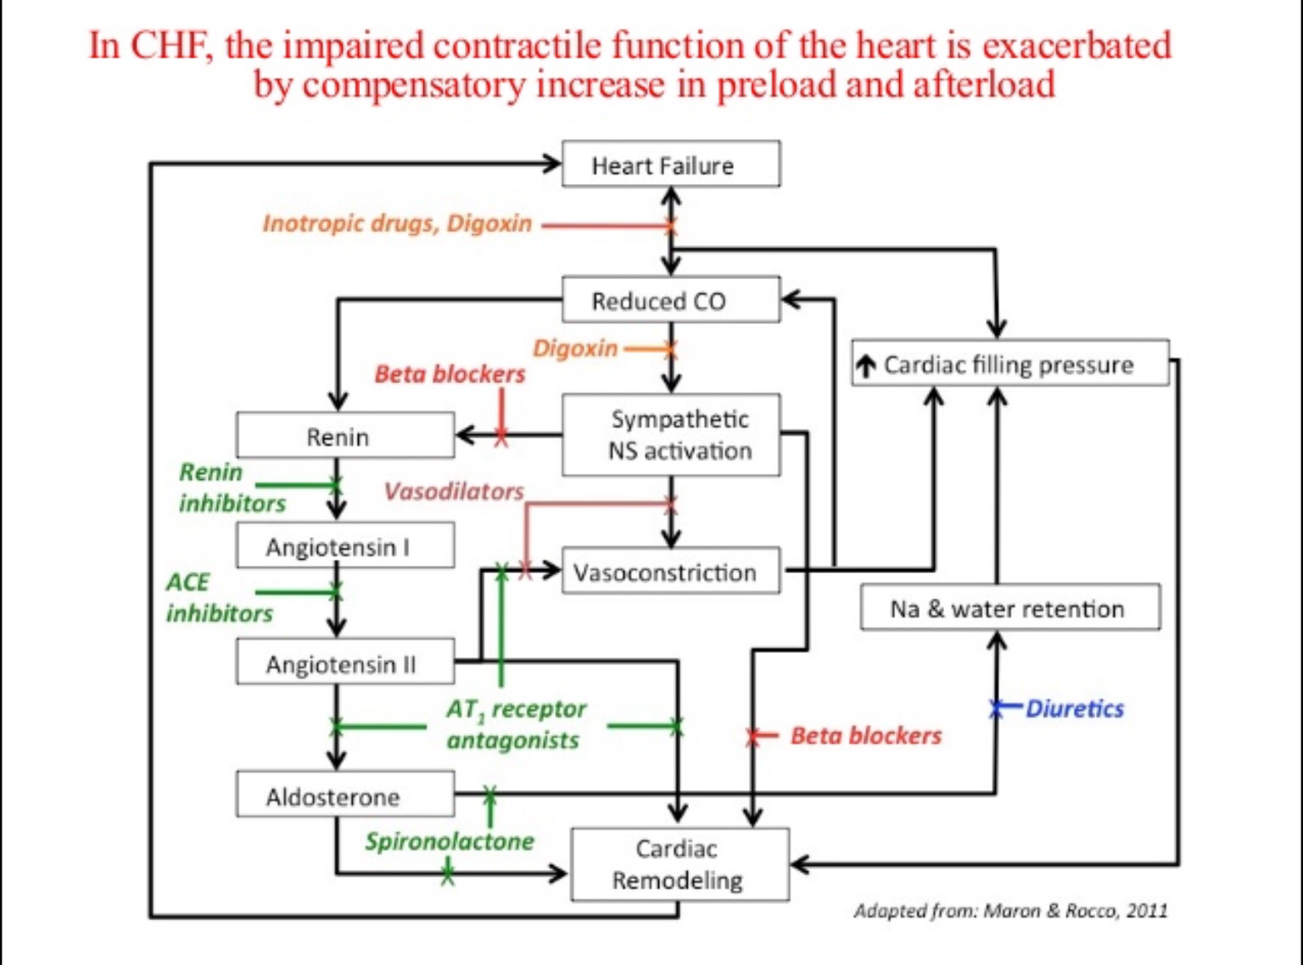

Slide 14
Diuretics
1.decreased jugular venous ditension
2. Decreased pulmonary congestion
3. Decreased peripheral edema
4. Decreased daily symptoms
5. Increased exercise tolerance
Monitor
Bp , electrolytes, renal function

Slide 15
ACE-I
reducing both the preload and afterload on the heart, thereby increasing cardiac output.
ACE inhibitors act upon the renin–angiotensin–aldosterone system, and they reduce afterload by reducing the formation of angiotensin II
These drugs also have an indirect effect on sodium and water retention by inhibiting the release of aldosterone and vasopressin, thereby reducing venous congestion and preload.
The increase in cardiac output leads to an improvement in renal perfusion, which further helps to alleviate oedema
Monitor Bp , renal function, k level

Slide 16
ARBs
Although comparisons of ACE inhibitors and ARBs have shown similar benefits on morbidity and heart failure mortality, only ACE inhibitors have been shown to have positive effects on all cause mortality. ARBs should, therefore, not be used instead of ACE inhibitors, unless the patient experiences intolerable side effects.

Slide 17
B- blockers
Carvedilol ,labetolol, metoprolol succinate
Blocks the effect of norepinephrin and other sympathetic neurotransmitters on the heart and vascular system
1. Decreases ventricular arrhythmias
2. Decreases cardiac hypertrophy and cardiac cell death
3. Decreases vasoconstriction and HR
Start low dose and increase every 2 weeks
Avoid abrupt discontinuation
Monitor Bp, HR, signs of congestion

Slide 18
Aldosterone antagonists
Spiranolactone and eplerenone
Blocks effects of aldosterone in the kidneys,heart and vasculature
Decrease fluid and Na retention
Eliminates catecholamine potentiation,decreases BP
Recommended in patients with NYHA class II- IV with an LEVF of 35% or less to reduce morbidity and mortality.
Monitor k level , renal function

Slide 19
Digoxin
Has positive inotropic effect,increase cardiac contractility and COP
digoxin is currently recommended for use as add-on therapy at low doses in patients with moderate-to-severe heart failure who remain symptomatic despite adequate doses of ACE inhibitor, β-blocker and diuretic treatment.
lack of effect on mortality
Minimal increase in cardiac contractility
Avoid digitalis toxicity

Slide 21
Nitrates/hydralazine
Nitrates cause venodilation, thereby reducing the symptoms of pulmonary congestion. hydralazine, which reduces the afterload combined with it to achieve a balanced effect on the venous and arterial circulation.
The combined effects of these two drugs lead to an increase in cardiac output, and a reduction in mortality in patients with heart failure.
Recommended in addition to ACE inhibitors and β-blockers to reduce morbidity and mortality for patients self-described as African American with NYHA classIII or IV HFrEF
The combination has mainly been reserved for patients unable to tolerate, or with a contraindication to, ACE inhibitor therapy.

Slide 22
Inotropic agents
particularly the sympathomimetic agents dobutamine and dopamine
These agents have inotrope-vasodilator effects which differ according to their action on α, β1, β2 and dopamine receptors (β1-agonists increase cardiac contractility, β2-agonists produce arterial vasodilation, dopamine agonists enhance renal perfusion)
Noradrenaline (norepinephrine) is an α-adrenoreceptor agonist where its vasoconstrictor action limits its usefulness in severely hypotensive patients such as those in septic shock.
Adrenaline (epinephrine) has β1, β2 and α-adrenoreceptor agonist effects and is used in patients with low vascular resistance.

Slide 23
Other agents
Direct-acting vasodilators such as sodium nitroprusside are rarely used except in the acute setting when they are given by continuous infusion.
Amlodipine and felodipine have a more selective action on vascular tissue and, therefore, a less pronounced effect on cardiac contractility than other calcium antagonists and should be the agents of choice where appropriate.
Sacubitril/valsartan (Entresto) novel drug in 2015, Sacubitrilprodrug metabolized to an active metabolite that inhibits neprilysin,increaseing levels of natriuretic peptides,decrease hospitalization ana all cause mortality.
Ivabradine selectively inhibits the I£ current in the sinoatrial node ,providing HR reduction.reduces HF hospitalizations for patients with symptomatic (NYHA class II and III),chronic stable HFrEF (LVEF of 35% or less) who are receiving evidence-based therapies,including B-blocker at maximum tolerated dose, and who are in sinus rhythm with HR of 70 beats/min or greater at rest.

Slide 25
