Slide 1
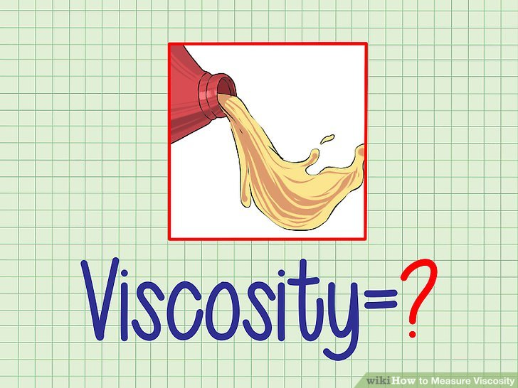
Lab 5
Viscosity
Assistant Lecturer
Hiba Sabah Zeina Dawood Sura Zuhair

Slide 2
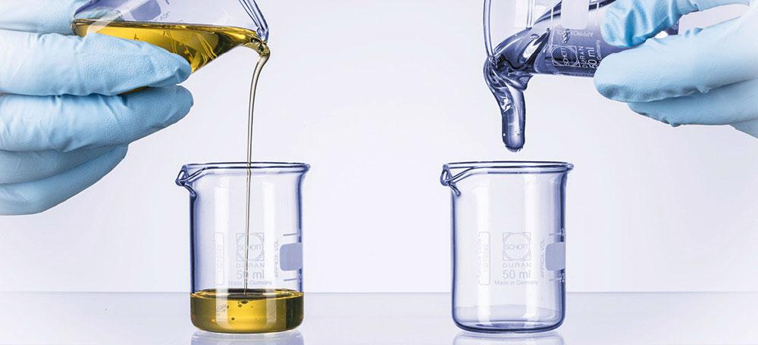
Introduction
Viscosity: is an expression of the resistance to flow of a system under an applied stress. The more viscous a liquid ,the greater the applied force is required to make it flow at a particular rate.
This lab is concerned with the flow properties of dilute colloidal systems and the manner in which viscosity data can be used to obtain the molecular weight of materials comprising the disperse phase. Viscosity studies also provide information regarding the shape of the particles in solution.

Slide 3
Materials classify according to the type of flow and deformation into:
Examples of Newtonian system: water or any simple liquid (gelatin solution, olive oil, glycerin, castor oil, chloroform and ethyl alcohol).
1
Examples of Non Newtonian system: complex liquid or systems which contain polymers ( colloidal solution, emulsion, liquid suspension and ointments).
2
The classification depends on whether or not their flow properties are according to the Newton's law of flow.

Slide 4
Einstein equation

Slide 6
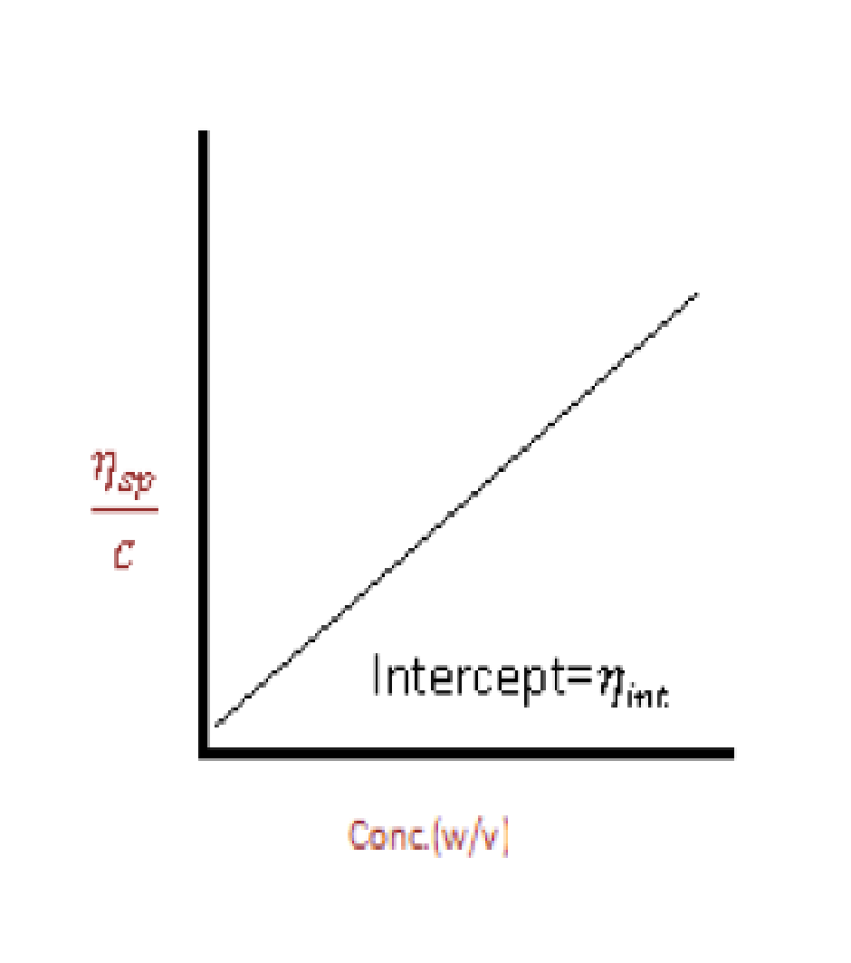
Where C the concentration is expressed in gram of colloidal particles per 100ml of total dispersion

Slide 8
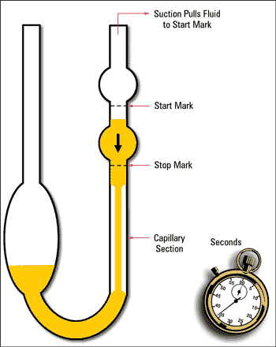
Addition of liquid
A
B

Slide 9
Experimental work
Part l: bring water, glycerin, 1% gelatin solution and prepare volumetric flask (50cc), pipette, capillary viscometer (suspended level viscometer).

Slide 10
Part ll:
A: To determine the concentration of unknown.
Procedure:
Prepare different concentrations w/w of glycerin in water 2%, 5%, 10%, 15%, 20% and 25% (50 ml of each one).
2) Measure the 𝜂 of these solutions by the viscometer knowing the density of each solution 1.003, 1.005, 1.018, 1.03, 1.037, 1.044 respectively. Then find 𝜂𝑟𝑒𝑙 and draw curve by plotting 𝜂𝑟𝑒𝑙 against conc. (w/w).
3) Find out the concentration of unknown from the curve by measuring its 𝜂𝑟el of unknown.
4) The line started from 1 since the viscosity of water is equal to 1 cp. The density of glycerine is 1.26 and water = 1.

Slide 11
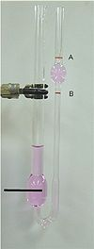
Calculation
viscosity of water is equal to 1cp
The density of and water = 1.
Conc | Density of sol.
2% | 1.003
5% | 1.005
10% | 1.018
15% | 1.03
20% | 1.037
25% | 1.044

Slide 12
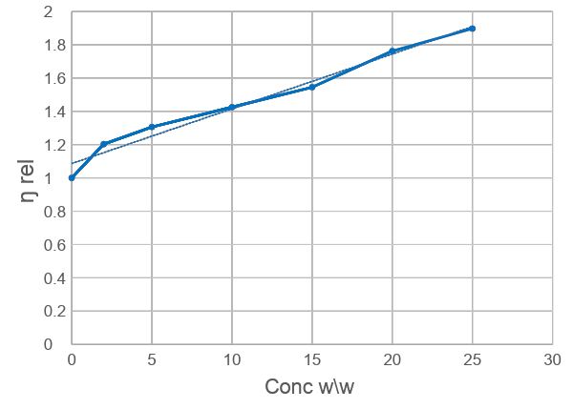
Calculate the unknown concentration for solution if you know the relative viscosity of unknown conc was 1.35 ?

Slide 13
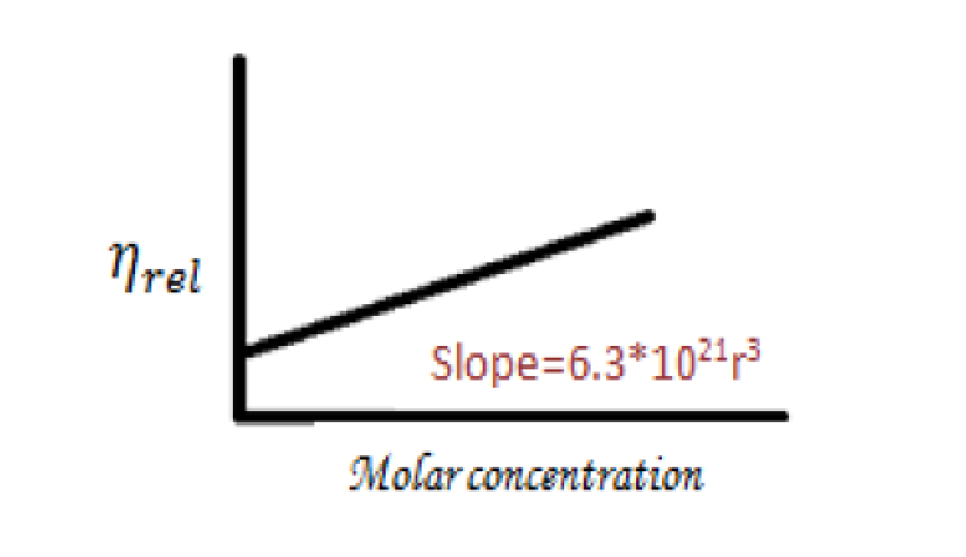
Part ll:
B: To determine the radius of particle by plotting 𝜂𝑟𝑒𝑙 against molar concentration.
Procedure: Prepare different concentrations of glycerine (w/v) then find 𝜂𝑟𝑒𝑙 of each concentration. Finally, find the radius from slope.
*each one of the concentration must be convert to molar conc.
* For 2% ( 2g\100ml) Molar concentration= Wt /M.wt * 1000/Vol
= 2/ 92.09 *1000/100
=0.217 M
Conc. | Molar conc.
2% | 0.217
5%
10%
15%
20%
25%

Slide 15
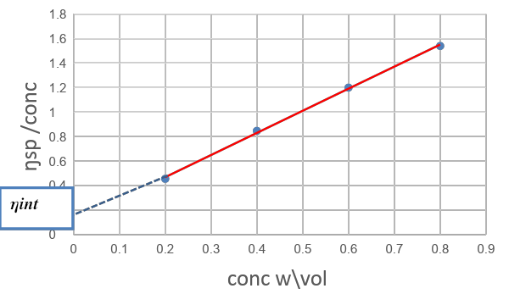
Calculation
Conc | p1 | t1(sec) | t2(sec) water | 𝜂1 | 𝜂𝑟𝑒𝑙 | 𝜂𝑠𝑝 (𝜂𝑟𝑒𝑙 -1) | 𝜂𝑠𝑝 /conc
0.2 | 1.05 |  | 5
0.4 | 1.08 |  | 5
0.6 | 1.11 |  | 5
0.8 | 1.2 |  | 5

