Slide 1
Chronic obstructive pulmonary disease (COPD)
Assist. Lect. Sura abbas

Slide 2
A 58-year-old man comes to see you because of shortness of breath. He has experienced mild dyspnea on exertion for a few years, but more recently he has noted worsening shortness of breath with minimal exercise and the onset of dyspnea at rest. He has difficulty reclining, and, as a result, he spends the night sitting up in a chair trying to sleep. He reports a cough with production of yellowish-brown sputum every morning throughout the year. He denies chest pain, fever, chills, or lower extremity edema. He has smoked about two packs of cigarettes per day since age 15 years. He does not drink alcohol. A few months ago, the patient went to an urgent care clinic for evaluation of his symptoms, and he received a prescription for some inhalers, the names of which he does not remember.

Slide 3
He was also told to find a primary care physician for further evaluation. On physical examination, his blood pressure is 135/85 mm Hg, heart rate 96 bpm, respiratory
rate 28 breaths per minute, and temperature 97.6°F. He is sitting in a chair, leaning forward, with his arms braced on his knees. He appears uncomfortable with labored respirations and cyanotic lips.(hypoxemia) He is using accessory muscles of respiration, and chest examination reveals wheezes and rhonchi bilaterally, but no crackles are noted. The anteroposterior diameter of the chest wall appears increased, (hyperinflation) and he has inward movement of the lower rib cage with inspiration.
Cardiovascular examination reveals distant heart sounds but with a regular rate and rhythm, and his jugular venous pressure is normal. His extremities show no cyanosis, edema, or clubbing.
FEV1/FVC 0.4

Slide 4
Most likely diagnosis: Chronic obstructive pulmonary disease (COPD) with acute exacerbation
• Next diagnostic step: Arterial blood gas to assess oxygenation and acid-base status
• Best initial treatment: Oxygen by nasal cannula, followed closely by bronchodilators, and steroids for inflammatory component

Slide 5
Staging
Typically the forced expiratory volume in first second of expiration (FEV1) will be less than 80% of expected, and some use a staging system of FEV1/FVC (forced vital capacity): <0.7 (mild), 0.3 to 0.5 (moderate), and <0.3 (severe)

Slide 6
Patient characteristics
Characteristically, patients with COPD present with progressively worsening dyspnea (first on exertion, then with activity, then at rest). Patient may vary in appearance from a “blue bloater” (chronic bronchitis, overweight, edematous, cyanotic) to a “pink puffer” (emphysema, thin, ruddy cheeks).

Slide 7
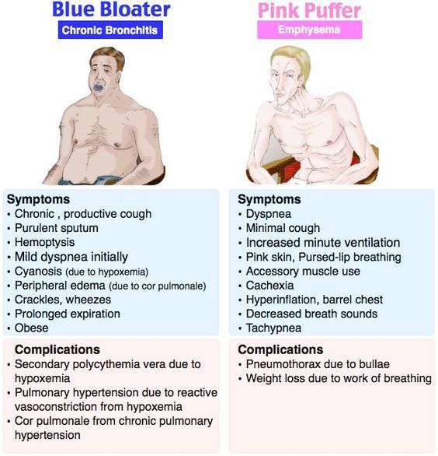

Slide 8
Important note
Reduced FEV1/FVC with minimal response to bronchodilators is the hallmark of COPD
.

Slide 9
Management
Management of severe COPD exacerbations focuses simultaneously on relieving airway obstruction and correcting life-threatening abnormalities of gas exchange.
Bronchodilators (beta-agonist and anticholinergic agents) are administered via handheld nebulizers;
high-dose systemic glucocorticoids accelerate the rate of improvement in lung function among these patients;
antibiotics should be given if there is suspicion of a respiratory infection.

Slide 11
Other therapies
Controlled oxygen administration with nasal oxygen at low flows or oxygen with Venturi masks will correct hypoxemia without causing severe hypercapnia.
Caution must be exercised in patients with chronic respiratory insufficiency whose respiratory drive is dependent on “relative hypoxemia”; these individuals may become apneic if excessive oxygen is administered

Slide 12
Cont.
Patients with a resting hypoxemia (PaO2 <55 mm Hg or SaO2 <88%) generally benefit from home oxygen therapy, which must be utilized at least 18 h/d.
Other therapies such as inhaled bronchodilators (beta-agonists and/or anticholinergics) or inhaled glucocorticoids used for symptomatic relief and to try to reduce the frequency of exacerbations.
Monotherapy with long-acting bronchodilators is preferred; combination therapy may be appropriate in symptomatic patients with an FEV1 less than 60% predicted,

Slide 13
Cont.
Combining albuterol plus ipratropium, a long-acting β2-agonist plus theophylline, or a long-acting β2-agonist plus tiotropium, produces a greater change in spirometry than either drug alone
Triple therapy with inhaled corticosteroid, long-acting β2- agonist, and tiotropium is commonly used. Triple therapy appears to improve lung function and quality of life but may not further reduce exacerbations or dyspnea

Slide 14
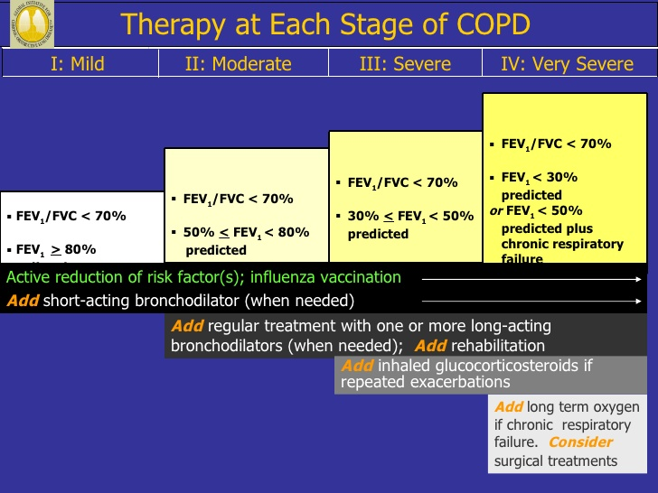

Slide 15
complications
Long-term complications of COPD from hypoxemia can cause pulmonary hypertension, secondary erythrocytosis, exercise limitation, and impaired mental functioning.
For patients with COPD who are stable, only smoking cessation, supplemental oxygen therapy for patients with chronic hypoxemia, and lung volume reduction surgery (Bullectomy, lung volume reduction surgery, and lung transplantation are surgical options for very severe COPD. )in selected patients have been shown to alter the natural history of the disease, and provide any reduction in mortality

Slide 16
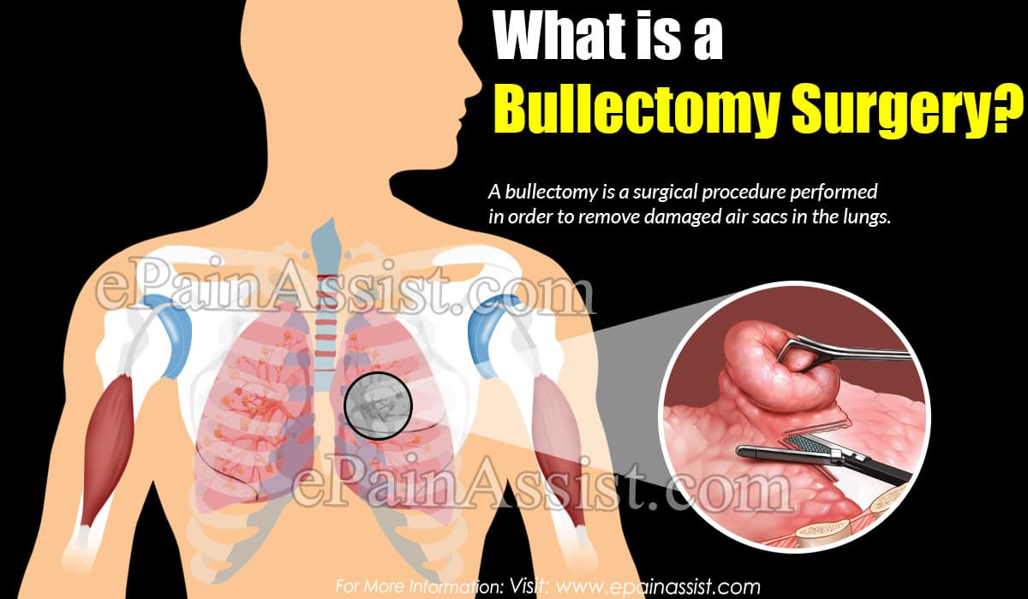

Slide 17


