Slide 1
Clinical pharmacy laboratory DM PART [1] Insulin
Done by:A.L
Zahraa Abudl-Ghani

Slide 2
Type I (IDDM):-
The disease characterized by an absolute deficiency of insulin caused by massive Beta cell destruction, the pancreas fails to respond to glucose.
IDDM shows classic symptoms of insulin deficiency (polydipsia, polyphagia, polyuria, and weight loss).
Type I diabetics require exogenous insulin and characterized by hyperglycemia and life threatening ketoacidosis.
The goal in administration exogenous insulin to control hyperglycemia, avoid ketoacidosis, and to avoid long-term complications.
Because insulin is a polypeptide, it is degraded in the GIT if taken orally. It therefore is generally administered by subcutaneous injection, or intravenously for regular insulin in emergency cases, insulin infusion is also contributed.

Slide 4
Insulins
Insulin plays a key role in the regulation of carbohydrate,fat, and protein metabolism. It is a polypeptide hormone ofcomplex structure. There are differences in the amino-acid sequence of animal insulins, human insulins and the human insulin analogues. Insulin may be extracted from pork pancreas and purified by crystallisation; it may also be extracted from beef pancreas, but beef insulins are now
rarely used. Human sequence insulin may be produced semi synthetically by enzymatic modification of porcine insulin or biosynthetically by recombinant DNAtechnology using bacteria or yeast . All insulin preparations are to a greater or lesser extent immunogenic in man but immunological resistance to insulin action is uncommon.
Insulin is inactivated by gastro-intestinal enzymes, and must therefore be given by injection; the subcutaneous route is ideal in most circumstances.

Slide 5
Insulin is needed by
1-All patients with ketoacidosis 2-Most patients with rapid onset of symptoms 3- Substantial loss of weight 4- Weakness 5-ketonuria 6-Afirst-degree relative who has type 1 diabetes.
7-Insulin is also needed for type 2 diabetes when other methods have failed to achieve good control.
8-Temporarily in the presence of inter current illness or preoperatively.
9-Pregnant women with type 2 diabetes may be treated with insulin when diet alone fails.

Slide 6
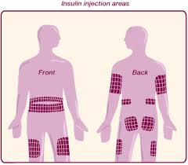
Insulin is usually injected into the upper arms, thighs, buttocks, or abdomen; absorption from a limb site may be increased if the limb is
used in strenuous exercise after the injection

Slide 8
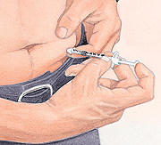

Slide 9
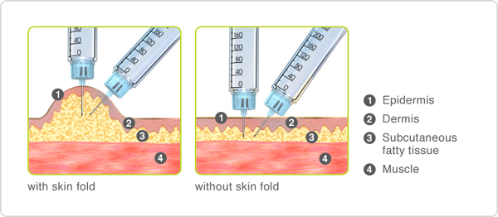

Slide 11
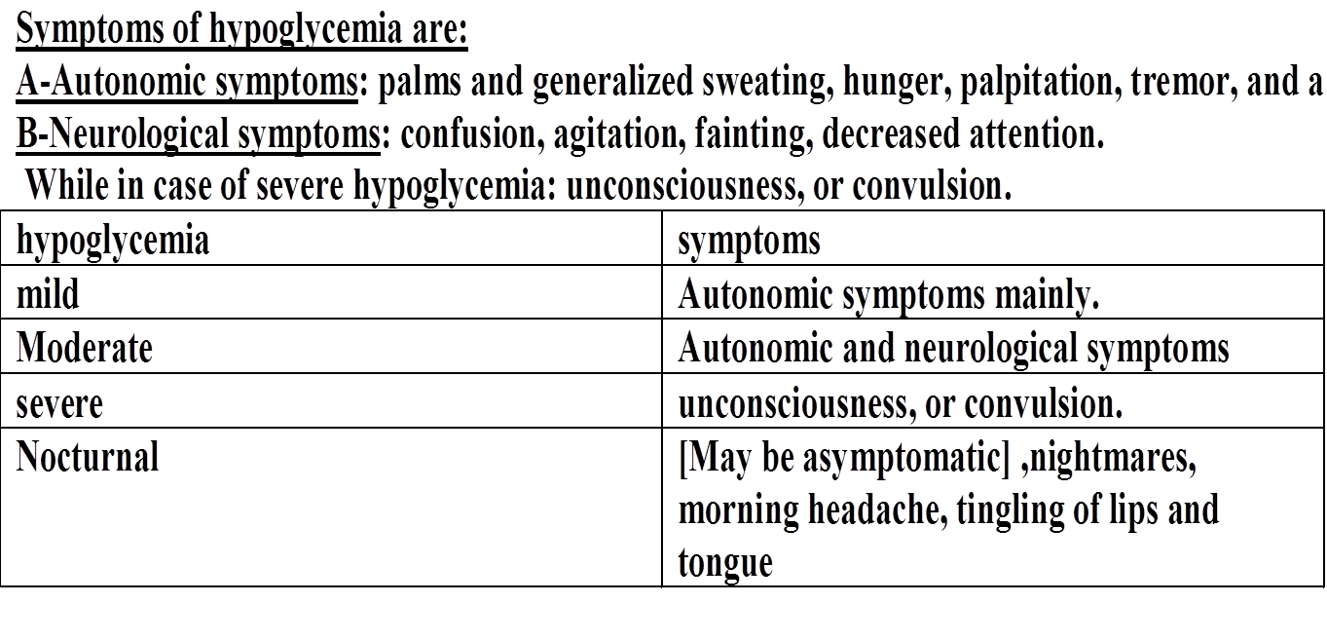
Generally subcutaneous insulin injections cause few problems;
lipodystrophy may occur but can be minimized by using
different injection sites in rotation. Local allergic reactions
are rare.
-Other side effect of insulin is hypoglycemia

Slide 12
Home Management:
10-20 gm of glucose and if the patient still symptomatic after 15 minutes , followed by another 10-20 gm of glucose . the quick source of sugar should be followed by a small complex carbohydrate or protein snack (e.g. milk,…)to provide continual source of glucose if a meal is not scheduled within the next 1 to 2 hours⁽¹⁾
Note: 10 gm of glucose is present in about:
2 tsp of sugar, 1/2 cup orange juice, 1/2 cup apple juice⁽¹⁾
Note: hypoglycemia caused by oral antidiabetic should be transferred to the hospital because hypoglycemic effect to the drug may persist for many hours (BNF)
In addition hypoglycemia caused unconsciousness is an emergency

Slide 13
Route(S) | Appearance | Duration | peak | Onset (hours) | Type of insulin
S.C, I.V⁽⁵⁾ | Clear صافي | 3-6⁽²⁾ | 1-2⁽²⁾ | 15-30 minutes⁽²⁾ | Rapid-acting insulin Insulin Lispro,Insulin aspart, and insulin glulisine
S.C, I.V, And I.M⁽⁵⁾ | Clear صافي | 6-8⁽³⁾ | 2-4⁽¹⁾ | 0.5-1.0⁽¹⁾ | Short-acting insulin ويسمى ايضا (soluble, regular ,neutral)
S.C⁽⁵⁾ only | Cloudy خابط Cloudy خابط | 18-24⁽³⁾ 18-24⁽³⁾ | 6-14⁽¹⁾ 6-14⁽¹⁾ | 1-2⁽¹⁾ 1-3⁽¹⁾ | Intermediate-acting insulin Isophane* insulin also called NPH(neutral protamine hagedorn) Lente
S.C⁽⁵⁾ only | Cloudy خابط Clear صافي | 24-36⁽¹⁾ 24⁽¹⁾ | 18-24⁽¹⁾ No pronounced peak | 4-6⁽³⁾ 4-6⁽³⁾ | long-acting insulin Ultrlente(insulin zinc susp., protamine zinc sup.) Insulin Glargine Insulin detemir

Slide 14
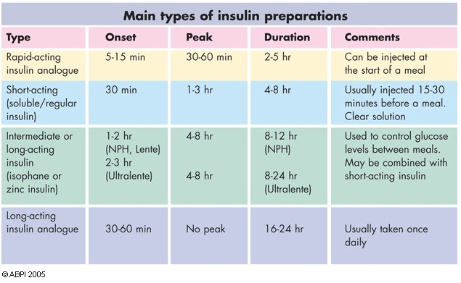

Slide 15
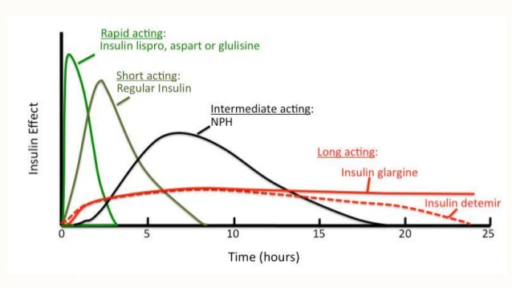

Slide 16
For those who have difficulty with, or prefer not to use, multiple injection regimens, a mixture of premixed short-acting insulin or rapid-acting insulin analogue with an intermediate-acting or long-acting insulin (most commonly in a proportion of 30% soluble insulin and 70% isophane insulin) can be given once or twice daily.
The dose of short-acting or rapid-acting insulin (or the proportion of the short-acting soluble insulin component in premixed insulin) can be increased in those with excessive postprandial hyperglycaemia. The dose of insulin is increased gradually according to the patient’s individual requirements, taking care to avoid troublesome hypoglycaemic reactions.
Insulin requirements may be increased by infection, stress, accidental or surgical trauma, and during puberty.
Requirements may be decreased in those with certain endocrine disorders (e.g. Addison’s disease, hypopituitarism), or in coeliac disease.
.

Slide 17
Examples of recommended insulin regimens
1. Multiple injection regimen: short-acting insulin or
rapid-acting insulin analogue, before meals. With
intermediate-acting or long-acting insulin, once or
twice daily.
2. Short-acting insulin or rapid-acting insulin analogue mixed with intermediate-acting or long-acting insulin, once or twice daily (before meals).
3. Intermediate-acting or long-acting insulin, once or
twice daily. With or without short-acting insulin or
rapid-acting insulin before meals;
4. Continuous subcutaneous insulin infusion

Slide 18
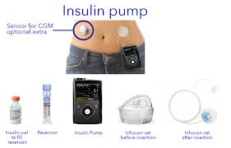
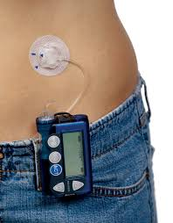
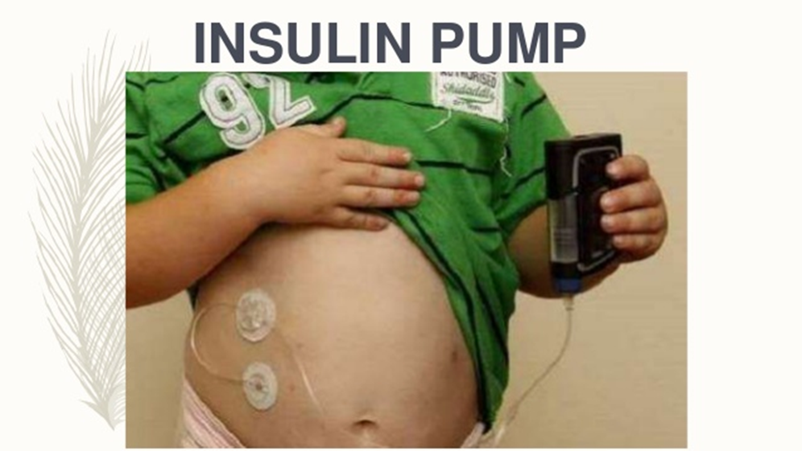

Slide 19
Short-acting insulins
-Soluble insulin is a short-acting form of insulin.
-given15 to 30 minutes before meals.
-Soluble insulin is the most appropriate form of insulin for
use in diabetic emergencies e.g. diabetic ketoacidosis and at the time of surgery. It can be given intravenously and
intramuscularly, as well as subcutaneously.

Slide 20
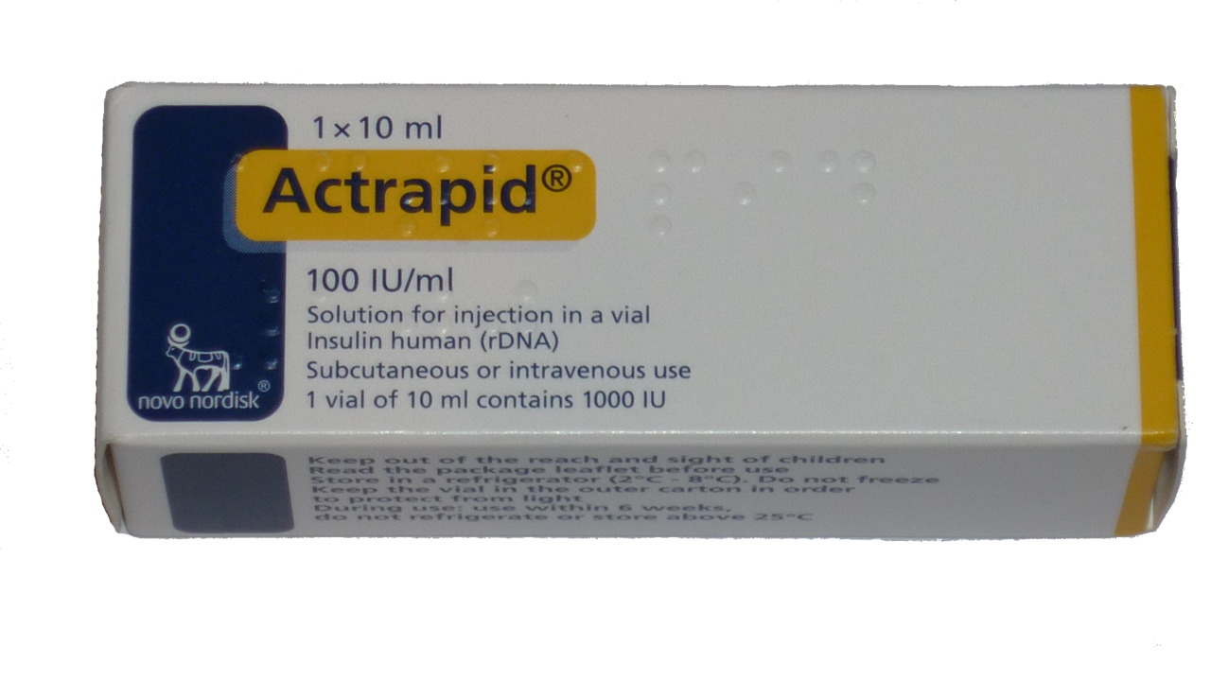
S.A.I

Slide 21
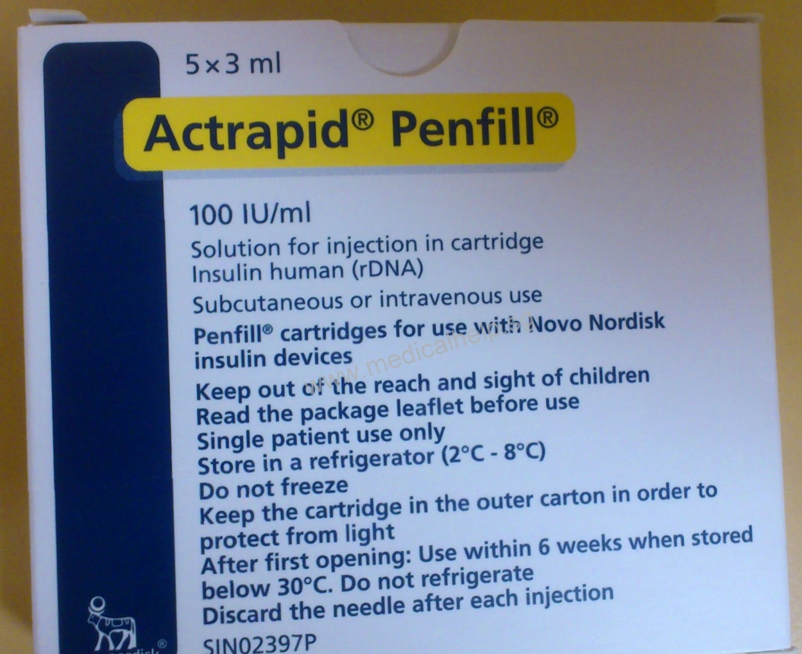

Slide 22
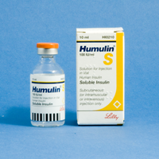
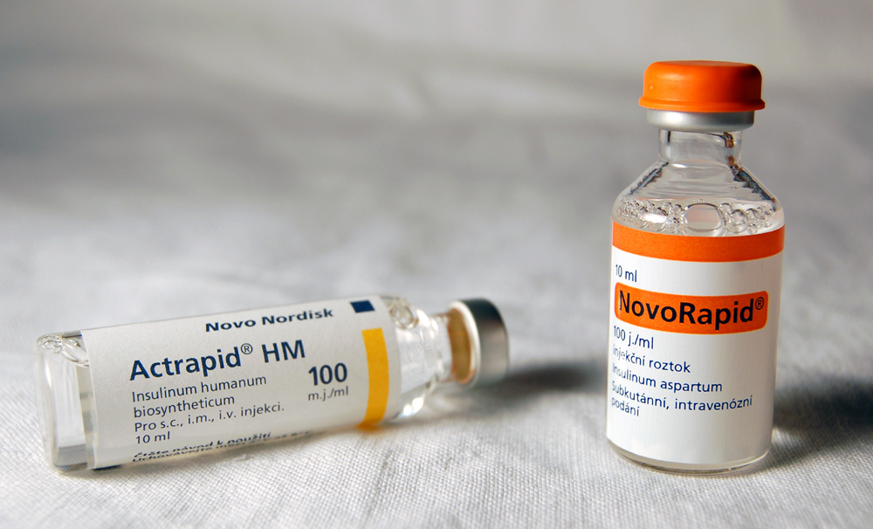

Slide 23
The rapid-acting human insulin analogues
Insulin aspart, Insulin glulisine, and Insulin lispro have a faster onset and shorter duration of action than soluble insulin; as a result, compared to soluble insulin, fasting and pre prandial blood glucose concentrations are a little higher, postprandial blood-glucose concentration is a little lower, and hypoglycaemia occurs slightly less frequently.
Subcutaneous injection of insulin analogues may be convenient for those who wish to inject shortly before or, when necessary, shortly after a meal. They can also help those susceptible to hypoglycaemia before lunch and those who eat late in the evening and are prone to nocturnal hypoglycaemia.

Slide 24
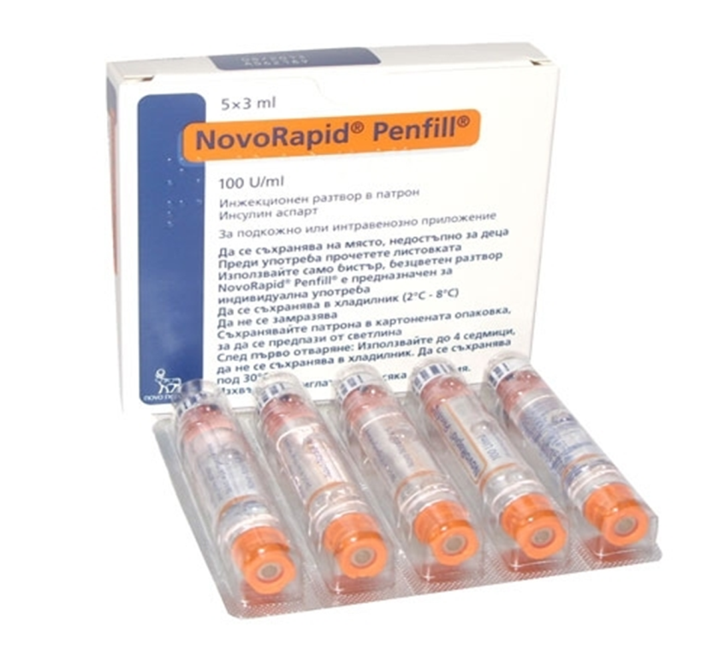
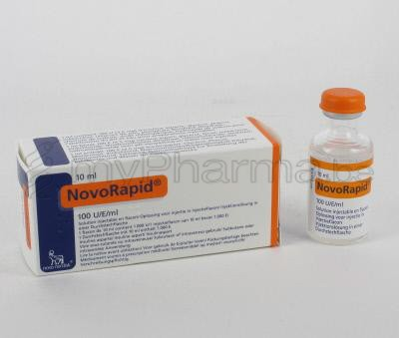
Insulin aspart
They administered by subcutaneous infusion. Insulin aspart and insulin lispro can be administered intravenously and can be used as alternatives to soluble insulin for diabetic emergencies and at the time of surgery.

Slide 25
Insulin glulisine

Slide 26
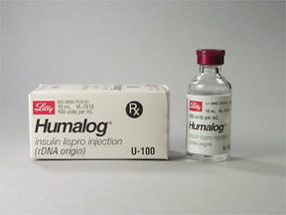
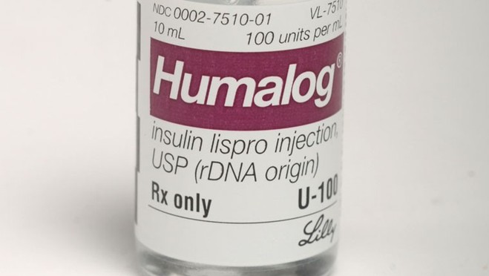
Insulin lispro

Slide 27
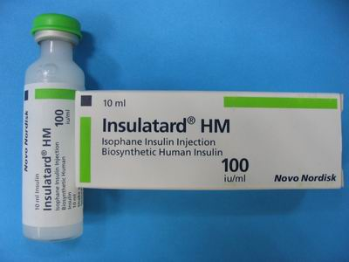
I.A.I[neutral protamin hygydron] NPH
Sterile buffered suspension of either porcine or human insulin
complexed with protamine sulfate (or another suitable
protamine)

Slide 28
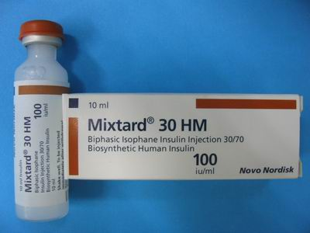

Slide 29
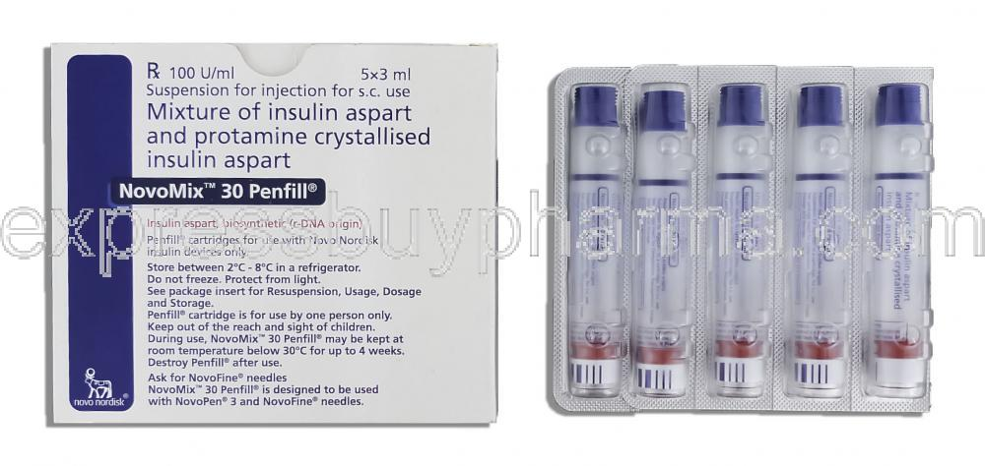
Biphasic insulin aspart

Slide 30
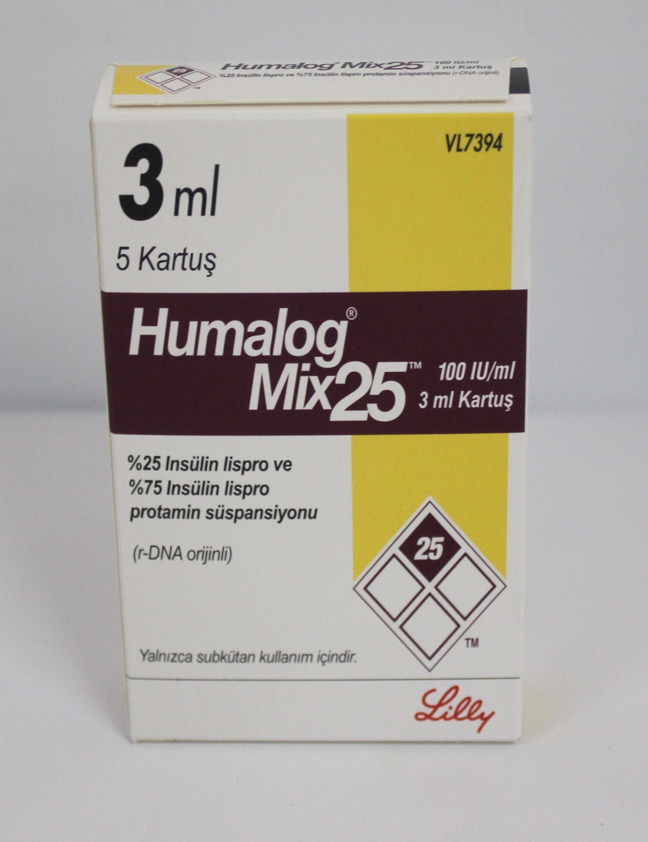
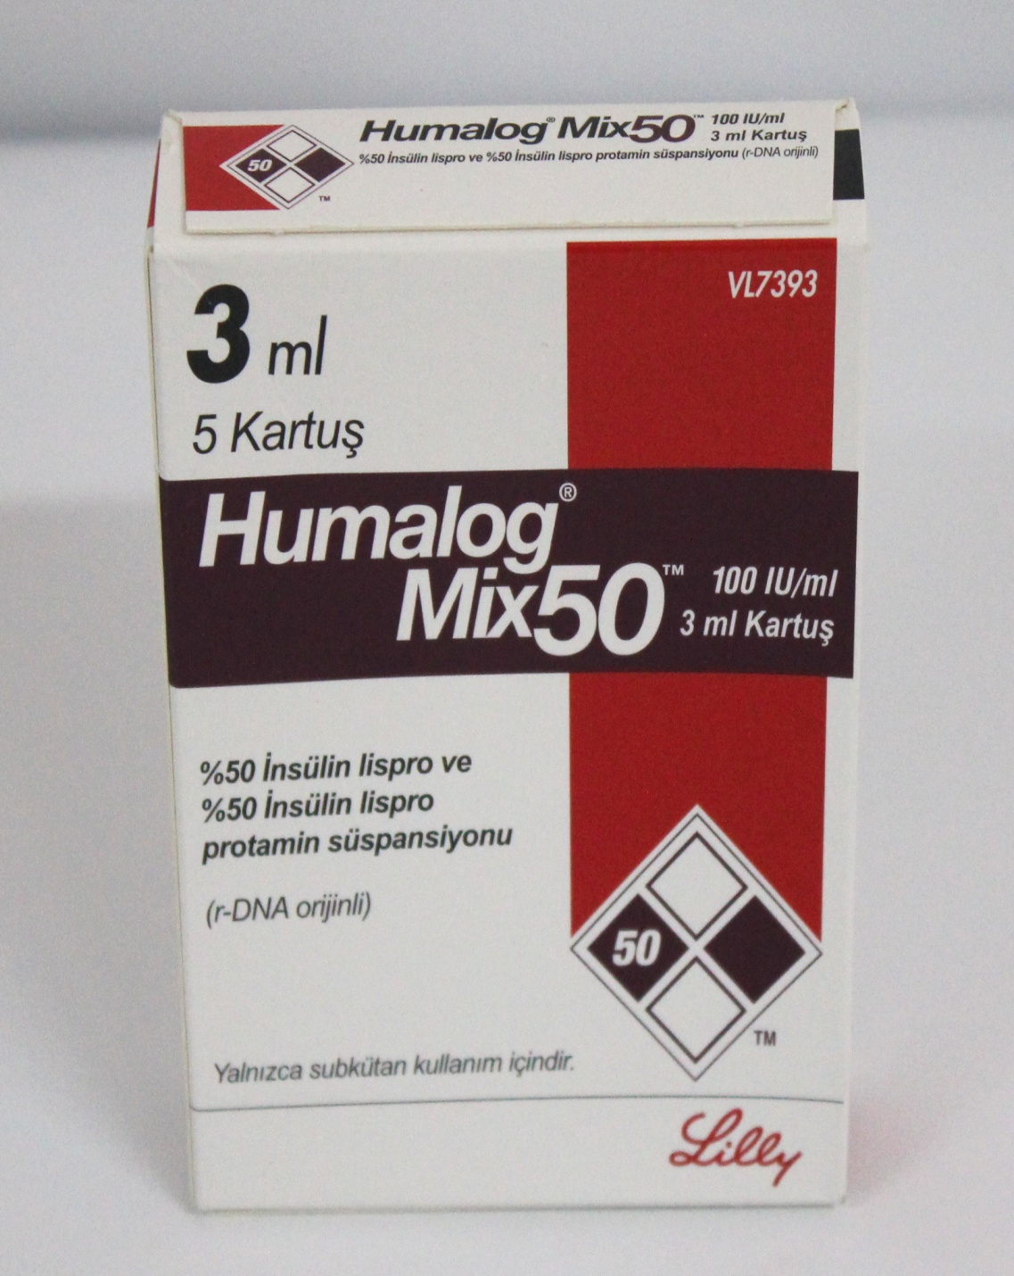
Biphasic insulin lispro

Slide 31
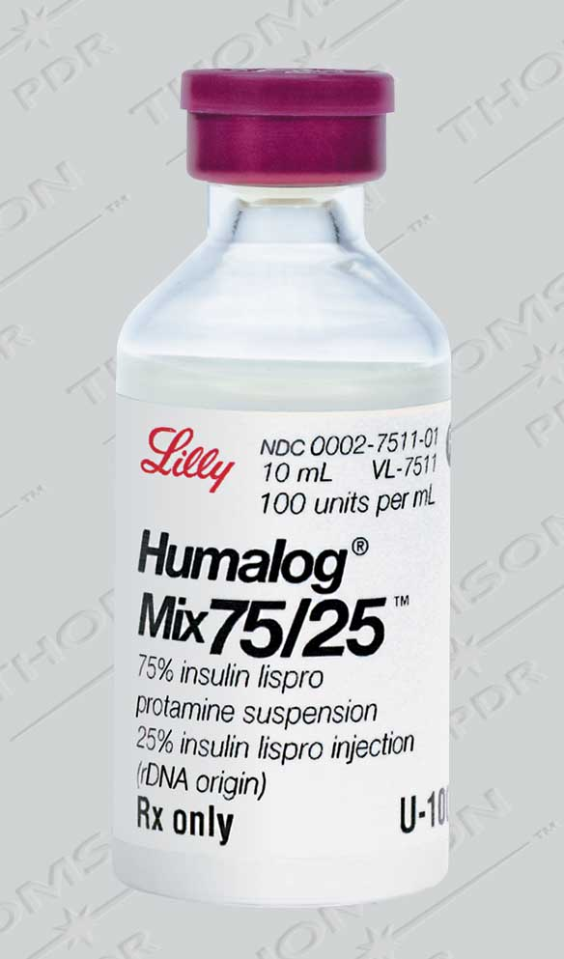

Slide 32
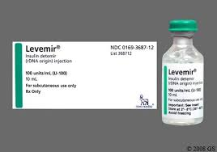
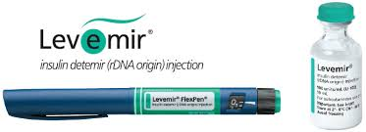
L.A.I

Slide 33
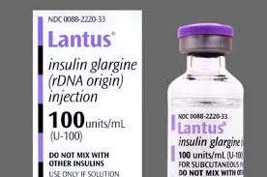
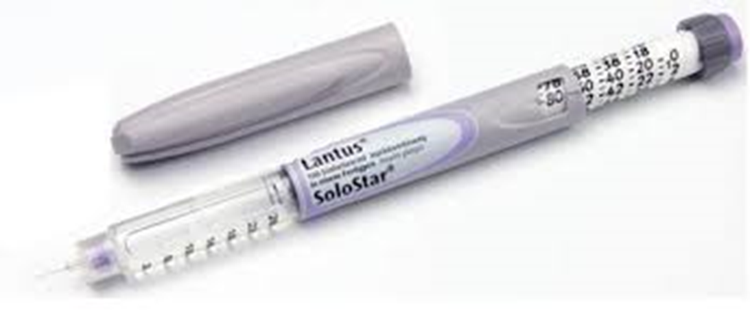
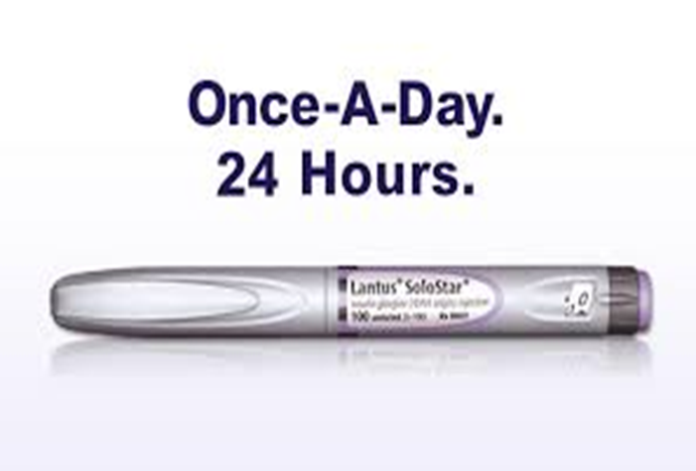

Slide 34
Insulin glargine is accepted for restricted use
within NHS Scotland
for the treatment of type 1 diabetes:
in those who are at risk of or experience unacceptable frequency or severity of nocturnal hypoglycaemia on attempting to achieve better hypoglycaemic control during treatment with other insulins
.as a once daily insulin therapy for patients who require
a carer to administer their insulin
It is not recommended for routine use in patients with
type 2 diabetes unless they suffer from recurrent episodes of hypoglycaemia or require assistance with their insulin injections.

Slide 35
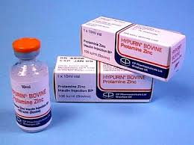
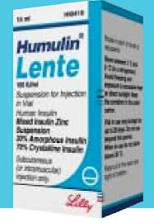
insulin zinc susp., protamine zinc susp

Slide 36
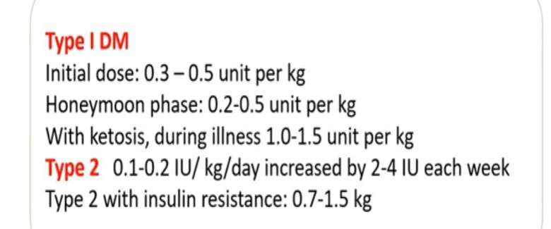
Calculation of insulin dose estimating of total daily insulin TDD

Slide 38
bedtime | Before** dinner | Before** lunch | Before** breakfast | Regimen
 | 1/3 of the total daily dose وهذه الجرعة بدورها تقسم بالشكل التالي 1/2 as I .A.I 1/2 as S.A.I (تخبط عادة في نفس السرنجة) |  | 2/3 of the total daily dose 2/3 as I .A.I 1/3 as S.A.I (تخبط عادة في نفس السرنجة) | 1
Method one :the morning dose of S.A.I cover the breakfast meal, the I.A.I cover the noon meal, the evening dose of S.A.I cover the evening meal, the I.A.I provide the basal insulin during the night and cover any snack which is ingested .

Slide 41
Basal /bolus insulin dose calculation for patient weighing 80kg

Slide 44
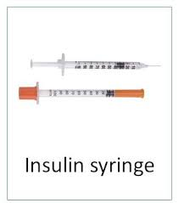

Slide 47
Insulin sensitivity factor is the drop in blood glucose level, measured in milligrams per deciliter (mg/dl), caused by each unit of insulin taken. Knowing their insulin sensitivity factor can help people with Type 1 diabetes to determine the dose of short-acting or rapid-acting insulin to take.
Health-care professionals use the “1500 rule” to calculate insulin sensitivity factor for people who use Regular (short-acting) insulin. The 1500 rule works as follows: Divide 1500 by the total daily dose of Regular insulin, in units. For example, if a person’s total daily dose is 30 units of Regular insulin, his insulin sensitivity factor would be 50 (1500 ÷ 30). So one unit of Regular insulin would be estimated to lower his blood glucose by 50 mg/dl.
Health-care professionals use the “1800 rule” to calculate insulin sensitivity factor for people who use the rapid-acting insulin analogs lispro (brand name Humalog), aspart (NovoLog), and glulisine (Apidra). This is done by dividing 1800 by the total daily dose of rapid-acting insulin. If the total daily insulin dose is 40 units, the insulin sensitivity factor would be 1800 divided by 40 = 45mg ldl decrease by 1 unit of insulin.
Insulin sensitivity factor can be calculated only for people with Type 1 diabetes. It cannot be calculated reliably for people with Type 2 diabetes, whose pancreases often still make some insulin and who have varying degrees of insulin resistance.

Slide 48
Example: patient typ1 DM LANTUS 20 IU AT NIGHT
ACTRAPID5IU EVERY MEAL
TDD=50
FBG=97
BRAKFAST BG=115
LUNCH BG=240
DINNER=110
1500/50=30
Lunch BG(240-180)=60
SO the sensitivity factor=60mg/dl
So 2iuactrapid are added to the dose of the lunch dose of insuline

Slide 51
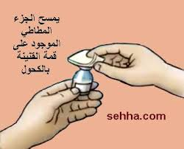
طريقة سحب الانسولين وطريقة رج الخابط وطريقة خبط الانسولين الصافي:
بقطعة من القطن المحتوية على الكحول-vial يمسح غطاء الـ

Slide 52
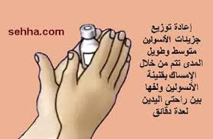
قبل الاستعمال قم بتدوير الانسولين الخابط بين راحتي اليدين ( مع تجنب الرج).

Slide 53
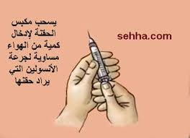
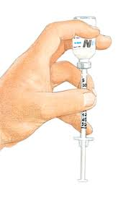
اسحب بسرنجة الانسولين كمية من الهواء تساوي في حجمها حجم جرعة الانسولين الخابط واحقنها فيvial الخابط ثم اسحب بسرنجة الانسولين كمية من الهواء تساوي في حجمها حجم جرعة الانسولين الصافي واحقنها فيvial الصافي ( .(Soluble
-اقلب vial الصافي واسحب الجرعة المقررة منه اولا ثم اقلب vial الخابط واسحب الجرعة المقررة منه (حتى لايتلوث الصافي بالخابط).

Slide 54
Mixing of insulins:
Regular Insulin may be mixed with NPH in any proportion and the resultant mixture is stable for at least 1 month at room temperature without change in the kinetic property of the regular⁽³⁾.
In contrast, the rapid action of regular insulin is significantly blunted when mixed with Lente or Ultrlente insulin.
(The excess zinc in Lente preparations binds the regular insulin
Converting it to intermediate acting form). When the two insulins are mixed just before the injection, the clinical importance of this effect appear to be minimal ⁽¹⁾
*Lente and Ultrlente may be mixed in any proportion at any time and are stable for long time ⁽³⁾.

Slide 55
Storage of insulin:
The pharmacists can advice the patient that:
A-Any unopened insulins are stored refrigerated (2-8 C⁰) (But not in the freezer) and the expiration date printed on the vials is used for unopened, refrigerated insulins⁽²⁾
B-Insulin's vial that are currently in use is kept at room temperature (injection of cold insulin is uncomfortable) and can be used for 1 month ^{(1,3)} ا.

Slide 56
Thank you

