Slide 1
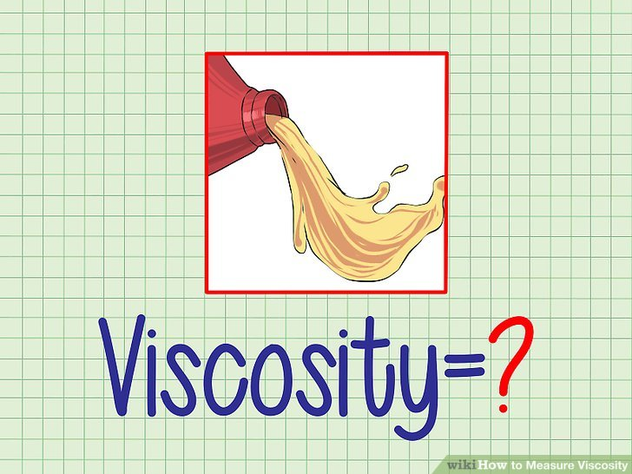
Lab 5
Viscosity
Assistant Lecturer
Hiba Sabah Zeina Dawood Sura Zuhair

Slide 2
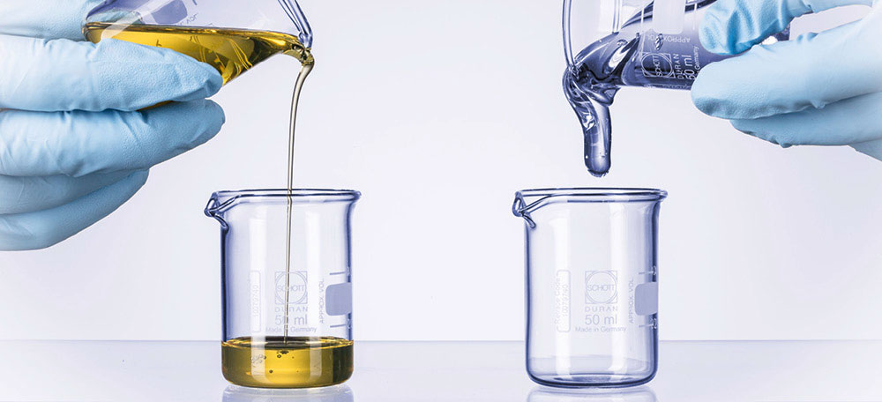
Introduction
Viscosity: is an expression of the resistance to flow of a system under an applied stress. The more viscous a liquid ,the greater the applied force is required to make it flow at a particular rate.
This lab is concerned with the flow properties of dilute colloidal systems and the manner in which viscosity data can be used to obtain the molecular weight of materials comprising the disperse phase. Viscosity studies also provide information regarding the shape of the particles in solution.

Slide 3
Materials classify according to the type of flow and deformation into:
Examples of Newtonian system: water or any simple liquid (gelatin solution, olive oil, glycerin, castor oil, chloroform and ethyl alcohol).
Examples of Non Newtonian system: complex liquid or systems which contain polymers ( colloidal solution, emulsion, liquid suspension and ointments).
1
2
The classification depends on whether or not their flow properties are according to the Newton's law of flow.

Slide 4
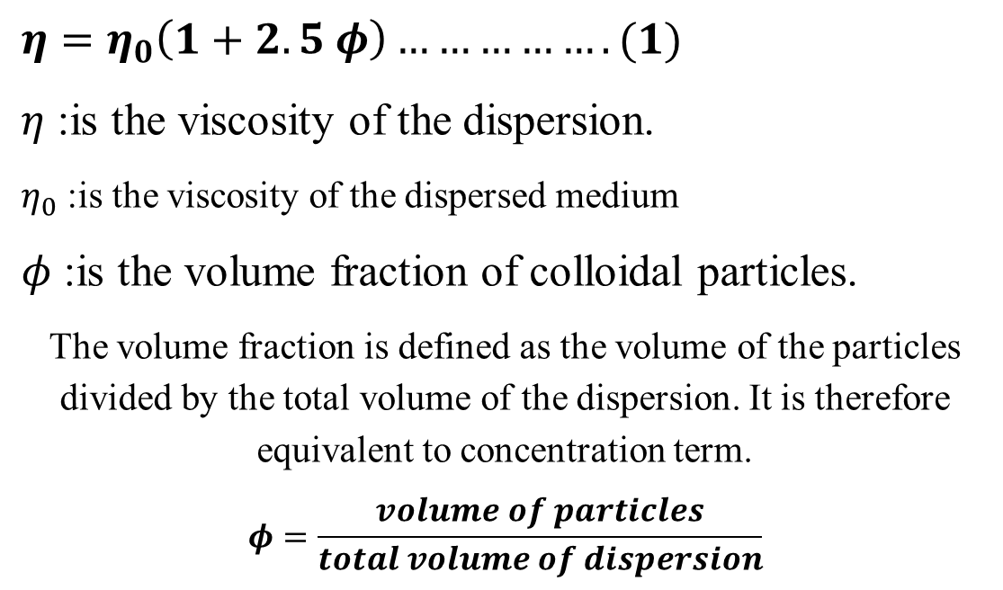
Einstein equation
$η=η_{0}\left(1+2.5 φ\right)…………….(1)$
$η$ :is the viscosity of the dispersion.
$η_{0}$ :is the viscosity of the dispersed medium
$φ$ :is the volume fraction of colloidal particles.
The volume fraction is defined as the volume of the particles divided by the total volume of the dispersion. It is therefore equivalent to concentration term.
$$φ=\frac{volume of particles}{total volume of dispersion}$$

Slide 5
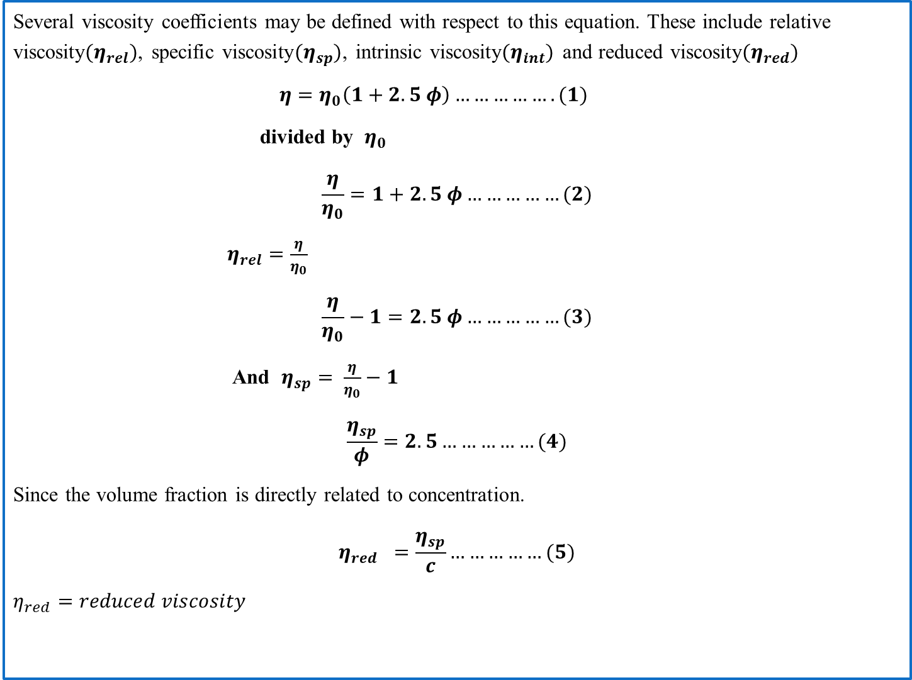
Several viscosity coefficients may be defined with respect to this equation. These include relative viscosity$(η_{rel})$, specific viscosity$(η_{sp})$, intrinsic viscosity$(η_{int})$ and reduced viscosity$(η_{red})$
$η=η_{0}\left(1+2.5 φ\right)…………….(1)$
divided by $η_{0}$
$$\frac{η}{η_{0}}=1+2.5 φ……………(2)$$
$η_{rel}=\frac{η}{η_{0}}$
$$\frac{η}{η_{0}}−1=2.5 φ……………(3)$$
And $η_{sp}= \frac{η}{η_{0}}−1$
$$\frac{η_{sp}}{φ}=2.5……………(4)$$
Since the volume fraction is directly related to concentration.
$$η_{red} =\frac{η_{sp}}{c}……………(5)$$
$η_{red}=reduced viscosity$

Slide 6
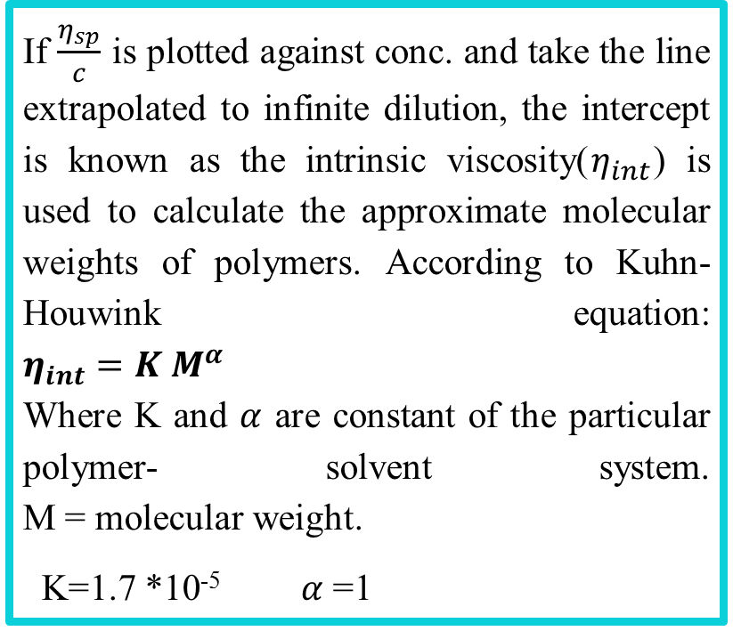
Where C the concentration is expressed in gram of colloidal particles per 100ml of total dispersion
If $\frac{η_{sp}}{c}$ is plotted against conc. and take the line extrapolated to infinite dilution, the intercept is known as the intrinsic viscosity($η_{int}$) is used to calculate the approximate molecular weights of polymers. According to Kuhn-Houwink equation: $η_{int}=K M^{α}$ Where K and $α$ are constant of the particular polymer- solvent system. M = molecular weight.
K=1.7 *10⁻⁵ $α$ =1

Slide 7
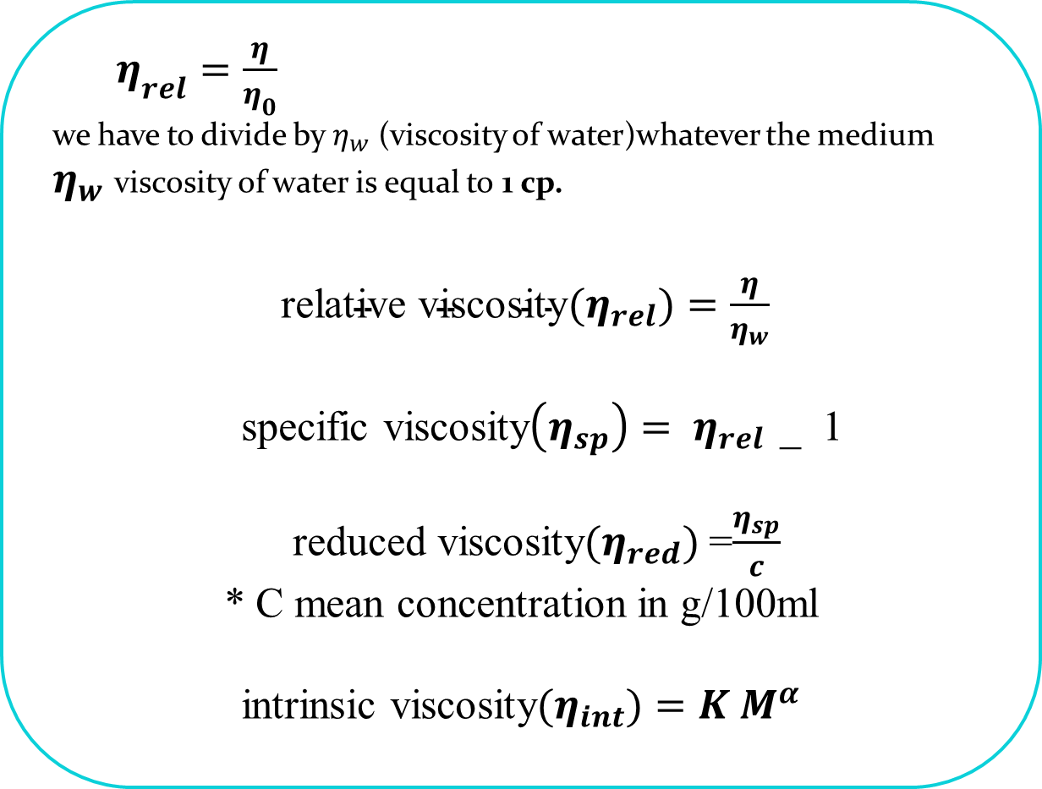
$η_{rel}=\frac{η}{η_{0}}$
we have to divide by $η_{w}$ (viscosity of water)whatever the medium
$η_{w}$ viscosity of water is equal to 1 cp.
$\text{relative} \text{viscosity}(η_{rel})=\frac{η}{η_{w}}$
specific viscosity$\left(η_{sp}\right)= η_{rel}$ _ 1
reduced viscosity$(η_{red})$=$\frac{η_{sp}}{c}$
* C mean concentration in g/100ml
intrinsic viscosity$(η_{int})=K M^{α}$

Slide 8
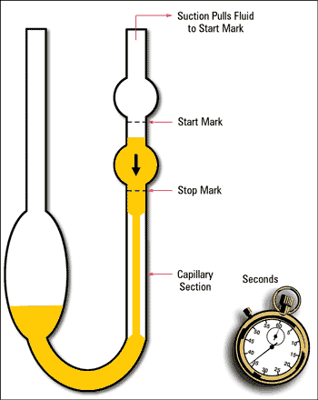
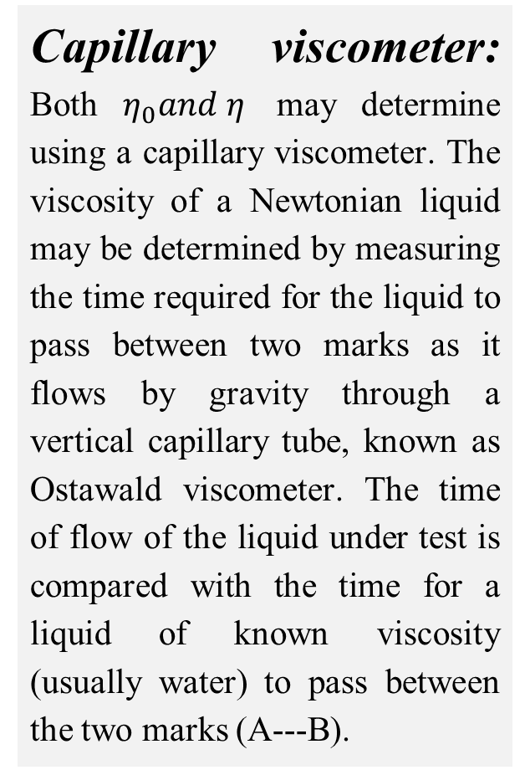
Capillary viscometer: Both $η_{0}and η$ may determine using a capillary viscometer. The viscosity of a Newtonian liquid may be determined by measuring the time required for the liquid to pass between two marks as it flows by gravity through a vertical capillary tube, known as Ostawald viscometer. The time of flow of the liquid under test is compared with the time for a liquid of known viscosity (usually water) to pass between the two marks (A---B).
Addition of liquid
A
B

Slide 9
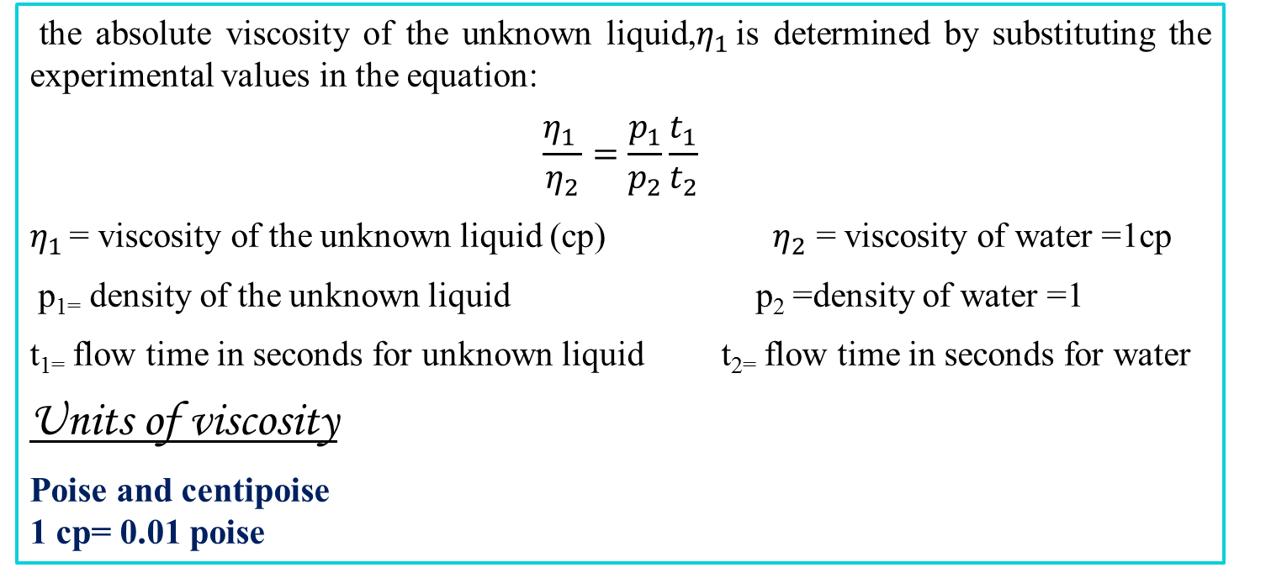
the absolute viscosity of the unknown liquid,$η_{1 }$is determined by substituting the experimental values in the equation:
$$\frac{η_{1 }}{η_{2}}=\frac{p_{1}}{p_{2}}\frac{t_{1}}{t_{2}}$$
$η_{1 }$= viscosity of the unknown liquid (cp) $η_{2}$ = viscosity of water =1cp
p₁₌ density of the unknown liquid p₂ =density of water =1
t₁₌ flow time in seconds for unknown liquid t₂₌ flow time in seconds for water
Units of viscosity
Poise and centipoise 1 cp= 0.01 poise
Experimental work
Part l: bring water, glycerin, 1% gelatin solution and prepare volumetric flask (50cc), pipette, capillary viscometer (suspended level viscometer).

Slide 10
Part ll:
A: To determine the concentration of unknown.
Procedure:
Prepare different concentrations w/w of glycerin in water 2%, 5%, 10%, 15%, 20% and 25% (50 ml of each one).
2) Measure the 𝜂 of these solutions by the viscometer knowing the density of each solution 1.003, 1.005, 1.018, 1.03, 1.037, 1.044 respectively. Then find 𝜂𝑟𝑒𝑙 and draw curve by plotting 𝜂𝑟𝑒𝑙 against conc. (w/w).
3) Find out the concentration of unknown from the curve by measuring its 𝜂𝑟el of unknown.
4) The line started from 1 since the viscosity of water is equal to 1 cp. The density of glycerine is 1.26 and water = 1.

Slide 11
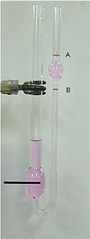
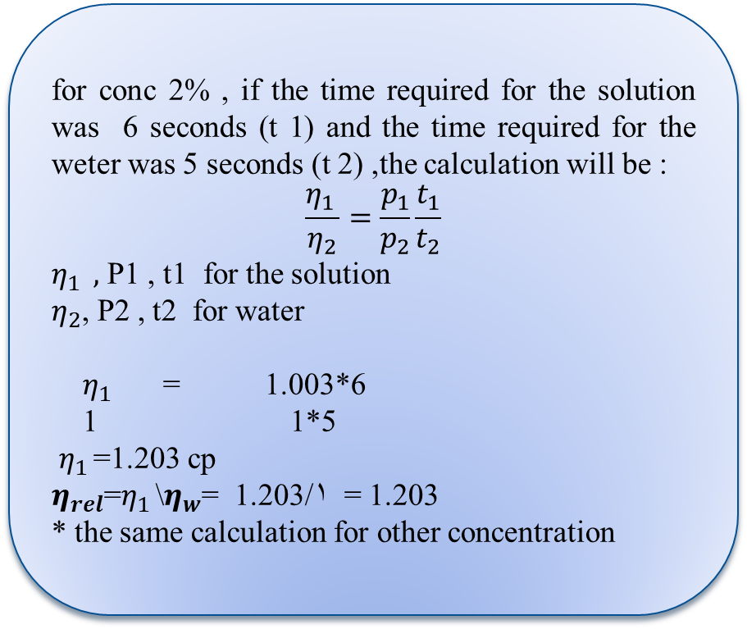
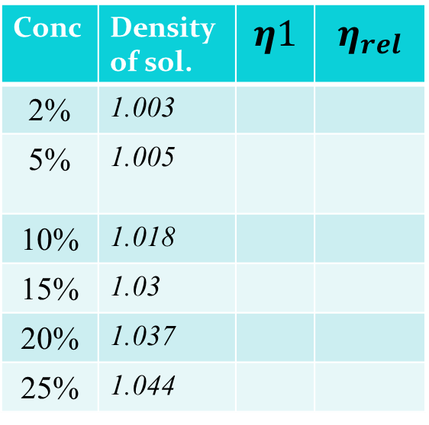
Calculation
viscosity of water is equal to 1cp
The density of and water = 1.
for conc 2% , if the time required for the solution was 6 seconds (t 1) and the time required for the weter was 5 seconds (t 2) ,the calculation will be :
$$\frac{η_{1 }}{η_{2}}=\frac{p_{1}}{p_{2}}\frac{t_{1}}{t_{2}}$$
$η_{1 } ,$ P1 , t1 for the solution
$η_{2}$, P2 , t2 for water
$η_{1 }$ = 1.003*6
1 1*5
$η_{1 }$=1.203 cp
$η_{rel}$=$η_{1 }$\$η_{w}$= 1.203/1 = 1.203
* the same calculation for other concentration
Conc | Density of sol. | $$η1$$ | $$η_{rel}$$
2% | 1.003
5% | 1.005
10% | 1.018
15% | 1.03
20% | 1.037
25% | 1.044

Slide 12
Calculate the unknown concentration for solution if you know the relative viscosity of unknown conc was 1.35 ?

Slide 13
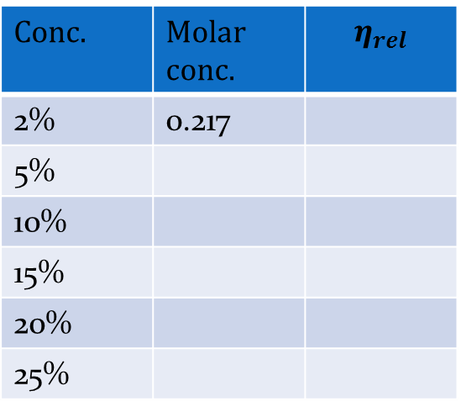
Part ll:
B: To determine the radius of particle by plotting 𝜂𝑟𝑒𝑙 against molar concentration.
Procedure: Prepare different concentrations of glycerine (w/v) then find 𝜂𝑟𝑒𝑙 of each concentration. Finally, find the radius from slope.
*each one of the concentration must be convert to molar conc.
* For 2% ( 2g\100ml) Molar concentration= Wt /M.wt * 1000/Vol
= 2/ 92.09 *1000/100
=0.217 M
Conc. | Molar conc. | $$η_{rel}$$
2% | 0.217
5%
10%
15%
20%
25%

Slide 14
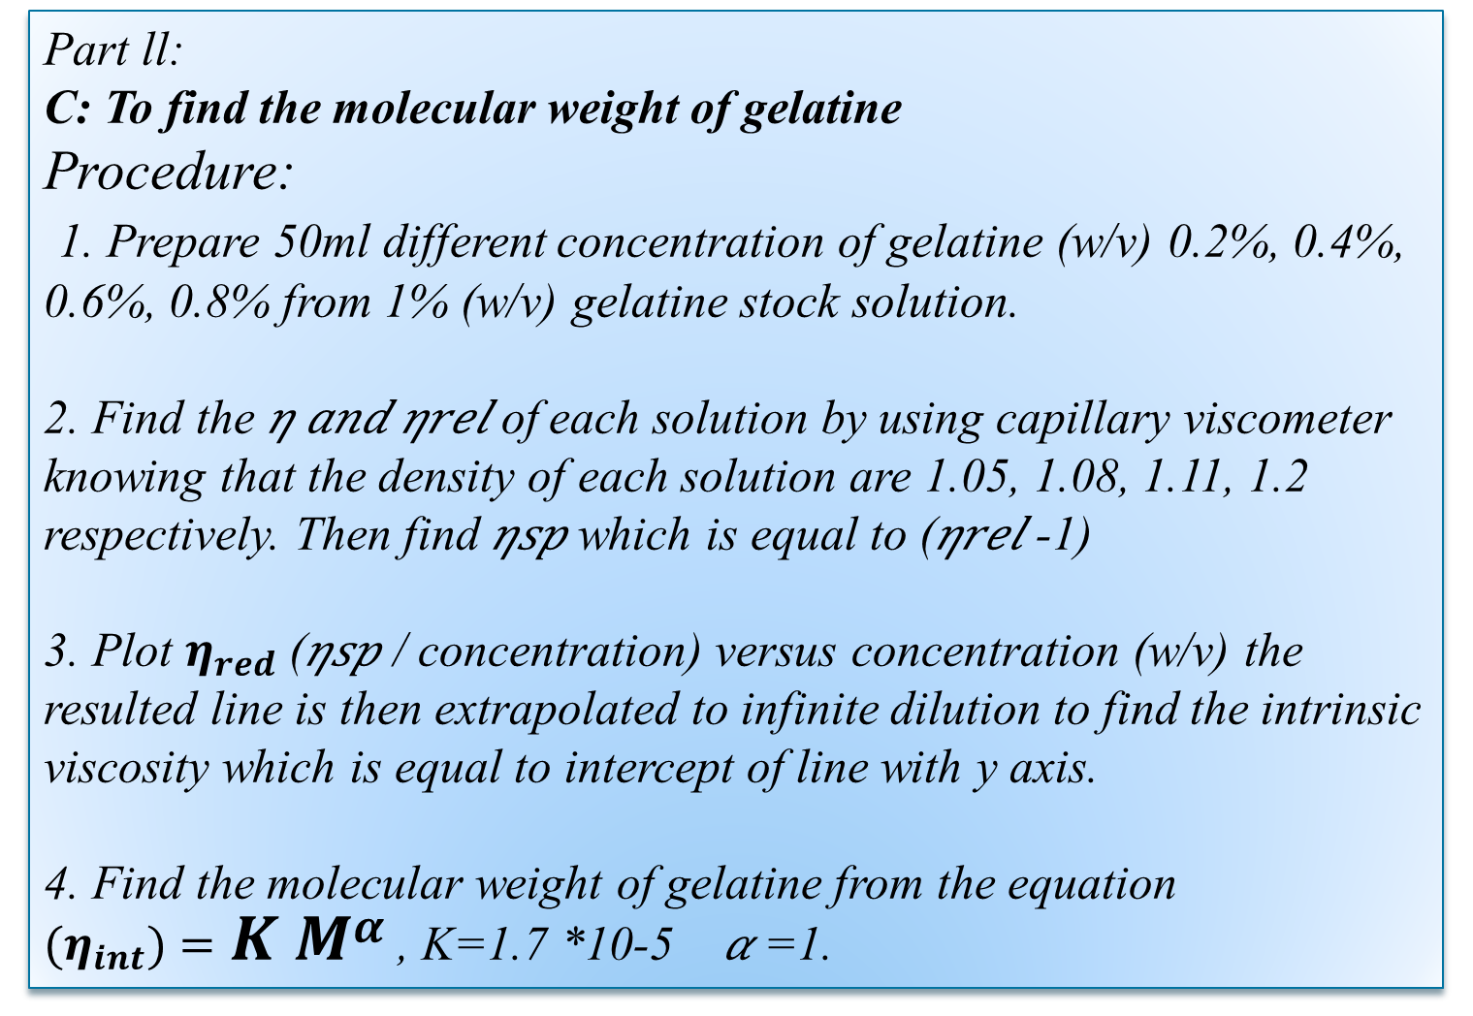
Part ll:
C: To find the molecular weight of gelatine
Procedure:
1. Prepare 50ml different concentration of gelatine (w/v) 0.2%, 0.4%, 0.6%, 0.8% from 1% (w/v) gelatine stock solution.
2. Find the 𝜂 𝑎𝑛𝑑 𝜂𝑟𝑒𝑙 of each solution by using capillary viscometer knowing that the density of each solution are 1.05, 1.08, 1.11, 1.2 respectively. Then find 𝜂𝑠𝑝 which is equal to (𝜂𝑟𝑒𝑙 -1)
3. Plot $η_{red}$ (𝜂𝑠𝑝 / concentration) versus concentration (w/v) the resulted line is then extrapolated to infinite dilution to find the intrinsic viscosity which is equal to intercept of line with y axis.
4. Find the molecular weight of gelatine from the equation
$\text{(}η_{int})=K M^{α}$ , K=1.7 *10-5 𝛼 =1.

Slide 15
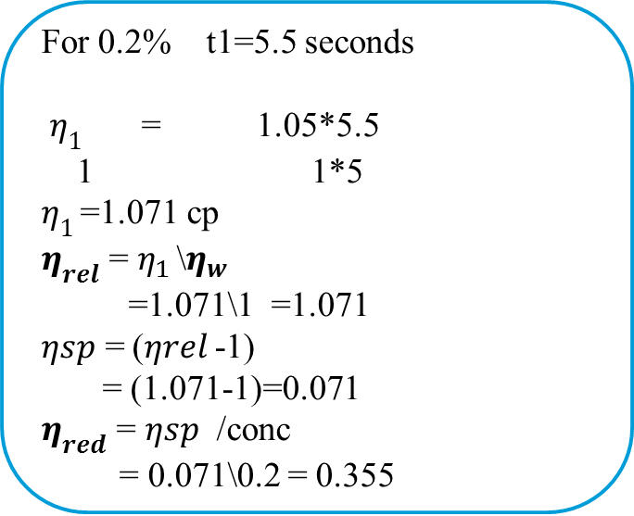

Calculation
Conc | p1 | t1(sec) | t2(sec) water | 𝜂1 | 𝜂𝑟𝑒𝑙 | 𝜂𝑠𝑝 (𝜂𝑟𝑒𝑙 -1) | 𝜂𝑠𝑝 /conc
0.2 | 1.05 |  | 5
0.4 | 1.08 |  | 5
0.6 | 1.11 |  | 5
0.8 | 1.2 |  | 5
For 0.2% t1=5.5 seconds
$η_{1 }$ = 1.05*5.5
1 1*5
$η_{1 }$=1.071 cp
$η_{rel}$ = $η_{1 }$\$η_{w}$
=1.071\1 =1.071
𝜂𝑠𝑝 = (𝜂𝑟𝑒𝑙 -1)
= (1.071-1)=0.071
$η_{red}$ = 𝜂𝑠𝑝 /conc
= 0.071\0.2 = 0.355
Intercept = ($η_{int})=K M^{α}$

Slide 16


