Slide 1
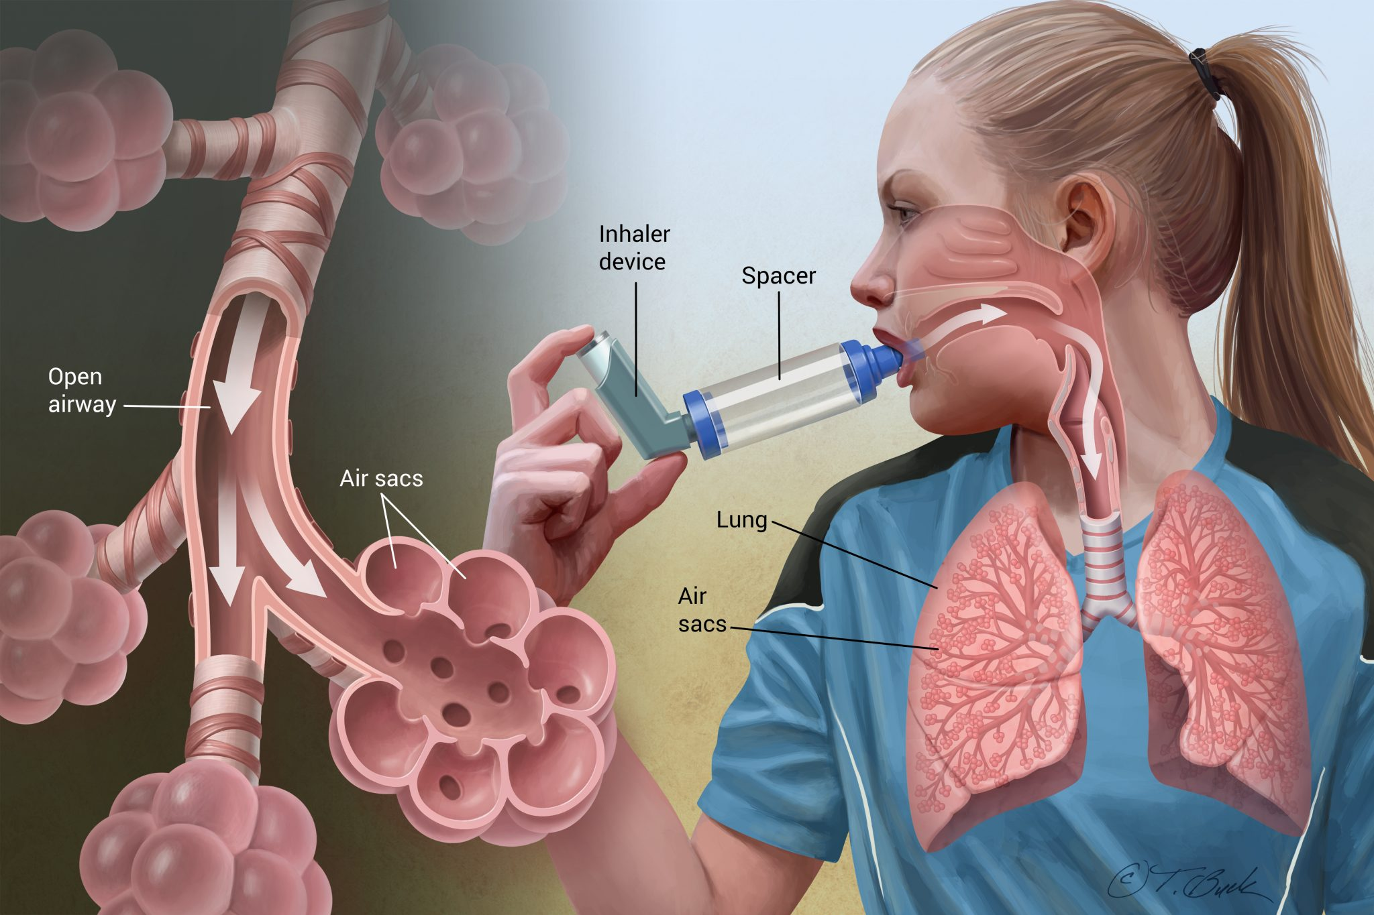
Asthma case presentation
Assist. Lec. sura abbas

Slide 2
Chief complaints
a 33-year-old female with asthma admitted to the emergency department after ingestion of 800 Mg of ibuprofen for knee pain. She presented with dyspnea at rest and can not complete one sentence and cough.
On examination PEF value is 35% of her best value, O₂ saturation is 65%

Slide 3
Medical history
Asthmatic since she was 8 years old
Medication history include symibicort inhaler
ventolin inhaler on need
, montelukast 10 mg tablet 1*1

Slide 4
Examination on admission at hospital
HIGH respiratory rate of 30/min
HIGH pulse rate of 145/ minute (60 pulse)
peak flow of 100 L/minute.
LOW PO2 of 8.4kPa (12-14kPa)
HIGH PCO2 of 7.2kPa (4.5-6.0kPa)
decreased pH 7.29 Normal(7.35-7.45)

Slide 5
Features of acute asthma exacerbations
Mild exacerbation: if the patient is only having dyspnea with activity and the PEF is at least 70% of the personal best value
moderate if the dyspnea limits activity and the PEF is 40% to 69% of the personal best
severe with PEF less than 40% and dyspnea interferes with conversation or occurs at rest
When the patient is not able to speak and the personal best PEF is less than 25% of the personal best predicted value, it is a life-threatening exacerbation

Slide 6
Features of acute severe asthma
• Peak expiratory flow (PEF) 40% of best (use % predicted if recent best unknown)
• Can’t complete sentences in one breath
• Respirations ≥25 breaths/min
• Pulse ≥110 beats/min
our case (with dyspnea at rest and can not complete one sentence and cough.
On examination PEF value is 35% )
HIGH respiratory rate of 30/min
HIGH pulse rate of 145/ minute (60 pulse)

Slide 7
Blood gas markers of a life threatening attack
• ‘Normal’ (4.6-6 kPa, 35-45 mmHg) PaCO2
• Severe hypoxia: PaO2 <8 kPa
• Low PH
LOW PO2 of 8.4kPa (12-14kPa)
HIGH PCO2 of 7.2kPa (4.5-6.0kPa)
decreased pH 7.29 Normal(7.35-7.45)

Slide 8
Exacerbation Factors
Exercise
Vaccines
Aspirin and NSAID
Non-selective BB

Slide 9
TREATMENT
Oxygen
SABA
CS
Ventilation
Iv magnesium sulphate
Iv aminophylline

Slide 10
IMMEDIATE TREATMENT
Oxygen to maintain SpO2 94-98%
Salbutamol 5 mg via an oxygen-driven nebulizer
Ipratropium bromide 0.5 mg via an oxygen driven nebulizer
Prednisolone tablets 40-50 mg or IV hydrocortisone 100 mg

Slide 11
IF LIFE THREATENING FEATURES ARE PRESENT:
Discuss with senior clinician and ICU team
Consider IV magnesium sulphate 1.2-2 g infusion over 20 minutes (unless already given)
Give nebulised β2 agonist more frequently e.g. salbutamol 5 mg up to every 15-30 minutes or 10 mg per hour via continuous nebulisation (requires special nebuliser)

Slide 12
SUBSEQUENT MANAGEMENT
IF PATIENT IS IMPROVING continue:
•Oxygen to maintain SpO2 94-98%
•Prednisolone 40-50mg daily or IV hydrocortisone 100 mg 6
hourly
•Nebulised β2 agonist and ipratropium 4-6 hourly
IF PATIENT NOT IMPROVING AFTER 15-30 MINUTES:
•Continue oxygen and steroids
•use continuous nebulisation of salbutamol at 5-10 mg/hour if an appropriate nebuliser is available. Otherwise give nebulised salbutamol 5 mg every 15-30 minutes
•Continue ipratropium 0.5 mg 4-6 hourly until patient is improving

Slide 13
IF PATIENT IS STILL NOT IMPROVING:
•Discuss patient with senior clinician and ICU
team .
•Consider IV magnesium sulphate 1.2-2 g
over 20 minutes (unless already give
• Senior clinician may consider use of IV β2
agonist or IV aminophylline or progression to
mechanical ventilation

Slide 14
MONITORING
Repeat measurement of PEF 15-30 minutes after starting treatment
• Oximetry: maintain SpO2 >94-98%
• repeat blood gas measurements within 1 hour of starting treatment
• Chart PEF before and after giving β2 agonists and at least 4 times daily throughout hospital stay
Transfer to ICU accompanied by a doctor prepared to intubate if:
Deteriorating PEF, worsening or persisting hypoxia, or hypercapnea .Exhaustion, altered consciousness Poor respiratory effort or respiratory arrest

Slide 15
DISCHARGE
discharge medication for 12-24 hours and inhaler technique checked and recorded
• PEF >75% of best or predicted and PEF diurnal variability
• Treatment with oral & inhaled steroids &bronchodilators. Or other drugs
• Own PEF meter & written asthma action plan
• Follow up within 2 days & 4 weeks RC

Slide 17
Drugs for chronic asthma
SABA and LABA
Inhaled CS
Systemic CS for short duration
Anticholinergic
LTRA
methylxanthines

Slide 20
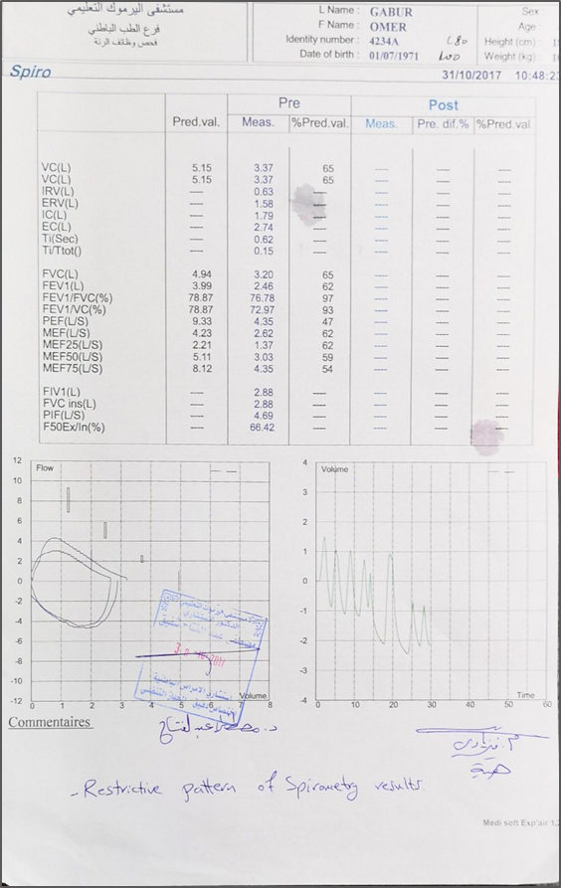
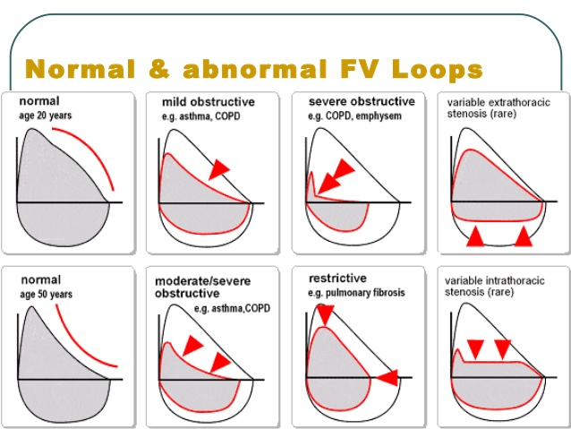
Sample of spirometry result of asthmatic patient

Slide 21
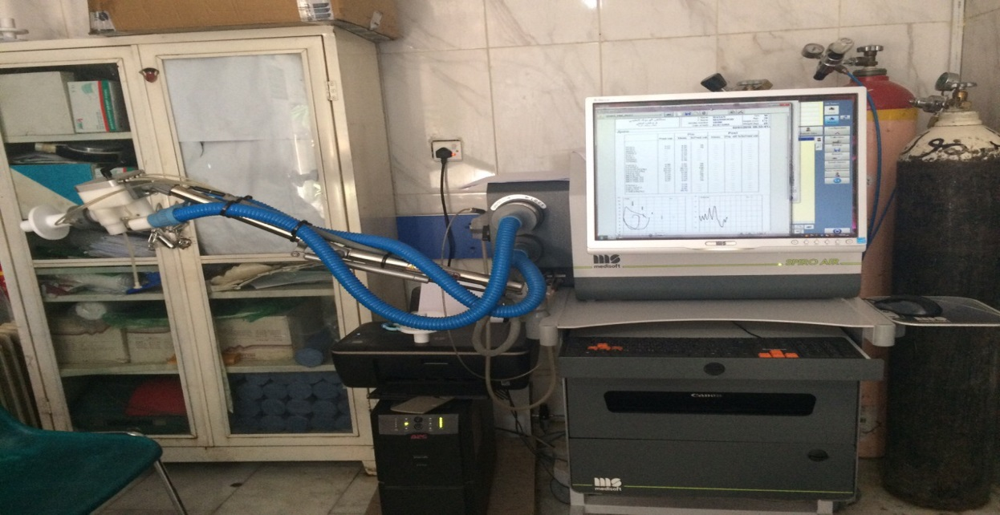
(Spirometry device in pulmonary function department / AL- Yarmouk teaching hospital )

Slide 22
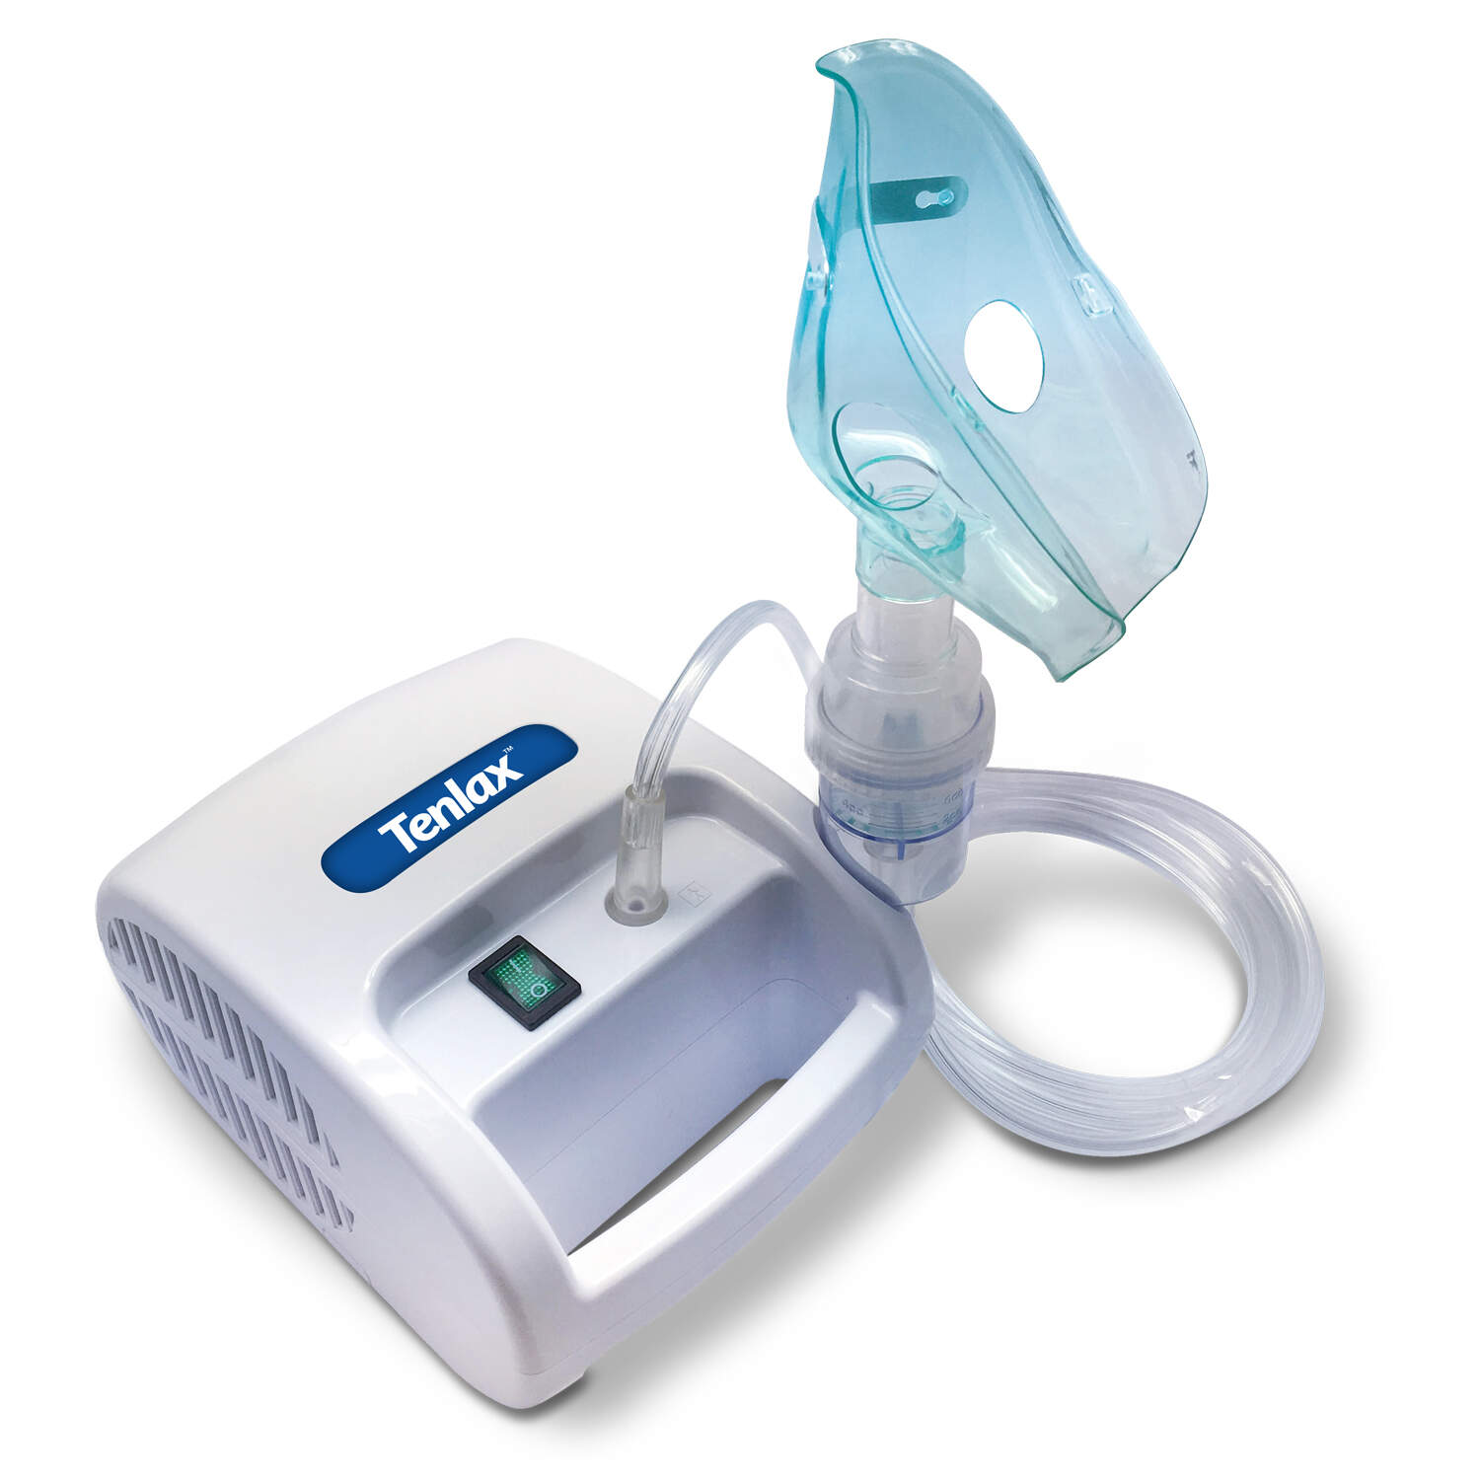
NEBULIZER
0.5 ml of salbutamol in 1.5 cc of normal saline

