Slide 1
Bile acid sequestrant and fibrates
Assist. Lec. Sura Abbas
Clinical pharmacy lab 4
4th stage

Slide 2
Bile acid sequestrants
DRUG ACTION
Bile acid sequestrants act by binding bile acids, preventing their reabsorption; this promotes hepatic conversion of cholesterol into bile acids; the resultant increased LDL-receptor activity of liver cells increases the clearance of LDL-cholesterol from the plasma.
Colestipol and cholestyramine

Slide 4
Caution and side effects
caution
Interference with the absorption of fat-soluble vitamins (supplements of vitamins A, D, K, and folic acid may be required when treatment is prolonged).
Pregnant and breast feeding with caution as although the drugs are not absorbed, they may cause fat-soluble vitamin deficiency on prolonged use.
Side effects
▶ Common or very common Constipation . Gastrointestinal discomfort . headache . nausea . Vomiting
▶ Uncommon Appetite decreased . diarrhea . gastrointestinal disorders
CONTRA-INDICATIONS Complete biliary obstruction (not likely to be effective)

Slide 5
DIRECTIONS FOR ADMINISTRATION
The contents of each sachet should be mixed with at least 100mL of water or other suitable liquid such as fruit juice or skimmed milk; alternatively it can be mixed with thin soups, cereals, yoghurt, or pulpy fruits ensuring at least 100mL of liquid is provided.
PATIENT AND CARER ADVICE Patient counselling on
administration is advised for powder (avoid other drugs at same time).
CAUTIONARY AND ADVISORY LABELS 13

Slide 6
Colestipol hydrochloride and cholestyramine
INDICATIONS AND DOSE (Hyperlipidaemias, particularly type IIa, in patients who have not responded adequately to diet and other appropriate measures
▶ BY MOUTH (colestipol)
▶ Adult: Initially 5 g 1–2 times a day, increased in steps of 5 g every month if required, total daily dose may be given in 1–2 divided doses; maximum 30 g per day
Cholestyramine: Adult: Initially 4 g daily, increased in steps of 4 g every week; increased to 12–24 g daily in 1–4 divided doses, adjusted according to response; maximum 36 g per day

Slide 7
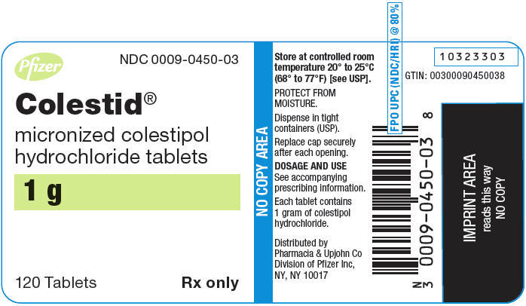

Slide 11
Bezafibrate
Adjunct to diet and other appropriate measures in mixed
hyperlipidaemia if statin contra-indicated or not
tolerated | Adjunct to diet and other appropriate
measures in severe hypertriglyceridaemia
▶ BY MOUTH USING IMMEDIATE-RELEASE MEDICINES
▶ Adult: 200 mg 3 times a day
▶ BY MOUTH USING MODIFIED-RELEASE MEDICINES
▶ Adult: 400 mg once daily, modified-release dose form is not appropriate in patients with renal impairment

Slide 12
CONTRA-INDICATIONS Gall bladder disease . hypoalbuminaemia . nephrotic syndrome . photosensitivity to fibrates
CAUTIONS Correct hypothyroidism before initiating treatment
l INTERACTIONS → Appendix 1: fibrates

Slide 13
PREGNANCY and breast feeding Manufacturers advise avoid—no information available
HEPATIC IMPAIRMENT Manufacturer advises avoid in significant impairment (except in fatty liver disease).
Renal impairment dose adjustment
MONITORING REQUIREMENTS Consider monitoring of liver function and creatine kinase when fibrates used in combination with a statin.

Slide 14
CAUTIONARY AND ADVISORY LABELS 21, 25
▶ Bezalip Mono (Teva UK Ltd)
Bezafibrate 400 mg Bezalip Mono 400mg modified-release tablets
▶ Fibrazate XL (Sandoz Ltd)
Bezafibrate 400 mg Fibrazate XL 400mg tablets\
Tablet
CAUTIONARY AND ADVISORY LABELS 21
▶ Bezafibrate (Non-proprietary)
Bezafibrate 200 mg Bezafibrate 200mg tablets
▶ Bezalip (Teva UK Ltd)
Bezafibrate 200 mg Bezalip 200mg tablets

Slide 16
Fenofibrate
INDICATIONS AND DOSE
Adjunct to diet and other appropriate measures in mixed
hyperlipidaemia if statin contra-indicated or not
tolerated | Adjunct to diet and other appropriate
measures in severe hypertriglyceridaemia | Adjunct to
statin in mixed hyperlipidaemia if triglycerides and HDL cholesterol inadequately controlled in patients at high cardiovascular risk

Slide 17
BY MOUTH USING CAPSULES
▶ Adult: Initially 200 mg daily, then increased if
necessary to 267 mg daily, maximum 200mg daily with
concomitant statin, 267mg capsules not appropriate
for initial dose titration
▶ BY MOUTH USING TABLETS
▶ Adult: 160 mg daily
DOSE ADJUSTMENTS DUE TO INTERACTIONS
▶ Manufacturer advises max. dose 200mg daily with
concurrent use of a statin.

Slide 18
CONTRA-INDICATIONS Gall bladder disease . Pancreatitis (unless due to severe hypertriglyceridaemia) . photosensitivity to ketoprofen
CAUTIONS Correct hypothyroidism before initiating
treatment
INTERACTIONS → Appendix 1: fibrates

Slide 19
PREGNANCY Avoid—embryotoxicity in animal studies.
BREAST FEEDING Manufacturers advise avoid—no information available.
HEPATIC IMPAIRMENT Manufacturer advises avoid—no information available.
RENAL IMPAIRMENT Manufacturer advises use with caution in mild-to-moderate impairment; avoid if eGFR less than 30 mL/minute/1.73m2.

Slide 20
MONITORING REQUIREMENTS Manufacturer advises monitor hepatic transaminases every 3 months during the first 12 months of treatment and periodically thereafter— discontinue treatment if levels increase to more than3 times the upper limit of normal; monitor serum creatinine levels during the first 3 months of treatment and periodically thereafter—interrupt treatment if creatinine level is 50% above the upper limit of normal.

Slide 21
Tablet
CAUTIONARY AND ADVISORY LABELS 21
▶ Fenofibrate (Non-proprietary)
Fenofibrate micronised 160 mg Fenofibrate micronised 160mg tablets | 28 tabletP £6.69 DT = £3.30
▶ Supralip (Mylan) Fenofibrate micronised 160 mg
Capsule
CAUTIONARY AND ADVISORY LABELS 21
▶ Fenofibrate (Non-proprietary) 67, 200 mg

Slide 22
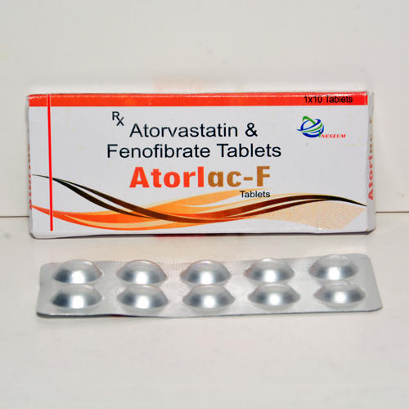
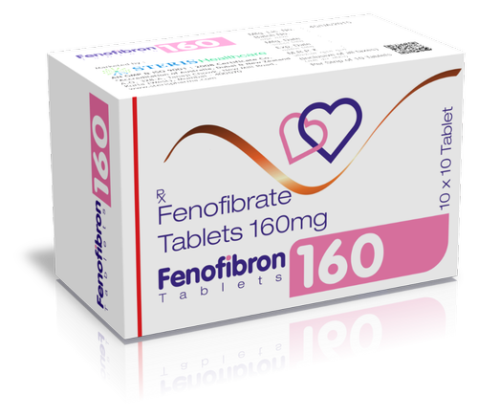

Slide 23
Gemfibrozil
INDICATIONS AND DOSE
Adjunct to diet and other appropriate measures in mixed hyperlipidaemia if statin contra-indicated or not tolerated | Adjunct to diet and other appropriate measures in primary hypercholesterolaemia if statin contra-indicated or not tolerated | Adjunct to diet and other appropriate measures in severe hypertriglyceridaemia | Adjunct to diet and other appropriate measures in primary prevention of cardiovascular disease in men with hyperlipidaemias if statin contra-indicated or not tolerated
▶ BY MOUTH
▶ Adult: 1.2 g daily in 2 divided doses, maintenance
0.9–1.2 g daily

Slide 24
CONTRA-INDICATIONS History of gall-bladder or biliary tract disease including gallstones . photosensitivity to fibrates
CAUTIONS Correct hypothyroidism before initiating treatment . elderly
INTERACTIONS → Appendix 1: fibrates
PREGNANCY and breast feeding, hepatic and renal impairment same as other fibrates

Slide 25
MONITORING REQUIREMENTS
▶ Monitor blood counts for first year.
▶ Monitor liver-function (discontinue treatment if
abnormalities persist).
▶ Consider monitoring creatine kinase if used in
combination with a statin.

Slide 26
Tablet
CAUTIONARY AND ADVISORY LABELS 22
▶ Gemfibrozil (Non-proprietary)
Gemfibrozil 600 mg tablets
Capsule
CAUTIONARY AND ADVISORY LABELS 22
▶ Lopid (Pfizer Ltd)
Gemfibrozil 300 mg capsules

Slide 27
