Slide 1

Cost-Effectiveness Analysis
Dr. Haider Raheem Mohammad

Slide 2
Efficacy versus effectiveness
An important distinction exists between efficacy and effectiveness. Efficacy analysis asks the question, "Can this medication work?" The answer usually is established in clinical trials. Effectiveness analysis addresses the question, "Does this medication work in the 'real world'?" A similar distinction is sometimes made in the pharmacoeconomics literature. A study that examined economic outcomes within a clinical trial may be considered a cost-efficacy study. A study conducted in a more routine clinical care situation would be considered cost-effectiveness.

Slide 3
Overview
Cost-effectiveness analysis (CEA) measures costs in dollars and outcomes in natural health units, which indicate an improvement in health such as cures, lives saved, or blood pressure reductions. This is the most common type of pharmacoeconomic analysis found in the pharmacy literature.
An advantage of using a CEA is that health units are common outcomes that are routinely measured in clinical trials, so they are familiar to practitioners. These outcomes do not need to be converted to monetary values.
A disadvantage to CEA is that the alternatives used in the comparison must have outcomes that are measured in the same clinical units. You cannot use CEA to directly compare the outcomes of an antihypertensive product (which may measure mm Hg changes to determine the outcome) with the outcomes of an asthma product (which may measure forced expiratory volume [FEV] to determine the outcome).

Slide 4
Overview
In addition, even if products for similar diseases or conditions are compared, more than one type of clinical outcome may be important. For example, when measuring the effects of hormone-replacement therapies, the effect on menopausal symptoms as well as bone mineral density measures may be salient. This may justify the calculation of multiple cost-effectiveness ratios for the comparison.
For many medications, both the effectiveness in treating the disease and the side effects of treatment may differ significantly between alternative treatments. For example, one chemotherapy regimen may be more effective in lengthening the time until the disease progresses than another chemotherapy regimen, but the more effective regimen may also cause more toxic side effects. With the CEA method, it is difficult to collapse different outcomes into one unit of measurement.
Some researchers consider cost-utility analysis (CUA) to be a special subset of CEA that uses units such as quality-adjusted life years (QALYs) to collapse different types of outcomes into one unit of measure.

Slide 5
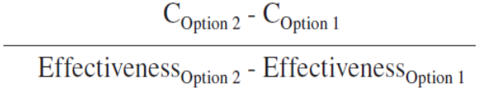
The rational for cost-effectiveness analysis
Cost-effectiveness analysis (CEA) provides a framework to compare two or more decision options by examining the ratio of the differences in costs and the differences in health effectiveness between options. The overall goal of CEA is to provide a single measure, the incremental cost-effectiveness ratio (ICER), which relates the amount of benefit derived by making an alternative treatment choice to the differential cost of that option. When two options are being compared, the ICER is calculated by the formula:

Slide 6
Introduction to cost-effectiveness analysis
Decision analysis is the most fundamental approach to cost-effectiveness analysis, being used to calculate the expected value of benefits and costs associated with each available alternative to identify the alternative with the maximum expected value.
An example of decision analysis is presented in Fig. 4.1. In this hypothetical case, a 50-year-old male patient is to decide whether to receive a laparoscopic cholecystectomy (gallbladder removal surgery) for gallbladder polyps found during medical examination.

Slide 7
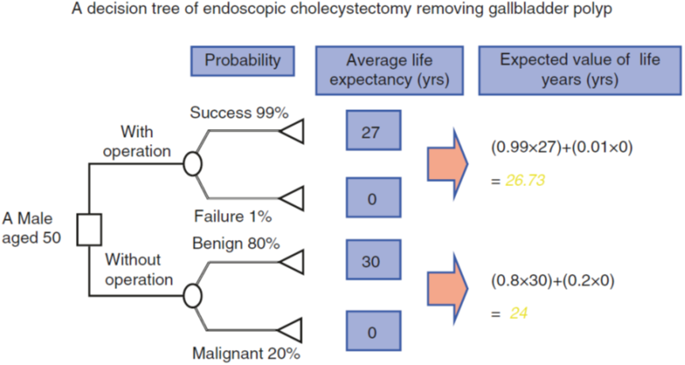
Fig. 4.1 Calculation of expected effectiveness.

Slide 8
Introduction to cost-effectiveness analysis
Typically, decision analysis proceeds through the following steps:
Identification of alternatives to be considered: Whether to receive laparoscopic cholecystectomy.
Structuring of the problem: A decision tree is constructed to model the decision process. A decision tree consists of decision nodes (squares), chance nodes (circles), terminal nodes (triangles), and branches that connect these nodes and represent the possible outcomes of each chosen alternative. In the simplest case, the following outcomes are expected: if surgery is chosen, it can be either successful or not; and if surgery is not chosen, no actions are taken, and the possibilities are that polyps are either benign or malignant.

Slide 9
Introduction to cost-effectiveness analysis
Assigning values: Probability estimates are assigned to branches emanating from chance nodes, and payoffs (resulting benefits) are assigned to terminal nodes. In this example, payoffs are assigned in terms of average life expectancy for each terminal node.
Calculation of expected value: The expected value for each chance node is calculated as the sum of all expected values, each calculated as the payoff multiplied by its probability.
Identification of the alternative with the maximum value: Since life expectancy is 26.73 years for surgery and 24 years for no surgery, the alternative to receive surgery is identified as the best option.
Sensitivity analysis: It determines, for instance, how the expected value changes if the probability of polyps being malignant becomes 80%.

Slide 10
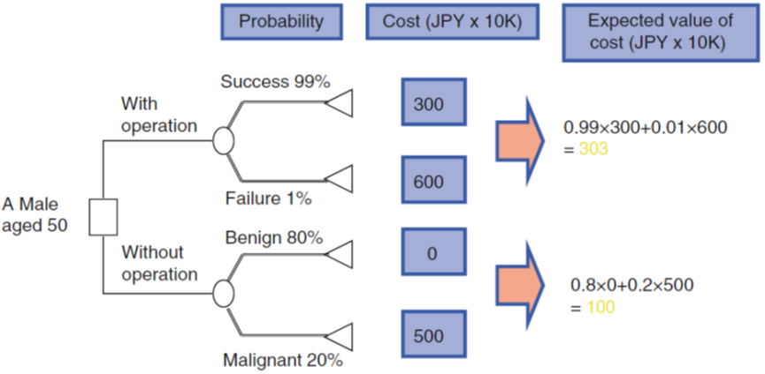
Introduction to cost-effectiveness analysis
Figure 4.2 presents another example, where the expected cost is calculated in the same manner. The cost for each terminal node represents the cumulative cost incurred from the decision to the terminal node. By substituting the payoff for each terminal node in Fig. 4.1 with the cost, the expected cost for each chance node can be calculated using the same formula. In this case, the expected cost is JPY 3.03 million for surgery and JPY 1 million for no surgery.

Slide 11
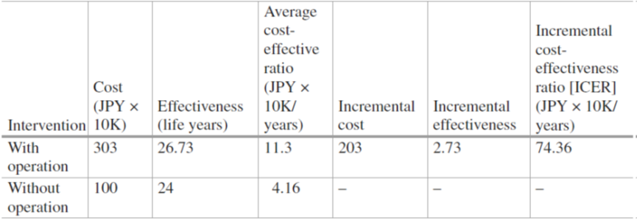
Introduction to cost-effectiveness analysis
Figures 4.1 and 4.2 indicate that, while surgery offers a longer life expectancy, the incurred cost is also higher. Therefore, the results of the cost-effectiveness analysis are summarized in a cost-effectiveness table (Table 4.1), in terms of intervention, cost, effectiveness, average cost-effectiveness ratio, difference in cost (incremental cost), difference in effectiveness (incremental effectiveness), and ICER. The table presents ICER as an index that summarizes the cost-effectiveness of the intervention.
Table 4.1 The result of the analysis: cost-effectiveness table.

Slide 12
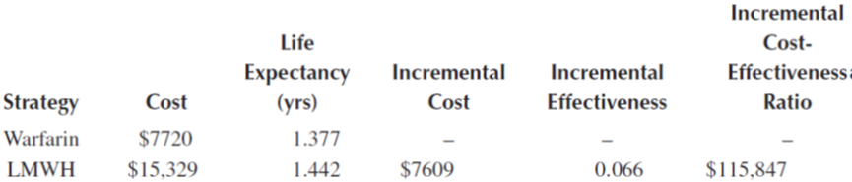
Introduction to cost-effectiveness analysis
Another example considers low molecular weight heparin (LMWH) compared with warfarin for the secondary prevention of venous thromboembolism in patients with cancer. Aujesky used a decision analysis model and data from a variety of sources to estimate the incremental cost-effectiveness of two anticoagulant regimens. Analysis results, with effectiveness in life years, are outlined in Table 4.2.
Table 4.2 Cost-effectiveness of LMWH compared with warfarin for the secondary prevention of venous thromboembolism.

Slide 13
Assessing cost-effectiveness
In an economic evaluation, the simplest way of comparing a new technology with the standard one (e.g., new and standard drugs) is to compare the average cost per effectiveness. For example, as shown in Fig. 4.3, if the cost and effectiveness are JPY 6.2 million and 0.72 quality-adjusted life-years (QALYs) for a new drug and JPY 5.4 million and 0.52 QALYs for the standard drug, respectively, the average cost per 1 QALY for the new and standard drugs are calculated as 8.61 (= 6.2/0.72) million JPY/QALY and 10.38 (= 5.4/0.52) million JPY/QALY, respectively. Accordingly, the average cost associated with the new drug is lower than that of the standard drug, suggesting the new drug is superior.

Slide 14
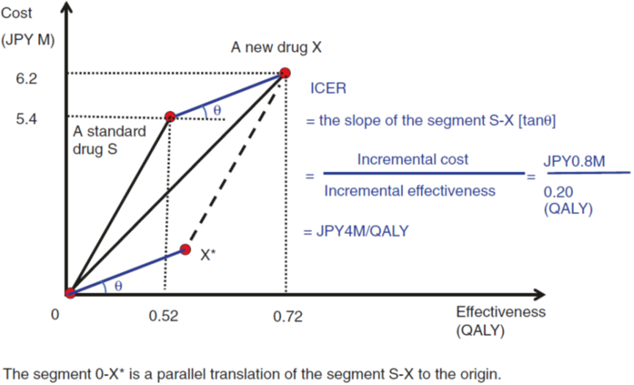
Fig. 4.3 Incremental Cost-Effectiveness Ratio.

Slide 15
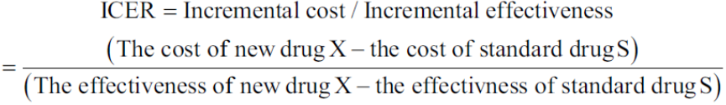
Assessing cost-effectiveness
The technique used to determine the ratio of cost increase to effectiveness increase as a measure of cost-effectiveness is referred to as incremental analysis. The concept of incremental analysis is frequently used in daily life. For instance, if a passenger traveling on the Euro Star train) finds the price for the first-class car is out of his/her price range, the passenger has no choice but to take coach class. On the other hand, if the price is within the budget, a rational passenger would consider whether the first-class car can make the added benefit (such as seats being more comfortable) worth, considering the difference in price between the two classes of cars.
Returning to the example in Fig. 4.3, the ratio of cost increase to effectiveness increase is represented by the slope of segment SX (the line through points S and X, representing a standard drug S and a new drug X, respectively). This slope is referred to as ICER and defined as follows:

Slide 16
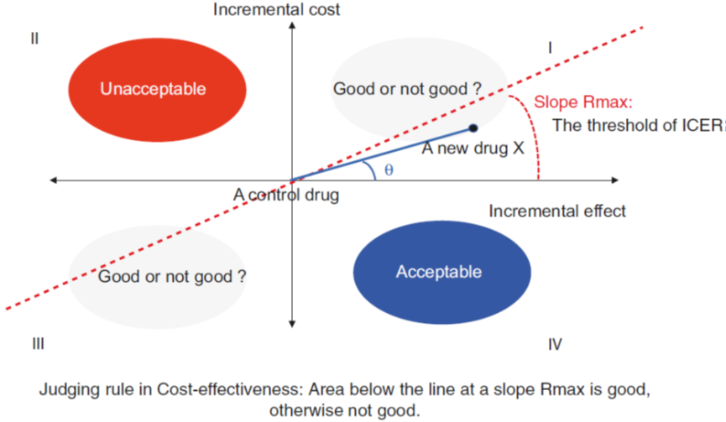
Assessing cost-effectiveness
For the example, in Fig. 4.3, given that the incremental cost of new drug X relative to standard drug S is JPY 0.8 (= 6.2–5.4) million and the incremental effectiveness between the two drugs is 0.2 (= 0.72–0.52) QALY, ICER is calculated as 4 (= 0.8/0.2) million JPY/QALY.
When the standard drug is plotted at the origin, which translates segment SX, ICER is represented by the slope (tan θ in Fig. 4.3) of the new segment OX*, which passes through the origin. This is the basis of the cost-effectiveness plane used in evaluating cost-effectiveness (Fig. 4.4).

Slide 17
Assessing cost-effectiveness
The cost-effectiveness plane, as shown in Fig. 4.4, consists of four quadrants. If the ICER lies in the fourth quadrant (more effective and less costly and referred to as simple or strong dominance), the new drug is cost-effective. Similarly, if the ICER lies in the second quadrant (costlier and less effective), the new drug is not cost-effective (being dominated). On the other hand, in the first and third quadrants, ICER can take any value from 0 to infinity and thus requires a standard (referred to as a threshold and represented as Rmax in Fig. 4.4), to which ICER is compared for evaluating the cost-effectiveness of the new drug.
Once the threshold Rmax is defined, the line through the origin with the slope Rmax can be used as threshold. That is, the drug is evaluated as being cost-effective if ICER falls below the threshold line, and not cost-effective if ICER lies above the line. In Fig. 4.4, new drug X lies below the threshold line (that is, tan θ < Rmax) and is thus evaluated as being cost-effective.

Slide 18
Assessing cost-effectiveness
An absolute standard for the threshold does not exist, being determined by the society’s willingness to pay depending on the economy of each nation. National Institute for Health and Care Excellence (NICE) in the UK has adopted a threshold of 20,000–30,000 GBP/QALY. World Health Organization (WHO) has recently endorsed a threshold of 1–3 times per capita GBP, although it lacks a theoretical basis and was likely recommended for convenience.
“Cost-effective” does not necessarily mean “cost reduction.” For instance, if ICER lies in the first quadrant, the cost will increase even below the threshold line. A “cost reduction” may be thus achieved in rare cases, where ICER lies in either the fourth (simple dominance) or third quadrant, below the threshold line, although new technologies almost always fall into the first quadrant. Also, the value of ICER varies depending on a selection of comparator, which requires further discussion on its selection.

Slide 19
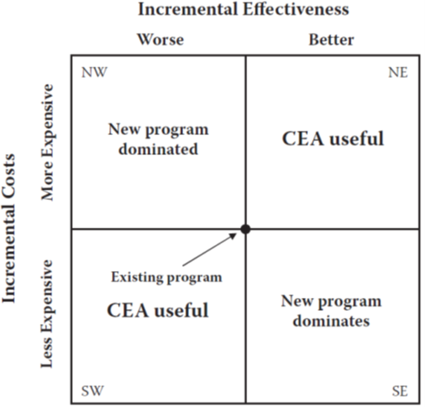
Figure 4.5 The cost-effectiveness plane.

Slide 20
Cost-effectiveness grid
A cost-effectiveness grid can be used to illustrate the definition of “cost-effectiveness” (Fig. 4.6). To determine whether a therapy or service is cost-effective, both the costs and the effectiveness must be considered. Think of comparing a new drug with the current standard treatment. If the new treatment (1) is both more effective and less costly (cell G), (2) is more effective at the same price (cell H), or (3) has the same effectiveness at a lower price (cell D), then it is considered cost-effective (darkly shaded cells in Fig. 4.6). On the other hand, if the new drug (1) is less effective and more costly (cell C), (2) has the same effectiveness but costs more (cell F), or (3) has lower effectiveness for the same costs (cell B), then it is not cost-effective (lightly shaded cells in Fig. 4.6). There are three other possibilities (cells with no shading in Fig. 4.6); the new drug (1) is more expensive and more effective (cell I) (a very common finding), (2) is less expensive but less effective (cell A), or (3) has the same price and the same effectiveness as the standard product (cell E). For the middle cell E, other factors may be considered to determine which medication might be best. For the other two cells, ICER is calculated to determine the extra cost for each extra unit of outcome.

Slide 21
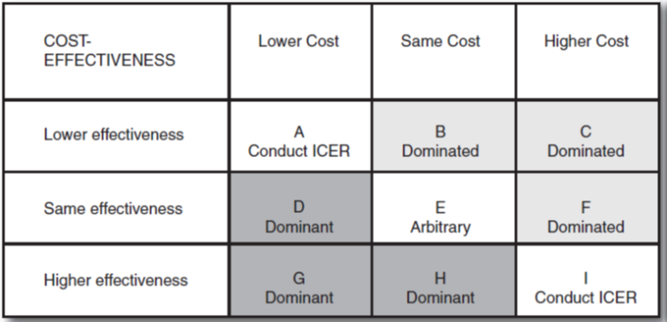
Figure 4.6 Cost-effectiveness grid.

Slide 22
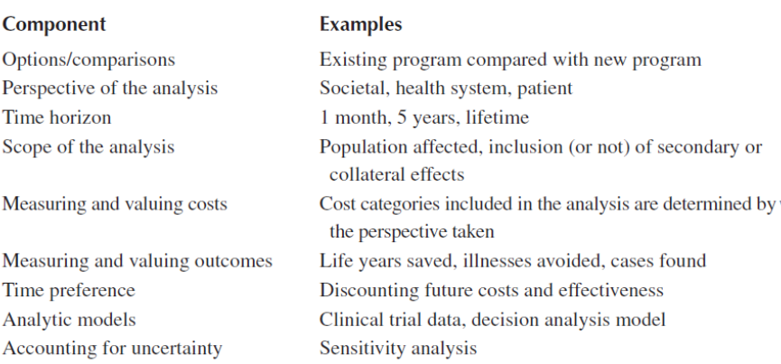
Basic components of a cost-effectiveness analysis
Several factors should be considered in the construction of a CEA (Table 4.3).
Table 4.3 Basic components of a cost-effectiveness analysis.

Slide 23
Composite article: CEA-asthma
Note: The composite article compares treatments for asthma. Three reviews of published articles that look at the economics of asthma treatment.
Title: Cost-Effectiveness Analysis of Adding a Second Agent to Inhaled Corticosteroids for Patients with Asthma
Introduction: Asthma is a chronic disorder characterized by bronchoconstriction and airway inflammation. Inhaled corticosteroids (ICSs) are used routinely in patients with asthma, but sometimes the use of ICS alone is not enough to effectively control asthma symptoms. Two new medications have become available that can be used in addition to ICSs, BreatheAgain and AsthmaBeGone. The objective of this study was to compare the costs and efficacy of two new adjunctive therapies, BreatheAgain and AsthmaBeGone, with ICS use alone.

Slide 24
Composite article: CEA-asthma
Methods: Adult asthma patients (age > 18 years) were enrolled and randomized into three groups: ICS + placebo, ICS + BreatheAgain, and ICS + AsthmaBeGone for 6 months. Both of the new medications were administered by inhalation once in the morning and once in the evening. ICS use was allowed as needed throughout the day. Per protocol, patients returned to the clinic once per month for 6 months. At these visits, FEV1 (forced expiratory volume in 1 second) was measured 2 to 4 hours after the morning doses of asthma medication. Patients kept diaries and recorded their use of all asthma medications, any asthma-related emergency room visits, hospitalizations or nonprotocol office or clinic visits, evening peak expiratory flow (PEF) measurements, and asthma-related symptoms (e.g., wheezing, shortness of breath, chest tightening, or nighttime awakening caused by their asthma).

Slide 25
Composite article: CEA-asthma
Methods: Costs were estimated based on all asthma-related nonprotocol-driven direct medical resources used. This included the study medications and any nonprotocol medical visits (office, clinic, emergency department, or hospitalization) related to asthma. Usual charges (in 2013 US dollars) by the study clinic were used to estimate the costs of each of these visits.
Two clinical outcomes were assessed: an improvement at 6 months in FEV1 of at least 12% from baseline and the number of SFDs during the 6-month study, defined as any day in which the patient recorded in a diary that he or she had none of the following symptoms: chest tightness, wheezing, shortness of breath, or nighttime awakening.

Slide 26
Composite article: CEA-asthma
Results: Exhibit 5.1 shows the baseline comparisons of the three groups of patients. Exhibit 5.2 lists the costs and outcomes for each group. Only one person was hospitalized because of asthma exacerbations during the 6-month trial. Most of the costs of treatment were medication costs. Exhibit 5.3 shows the average costs per clinical outcome, and Exhibit 5.4 shows the ICERs for the three comparisons. Based on the analysis, although the ICS + placebo group was the least costly, it was also the least effective. The ICS + AsthmaBeGone group was comparable to the ICS + BreatheAgain in effectiveness but was less costly.
Conclusions: Adding either of these new adjunctive treatments to ICS was associated with clinical improvement as shown by both the improvement in FEV1 measures and the increase in SFDs recorded by this population of asthma patients at a relatively low increase in cost (<$5 per additional SFD; <$900 per additional successful treatment). AsthmaBeGone had similar effectiveness to BreatheAgain but at a lower cost.

Slide 27
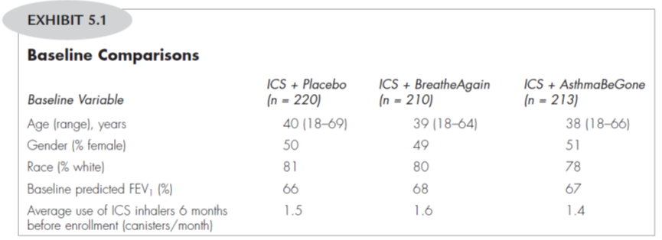

Slide 28
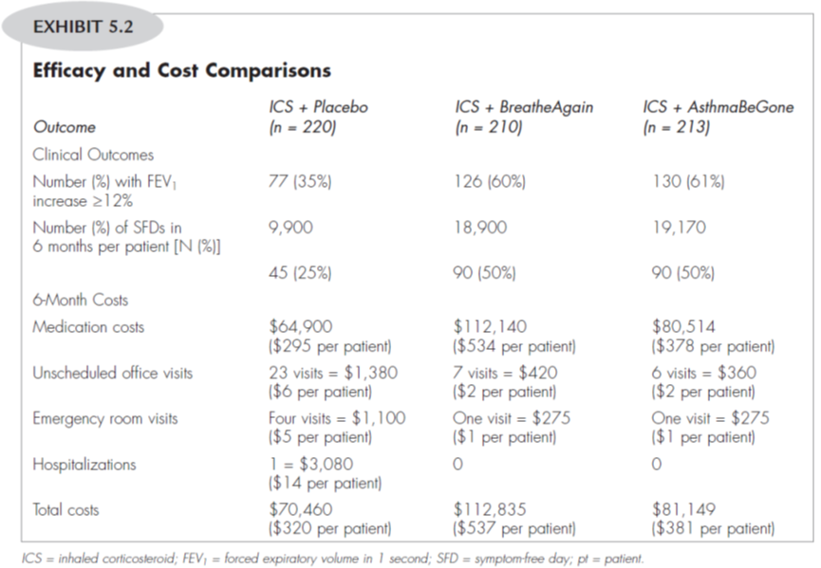

Slide 29
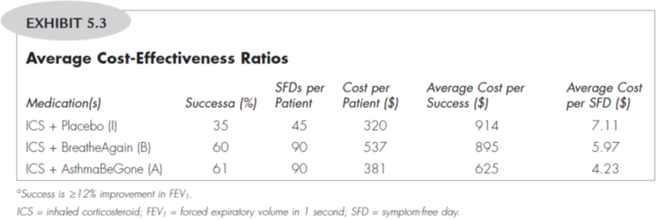

Slide 30
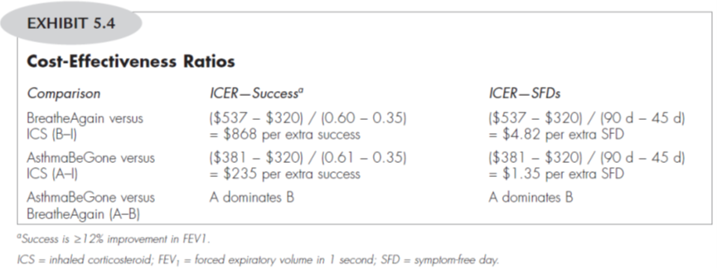

Slide 31
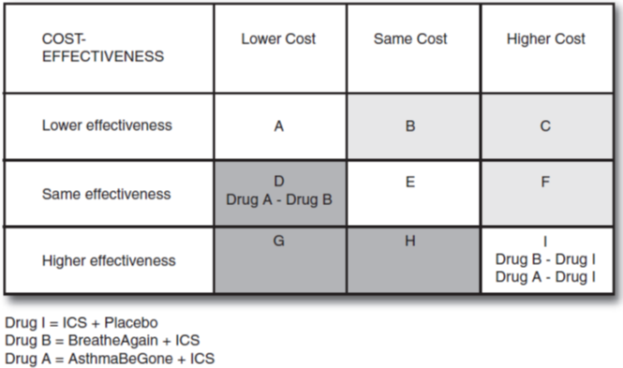
Composite article: CEA-asthma
Which cells of Cost-Effectiveness Grid represent the following comparisons?
BreatheAgain + ICS compared with ICS + Placebo
AsthmaBeGone + ICS compared with ICS + Placebo
AsthmaBeGone + ICS compared with BreatheAgain + ICS
Both active drugs (AsthmaBeGone and BreatheAgain) in combination with ICS are more effective that ICS + placebo but also more expensive (cell I), indicating the need to calculate an ICER. AsthmaBeGone and BreatheAgain have the same effectiveness, but AsthmaBeGone is less expensive (cell D), so it would be a cost-effective alternative compared with BreatheAgain.

Slide 32

Thank You

