Slide 1
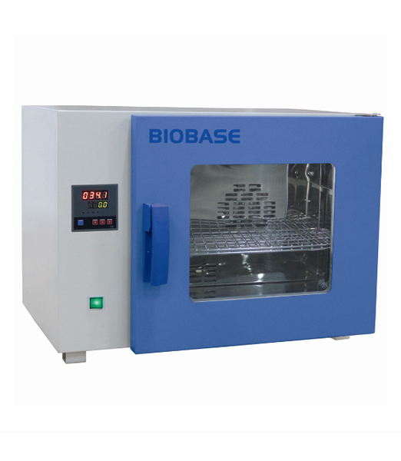
DRYING
Lab -5-

Slide 2
Drying
Drying
Drying :- is the removal of liquid from material by application of heat.
It is accomplished by
transfer of a liquid from a surface into an unsaturated vapor phase.

Slide 3
Purposes of drying:
1- Unit of process in pharmaceutical manufacturing
(e.g. preparation of granules then dispense as capsules or tablets).
2- Reduce bulk and weight lower the cost of transportation and storage.
3- Aid in preservation of animal and vegetable drugs by minimizing mold and bacterial growth in moisture laden material
4- facilitate comminution by increasing friability.

Slide 4
Factors affecting drying
1-Drying temperature
4- Agitation of the sample bed
6- Type of the material
2- Moisture content of the sample
3- Air flow rate
5- Layer thickness of the sample

Slide 5
Classification of solids on drying behavior
1- Granular or crystalline solids (water is held in shallow and open surface pores as well as in interstitial spaces between particles that are easily accessible to the surface).
2- Amorphous, fibrous or gelatinous solids (moisture is an integral part of the molecular structure as well as being physically entrapped in fine capillaries and small interior pores).
Ex: calcium sulfate, zinc oxide, magnesium oxide
Ex: starch, insulin and aluminum hydroxide.
Note: Amorphous solids are difficult to dry than granular or crystalline solids.

Slide 6
Classification of dryers based on solid handeling
1- Static-bed dryers- systems
A- tray and truck dryers
B- tunnel and conveyor dryer
2- moving-bed dryers-systems
A. turbo-tray dryer
B. pan dryer
3- fluidized - bed dryers systems
4- pneumatic dryers system
5- specialized drying methods
A- Freeze dryer
B- microwave drying

Slide 7
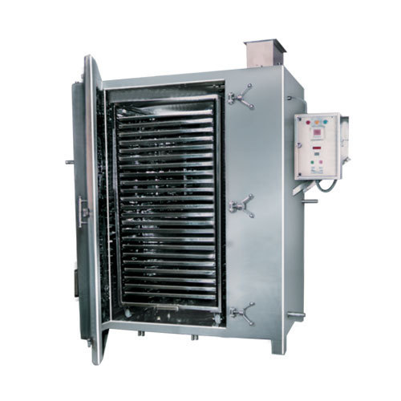
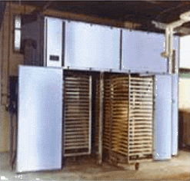
1- Static-bed dryers- systems
A- tray and truck dryers: it consist from cabinet in which the material dried is spread on tiers of trays .

Slide 8
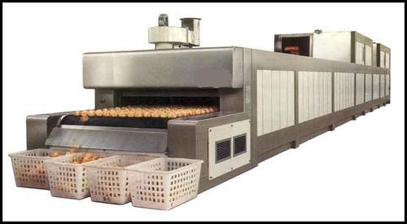
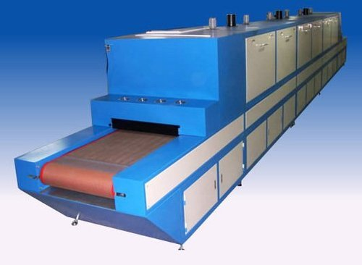
1- Static-bed dryers- systems
B- tunnel and conveyor dryer: an adaptation of truck dryer for continuous drying.

Slide 9
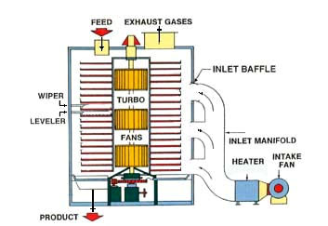
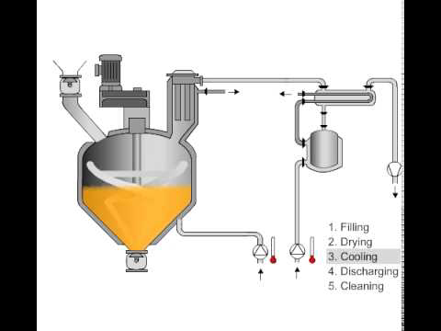
2- moving-bed dryers-systems
The drying particles are partially separated so that they flow over each other.
A. turbo-tray dryer
B. pan dryer (generally
Used for small patches of
pastes and slurries)

Slide 10
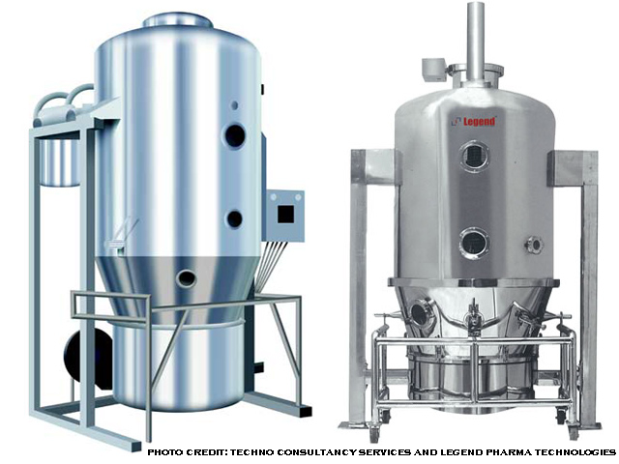
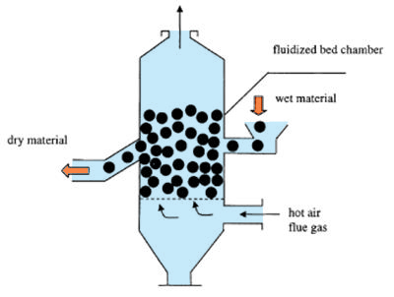
3- fluidized - bed dryers systems
Solid particles are partially suspended in upward moving gas steam.

Slide 11
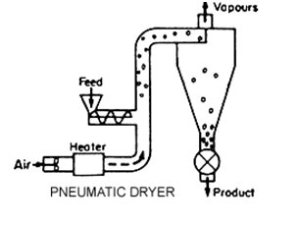
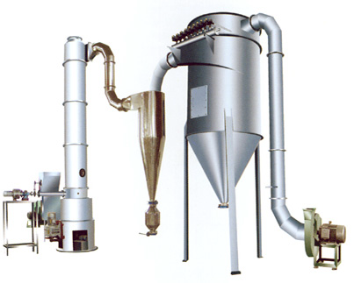
4- pneumatic dryers system
Like spray drier, where the drying particles are entrained and conveyed in a high velocity gas stream.
It is only used for drying of fluid materials like paste and slurries.

Slide 12
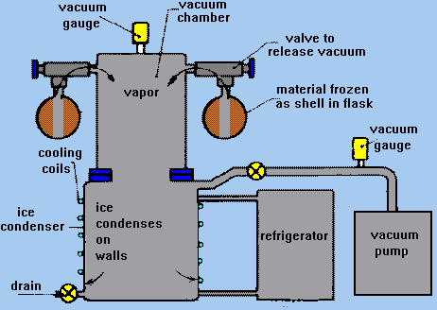
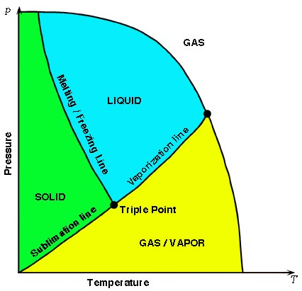
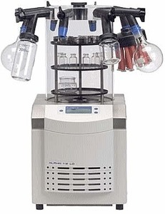
5- specialized drying methods
A- Freeze dryer

Slide 13
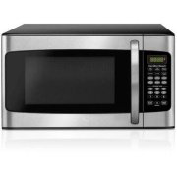
5- specialized drying methods
B- Microwave drying:- here instead of applying heat externally to material, energy in form of microwaves is converted into internal heat by interaction with material itself

Slide 14
Solids drying
The moisture in a solid can be expressed on a wet-weight or dry-weight basis.
Wet-weight basis: loss on drying
%LOD = wt. of water in sample × 100
total wt. of wet sample
Dry-weight basis: moisture content
%MC = wt. of water in sample × 100
wt. of dry sample
Note: MC can be measured by using moisture analyzer or by using oven

Slide 15
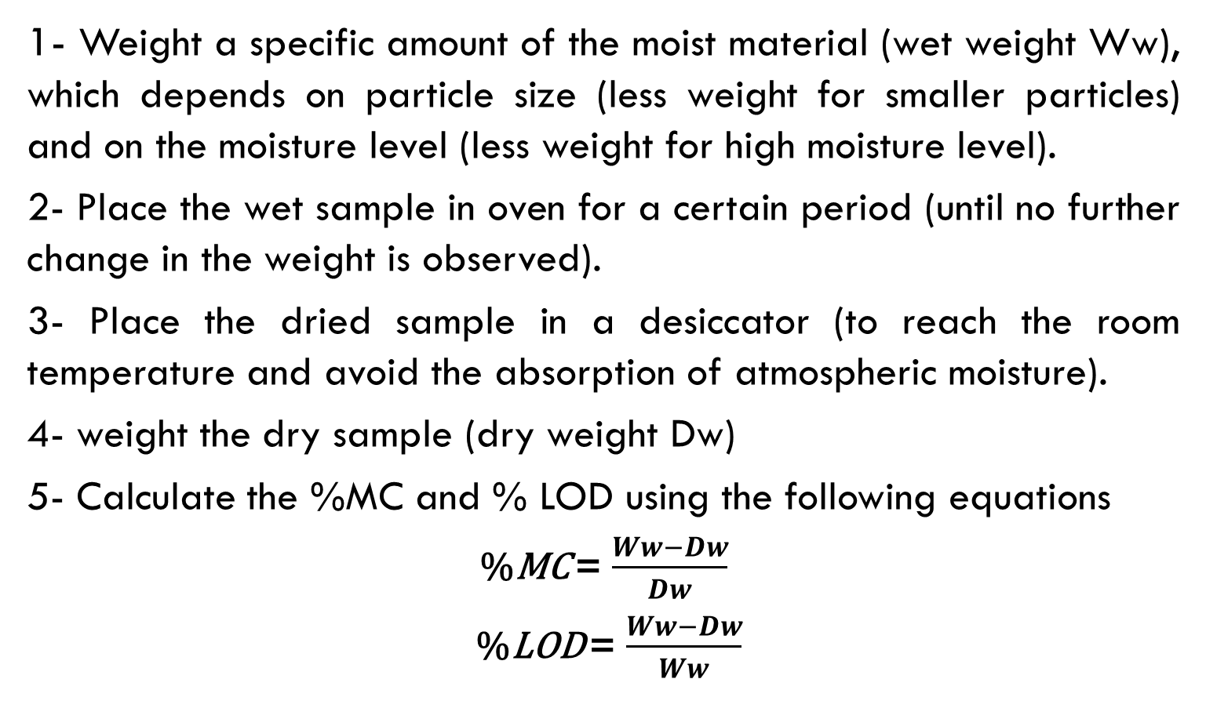
Procedure
1- Weight a specific amount of the moist material (wet weight Ww), which depends on particle size (less weight for smaller particles) and on the moisture level (less weight for high moisture level).
2- Place the wet sample in oven for a certain period (until no further change in the weight is observed).
3- Place the dried sample in a desiccator (to reach the room temperature and avoid the absorption of atmospheric moisture).
4- weight the dry sample (dry weight Dw)
5- Calculate the %MC and % LOD using the following equations
%MC = $\frac{Ww−Dw}{Dw}$
%LOD = $\frac{Ww−Dw}{Ww}$

Slide 16
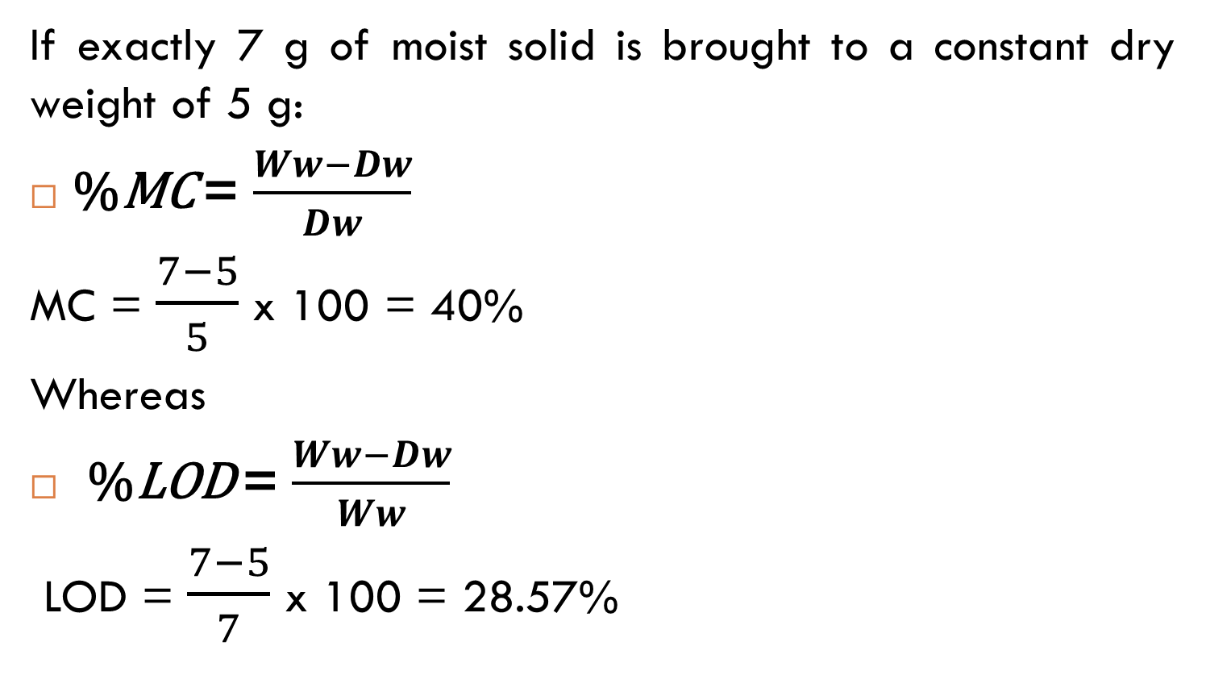
Example
If exactly 7 g of moist solid is brought to a constant dry weight of 5 g:
%MC = $\frac{Ww−Dw}{Dw}$
MC = $\frac{7−5}{5}$ x 100 = 40%
Whereas
%LOD = $\frac{Ww−Dw}{Ww}$
LOD = $\frac{7−5}{7}$ x 100 = 28.57%

Slide 17
For more information you can follow these links
https://www.youtube.com/watch?v=VkVu5qDgs_Q
https://www.youtube.com/watch?v=MEKHkpgVZog

Slide 18


