Slide 1
Chronic stable angina
Lec.Dr. Abeer A. Rashid

Slide 2
Definition
a clinical syndrome characterised by discomfort in the chest, jaw, shoulder, back, or arms, typically elicited by exertion or emotional stress and relieved by rest or nitroglycerin

Slide 5
The major determinants of myocardial oxygen consumption are
heart rate
contractility
and intramyocardial wall tension during systole

Slide 6
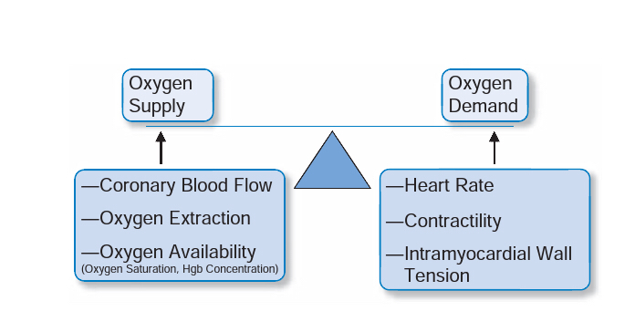
Determinants of myocardial oxygen supply and demand

Slide 7
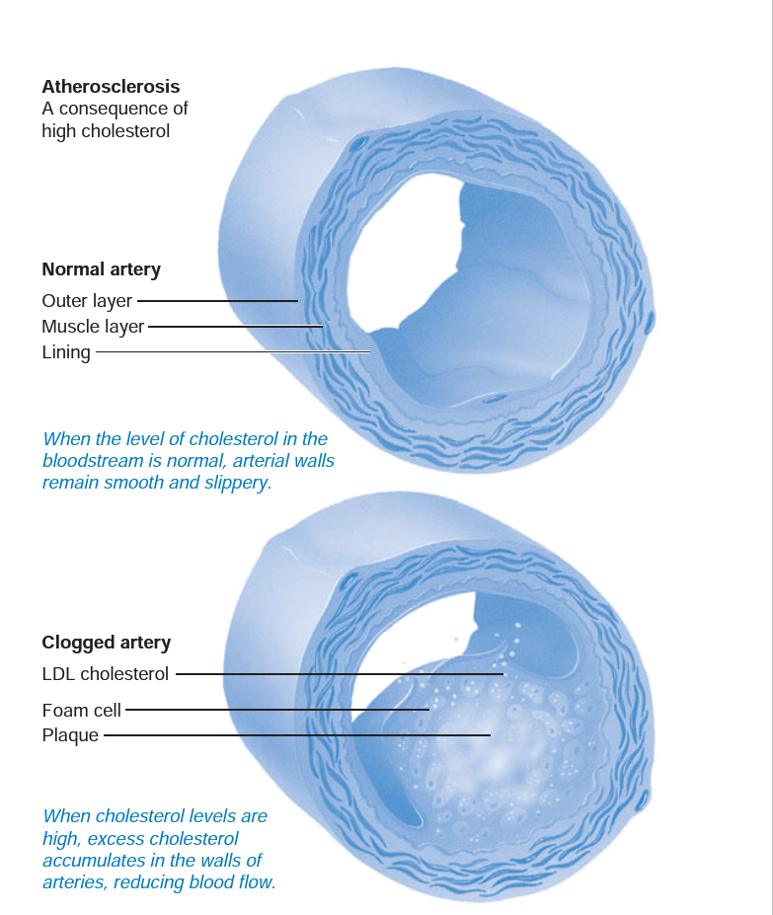
Process of atherosclerosis

Slide 8
Endothelial function

Slide 9
Clinical presentation of angina pectoris

Slide 10
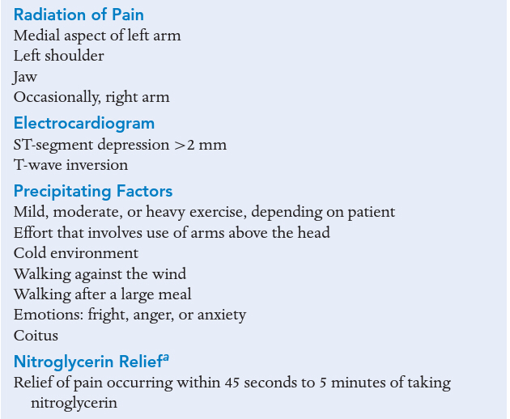

Slide 11
Diagnosis
A12-lead ECG
It is not useful in establishing a definitive diagnosis of CAD, the ECG will be useful at detecting important information regarding conduction abnormalities,left ventricular hypertrophy,ongoing ischemia,or evidence of a previous myocardial infarction
STRESS TESTING
help evaluate how well the heart performs with activity. During a stress test, you will usually be asked to perform physical exercise, like walking on a treadmill.

Slide 12
Diagnosis
Non-invasive techniques, including magnetic resonance imaging (MRI) and multi-slice CT scanning, are being developed and tested as alternatives to angiography.

Slide 13
Goals of treatment
To Reduce or eliminate the symptoms of angina to improve the quality of life.
To halt progression of atherosclerosis and prevent complications of the disease, such as MI and death

Slide 14
Treatment

Slide 15
Non pharmacological treatment
LIFESTYLE MODIFICATIONS
increased physical activity
smoking cessation
weight loss
RISK FACTOR MODIFICATION
Noexposure to environmental tobacco smoke
Optimize blood pressure , blood glucose and cholesterol level

Slide 16
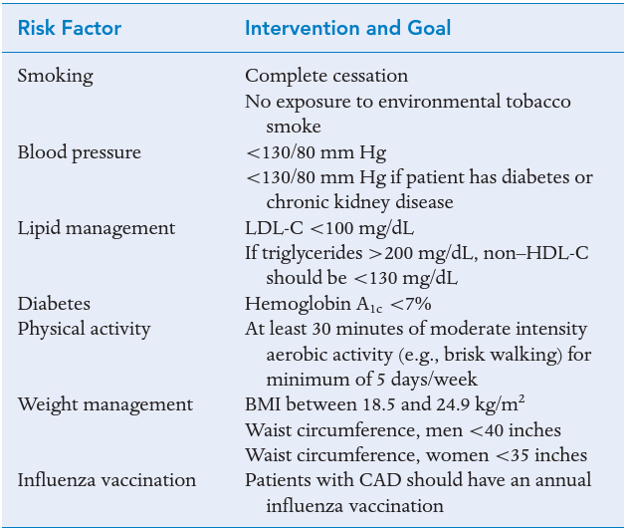

Slide 17
Pharmacological treatment
ANTIPLATELET THERAPY
Aspirin (ASA) therapy has been demonstrated to reduce the incidence of MI and sudden cardiac death in patients with chronic stable angina.
(ACC)/AHA recommend an ASA dose of 75 to 162 mg daily for the prevention of MI and death in patients with CAD.
Clopidogrelrepresentsasuitablealternativeantiplateletagent to prevent MI anddeath in chronic stable angina patients unable to take ASA.
dual antiplatelet therapy in patients with CAD is currently limited to those who have had a recent ACS or recent percutaneous coronary intervention (PCI) plus stent placement.

Slide 18
ACE-I
Greatly decrease CV events in patients with CHD
Should be considered in all patients who also have an LVEF of 40% or less, HTN,DM, and /or CKD
In addition to the vasodilation caused by inhibiting the production of angiotensin II, ACE inhibitors have anti-inflammatory, antithrombotic and antiproliferative properties.

Slide 19
Statins
Statins should be prescribed alongside lifestyle advice for both primary prevention of CVD and in those with established CVD
Most patients with stable angina will be on statins for their cholesterol-lowering effects.
In addition to cholesterol-lowering properties, statins also have antithrombotic, anti-inflammatory and antiproliferative properties.

Slide 20
Anti-Ischemic Pharmacotherapy
Agents used in the treatment of patients with chronic stable angina primarily affected either determinants of myocardial oxygen supply, myocardial oxygen demand, or both. Within this paradigm,β-blockers,calcium-channel blockers(CCBs),and chronic nitrate therapy have demonstrated effectiveness in the prevention of ischemic symptoms

Slide 21
B-blockers
Lower myocardial oxygen demand by low-ering heart rate, ,myocardial contractility ,and intra-myocardial wall tension.
β-blockers with intrinsic sympathomimetic activity are not routinely used in patients with stable angina due to reduced efficacy
The dose of β-blocker should be titrated to agoal resting heart rate of 55 to 60 beats per minute and therefore will be patients pecific.
β-Blockers should be avoided in patients with primary vasospastic angina and may worsen symptoms in patients with reactive airway disease

Slide 22
NITRATES
Nitrates can increase myocardial oxygen supply through vasodilation of the coronary arteries ,as well as reduce myocardial oxygen demand through the reduction of preload.
Nitrates produce vasodilation through the biotransformation and the release of NO.
Regardless of the formulation ,all nitrate options are effective at preventing or relieving ischemic symptoms if used appropriately ,including the use of anitrate-free interval.

Slide 23
Nitrates
Long-acting nitrates are effective agents for the prevention of anginal symptoms .
Sublingual NTG is a vital agent to treat and relieve acute anginal attacks.
Common side effects of nitrate therapy include hypotension, dizziness, and headache.
Headache often will resolve with continued therapy and may be treated with acetaminophen.
Concomitant administration with phospho diesterase type 5 inhibitors (within 24 hours for sildenafil and vardenafil, 48 hours fort aladafil) is contraindicated due to the risk of life-threatening hypotension.

Slide 24
CALCIUM-CHANNEL BLOCKERS
Both diltiazem and verapamil exert qualitatively similar effects on myocardial and peripheralt issue. They slow conduction and prolong the refractory period in the AV node.
They are moderate peripheral vasodila-tors and potent coronary artery vasodilators.
Only nicardipine and amlodipine currently are approved for the treatment of chronic stable angina pectoris. In addition, amlodipine is indicated for vasospastic angina.
Dihydropyridines do not slow cardiac conduction and, therefore, have no antiarrhythmic action.
They are,however, more potent peripheral vasodilators and may be associated with a reflex increase in the heart rate.

Slide 25
CCBs
Both dihydropyridine(DHP) and non-dihydropyridine(non-DHP) CCBs produce an increase in myocardial oxygen supply through vasodilation of the coronary arteries, as well as reduce myocardial oxygen demand through lowering of intra myocardial wall tension

Slide 26
RANOLAZINE
Is an anti-ischemic agent that inhibits the late sodium current, thereby reducing intracellular sodium.
By inhibiting sodium influx, ranolazine effectively prevents ischemia-induced contractile dysfunction and delays the onset of angina.
A key distinction between ranolazine and traditional antianginal agents is that it has no appreciable effect on heart rate and blood pressure.

Slide 27
Ranolazine
is available as an extended release tablet that is dosed twice daily. Patients should be initiated at a dosage of 500 mg orally twice daily, which can be titrated up to amaximum dosage of 1,000 mg twice daily.
The drug is extensively metabolized in the liver through both cytochrome P-450 enzymes CYP3A4 and CYP2D6.
ranolazine is contraindicated in patients with significant hepatic dysfunction and in those receiving potent inhibitors and inducers of CYP3A4 such as ketoconazole or rifampin,

Slide 28
Ivabradine
class of antianginal agents which block the If current.
This regulates pacemaker activity in the sinoatrial node and controls heart rate. Inhibition, there-fore, reduces heart rate without affecting the force of contrac-tion.
Ivabradine is similar in efficacy to atenolol and CCBs and may be of particular use in patients in whom β-blockers are contraindicated.

Slide 29
Nicorandil
is a compound that exhibits the properties of a nitrate but which also activates ATP-dependent potassium channels.
Cause reduction in unplanned admission to hospital with chest pain.

