Slide 1

Physical Pharmacy Lab - 4 -
Surface Tension
Done by:
Assist. Lec. Sura Zuhair
Assist. Lec. Zeina Dawood
Assist. Lec. Hiba Sabah

Slide 2
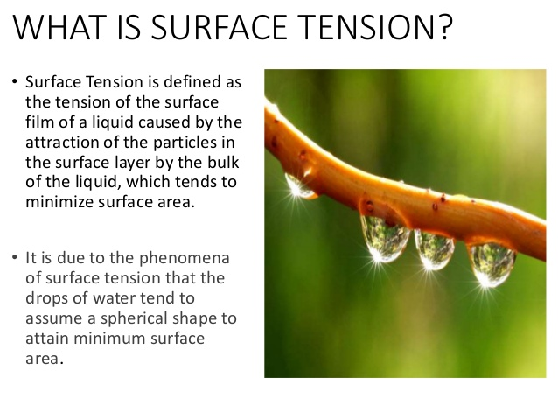
H.W/ Why the free drops of water form spherical droplets?

Slide 3
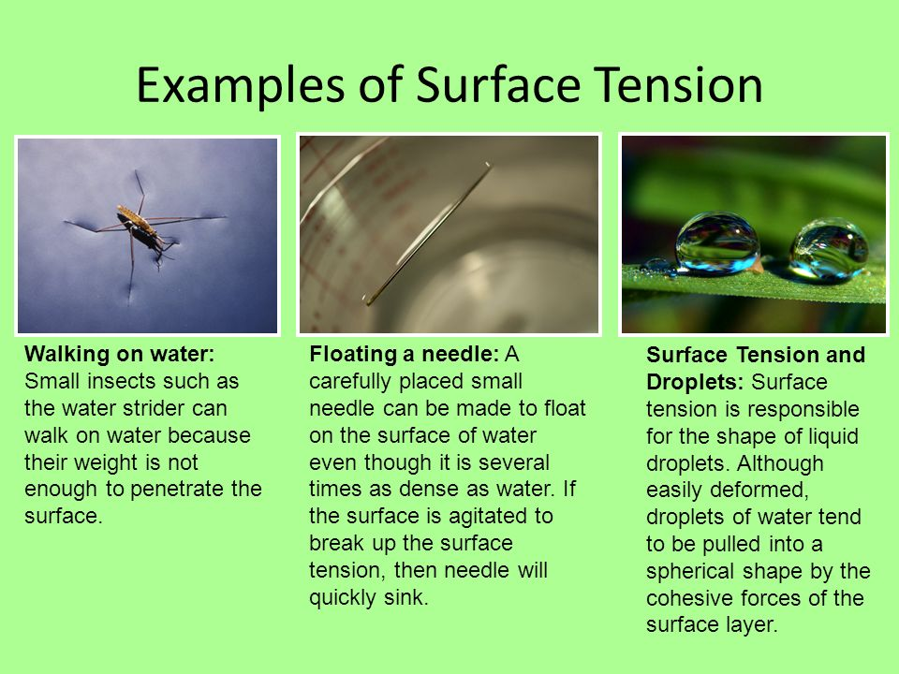

Slide 4
Surface: is used when referring to either a gas-solid or a gas-liquid interface.
The tension in the surface: is the force per unit length that must be applied to the surface so as to counterbalance the net inward pull. It has the units of dyne/cm. as shown in Figure 1.

Slide 5
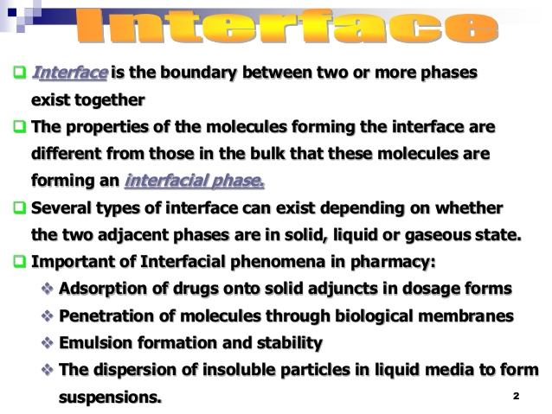

Slide 6

Interfacial tension: is the force per unit length existing at the interface between two immiscible liquid phases and has the unit of dynes/cm.
ordinarily; it is less than surface tension because the adhesive forces between liquid phases forming an interface are greater than when a liquid and a gas phase exist together.
It follows that if two liquids are completely miscible; no interfacial tension exists between them.

Slide 7
Furthermore, there are two important terms related to forces.
First, Cohesive forces are the intermolecular forces which cause a tendency in liquids to resist separation. These attractive forces exist between molecules of the same substance. While,
Second, adhesive forces are the attractive forces between unlike molecules. They are caused by forces acting between two substances, such as mechanical forces (sticking together) and electrostatic forces (attraction due to opposing charges)

Slide 8
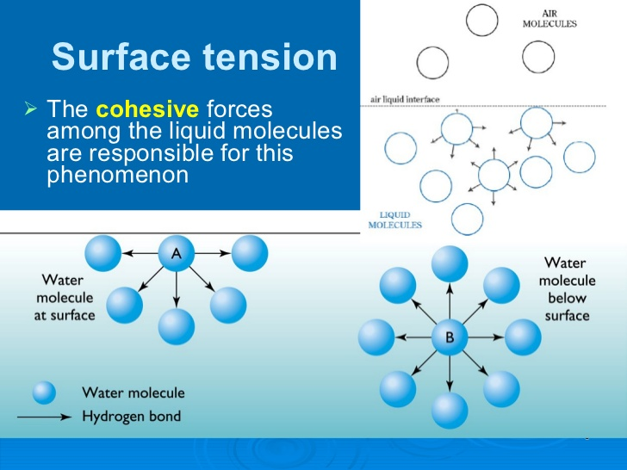
A molecule in the surface experiences a net attractive force pointing toward the liquid interior, because there are no molecules of the liquid above the surface.
A molecule within the bulk liquid is surrounded on all sides by other molecules, which attract it equally in all directions, leading to a zero net force.

Slide 9
Factors affecting surface tension
1. Temperature
2. Surface active agents(S.A.A): addition of surfactants to water decreases the surface tension. Because surfactants in water orient themselves at interface in such away to remove hydrophobic tail away from aqueous phase, as a result some of water molecules at the interface replaced by non-polar part of surfactant and since attractive force between surfactant molecules (cohesive force) & between S.A.A and water (adhesive force) less than cohesive force between water molecules a lone (i.e. decrease cohesive force leads to decrease net effect (cohesive- adhesive) leads to decrease surface tension).

Slide 10

Methods to measure surface tension
There are several methods of surface tension measurements:
1. Drop weight method: The surface tension of the liquid is related to the weight of a drop of that liquid which falls freely from the end of the tube by the expression
у= surface tension (gm.cm/sec² = dyne /cm)
M=mass of one drop,
R= radius,
F= correction factor
G= 980 cm/sec² or 9.8 m/sec²

Slide 11
Procedure
1- Check that the glass tip is very clean & free from any defect particularly around the edges
2-Allow the drop (e.g. water) to detach slowly from the tip & collect 10 -15 drops in a beaker under constant conditions (constant temperature).
3-Finally, measure the radius of tip.
It is important that the drop has been correctly formed & detached and the rate of detachment should not exceed 1 drop in 2 sec, & vibration must be guarded against as well as check the end of the tip is horizontal.

Slide 12
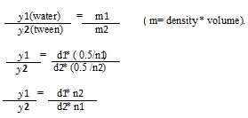
2. Modification of drop weight method (drop number method):-
It may be performed by counting the numbers of drop (n) by certain volume (0.5 ml) under conditions similar to that prescribed previously. A comparison with liquid of known surface tension must be similarly treated by using
the same tube under the same condition.
Surface tension of water =72.8 at 25 c⁰& d=1

Slide 13
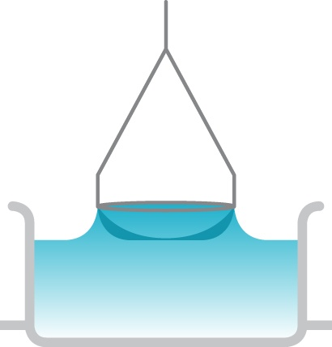
3. Ring detachment method (Du Noüy Ring Tensiometer): The principle of the instrument depend on the fact that the force necessary to detach a platinum ring immersed at the surface or interface is proportional to the surface or interfacial tension.

Slide 14
4- Capillary rise method:-
In this method when inversed tube (capillary tube) in a liquid, the tube will be risen up to a certain distance by a liquid , it depends on:
surface tension of liquid ( increasing surface tension leading to increase height of liquid) and
on the cross section area of that tube ( increase area leads to decrease height).

Slide 15
Experimental work
The aim of the experiment is to determine the surface tension of liquids in addition to the C.M.C. of surfactant such as tween.
Materials and equipment:-
-Distilled water, solution 2% tween60
-graduated pipette, beaker , conical and volumetric flask( 50 cc).

Slide 16
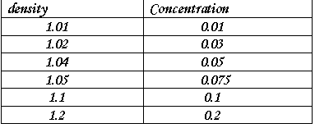
Procedure:
1. Use modified drop weight method to measure the surface tension of the concentrations of tween60 (0.01%, 0.03 %, 0.05%, 0.075%, 0.1%, 0.2%), then prepare 50 ml of each solution by dilution method using 2% stock solution.
2. Plot surface tension versus concentration.
3. Determine C.M.C. of tween60 from the plot (n water=16) (δ water =72.8).
The densities of the concentration used are as follows:-
Use water as a standard liquid (surface tension =72.8 & its density = 1).

Slide 17

How to prepare our solution for the experiment
For example: to prepare 50 mL of 0.01% tween60 from 2%stock solution by using dilution
C1V1 = C2 V2
2 %*V1 =0.01%* 50
V1= 0.25mL take from stock solution 2%tween 60 (using pipette ) put it in the volumetric flask then complete the volume to 50 mL by adding D.W
*The same procedure and calculation for preparation of the other concentration

Slide 18
Steps of the experiment
Prepare diluted solution for example 0.01% in volumetric flask
Now use the equation to find the surface tension
Take 0.5 mL of the prepared solution by using 1mL pipette and dropped the liquid in the beaker and count the no. of drops

Slide 19
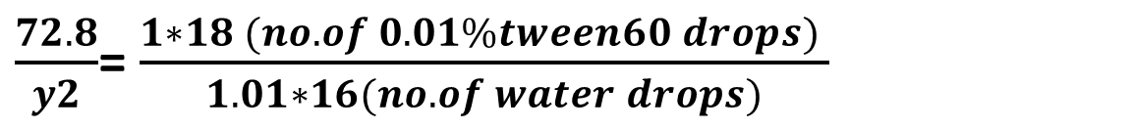
To find the surface tension
$\frac{72.8}{y2}$= $\frac{1∗18 (no. of 0.01\%tween60 drops) }{1.01∗16(no. of water drops)}$
y2= 65.53 dyne/ cm
Surface tension of 0.01%tween60 solution

Slide 20
To find C.M.C
S.T
Conc.

Slide 21

It's time for question???

