Slide 1
Preformulation
Preliminary Evaluation and Molecular Optimization when the first quality sample of the new drug becomes available, probing experiments should be conducted to determine the magnitude of each suspected problem area. If a deficiency is detected, then the project team should decide on the molecular modification(s) that would most likely improve the drug's properties. Salts, prodrugs, solvat.es, polymorphs, or even new analogues may emerge from this modification effort.

Slide 2
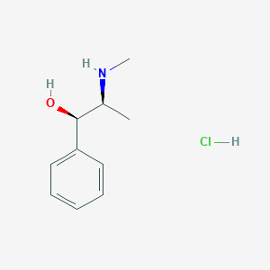
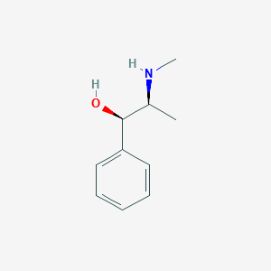
Although each of these modification approaches has proven beneficial, the salt and prodrug approaches are the most common. Most salts of organic compounds are formed by the removal of a proton to form an ionized drug molecule, which is then neutralized
with a counter ion. Ephedrine hydrochloride, for example, is prepared by addition of a proton to the basic secondary nitrogen atom on ephedrine, resulting in a protonated drug molecule (ephedrine-HCl), which is neutralized with a chloride anion (ephedrine-HCl). In general, organic salts are more water-soluble than the corresponding un-ionized molecule, and hence, offer a simple means of increasing dissolution rate and improving bioavailability.

Slide 3
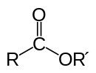
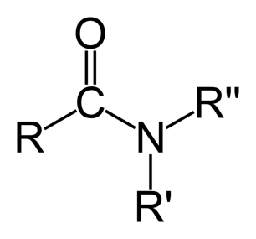
While salt formation is limited to molecules with ionizable groups, prodrugs may be formed
With any organic molecule having a chemically reactive functional group.
Prodrugs are synthetic derivatives (e.g., esters and amides) of drug molecules that may have intrinsic pharmacologic activity but usually must undergo some transformation in vivo to liberate the active drug molecule.
Through the formation of a prodrug, a variety of side chains or functional groups may be added to improve the biologic and/or pharmaceutical properties of a compound. Some of the biologic response parameters that may be altered by prodrug formation are absorption due to increased lipophilicity or increased water solubility, duration of action via blockade of a key metabolic site, and distribution to organs due to changes in lipophilicity.
Examples of biologic improvements are abundant in the steriod and prostaglandin prodrug literature. Pharmaceutical improvements resulting from prodrug formation include stabilization, an increase or decrease in solubility, crystallinity, taste, odor, and reduced pain on injection.

Slide 4
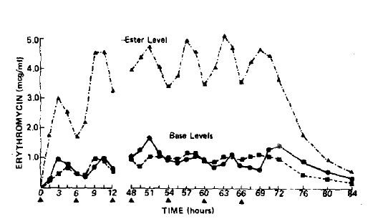
Erythromycin estolate is an example of a prodrug with improved pharmaceutical properties .
In aqueous solutions, protonated erythromycin is water-soluble, has a bitter taste, and is rapidly hydrolyzed in gastric acid (t 10% = 9 sec) to yield inactive decay products.
To overcome this problem, the water-insoluble lauryl sulfate salt of the propionate ester prodrug ( estolate) was formed for use in both suspension and capsule dosage forms.
Erythromycin propionate is inactive as an antimicrobial and must undergo ester hydrolysis to yield bioactive erythromycin.
In an oral q.i.d. bioavailability comparison between Upjohn's enteric coated tablet formulation of erythromycin base and capsule formulation of erythromycin estolate (Fig. 8-4), the lipophilic ester prodrug was absorbed four times more efficiently than the formulated free base, but hydrolyzed only 24% in serum to produce equivalent plasma levels of bioactive erythromycin base.
Thus, a prodrug was used to overcome a pharmaceutical formulation problem without compromising bioavailability.

Slide 5
To date, most prodrugs have been esters or amides designed to increase lipophilicity. Unfortunately, this type of modification often decrease water solubility and thus decreases the concentration gradient across the cell membrane, which controls the rate of drug absorption.
This trade-off between lipophilicity and concentration gradient is generally assumed to
result in a net improvement in absorption. In 1980, Amidon suggested the making of water
soluble prodrugs by adding selected amino acids that are substrates for enzymes located in the intestinal brush border.
Assuming that enzyme cleavage was not rate-limiting, and that the liberated drug molecule would remain in the lipophilic membrane, then the resulting membrane transport of the parent compound should be very rapid, owing to the large concentration gradient of liberated drug across the membrane, as illustrated in Figure 8-5.
Using the lysine ester prodrug-of estrone, a potential increase of five orders of magnitude in adsorption rate was found in vivo using perfused rat intestines.
Although any of the modifications discussed may provide an increase in bioavailability,
chemical instability or a lack of synthetic feasibility may prohibit the commercial development of a modified drug molecule.
Whatever the case, the molecular form of the drug advancing from this preliminary evaluation should have a substantial chance of successfully progressing through the drug development process.

Slide 6
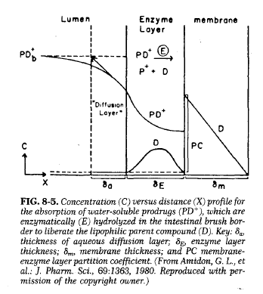

Slide 7
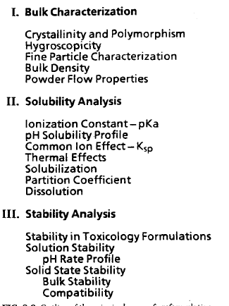

Slide 8
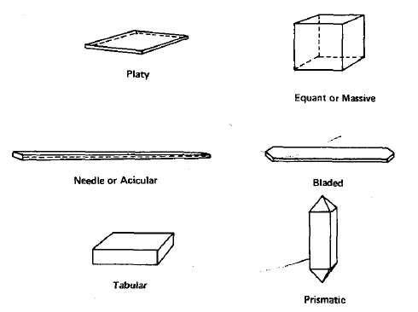
Crystallinity and Polymorphism
Crystal habit and the internal structure of a drug can affect bulk and physicochemical properties, which range from flowability to chemical stability. Habit is the description of the outer appearance of a crystal whereas the internal structure is the molecular arrangement within the solid. Several examples of different habits of crystals are shown in Figure 8-7.
The internal structure of a compound can be classified in a variety of ways, as shown in Figure8-8. The first major distinction is whether the solid is crystalline or amorphous. Crystals are characterized by repetitious spaces of constituent atoms or molecules in a three-dimensional array, whereas amorphous forms have atoms or molecules randomly placed as in a liquid.
Amorphous forms are typically prepared by rapid precipitation, lyophilisation or rapid cooling of liquid melts. Since amorphous forms are usually of higher thermodynamic energy than corresponding crystalline forms, solubilities as well as dissolution rates are generally greater.
Upon storage, amorphous solids tend to revert to more stable forms. This thermodynamic instability, which can occur during bulk processing.

Slide 9
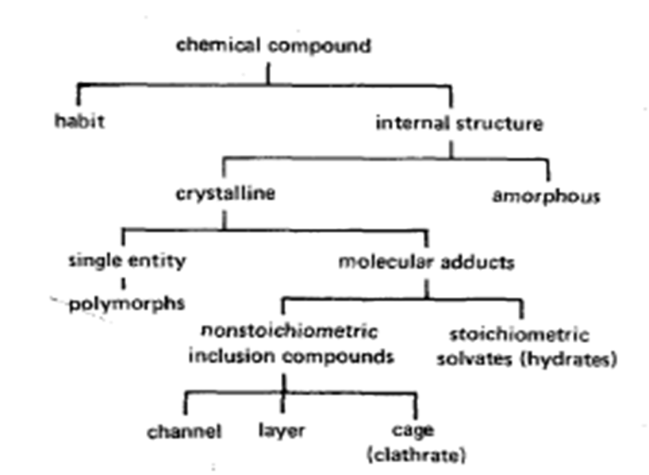
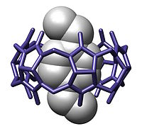
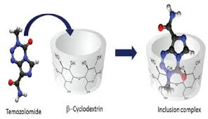
A crystalline compound may contain either a stoichiometric or nonstoichiometric amount of crystallization solvent.
Nonstoichiometric adducts, such as inclusions or clathrates, involve entrapped solvent molecules within the crystal lattice. Usually this adduct is undesirable, owing to its lack of reproducibility, and should be avoided for development. A stoichiometric adduct, commonly referred to as a solvate, is a molecular complex that has incorporated the crystallizing solvent molecules into specific sites within the crystal lattice. When the incorporated solvent is water, the complex is called a hydrate, and the terms hemihydrate, monohydrate, and dihydrate describe hydrated forms with molar equivalents of water corresponding to half, one, and two. A compound not containing any water within its crystal structure is termed anhydrous.
Inclusion compound host-gust

Slide 11
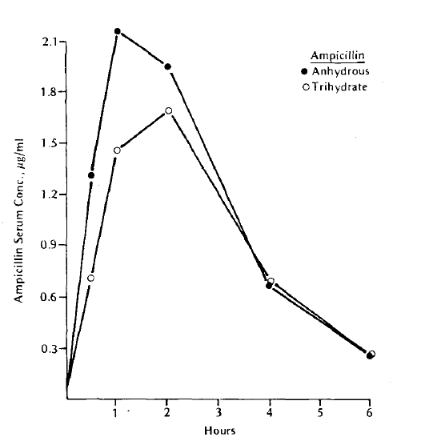
Identification of possible hydrate compounds is important since their aqueous solubilities can be significantly less than their anhydrous forms . Conversion of an anhydrous compound to a hydrate within the dosage form may reduce the dissolution rate and extent of drug absorption. An example of the in vivo importance of solvate forms is shown in Figure 8-9, where the anhydrous and trihydrate forms of ampicillin were administered orally as a suspension to human subjects. The more soluble anhydrous form (1 0 mg/ml) produced higher and earlier peaks in the blood serum levels than the less soluble trihydrate form.

Slide 12
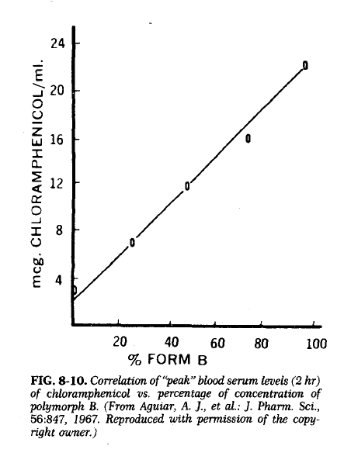
Polymorphism is the ability of a compound (or element o crystalize as more than one distinct crystalline species with different internal lattices.
Chemical stability and solubility changes due to polymorphism can have an impact on a
drug's bioavailability and its development program.
Chloramphenicol palmitate exists in three crystalline polymorphic forms (A, B, and C) and
an amorphous form. Aguiar and co-workers investigated the relative absorption of polymorphic forms A and B from oral suspensions administered to human subjects. As summarized in Figure 8-10, "peak" serum levels increased substantially as a function of the percentage of form B polymorph, the more soluble polymorph the internal structure of the solid. Many physicochemical properties vary with the internal structure, melting point, density, hardness, crystal shape. optical properties. and vapor pressure.
Characterization of polymorphic and solvated forms involves quantitative analysis of these differing physicochemical properties.

Slide 13
Microscopy
All substances that are transparent when examined under a microscope that has crossed polarizing filters are either isotropic or anisotropic. Amorphous substances, such as supercooled glasses and noncrystalline solid organic compounds, or substances with cubic
crystal lattices, such as sodium chloride, are isotropic materials, which have a single refractive index. With crossed polarizing filters, these isotropic substances do not transmit light, and they appear black materials with more than one refractive index are anisotropic and appear bright with brilliant colors (birefringence) against the black polarized background. The interference colors depend upon the crystal thickness and the differences in refractive indices.
Anisotropic substances are either uniaxial, having two refractive indices, or biaxial, having three principal refractive indices.

Slide 14
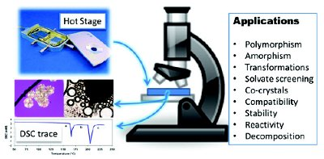
The polarizing microscope fitted with a hot stage is a useful instrument for investigating
polymorphism, melting points, transition temperatures, and rates of transition at controlled
heating rates. In addition, the hot-stage microscope facilitates differentiation of DSC endotherms for polymorphic transitions from desolvation processes A problem often encountered during thermal microscopy is that organic molecules can degrade during the melting process, and recrystallization of the melt may not occur, because of the presence of contaminant degradation products.

Slide 15
Thermal Analysis.
Differential scanning calorimetry (DSC) and differential thermal analysis (DTA) measure the heat loss or gain resulting from physical or chemical changes within a sample as a function of temperature. Examples of endothermic (heat-absorbing) processes are fusion, boiling, sublimation, vaporization. desolvation, solid-solid transitions and chemical degradation. crystallization and degradation are usually exothermic processes.
Quantitative measurements of these processes have many applications in preformulation studies including purity, polymorphism, solvation, degradation, and excipient compatibility.
For characterizing crystal forms, the heat of fusion, ΔHf, can be obtained from the area-under- the DSC-curve for the 'melting endotherm. Similarly, the heat of transition from one polymorph to another may be calculated as shown by Guillory for several sulfonamides.
A sharp symmetric melting endotherm can indicate relative purity, whereas broad, asymmetric curves suggest impurities or more than one thermal process. Heating rate affects the kinetics and hence the apparent temperature of solid solid transitions.
A variable with DSC experiments is the atmosphere in contact with the sample. Usually, a
continual nitrogen purge is maintained within the heating chamber; however, the loss of a volatile counter ion such as ethanolamine or acetic acid during a polymorphic transition may produce misleading data unless the transition occurs within a closed system. In contrast, desolvation of a dihydrate-species, as shown in Figure 8-11; releases water vapor, which if unvented can generate degradation prior to the melting point of the anhydrous form. During initial testing, a variety of atmospheres should be tried until the observed thermal process becomes fully understood.

Slide 16
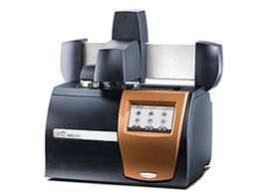
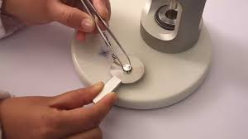
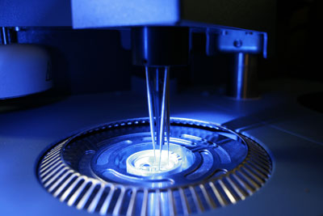
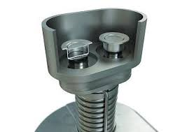
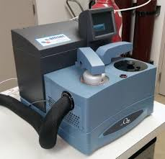

Slide 17
Thermogravimetric analysis (TGA) measures changes in sample weight as a function of time (isothermal) or temperature. Desolvation and decomposition processes are frequently monitored by TGA. Comparing TGA and DSC data recorded under identical conditions can greatly aid in the interpretation of thermal processes.
In Figure 8-11, the dihydrate form of an acetate salt loses two moles of water via an endothermic transition between 70° and 90°C. The second endotherm at 155°C corresponds to the melting process, with the accompanying weight loss due to vaporization of acetic acid as well as to decomposition.
TGA and DSC analysis can also be used to quantitate the presence of a solvated species
within a bulk drug sample. For the above example, 10% of the dihydrate form was easily detected by both methods.
Degradation during thermal analysis may provide misleading results, but may be detected by high-performance liquid chromatography (HPLC) analysis of samples heated under representative conditions for retention of drug or appearance of decay products

Slide 18
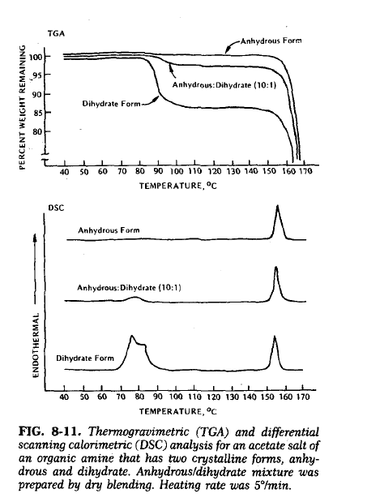

Slide 19
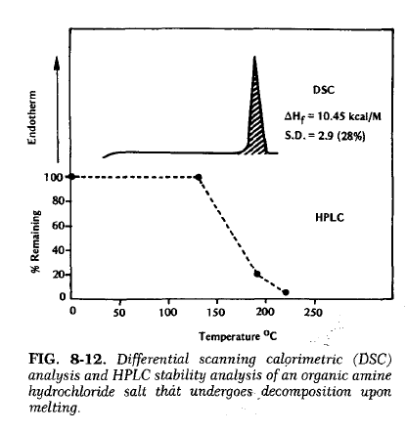

Slide 20
X-Ray
An important technique for establishing the batch-to-batch reproducibility of a crystalline form is x-ray powder diffraction. Random orientation of a crystal lattice in a powder sample causes the x-rays to scatter in a reproducible pattern of peak intensities at distinct angles (Ɵ) relative to the incident beam

Slide 21
Polymorphism
Polymorphs can be classified as one of two types: enatiotropic (one polymorph can be reversibly changed into another by varying temperature or pressure, e.g., sulfur or monotropic (one polymorphic form is unstable at all temperatures and pressures, e.g., glyceryl stearates).
There is no general way of relating enatiotrophy and monotrophy to the properties of the polymorphs, except by locating the transition temperature or the lack of one. At a specified pressure, usually 1 atmosphere, the temperature at which two polymorphs have identical free energjes is the transition temperature, and at that temperature, both forms can coexist and have identical solubilities in any solvent as well as identical vapor pressures.
Below the solid melting temperatures, the polymorph with the lower free energy, corresponding to the lower solubility or vapor pressure, is the thermodynamically
stable form.
During prefomulation, it is important identify the polymomph that is stable at room temperature and to determine whether polymerphic transitions are possible within the temperature range used for stability studies and during processing (drying, milling, etc.).

Slide 22
A free energy-temperature curve at 1 atmosphere should be constructed since temperature is usually a more critical variable than pressure in pharmaceutics. As previously discussed, chloramphenicol palmitate has three known polymorphic forms, which are thermodynamically described by a van't Hoff plot of free energy (as determined from solubility measurements) versus temperature (Fig. 8-14). Transition temperatures are shown by intersection of the extrapolated lines; 50°C for forms A and C, and 88°C for forms A and B. Form A is the stable form at termperatures less than 50°C. Transition temperatures obtained by extrapolation of van't Hoff plots are susceptible to large errors.
Direct measurements of transitions are preferred to support the extrapolated intersection points in the solubility-temperature diagrams. The most direct means for determining transition temperatures is microscopic observation of samples held at constant temperatures. Unfortunately, these solid-solid or solid-vapor solid transitions usually occur slowly, owing to large activation energies and slow nucleation. To facilitate the conversion rate, a single polymorph or a mixture of forms can be granulated in a "bridging" solvent at various temperatures. The drug should be only sparingly soluble in the bridging solvent, and solvate formation should not occur. These experiments can be conducted quickly with a polarizing microscope, or samples can be stored in sealed containers at controlled temperatures and periodically examined by other suitable analytic methods.

Slide 23
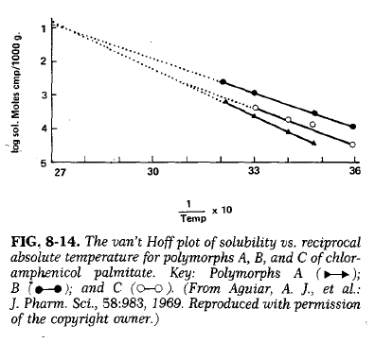

Slide 24
Hygroscopicity
Many drug substances, particularly water-soluble salt forms, have a tendency to adsorb atmospheric moisture. Adsorption and equilibrium moisture content can depend upon the
Atmospheric humidity, temperature surface area, exposure, and the mechanism for moisture uptake, as described by Van Campen and coworkers. Deliquescent materials adsorb sufficient water to dissolve completely, as is observed with sodium chloride on a humid day. Other hygroscopic substances adsorb water because of hydrate formation or specific site adsorption. With most hygroscopic materials, changes in moisture level can greatly influence many important parameters, such as chemical stability, flowability, and compactibility.
To test for hygroscopicity, samples of bulk drug are placed in open containers with a thin
powder bed to assure maximum atmosphoric exposure. These samples are then exposed to a range of controlled relative humidity environments prepared with saturated aqueous salt soluitions.
Moisture uptake should be monitored at time points representative of handling (0 to 24
hours) and storage (0 to 12 weeks). Analytic methods for monitoring the moisture level (i.e.,
gravimetry, TGA, or gas chromatography) depend upon the desired precision and the amount of moisture adsorbed onto the drug sample.
Normalized (mg H20/g sample) or percentage- of-weight-gain data from these hygroscopic
studies are plotted against time to justify special handling procedures kinetically. A plot of normalized equilibrium versus relative humidity data may support the need for storage in a low humidity environment or for special packaging with a desiccant. As these studies proceed, additional testing of powder flow, dissolution, or stability of "wet" bulk may be warranted to lend further support to the need for humidity controls.

Slide 25
Fine Particle Characterization
Bulk flow, formulation homogeneity, and surface area controlled processes such as dissolution
Chemical reactivity are directly affected by size, shape, and surface morphology of the
drug particles. In general, each new drug candidate should be tested during preformulation
with the smallest particle size as is practical to facilitate preparation of homogeneous samples
and maximize the drug's surface area for interactions.
In conjunction with light microscopy, stream counting devices, such as the Coulter counter
& and HIAC counter often provide a convenient method for characterizing the size distribution
of a compound. Samples are prepared for analysis by the Coulter counter by dispersing the material in a conducting medium such as isotonic saline with the aid of ultrasound and a few drops of surfactant. A known volume (0.5 to 2 ml) of this suspension is then drawn into a tube
through a small aperture (0.4 to 800 microns in diameter), across which a voltage is applied. As each particle passes through the hole, it ·is counted and sized according to the resistance
generated by displacing that particle's volume of conducting medium. Given that the instrument has been calibrated with standard spheres, the counter provides a histogram output (frequency versus size) within the limits of that particular aperture tube. Several different sizes of aperture tubes should be used to assure accurate counting of single particles. Other stream counters are based on the principles of light blockage or laser light scattering for sizing each particle.

