Slide 1
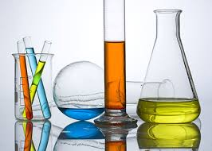
Physical pharmacy
Experiment NO. 3
Surface Active Agents
Done by :
Assistant lecturer
Hiba Sabah Sura Alkazzaz Zeina Dawood

Slide 2
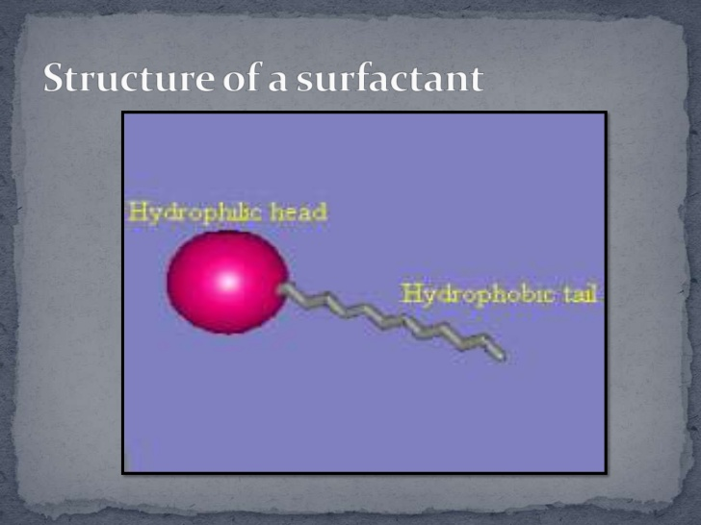
introduction
Surface-active agent or surfactant are molecules and ions that are adsorbed at interfaces. Surfactants are materials that lower the surface tension (or interfacial tension) between two liquids or between a liquid and a solid. An alternative term is amphiphile, which suggests that the molecule or ion has a certain affinity for both polar and non-polar solvents. They are used in many pharmaceutical preparations as wetting agents, emulsifiers, solubilizing and antifoaming agents.

Slide 3
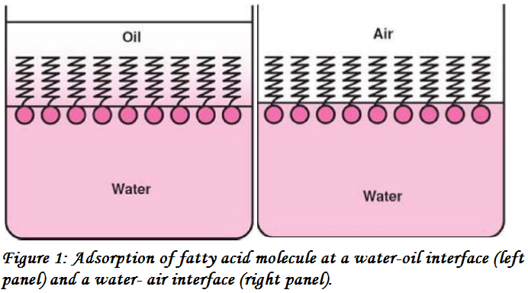
When such molecule is placed in an air-water or oil-water system, the polar groups are attached or oriented toward the water, and the non-polar groups are oriented toward the air At the air-water interface, or oriented toward the oil at the oil-water interface (Figure 1).

Slide 4
Surfactants are classified
According to their chemical structure and, more specifically, their polar group:
Anionic surfactant such as sodium dodecyl sulfate (SDS^{®)}
Cationic surfactant such as cetyl trimethyl ammonium bromide (CTAB®)
Non-ionic surfactant such as poly oxy ethylene (Tween^{®)}
Ampholytic (Zwitterionic®) surfactant such as phospholipids

Slide 5
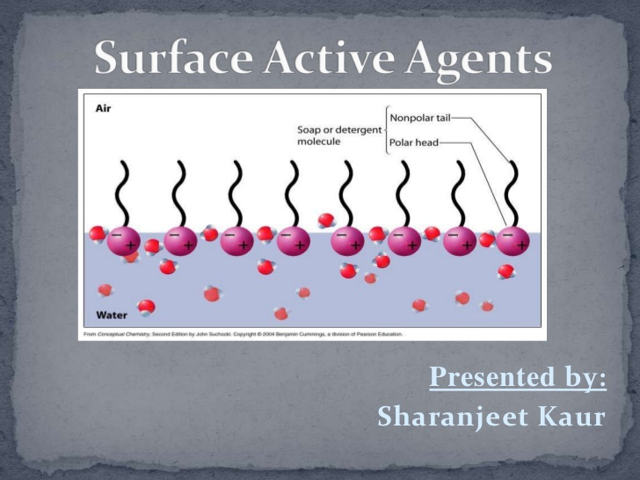

Slide 6
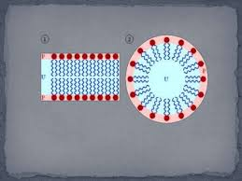
Micelles and the critical micelle concentration
Amphiphiles are characterised by having two regions of opposing solution affinities within the same molecule or ion. When Surface active agents present in a liquid medium at low concentration, the amphiphiles exist separately (a size as a sub-colloidal).
As the concentration is increased, aggregation occurs over a narrow range of concentration .These aggregates which may contain 50 or more monomers, are called micelles. Because the diameter of each micelle is of the order of 50 Å micelle lies within the size range designed as colloidal.

Slide 7
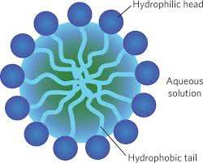
In general, Micelles are lipid molecules that arrange themselves in a spherical form in aqueous solutions. The formation of a micelle is a response to the amphipathic nature of fatty acids, meaning that they contain both hydrophilic regions (polar head groups) as well as hydrophobic regions (the long hydrophobic chain). The location of the molecule undergoing solubilisation in a micelle is related to the balance between the polar and non-polar properties of the molecule. The increase in solubility is due to adsorption or incorporation of the solute molecules into or in the colloidal particle (micelle).

Slide 8

Spherical micelle.
Cylindrical micelle.
Bilayer
micelle.
Shapes of micelles:

Slide 9
Critical Micelle Concentration (C.M.C): The concentration of monomers at which micelles form. An important property of amphiphilic colloid in solution is the ability of the micelle to increase the solubility of materials that are normally insoluble or only slightly soluble in the dispersion medium used this phenomenon is known as solubilisation.
Experimental work
Part l: bring Salicylic acid powder, Tween60, distilled water, phenol red indicator, volumetric flask (50ml), conical flask (50ml), graduated pipettes, burette, filter paper, funnel, and a balance. Prepare NaOH Solution (0.05N).
Part ll: The aim of the experiment is to show the effect of increasing the concentration of Tween on the solubility of salicylic acid.

Slide 10
Procedure:
Prepare different concentration of tween60 (0%, 0.05%, 0.5%, 1%, 2%, 3%), prepare 50 mL of each solution (use volumetric flask and pipette) from stock solution 5% (C1V1=C2V2).
Place 25ml of each concentration in a conical flask of (50mL) then add 0.25g salicylic acid to each flask.
Shake the flasks for 10 minutes.
Set to settle for another 10 minutes to permit the undissolved salicylic acid to settle down (filter if necessary).
Withdraw 10mL of filtrate solution and titrate with standardized NaOH solution (0.05N) using phenol red as indicator. The end point is a point when the colour changes from yellow to pink. Measure the end points.
Plot the total solubility (mg/mL) or (g/100ml) of salicylic acid against a concentration of tween 60.

Slide 11
Step no(1) of procedure
To prepare 50 ml of 0% tween60 that mean we will not use tween 60 ,just add 50 ml D.W in the volumetric flask
To prepare 50 ml of 0.05% tween60 from 5%stock solution by using dilution
C1V1 = C2 V2
5 %*V1 =0.05%* 50
V1= 0.5ml take from stock solution 5%tween 60 (using pipette ) put it in the volumetric flask then complete the volume to 50 ml by adding D.W
*The same procedure and calculation for preparation of the other concentration

Slide 12
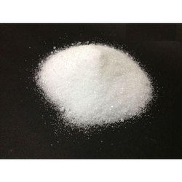
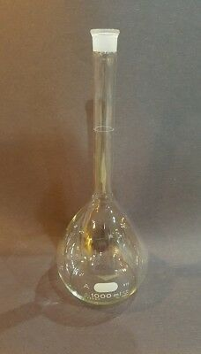
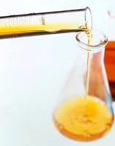
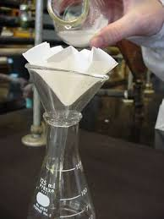
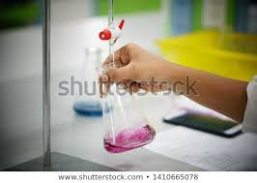
Steps of experiment
prepare 50 mL of different concentration of tween 60 from stock solution 5%tween 60
(C1V1=C2V2).
add 0.25g salicylic acid to each flask.
Place 25ml of each concentration in a conical flask
Withdraw 10mL of filtrate solution and titrate with standardized (0.05N) NaOH solution using phenol red as indicator. Measure the end points.
Shake the flasks for 10 minutesSet to settle for another 10 minutes (filter if necessary).

Slide 13
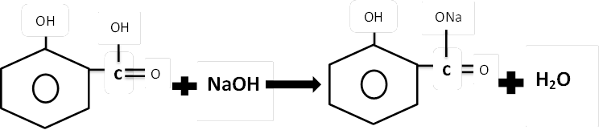
Calculation
1M.wt of salicylic acid= 1M.wt NaOH
1eq.wt of salicylic acid= 1eq.wt NaOH
138.1g = 1L of 1N NaOH
138.1g =1000ml of 1N NaOH
(138.1/1000) g =1ml of 1N NaOH
138.1/1000*0.05 =1ml of 0.05N NaOH
Therefore, 0.0069g of salicylic acid is the chemical factor.
Chemical factor* end point= g salicylic acid/10 ml.

Slide 14
If the end point for 0%tween 60 was 2.6ml
The calculation will be
End point *chemical factor = g of salicylic acid in 10ml (filtrate)
2.6 ml * 0.0069 =0.0179 g of salicylic acid in10 ml
The solubility of salicylic acid in (g\100ml)
0.0179g 10ml
X 100ml
X= 0.179 g\100ml of salicylic acid
*The same calculation for other end points

Slide 15
Conc. of tween60 | E.P (mls of NaOH) | Grams of S.A in 10 ml | Grams of S.A in 100 ml
0%
0.05%
0.5%
1%
2%
3%

Slide 16


