Slide 1
Cost Analysis
Dr. Haider Raheem Mohammad

Slide 2
Introduction
Costs are broadly defined as “the value of resources used to produce a good or service”. In the context of a health program, resources include people, facilities, equipment, and supplies. The costs associated with these resources are the focus of the programmatic cost analysis.

Slide 3
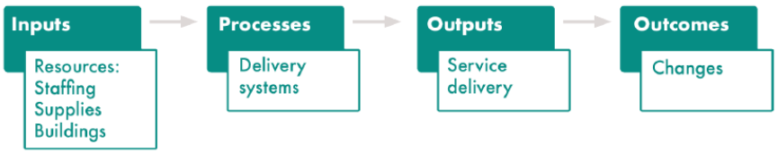
What is cost analysis?
Cost analysis is the first half of a full economic evaluation, in which the analyst estimates and categorizes the cost of a health intervention or service. A “systems framework,” such as in Figure 3.1, illustrates the process by which the program inputs/costs are linked to intermediary processes or actions that ultimately result in outputs and, eventually, long-term changes in health outcomes.
Figure 3.1 Systems approach to understanding cost analysis.

Slide 4
What is cost analysis?
“Costing” is a common shorthand for referring to the process of cost estimation that takes place in an economic evaluation. The terms “costing” and “cost analysis” are used interchangeably in this lecture.
Cost analysis is feasible in low- and middle-income country (LMIC) settings. It can be quick, simple, and affordable when compared with other forms of economic evaluation. It is also feasible to perform cost analysis retrospectively in a LMIC setting, depending on the data systems in place.

Slide 5
Study Design and Scope
The first component of any research study is the establishment of the scope and methods. A cost analysis is no different. Several decisions need to be made when determining how to approach data collection for a costing activity. Many of these decisions are driven by the research question to be answered.
• First, determine the perspective.
• Second, establish the primary purpose, population, and focus of the cost estimation activity.
• Third, decide whether the analysis will be limited to financial costs or will include economic costs. Will the study address all costs of a program or only additive (incremental) costs? What costs will be included and excluded?
• Fourth, define the unit of measurement.
• Fifth, set the period for when data are collected.

Slide 6
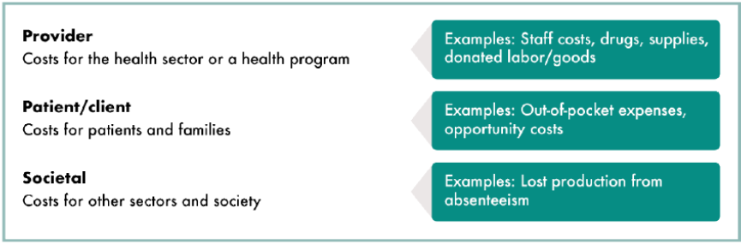
Cost perspective
Define the perspective of the study or “the viewpoint from which it is conducted”. A study’s perspective is determined at the outset because it affects the research question being addressed, method, cost elements, and statistical analysis. The potential perspectives are the patient, provider, purchaser (payer), sponsor (e.g., employer), government, and societal. The most commonly discussed are provider, patient, and society. Figure 3.2 presents the costs that may be associated with these three major perspectives.
Figure 3.2 Cost elements to consider for different study perspectives.

Slide 7
Decision problems
Next, the researcher defines the decision problem or economic question to be answered when conducting the cost estimation. Like traditional evaluation research questions, there are basic contextual factors that should be outlined. The factors include “what,” “who,” “how,” and “why” the study is being conducted.
• What is it that the cost study is designed to consider? Define the activity, service, intervention, or output being studied.
• Who is the target population?
• How is the program implemented? Define the delivery mechanism, such as a health system, specific type of facility, or community. Researchers may also want to define the phase of the program, such as a pilot program or scale-up.
• Why is the program important? Identify the epidemiological indicators, such as incidence or prevalence of the illness being addressed and that the program seeks to influence.

Slide 8
Costing frameworks
Once the costing study has been defined by addressing the decision problems, researchers decide what broad categories of costs to include in the analysis.
Financial and economic costs
The difference between economic and financial costs is a foundational component of the cost analysis method. A study will collect and present either the financial or economic costs, and the approach used should be clearly stated.
Financial costs are direct expenditures on resources. When a payment is made for a good, service, or labor, it is considered a financial cost. The estimation of financial costs relies on knowing the price of that resource and the quantity—information most likely obtained from program financial records (electronic and paper). It also requires an understanding of who paid for the resource.

Slide 9
Financial and economic costs
Economic costs represent the costs “in terms of the alternative uses that have been foregone by using a resource in a particular way”. Economic costs are a broader category of costs and include financial costs and opportunity costs. Opportunity costs include the value of donated supplies, labor, or space. Sometimes called implicit costs, these costs are often more difficult to measure. Example is free HIV test kits used at a clinic.
Economic costing also includes productivity costs (sometimes called indirect costs), which are the costs of lost productivity time due to death or disability. Out-of-pocket expenses incurred by patients for transportation or child care when seeking a service or program are likewise considered and included in an economic cost analysis.

Slide 10
Full and incremental costs
A full cost analysis is when researchers estimate the cost of all inputs to a program or service. An incremental cost analysis considers the cost of adding or expanding to an existing program or services, not considering the cost of existing programming.
Incremental cost analysis is useful when there is a major new input or program component being added to an existing program. It is less time and resource intensive than a full cost analysis.

Slide 11
Other costs to consider
There are several major categories of cost inputs that should be reviewed for applicability in cost analysis:
Above-site costs, also called upstream costs, “include various support services or activities provided by central administration” and may include office and administrative costs of head offices, training or outreach, demand generation, or centralized laboratory services. These costs are commonly excluded even though they constitute a large proportion of intervention costs.
Research expenses and “costs of supporting change” (costs of changes due to updated guidance, reorganization of services, etc.) are two additional inputs that are often overlooked or excluded but whose contributions and costs should be closely assessed for inclusion.
Societal costs are linked to costing that takes a societal perspective. They involve a wider range of possible costs, such as loss of production from work absenteeism.

Slide 12
Determining the unit of analysis
The unit of analysis generally refers to the unit cost that the study is designed to estimate. The following cost definitions should be considered as units of analysis on their own and are also helpful for defining the unit cost.
The total cost is the entire cost of producing a quantity of services or an output for a particular project or program. Total costs are the result of either a full or incremental cost analysis. An example of total cost is the entire cost of delivering HIV testing services at a public health center (PHC) in Nigeria.

Slide 13
Determining the unit of analysis
Average cost is the total cost of producing a quantity of services or an output, divided by the total units of the output produced. An example is taking the total cost of delivering HIV testing services at the selected PHC in Kano, Nigeria and dividing it by the total number of HIV tests delivered during the same period.
Marginal cost is the cost of producing one additional unit of an output. An example is the cost of delivering one additional HIV test at a specific testing site. As a program expands, the marginal cost may increase, for example, if the program expands to target populations that are more difficult (expensive) to reach. When marginal costs increase, average costs also increase.

Slide 14
Time horizon
The last step in designing a costing study is to determine the “when” or the period that the study covers. The time horizon is the period during which costs are measured. Researchers should present a clear description of the period(s) chosen and why.
A typical cost analysis may look at a one-year or six-month period of an ongoing program. Other interventions may have a duration of a few months to several years, allowing the researcher to collect costs for the entire duration of the intervention or planning cycle.
It may make sense to disaggregate costs into different periods to reflect the phases of an intervention and related variations in average cost. An example is to distinguish start-up costs (defined as all costs incurred before the start of service delivery) from implementation costs.

Slide 15
Data Collection Method
After establishing the major components of the study, the next decisions concern methods for the collection of the cost data.
• First, decide on the timing for data collection as it aligns to program implementation.
• Second, identify the types of costs that will be collected.
• Third, decide from what levels the costs will be collected.
• Fourth, choose the valuation method and analytical approach that will be used to measure the costs.
• Fifth, outline the sources and data collection tools that will be used.
• Sixth, consider sampling and data quality.

Slide 16
Data collection timing
The method for collecting cost data over time is determined by whether the cost study is prospective or retrospective. Prospective data collection is used when it is possible to collect data during the implementation of the health service activity.
Retrospective data collection approaches use existing data and information on the resources consumed during the development and implementation of the health service activity. Although retrospective cost estimation methods are often the least costly approach, they rely on the availability and accuracy of the original database and cost recording systems, meaning that accuracy and reliability can vary widely.

Slide 17
Types of costs
There are many ways to define the costs that are commonly used as part of costing studies. These definitions and categories are not mutually exclusive. The researcher should decide how to categorize and group costs, what terms are preferred, and which terms are most appropriate given the context of the research study.

Slide 18
Direct and indirect costs
Direct costs refer to those resources that can be clearly linked to an output. For example, in the delivery of health services, the value of HIV test kits can be clearly linked to the provision of HTC services.
Indirect costs are those costs that cannot be directly identified with a service or product but are included in the costs of supporting the activities; for example, costs associated with collecting statistics, clinic administration, and office spaces or supplies.

Slide 19
Joint costs and non-joint costs
Joint costs are the costs of resources that are shared by more than one client, participant, or service. Non-joint costs are costs that can be completely allocated to the service or activity for which they are incurred. In this context, non-joint costs are the value of an HIV test kit and other disposable medical supplies used during a single patient visit for HTC. The joint costs are the value of staff time spent on the visit, equipment, and other administrative costs, such as clinic space.

Slide 20
Capital and recurrent costs
Recurrent costs are expenses incurred in the day-to-day provision of services, apart from personnel and commodity and pharmaceutical costs. These may include (for example) building utilities and rent, and transportation and fuel costs.
Capital costs are considered investment expenses and are treated differently than operating costs. They include expenditures on durable goods or equipment. Capital costs generally have benefits longer than one year.

Slide 21
Fixed and variable costs
Fixed costs are costs that remain the same regardless of the quantity of goods or services produced. This includes both recurrent and capital costs, if the value of the resources remains constant over the duration of the period being considered.
Variable costs are the counterpart of fixed costs, constituting all costs that can change depending on the quantity of the inputs.

Slide 22
Costs at different levels of service
Depending on the decision problem and purpose of the cost analysis, costs can be incurred at multiple levels of service delivery or programming. For example, a large-scale primary care association in Ghana delivers services at more than 50 service delivery points. There are regional offices, a central office, and related overhead costs incurred at the donor level, which in this case would be the central government ministry that supports this organization.

Slide 23
Cost estimation approaches
Just as costs can be broken down into several categories, there are several approaches available to estimate costs. They include cost accounting methods, such as step-down cost accounting (SDCA) and activity-based costing (ABC). Researchers should decide whether to collect costs by aggregating individual cost elements (bottom-up approaches) or by disaggregating high-level expenditures into cost categories or facilities (top-down approaches). Mixed methods costing allows these accounting methods to be combined to suit the needs of the costing study.

Slide 24
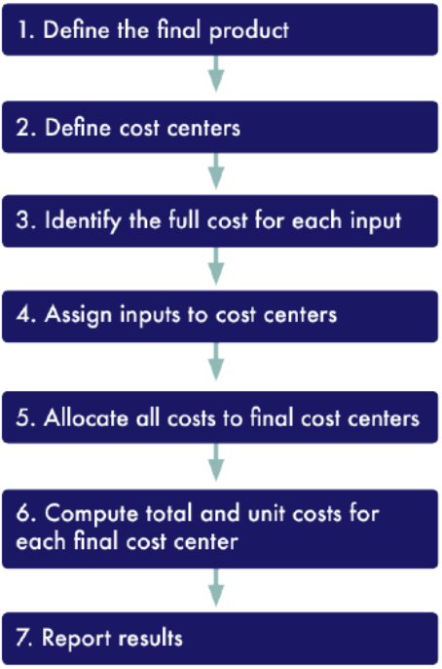
Cost estimation approaches
Step-down cost accounting is an analytical approach to calculating unit costs that relies on a step-by-step approach. SDCA is typically broken into six or seven steps (Figure 3.3).
Figure 3.3 Step-down cost accounting steps.

Slide 25
Cost estimation approaches
Activity-based costing assigns resource costs to cost objects, such as products, services, or customers, based on the activities performed. ABC is considered a better way of costing clinically-provided services compared with traditional costing approaches that measure costs at the departmental level using top-down allocation procedures.
In a study of a hospital in Iran, researchers used ABC to calculate the costs of medical services using ABC and a more traditional approach. The study revealed significant differences in the cost estimates using the two approaches. For example, emergency visit costs per patient were estimated as $29.21 using ABC compared with $19.20 using a more traditional approach. Similarly, radiology costs per patient were estimated at $4.01 versus $1.79 for ABC and a traditional approach, respectively.

Slide 26
Bottom-up versus top-down approaches
Bottom-up approaches may be either retrospective or prospective, and often lead to more detailed, accurate, and reliable cost estimates. Possible data sources for bottom-up approaches are inventories, supply lists, or use of direct observation and patient flow analyses. Bottom-up approaches to data collection and analysis are time consuming.
Because top-down approaches frequently rely on financial and accounting records and other databases, they are retrospective. Top-down approaches rely on comprehensive data sources and aggregated cost data. Top-down approaches tend to be more efficient and less time-consuming but risk some loss of accuracy in the estimations they provide.

Slide 27
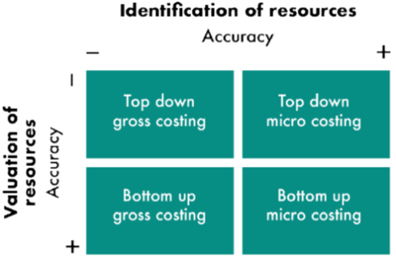
Bottom-up versus top-down approaches
Sometimes used interchangeably with bottom-up and top-down costing, micro costing and gross costing methods are additional methodological approaches that can be layered on top of a top-down or bottom-up approach. Micro costing focuses on highly detailed cost inputs. When done using a bottom-up approach, micro costing is most likely to provide an accurate identification and valuation of resources (Figure 3.4).
Gross costing approaches use aggregate information on resource use, commonly estimating total costs and dividing by the relevant unit of interest.
Figure 3.4 Cost estimation method matrix.

Slide 28
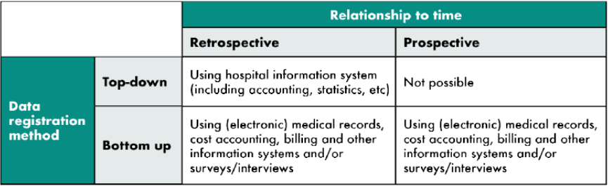
Data sources and measurement
Sources of cost data are extensive. In some cases, data will be collected from existing sources, such as financial reporting or payroll systems; records for such expenditures as utilities; reimbursements and subgrant payments; pay slips; procurement records, etc. Depending on the research question of interest and the availability (or lack thereof) of records, the researcher can collect specific cost-related data through more direct methods or tools, such as interviewing, observation, or surveys. Figure 3.5 presents a basic overview of the relationships among measurement methods, the data collection time, and sources of cost data.
Figure 3.5 Relationships among measurement methods, data collection time, and data sources.

Slide 29
Sampling
Depending on the nature of the costing activity taking place, there may be a need for sampling sites or clinics. First, whether sampling is needed should be decided based on the number of sites, organizations, or entities from which data need to be collected. If the number is small, it may be feasible to collect information from every facility or location. If the number of sites is too large, then sampling is needed.

Slide 30
Analyzing and Presenting Cost Data
After the cost data have been collected from a variety of sources, they should be organized and analyzed to be of use to decision makers.
Cost studies and cost systems
Cost studies are often one-off studies that differ in approach and structure based on the existing records that are in place at an organization. There is usually great variation in the cost elements included, the methods used to gather costs, and geographic coverage, making comparisons and use of the data in other settings difficult.
A cost system is a tool that makes use of the widespread availability of routine data at health service delivery organizations to collect cost data routinely using existing records. It treats cost data as M&E data, enabling organizations to use cost data to inform program management and decision making.

Slide 31
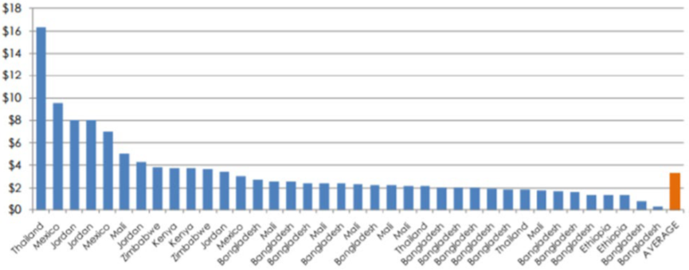
Cost studies and cost systems
Figure 3.6 is an example of a comparison of family planning cost studies. The example looks at the cost per visit for injectables, a type of long-lasting reversible contraceptive. In this situation, there is an interest in understanding how the variation can be due to differences in the service delivery approach (was service delivery at a clinic or in the community?), differences in salaries for personnel, or other programmatic features. Unfortunately, conclusions about the impact of a program feature cannot be drawn, because of the wide variation in methods used for these studies.
Figure 3.6 Injectable cost per visit (2010).

Slide 32
Case Study: The Costs of HIV Treatment, Care, and Support Services in Uganda
Background
This study assessed the cost of HIV care services in public and non-public facilities that provide HIV care and support services in Uganda. The research gathered data from 12 sites and included adult and pediatric patients. The objectives were:
• To determine the average annual unit cost per patient (adult and child) for specific HIV treatment, care, and support services.
• To establish the key cost components or “drivers” of the HIV treatment, care, and support services.
• To determine the costs borne by patients (“out-of-pocket costs”) that are not incurred in a clinical facility.
• To compare cost variations by level of service delivery.

Slide 33
Case Study: The Costs of HIV Treatment, Care, and Support Services in Uganda
Methods
The data collected were used to estimate the per-patient costs for both ART and non-ART patients. Patient-level information was gathered on services received, physical functionality, socioeconomic background characteristics, and costs incurred by patients when receiving care.
A purposive sample of 12 of Uganda’s accredited ART centers was chosen to reflect key characteristics thought to influence unit cost, including: level of service delivery; major implementing partner; type of ownership; and geographic location. The main sampling criterion was level of service delivery, with the final sample proportionally selected to represent the five service delivery levels in the country.

Slide 34
Case Study: The Costs of HIV Treatment, Care, and Support Services in Uganda
Methods
The study aimed to conduct 600 patient interviews (an average of 50 per site) with adults, and 200 (an average of approximately 16 per site) with children (or their caregivers.) The numbers constituting each sample were determined to ensure a reasonable representation of the site populations and to facilitate any required subgroup analysis.
Data were collected at the facility level on major cost elements, such as staffing, patient load, and services provided. The study captured both financial and economic costs.

Slide 35
Case Study: The Costs of HIV Treatment, Care, and Support Services in Uganda
Methods
Direct costs collected were:
• Staff time in caring for clients
• Commodities, including drugs to prevent and treat opportunistic infections; antiretrovirals (ARVs); and medical consumables and supplies used for clinic visits and for laboratory testing
• Capital expenditures for medical equipment; vehicles used directly for client care; and physical infrastructure used for client care
Indirect cost data collected at the facility were:
• Labor cost of administrative staff
• Overhead expenses (e.g., office supplies, travel expenses, communication), and equipment and building use generically at a facility
• Depreciation of equipment and assets (e.g., equipment and furniture in the clinical and diagnostic units)
• Costs to program clients (e.g., client time, transport, meals, out-of-pocket payments, user fees for services or drugs) and waiting time at the facility (to assess lost work time)

Slide 36
Case Study: The Costs of HIV Treatment, Care, and Support Services in Uganda
Findings
Results showed that the annual facility-level cost of providing HIV treatment, care, and support to adult HIV patients ranged from Ugandan shillings (UGX) 254,000 to UGX 824,000 ($116.28 to $376.20) across the 12 sites, with a median cost of UGX 567,000 ($258.78). When restricted to adults on ART, annualized costs ranged from UGX 403,000 to UGX 1,330,000 ($183.54 to $606.48), with a median of UGX 734,000 ($335.16). For child HIV patients, the study found that costs ranged from UGX 190,000 to UGX 1,869,000 ($86.64 to $852.72), with a median cost of UGX 630,000 ($287.28).

Slide 37
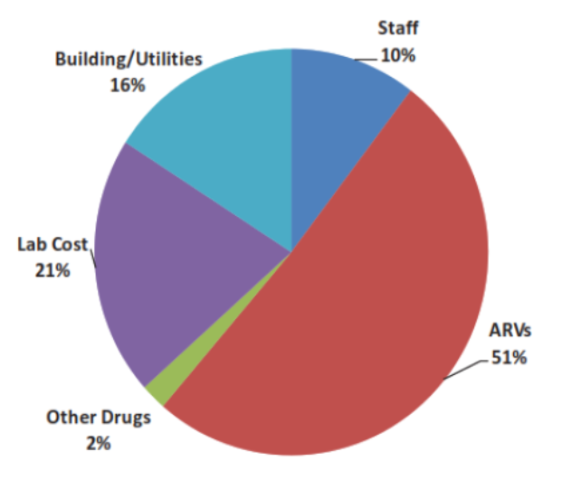
Figure 3.7 Distribution of cost elements, adults, 12 sites.

Slide 38
Case Study: The Costs of HIV Treatment, Care, and Support Services in Uganda
Findings
The main cost drivers for both adults and children were ARVs and laboratory tests (Figure 3.7). Among all adults, ARVs accounted for 51 percent of costs, and for children, ARVs accounted for 69 percent. For laboratory services, the percentages were 21 percent and 16 percent, respectively. First-line drugs accounted for the largest share of ARVs. The study also found that among the facilities contacted, public hospitals had a higher cost per adult patient than did non-public, not-for-profit hospitals, but only by approximately 12 percent (UGX 655,018 versus UGX 582,894.) Public hospitals had lower staff costs per patient whereas laboratory costs were higher. By contrast, PHCs had much lower per-patient costs than non-PHCs for adults (UGX 335,625 versus UGX 512,073.) The major factor here was much cheaper staff costs in PHCs (UGX 28,850 versus UGX 168,845.) Similar patterns were found for children.

Slide 39

Thank You

