Slide 1
Hypertension
Lec. Dr. Abeer A. Rashid

Slide 2
Definition
It can be defined as a condition where blood pressure is elevated to an extent that clinical benefit is obtained from blood pressure lowering.
Blood pressure measurement includes systolic and diastolic components
It is an important risk factor for the future development of cardiovascular disease

Slide 3
There is no clear cut-off point between hypertensive and normotensive subjects
Blood pressure of 140/90 mmHg is considered the upper limit of ‘normal’.
While diastolic pressure peaks at age 50, systolic pressure continues to increase with advancing age, making isolated systolic hypertension a common feature of old age.

Slide 4
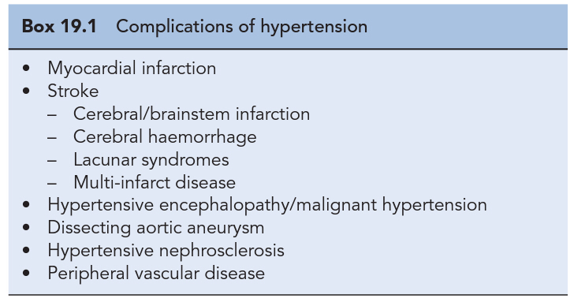

Slide 5
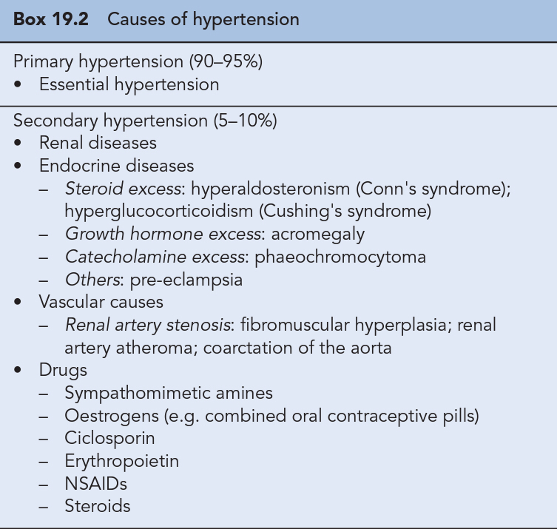

Slide 6
Regulation of blood pressure
The mean blood pressure is the product of cardiac output and total peripheral resistance.
In most hypertensive individuals, cardiac output is not increased and high blood pressure arises as a result of increased total peripheral resistance caused by constriction of small arterioles.

Slide 7
homeostatic reflexes have evolved to provide blood pressure homeostasis
Minute-to-minute changes in blood pressure are regulated by the baroreceptor reflex, while the renin–angiotensin–aldosterone system is important for longer term salt, water and blood pressure control.
Long-term increases in shear stress can cause vascular remodelling of the endothelium which lead to the formation of a procoagulant rather than anticoagulant surface.
At the same time, systems that lead to vascular relaxation, for example nitric oxide, are overcome by increased sensitivity to vasoconstricter substances such as endothelin which predispose to vascular disease and further increases in peripheral resistance which lead to a vicious cycle increasing blood pressure further due to the increase in vascular resistance.

Slide 8
Other substances with a role in controlling blood pressure include atrial natriuretic peptide, bradykinin and antidiuretic hormone.
Some new therapies seek to treat high blood pressure by modifying responses to these substances, for example, the endothelin antagonist darusentan.

Slide 9
Clinical presentation
Malignant hypertension
greatly elevated blood pressure (usually >220/120 mmHg) associated with evidence of ongoing small vessel damage. Fundoscopy may reveal papilloedema, haemorrhages and/or exudates, while renal damage can manifest as haematuria, proteinuria and impaired renal function.
Malignant hypertension is a medical emergency that requires hospital admission and rapid control of blood pressure over 12–24 h towards normal levels.

Slide 10
Diagnosis of hypertension
Blood pressure should be measured using a well-maintained sphygmomanometer of validated accuracy.
Blood pressure should initially be measured in both arms and the arm with the highest value used for subsequent readings.
The subject should be relaxed and, at least at the first presentation, blood pressure should be measured in both the sitting and the standing positions.
An appropriate sized cuff should be used since one that is too small will result in an overestimation of the patient's blood pressure. The arm should be supported level with the heart

Slide 11
white coat’ hypertension
Some people develop excessive and unrepresentative blood pressure rises when attending the doctor's surgery, so-called ‘white coat’ hypertension.
These patients can be diagnosed if they use a blood pressure machine themselves at home or by 24-h ambulatory blood pressure monitoring.

Slide 12
Treatment

Slide 13
Non-pharmacological approaches
Patients with mild hypertension in the range 140–159/90–100 mmHg can be assessed for levels of risk while offered lifestyle advice.
1. Weight reduction
2. Adopt DASH eating plan
3. Reduce Na intake
4. Physical activity
5. Moderation of alcohol consumption

Slide 14
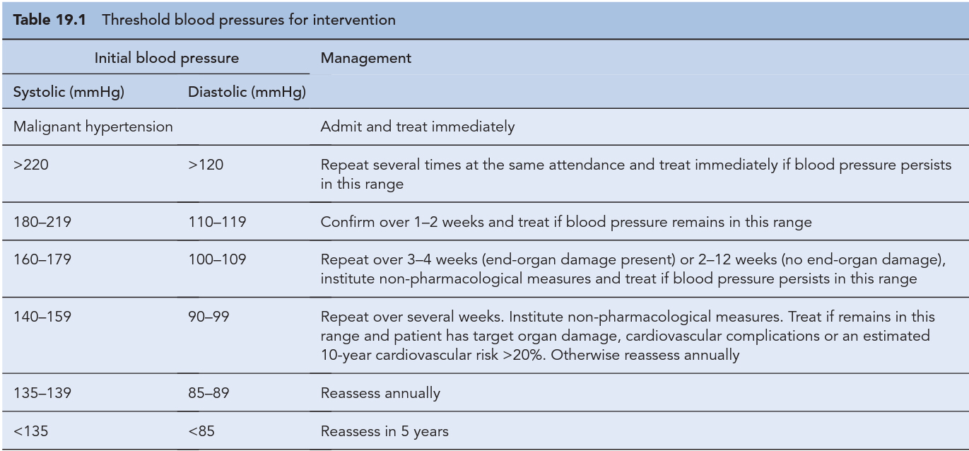

Slide 15
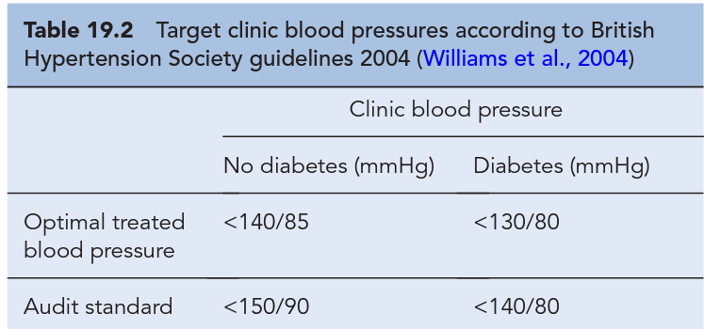
Blood pressure target

Slide 16
Antihypertensive drug classes
β-Adrenoreceptor antagonists
Diuretics
renin-angiotensin-aldosteroneantagonists
Calcium channel blockers
α-Adrenoreceptor blockers
Centrally acting agents
Other agents

Slide 17
β-Adrenoreceptor antagonists
β-Adrenoreceptor blockade reduces car-diac output in the short term and during exercise. They also reduce renin secretion by antagonising β-receptors in the juxta-glomerular apparatus.
Selective
Non selective
β-Blockers do remain most suitable for younger hypertensives who have another indication for β-blockade, such as coronary heart disease. b-Blockers are also effective in suppressing atrial fibrillation.

Slide 18
Diuretics
Thiazide diuretcs
Initially, they reduce blood pressure by reducing circulating blood volume but in the longer term they reduce total peripheral resistance, suggesting a direct vasodilatory action.
Initially, they reduce blood pressure by reducing circulating blood volume but in the longer term they reduce total peripheral resistance, suggesting a direct vasodilatory action.
No ceiling effect
Not effective if creatinin clearance is < 30 mg/dl

Slide 19
Loop diuretics
Loop diuretics are no more effective at lowering blood pressure than thiazides unless renal function is significantly impaired or the patient is receiving agents that inhibit the renin–angiotensin system. They are also a suitable choice if heart failure is present.
Have ceiling effects
Used when creatinin cl < 30 mg/dl

Slide 20
Spironolactone, an aldosterone antagonist, is not suitable for first-line therapy but is an increasingly important treatment option for patients with resistant hypertension.
Where hyperaldosteronism is suspected, spironolactone may prove to be effective.
Spironolactone is a potassium sparing diuretic and should be used with caution especially if used in combination with ACE inhibitors or angiotensin receptor blockers

Slide 21
renin-angiotensin-aldosteroneantagonists
ACE inhibitors block the conversion of angiotensin I to angiotensin II, while ARBs block the action of angiotensin II at the angiotensin II type 21 receptor. Since angiotensin II is a vasoconstrictor and stimulates the release of aldosterone, antagonism results in vasodilation and potassium retention as well as inhibition of salt and water retention.
ACE inhibitors also block kininase production and, thus, prevent the breakdown of bradykinin. This appears to be important in the aetiology of ACE inhibitor induced cough
Cause angioedema

Slide 22
Ca+ channel blocker
These agents block slow calcium channels in the peripheral blood vessels and/or the heart.
The dihydropyridine group work almost exclusively on l-type calcium channels in the peripheral arterioles and reduce blood pressure by reducing total peripheral resistance.
In contrast, the effect of verapamil and diltiazem are primarily on the heart, reducing heart rate and cardiac output.
Long-acting dihydropyridines are preferred because they are more convenient for patients and avoid the large fluctuations in plasma drug concentrations that may be associated with adverse effects.

Slide 23
α-Adrenoreceptor blockers
Drugs of this class antagonise α-adrenoceptors in the blood vessel wall and, thus, prevent noradrenaline (norepinephrine)induced vasoconstriction.
As a result, they reduce total peripheral resistance and blood pressure.
Prazosin was originally used but had the disadvantage of being short-acting and causing first-dose hypotension. Newer agents such as doxazosin and terazosin have a longer duration of action.
They can frequently cause postural hypotension but may alleviate symptoms in men with prostatic hyperterophy.

Slide 24
Centrally acting agents
Methyldopa and moxonidine inhibit sympathetic outflow from the brain, resulting in a reduction in total peripheral resistance.
Methyldopa is not widely used because it has pronounced central adverse effects, including tiredness and depression.
Methyldopa continues to be used in pregnancy, since it does not cause fetal abnormalities.

Slide 25
Other agents
Minoxidil is a powerful antihypertensive drug but its use is associated with severe peripheral oedema and reflex tachycardia. It causes pronounced hirsutism and is not a suitable treatment for women.
Hydralazine can be used as add-on therapy for patients with resistant hypertension but is not well tolerated as it is a profound vasodilator and may occasionally be associated with drug-induced systemic lupus erythematosus.
Sodium nitroprusside is a direct-acting arterial and venous dilator that is administered as an intravenous infusion for treating hypertensive emergencies and for the acute control of blood pressure during anaesthesia.

Slide 26
Special patients groups

Slide 27
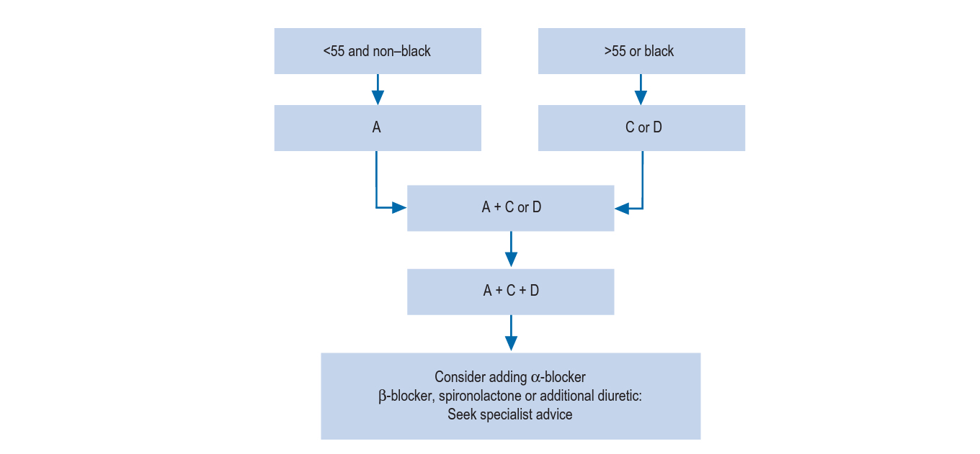

Slide 28
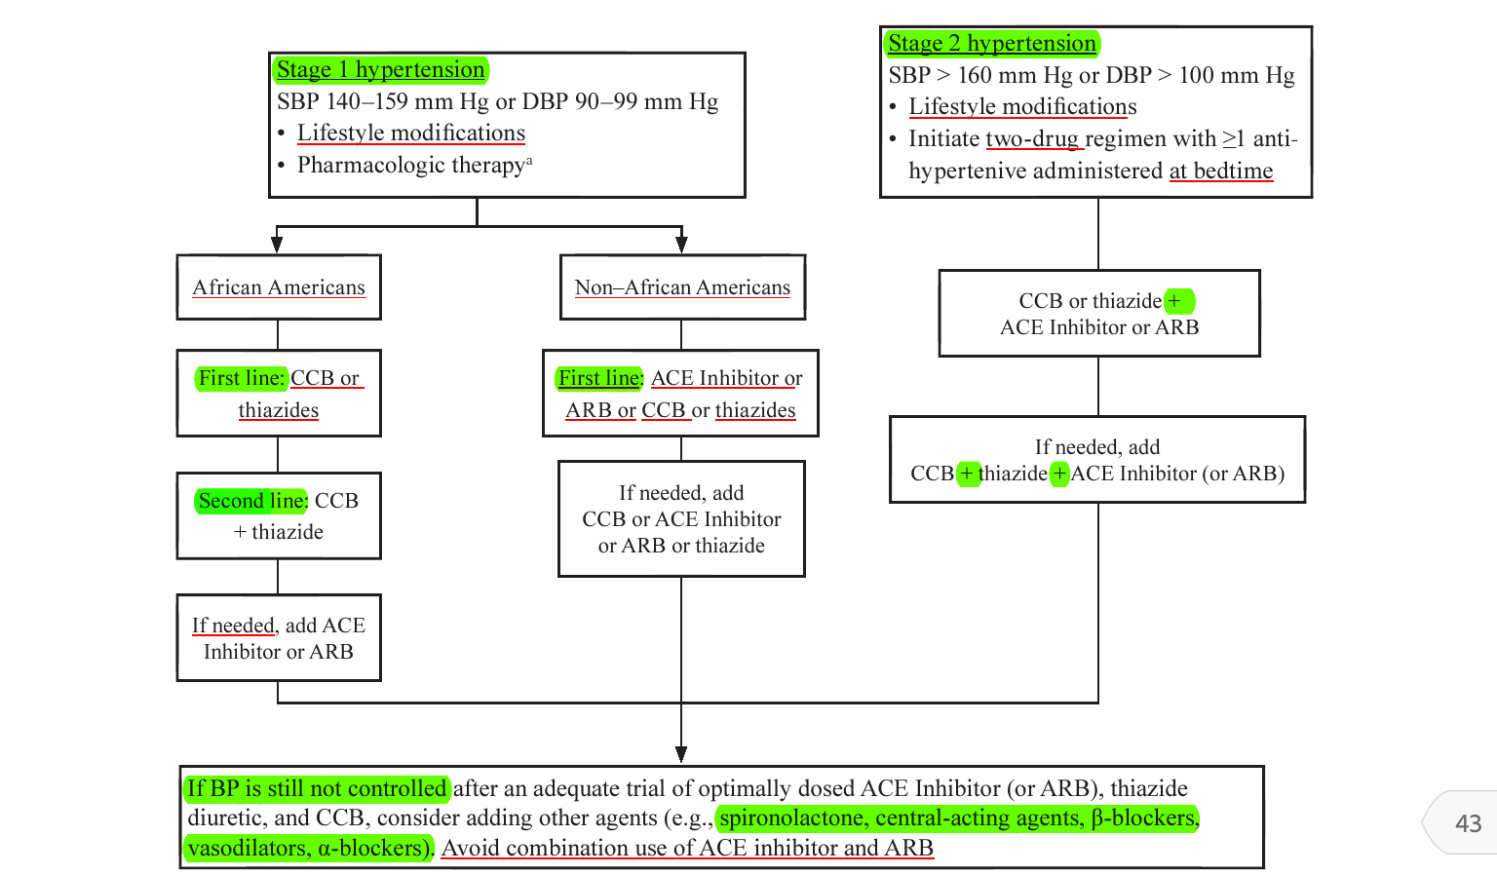

Slide 29
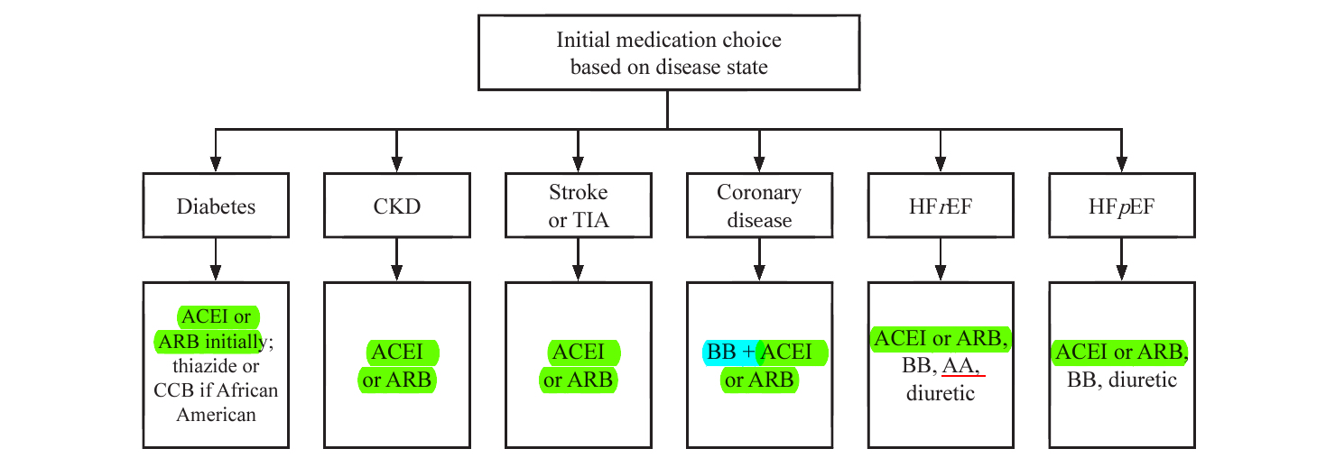

Slide 30
Patient case

Slide 31
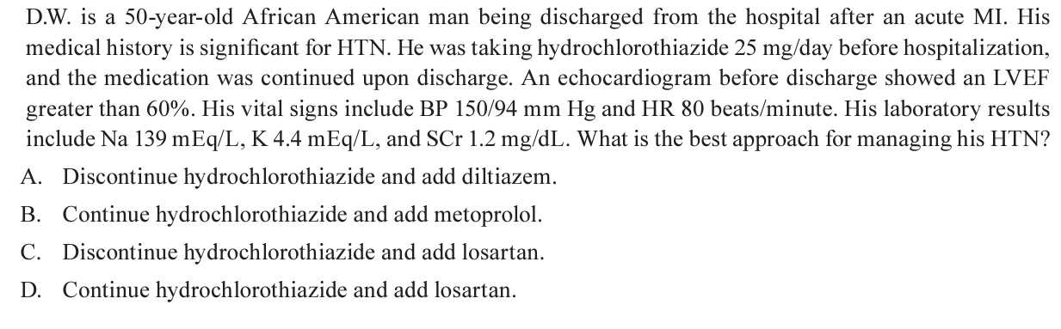

Slide 32
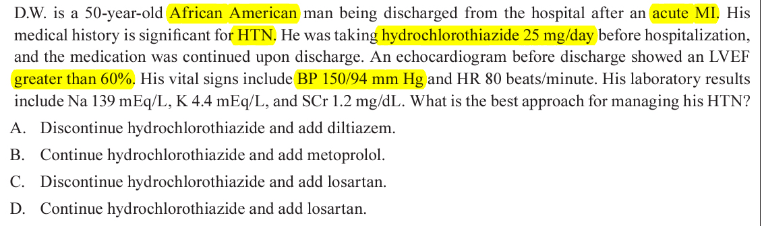

Slide 33


