Slide 1
Cardiovascular system part 2
Assist. Lec. Sura abbas
Assist. Lec. Lubab tareq

Slide 2


Slide 4
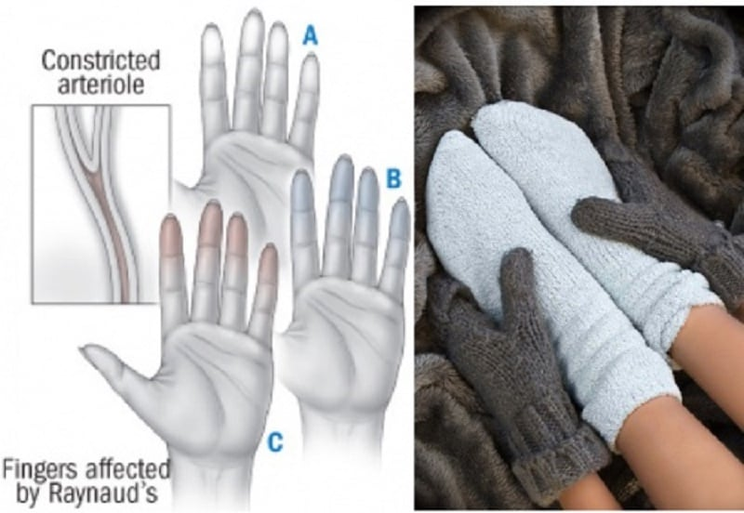

Adverse effects of BB
Beta blockers are generally well tolerated and most adverse effects are mild and transient.
Reactions may be more severe after intravenous than oral doses;
ocular use has also been associated with systemic adverse effects.
Among the most serious adverse effects are heart failure, hypotension, heart block, and bronchospasm.
fatigue and coldness of the extremities; when beta blockers are used for long-term treatment of asymptomatic diseases such as hypertension, such effects may be an important determinant of patient compliance

Slide 5
Adverse effects of BB
Cardiovascular effects include bradycardia and hypotension; heart failure or heart block may be precipitated or worsened in patients with underlying cardiac disorders. Abrupt withdrawal of beta blockers may exacerbate angina and may lead to sudden death.
Bronchospasm, shortness of breath, and dyspnoea may be precipitated, particularly in patients with a history of obstructive airways disease, due to blockade of beta2 receptors in bronchial smooth muscle. Drugs with selectivity for beta1 receptors or with intrinsic sympathomimetic activity at beta2 receptors may be less likely to induce bronchospasm
CNS effects include headache, depression, dizziness, hallucinations, confusion, amnesia, and sleep disturbances including nightmares. Coma and convulsions have been reported after beta-blocker overdosage. Beta blockers that are lipid soluble are more likely to enter the brain and would be expected to be associated with a higher incidence of CNS adverse effects,

Slide 6
Adverse effects of BB
Adverse gastrointestinal effects include nausea and vomiting, diarrhoea, constipation, and abdominal cramping.
Beta blockers interfere with carbohydrate and lipid metabolism and can produce hypoglycaemia, hyperglycaemia, and changes in blood concentrations of triglycerides and cholesterol
Skin rash, pruritus, exacerbation of psoriasis, excess sweating, and reversible alopecia have occurred with use of beta blockers.

Slide 7
Adverse effects of BB
Decreased tear production, blurred vision, conjunctivitis, and soreness are among the ocular symptoms that have been reported.
Haematological reactions include nonthrombocytopenic purpura, thrombocytopenia, and rarely agranulocytosis. Transient eosinophilia can occur.
An asymptomatic increase in antinuclear antibodies has occurred with many beta blockers; SLE has also been reported.
Other adverse effects reported with some beta blockers include dry mouth, raised liver enzymes, male impotence, sclerosing peritonitis, and retroperitoneal fibrosis.

Slide 8
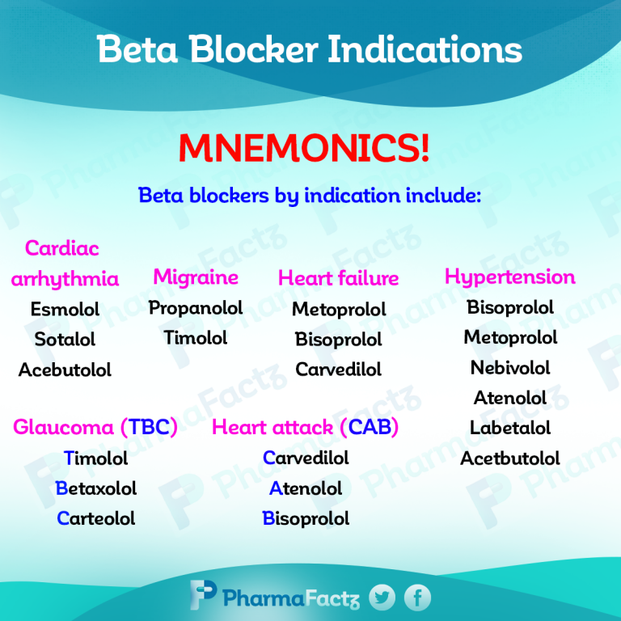

Slide 9
Other Uses of Beta- blockers:
Beta-blockers can be used to control the pulse rate in patients with phaeochromocytoma. However, they should never be used alone as beta-blockade without concurrent alpha-blockade may lead to a hypertensive crisis
2. Thyrotoxicosis (Beta-blockers are used in pre-operative preparation for thyroidectomy. Administration of propranolol hydrochloride can reverse clinical symptoms of thyrotoxicosis within 4 days.
3. Beta-blockers have been used to alleviate some symptoms of anxiety; probably patients with palpitation, tremor, and tachycardia respond best.

Slide 10
contraindiactions
Asthma . cardiogenic shock . hypotension . marked bradycardia . metabolic acidosis . phaeochromocytoma (apart from specific use with alphablockers) Prinzmetal’s angina . second-degree AV block . severe peripheral arterial disease . sick sinus syndrome .third-degree AV block . uncontrolled heart failure

Slide 11
CONTRA-INDICATIONS, FURTHER INFORMATION
▶ Bronchospasm Beta-blockers, including those considered to be cardioselective, should usually be avoided in patients with a history of asthma, bronchospasm or a history of obstructive airways disease.
However, when there is no alternative, a cardioselective beta-blocker can be given to these patients with caution and under specialist supervision. (carvedilol found to be safer)
In such cases the risk of inducing bronchospasm should be appreciated and appropriate precautions taken.

Slide 12
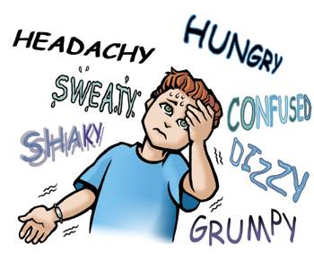
Cautions:
Diabetes . first-degree AV block . history of obstructive airways disease (introduce cautiously) . myasthenia gravis . portal hypertension (risk of deterioration in liver function) . psoriasis . symptoms of hypoglycaemia may be masked . symptoms of thyrotoxicosis may be masked

Slide 13

Caution is advised in patients with a history of hypersensitivity—may increase sensitivity to allergens and result in more serious hypersensitivity response.
Furthermore beta-adrenoceptor blockers may reduce response to adrenaline (epinephrine).
PREGNANCY Beta-blockers may cause intra-uterine growth restriction, neonatal hypoglycaemia, and bradycardia; the risk is greater in severe hypertension.

Slide 14
Breast feeding and monitoring parameters
With systemic use in the mother, infants should be monitored as there is a risk of possible toxicity due to beta-blockade. However, the amount of most betablockers present in milk is too small to affect infants.
Monitor lung function (in patients with a history of obstructive airway disease).

Slide 15

Treatment cessation
Avoid abrupt withdrawal especially in ischaemic heart disease. Sudden cessation of a beta-blocker can cause a rebound worsening of myocardial ischaemia and therefore gradual reduction of dose is preferable when beta-blockers are to be stopped.

Slide 16
carvedilol
INDICATIONS AND DOSE
Hypertension
▶ BY MOUTH ▶ Adult: Initially 12.5 mg once daily for 2 days, then increased to 25 mg once daily; increased if necessary up to 50 mg daily, dose to be increased at intervals of at least 2 weeks and can be given as a single dose or in divided doses
▶ Elderly: Initially 12.5 mg daily, initial dose may provide satisfactory control
Adjunct to diuretics, digoxin, or ACE inhibitors in symptomatic chronic heart failure
▶ BY MOUTH▶ Adult: Initially 3.125 mg twice daily, dose to be taken with food, then increased to 6.25 mg twice daily, then increased to 12.5 mg twice daily, then increased to 25 mg twice daily, dose should be increased at intervals of at least 2 weeks up to the highest tolerated dose, max. 25mg twice daily in patients with severe heart failure or body-weight less than 85 kg; max. 50mg twice daily in patients over 85 kg

Slide 17
HEPATIC IMPAIRMENT Manufacturer advises avoid in severe impairment. Dose adjustments Manufacturer advises dose adjustment may be required in moderate impairment.
MONITORING REQUIREMENTS Monitor renal function during dose titration in patients with heart failure who also have renal impairment, low blood pressure, ischaemic heart disease, or diffuse vascular disease.
MEDICINAL FORMS. Forms available from special-order manufacturers include:
oral suspension
Tablet
CAUTIONARY AND ADVISORY LABELS 8
▶ Carvedilol (Non-proprietary) 3.125 mg, 6.25mg, 25 mg

Slide 18
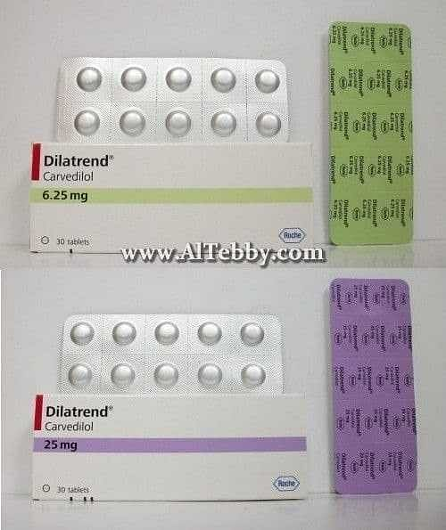
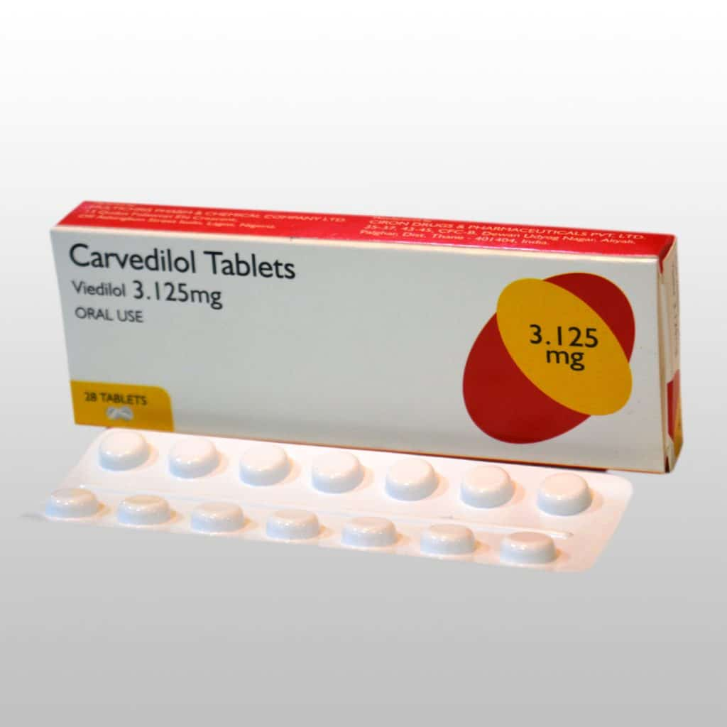

Slide 19
propranolol
INDICATIONS AND DOSE
Hypertension
▶ BY MOUTH
▶ Adult: Initially 80 mg twice daily, dose should be increased at weekly intervals as required; maintenance 160–320 mg daily
Angina
▶ BY MOUTH
▶ Adult: Initially 40 mg 2–3 times a day; maintenance 120–240 mg daily

Slide 20
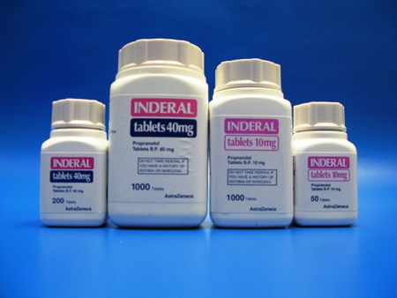
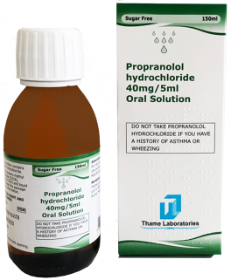
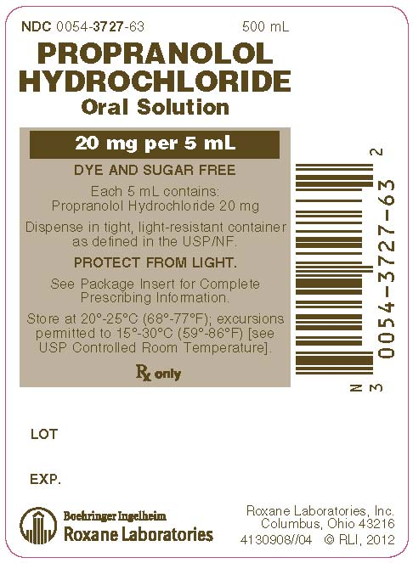
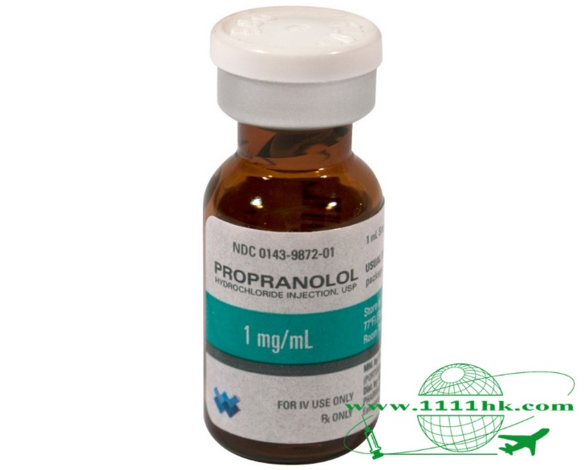
Oral solution: Propranolol hydrochloride 1 mg per 1 ml, 2mg per 1 ml, 8mg per 1 ml, 10 mg per 1 ml
Modified release capsule 80 mg , 160 mg
Tablet 10 ,40, 80 ,160 mg

Slide 21
Timolol maleate
INDICATIONS AND DOSE
Hypertension
▶ BY MOUTH
▶ Adult: Initially 10 mg daily in 1–2 divided doses, then increased if necessary up to 60 mg daily, doses to be increased gradually. Doses above 30mg daily given in divided doses, usual maintenance 10–30 mg daily; maximum 60 mg per day

Slide 22


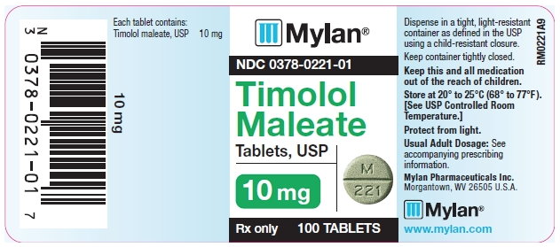
MEDICINAL FORMS
Tablet
CAUTIONARY AND ADVISORY LABELS 8
▶ Timolol maleate (Non-proprietary) Timolol maleate 10 mg
Timolol with amiloride and hydrochlorothiazide
Timolol with bendroflumethiazide

Slide 23
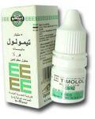
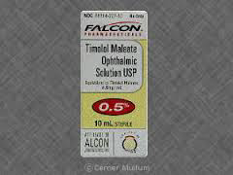
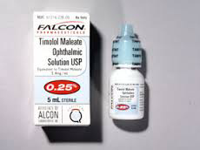
Glaucoma

Slide 24
Atenolol
INDICATIONS AND DOSE
Hypertension
▶ BY MOUTH
▶ Adult: 25–50 mg daily, higher doses are rarely necessary
Angina
▶ BY MOUTH
▶ Adult: 100 mg daily in 1–2 divided doses

Slide 25
RENAL IMPAIRMENT
Dose adjustments ▶ With oral use Max. 50 mg daily if eGFR 15–35 mL/minute/1.73m2; max. 25mg daily or 50mg on alternate days if eGFR less than 15 mL/minute/1.73m2.
DIRECTIONS FOR ADMINISTRATION For intravenous infusion (Tenormin ®), give intermittently in Glucose 5% or Sodium chloride 0.9%. Suggested infusion time 20 minutes.

Slide 26
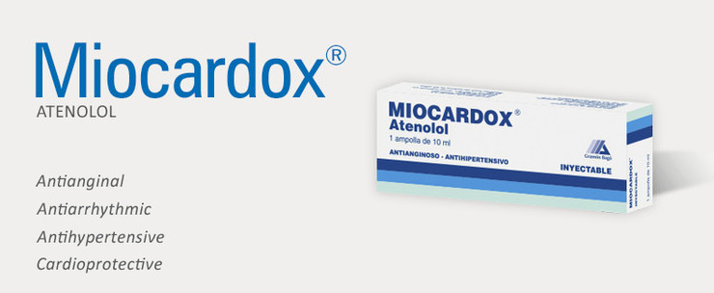
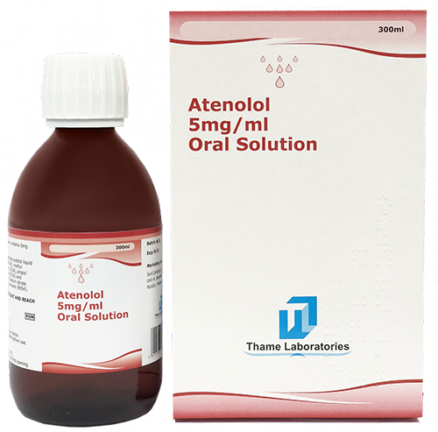


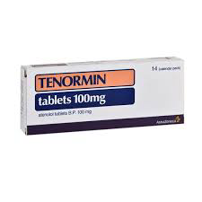
Atenolol 5 mg / 10 ml ampoule (0.5 mg/ml)
Atenolol 5 mg per 1 ml (25mg/5ml)

Slide 27
Vasodilator anti-hypertensive drugs

Slide 28
Vasodilators have a potent hypotensive effect, especially when used in combination with a beta-blocker and a thiazide.
Hydralazine hydrochloride is given by mouth as an adjunct to other antihypertensives for the treatment of resistant hypertension but is rarely used; when used alone it causes tachycardia and fluid retention.
Sodium nitroprusside [unlicensed] is given by intravenous infusion to control severe hypertensive emergencies when parenteral treatment is necessary.

Slide 29
Hydralazine hydrochloride
lINDICATIONS AND DOSE
Moderate to severe hypertension (adjunct)
▶ BY MOUTH
▶ Adult: Initially 25 mg twice daily, increased if necessary up to 50 mg twice daily
Heart failure (with long acting nitrate) (initiated in hospital or under specialist supervision)
▶ BY MOUTH
▶ Adult: Initially 25 mg 3–4 times a day, subsequent doses to be increased every 2 days if necessary; usual maintenance 50–75 mg 4 times a day

Slide 30
Contraindications and cautions
CONTRA-INDICATIONS Acute porphyrias . corpulmonale . dissecting aortic aneurysm . high output heart failure . idiopathic systemic lupus erythematosus . myocardial insufficiency due to mechanical obstruction . severe tachycardia
CAUTIONS Cerebrovascular disease . coronary artery disease (may provoke angina, avoid after myocardial infarction until stabilised) . occasionally blood pressure reduction too rapid even with low parenteral doses

Slide 31
l INTERACTIONS → Appendix 1: hydralazine
SIDE-EFFECTS
▶ Common or very common Angina pectoris . diarrhoea . dizziness . flushing . gastrointestinal disorders . headache . hypotension . joint disorders . lupus-like syndrome (after long-term therapy with over 100 mg daily (or less in women and in slow acetylator individuals)) . myalgia . nasal congestion . nausea . palpitations . tachycardia . vomiting

Slide 32
SIDE-EFFECTS, FURTHER INFORMATION The incidence of side-effects is lower if the dose is kept below 100mg daily, but systemic lupus erythematosus should be suspected if there is unexplained weight loss, arthritis, or any other unexplained ill health.
PREGNANCY Neonatal thrombocytopenia reported, but risk should be balanced against risk of uncontrolled maternal hypertension. Manufacturer advises avoid before third trimester.
BREAST FEEDING Present in milk but not known to be harmful.
Monitoring Monitor infant in breast-feeding.
HEPATIC IMPAIRMENT Manufacturer advises caution (risk of accumulation).
Dose adjustments Manufacturer advises adjust dose or dosing interval according to clinical response.
RENAL IMPAIRMENT Dose adjustments Reduce dose if eGFR less than 30 mL/minute/1.73m2.
MONITORING REQUIREMENTS Manufacturer advises test for antinuclear factor and for proteinuria every 6 months and check acetylator status before increasing dose above
100mg daily, but evidence of clinical value unsatisfactory.

Slide 33
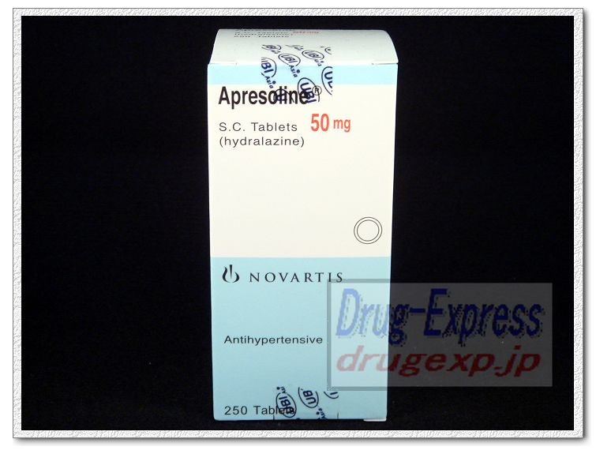
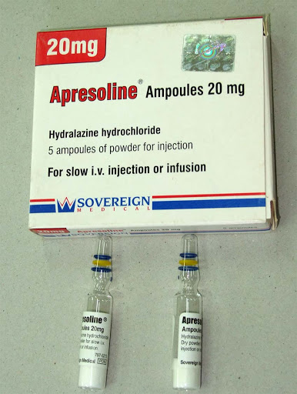
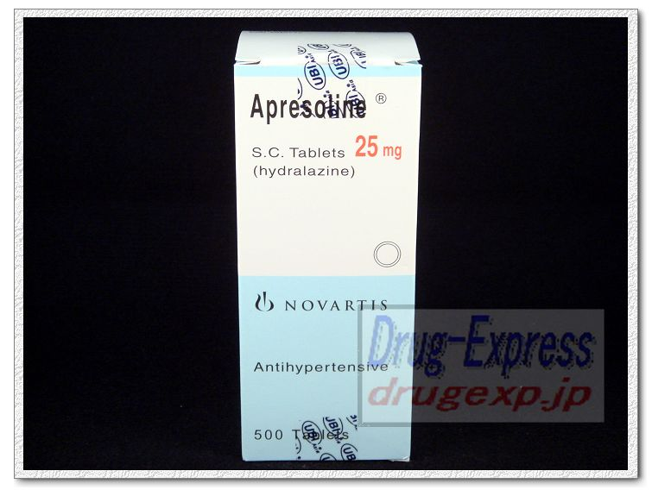
25,50 mg tablet
20 mg powder for injection( use0.9 % NS, continuous infusion(500ml))

Slide 34
Sodium nitroprusside
INDICATIONS AND DOSE
Hypertensive emergencies
▶ BY INTRAVENOUS INFUSION
▶ Adult: Initially 0.5–1.5 micrograms/kg/minute, adjusted in steps of 500 nanograms/kg/minute every 5 minutes, usual dose 0.5–8 mcg/kg/minute, use lower doses if already receiving other antihypertensives, stop if response unsatisfactory with max. dose in 10 minutes, lower initial dose of 300 ng/kg/minute has been used

Slide 35
CONTRA-INDICATIONS Compensatory hypertension . Leber’s optic atrophy . severe vitamin B12 deficiency
CAUTIONS Elderly . hyponatraemia . hypothermia .hypothyroidism . impaired cerebral circulation . Ischaemic heart disease
INTERACTIONS → Appendix 1: sodium nitroprusside
SIDE-EFFECTS Abdominal pain . anxiety . chest discomfort. dizziness . headache . hyperhidrosis . nausea . Palpitations . vomiting
SIDE-EFFECTS, FURTHER INFORMATION Side-effects
associated with over rapid reduction in blood pressure: Headache, dizziness, nausea, retching, abdominal pain, perspiration, palpitation, anxiety, retrosternal
discomfort—reduce infusion rate if any of these side effects occur.

Slide 36
Overdose Side-effects caused by excessive plasma concentration of the cyanide metabolite include tachycardia, sweating, hyperventilation, arrhythmias, marked metabolic acidosis
PREGNANCY Avoid prolonged use—potential for accumulation of cyanide in fetus.
BREAST FEEDING No information available. Caution advised due to thiocyanate metabolite.
HEPATIC IMPAIRMENT Use with caution. Avoid in hepatic failure—cyanide or thiocyanate metabolites may accumulate.
RENAL IMPAIRMENT Avoid prolonged use—cyanide or thiocyanate metabolites may accumulate.
MONITORING REQUIREMENTS Monitor blood pressure (including intra-arterial blood pressure) and blood- also blood thiocyanate concentration.
TREATMENT CESSATION Avoid sudden withdrawal:terminate infusion over 15–30 m.

Slide 37
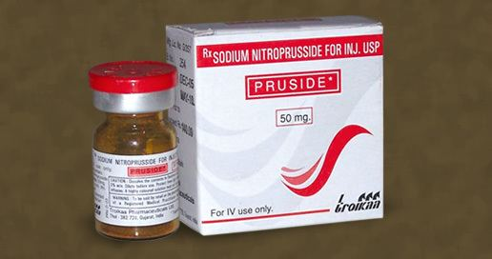
Sodium nitroprusside dihydrate 50 mg
DIRECTIONS FOR ADMINISTRATION For continuous intravenous infusion in Glucose 5%, infuse via infusion device to allow precise control. For further details, consult product literature. Protect infusion from light.

Slide 38
Centrally acting antihypertensive drugs

Slide 39
Methyldopa is a centrally acting antihypertensive; it may be used for the management of hypertension in pregnancy.
INDICATIONS AND DOSE
Hypertension
BY MOUTH
Adult: Initially 250 mg 2–3 times a day, dose should be increased gradually at intervals of at least 2 days; maximum 3 g per day
Elderly: Initially 125 mg twice daily, dose should be increased gradually; maximum 2 g per day
CONTRA-INDICATIONS Acute porphyrias, depression . phaeochromocytoma
CAUTIONS History of depression . history of hepatic impairment

Slide 40
SIDE-EFFECTS Abdominal distension . amenorrhoea . angina pectoris . angioedema . arthralgia . asthenia . atrioventricular block . bone marrow failure . bradycardia .breast enlargement . cardiac inflammation . carotid sinus syndrome . cerebrovascular insufficiency . Choreoathetosis . cognitive impairment . constipation . depression . diarrhoea . dizziness . dry mouth . eosinophilia . Facial paralysis . fever . gastrointestinal disorders . granulocytopenia . gynaecomastia . haemolytic anaemia .headache . hepatic disorders . hyperprolactinaemia . lactation disorder . leucopenia . lupus-like syndrome . myalgia . nasal congestion . nausea . nightmare . oedema .pancreatitis . paraesthesia . parkinsonism . Postural hypotension . psychiatric disorder . psychosis . sedation . sexual dysfunction . sialadenitis . skin reactions . thrombocytopenia . tongue burning . Tongue discolouration . toxic epidermal necrolysis . Vomiting
SIDE-EFFECTS, FURTHER INFORMATION Side-effects are minimised if the daily dose is kept below 1g.

Slide 41
PREGNANCY Not known to be harmful.
BREAST FEEDING Amount too small to be harmful.
HEPATIC IMPAIRMENT Manufacturer advises avoid in active disease.
RENAL IMPAIRMENT Increased sensitivity to hypotensive and sedative effect.
Dose adjustments Start with small dose.
MONITORING REQUIREMENTS Monitor blood counts and liver-function before treatment and at intervals during first 6–12 weeks or if unexplained fever occurs
EFFECT ON LABORATORY TESTS Interference with laboratory tests. Positive direct Coombs’ test in up to 20% of patients (may affect blood cross-matching).

Slide 42
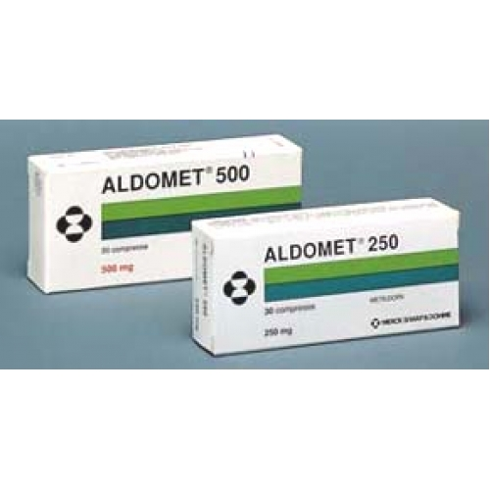
PATIENT AND CARER ADVICE
Driving and skilled tasks Drowsiness may affect performance of skilled tasks (e.g. driving); effects of alcohol may be enhanced.
Tablet
CAUTIONARY AND ADVISORY LABELS 3, 8
▶ Methyldopa (Non-proprietary)
Methyldopa anhydrous 125 mg, 250 mg, 500 mg tablet

Slide 43


