Slide 1
Rheology
Lab3 Industrial Pharmacy

Slide 2
Definition
Rheology is the flow properties of pharmacological particles.
Rheo= Flow

Slide 3
Disadvantages of using powders
The most popular dosage forms was powder but by time it’s converted to tablets and capsules because of the following disadvantages of powder dosage form:
1. Inaccuracy in weight.
2. Can not be used for drugs having hygroscopicity because it absorb moisture.
3. Can not be used for powders that have bad taste.

Slide 4
Why we study rheology of powder!!
Powder or granules utilized in a particular form during some phase of manufacture.
i.e. (A- Modern tablet machine can produce 5-20 thousands tablets/min, B- Capsule machine can produce about 150 thousands capsules/min
To ensure this type of production (the integrity of powder flow rate)
We should ensure flowability of the powder.

Slide 5
Types of powder flowability:
Freely flowable powder
Non-freely (sticky) flowable powder

Slide 6
Factors reducing flow rate
Intermolecular forces:
Weak cohesive forces on the surface of the particles of different charges (Vander Waals forces).
E.g. When two molecules interact (brought close together) both repulsive and attractive forces (opposite charges on both molecules are close together)operate.
Molecules will attract to each other leading to bad flowability.
Vander Waals Forces

Slide 7
Frictional Forces (electrostatic forces):
Present on the surface of the particle and they manifest their effect due to friction between particles during movement.
Note: As the surface area increases
friction increases
formation of charges increases
flowability decreases.

Slide 8
Note:
Charges developed depend on:
A- Particle size.
C- Type of motion produced in it (like harmonic, circular, random and rotary) .
B- Materials involved.

Slide 9
3. Shape of particles:
Good flowability
Spherical particle with small surface area.
Bad flowability
A-Irregular particles or particles with needle and crystalline shape.
B- Flat particles and particles with rough surface.

Slide 10
4. Size of the particles:
Bad Flowability
(small particles have high surface area and high frictional forces).
Note: if the size of the particle is too large it may not be able to enter the orifices of the instrument.
Flow rate
Particle size

Slide 11
5. Moisture:
Good Flow: The flow by the absorbed layer of moisture on the particle surface
Reduce the chance of any complicating electrostatic effect by producing conduction path of charge dissipation.
Bad Flow: Excessive moisture higher than that of 50 %
forming moisture bridges between particle which will cause sticky mixture.

Slide 12
Improving flowability by
1.Formulation additives (glidants):
A- Talc.
B- Magnesium oxide
C- Colloidal silicon Dioxide
(They generally act by disrupting the continuous film of adsorbed water surrounding the moist particles in addition to lodging in the surface irregularities forming a more rounded structure reducing the bulk density of tightly packed powder).
2. Force feeder (which push the powder down in the die).
3. Vibrating Hooper (provide regular vibration allowing the powder to flow continuously).

Slide 13
Note:
Bad flowable powder may cause the following :
1- Weight variation in the final product.
2- Non uniform particle packing.
3- Air entrapment within the powder which may cause tableting problems.
4- Excessive fine particles which cause lubricating problems.

Slide 14
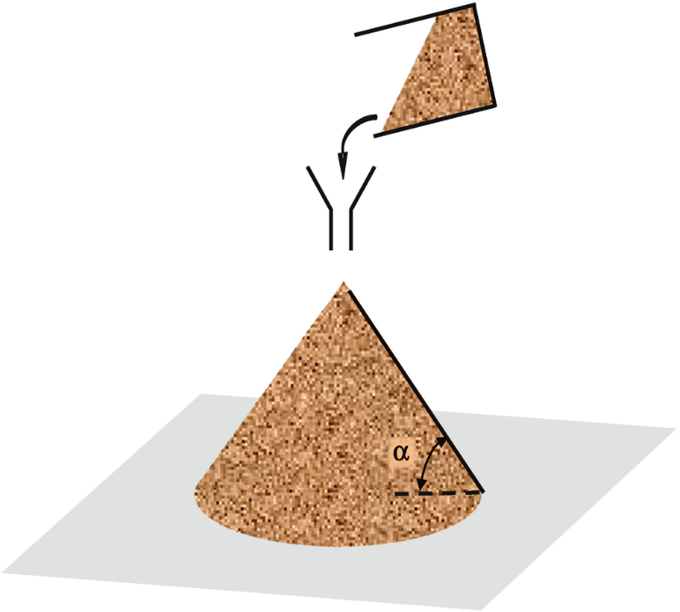
Measurement of flowability
Flow meter (determine the flow rate and provide a means of quantifying uniformity of flow).
Angle of repose (funnel and petri dish method)
Simple method for estimating the flow properties of a powder, by allowing the powder to flow through a funnel and fall freely onto a surface, the height and the diameter of the resulting cone will be measured and the angle of repose (which is the maximum angle between the free standing surface of the powder heap and the horizontal plane).

Slide 15
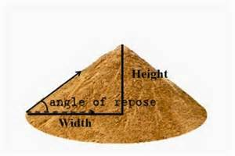
This angle can be calculated from the following equation:
tan θ = h / r
Where θ = angle of repose,
h = height of the powder cone,
and r = radius of the cone.

Slide 16
Notes:-
- Angle of repose range from 0°- 90° depending on type of powder, it is related to density, surface area, shape of particles, coefficient of friction of the material.
- The value of angle of repose increases if the powder is cohesive.

Slide 17
This table represent the scale of flow determined from Carr’s scale of flowability:
Angle of repose | Flow property
25° -30° | Excellent
31°-35° | Good
36°-40° | Fair (aid not required)
41°-45° | Passable (may hang up)
46°-55° | Poor (must agitate , vibrate)
> 55° | Very poor

Slide 18
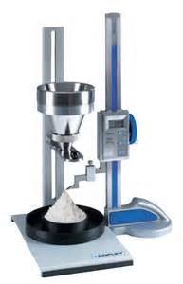
Angle of repose measurement
1- Fixed funnel free standing cone method
2- Fixed cone method

Slide 19
Fixed funnel free standing cone method
1-Keep the funnel on constant height (about 2 cm) on a horizontal plane.
2-The powder to be measures poured gradually through the funnel onto a paper until the Pile apex reaches the tip of the funnel.
3-Mark the base of the formed pile and remove the powder.
4-Measure the diameter of the formed circle (2 readings) and take the average (d1+d2/2)
5- Find the radius (d/2)
6- Calculate θ (tan θ= h/r)

Slide 20
Fixed Cone method
1-The diameter or radius (r) of the pile base is kept constant by using a petridish on a horizontal plane.
2-The funnel should be kept in the center of the petridish .
3- The height of the funnel is changeable keeping a (2-4 cm) space between the Pile apex and the tip of the funnel during powder pouring.
4-The end point is reached when the base of the petiridish is fully covered with the powder.
5- Find the height of the formed pile.
6- Calculate θ (tan θ= h/r)

Slide 21
Please use the following links for the experimental work
https://www.youtube.com/watch?v=4J61a6-zBDA
https://www.youtube.com/watch?v=mpf1wxG0R7c&t=319s

Slide 22


