Slide 2
Toxicology is the study of the adverse effects of chemicals on living organisms.
Xenobiotic - man-made substance and/or produced by plants, animals, or bacteria but not normally found in the body.
A toxicologist is trained person to examine the nature of those effects (including their cellular, biochemical, and molecular mechanisms of action)

Slide 3
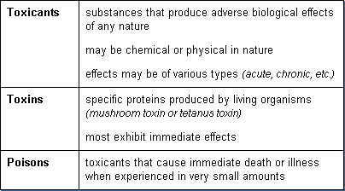
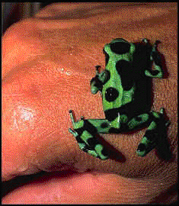
* Poisonous substances are produced by plants, animals, or bacteria.
Phytotoxins Zootoxins Bacteriotoxins
found in the body.

Slide 4
Measures of Toxicity
 The normal procedure is to expose test animals
By ingestion
application to the skin
 By placing the test material in the water or air of the test animals’ environment

Slide 5
testing Lab animals
– Rats, mice, dogs, monkeys etc
• Safety in experimental animals does not necessarily indicate the same in humans.
– Example: Thalidomide a human teratogen shows toxicity(caused shortening or complete absence of limbs) at doses as low as 0.5-1 mg/kg and has little or no effect in mice or rats at doses as high as 4000 mg/kg.

Slide 6
Measures of Toxicity
 Mortality (death)
 Teratogenicity (ability to cause birth defects)
 Carcinogenicity (ability to cause cancer), and,
 Mutagenicity (ability to cause heritable change in the DNA)

Slide 7
Measures of Toxicity:
LD50
The amount (dose) of a chemical which produces death in 50% of a population of test animals to which it is administered by any of a variety of
methods
mg/kg
Normally expressed as milligrams of substance per kilogram of animal body weight

Slide 8
The Median Lethal Concentration
LC50
The concentration of a chemical in an environment
(generally air or water) which produces death in
50% of an exposed population of test animals in a
specified time frame
mg/L
Normally expressed as milligrams of substance per liter of air or water (or as ppm)

Slide 9
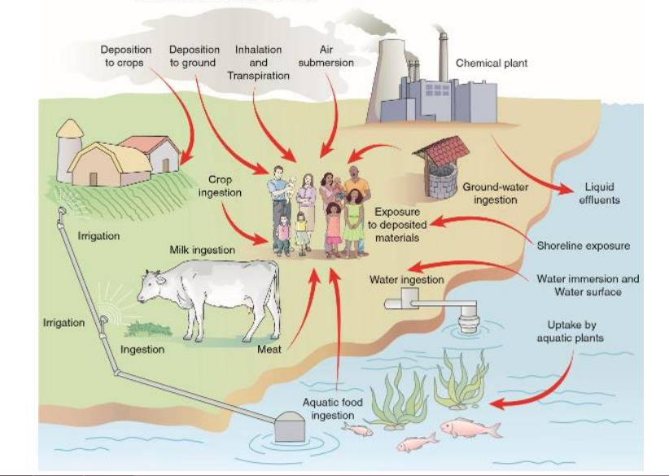
The exposure
Exposure, like many of the terms in toxicology, has several different aspects, the most important of which are
1) route of exposure,
2) frequency of exposure
3) duration of exposure

Slide 10
Routes and site of Exposure
An agent exerts its effects when it enters or comes into contact with the body, or in other words, when an individual has been exposed to it.
1) Oral ⇒ GI tract
2) Inhalation ⇒ Lungs
3) Topical, percutaneous, or dermal ⇒ Skin
4) Ocular, conjunctiva, cornea ⇒ Eyes
5) Other routes ⇒ IP, SC, IM, ID, IV…..

Slide 11
Duration and Frequency of
Exposure
 Toxicologists usually divide the exposure of experimental
animals to chemicals into four categories:
 Acute exposure is defined as exposure to a chemical for less
than 24 h
 Subacute exposure refers to repeated exposure to a chemical for 1 month or less
 Subchronic for 1 to 3 months
 Chronic for more than 3 months

Slide 12
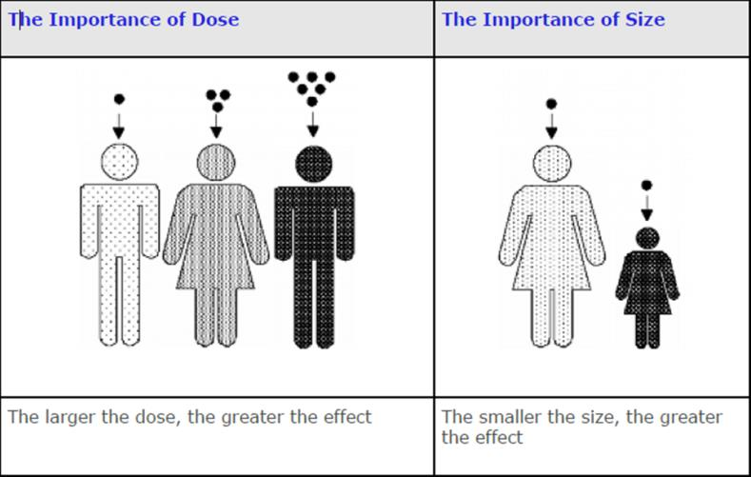
Dose response
 The characteristics of exposure and the spectrum of effects come together in a correlative relationship customarily referred to as the dose-response relationship
 Two types
 Individual to varying doses of a chemical, Response of an
individual organism to varying doses of a chemical
 Population of individuals
Dose response
 The characteristics of exposure and the spectrum of effects come together in a correlative relationship customarily referred to as the dose-response relationship
 Two types
 Individual to varying doses of a chemical, Response of an
individual organism to varying doses of a chemical
 Population of individuals

Slide 13
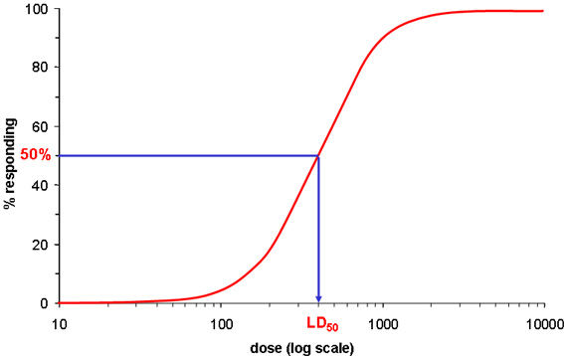
dose-response relationship

Slide 14
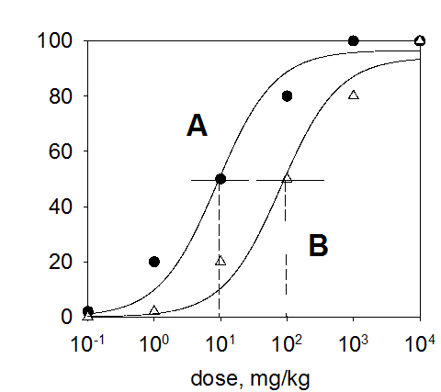
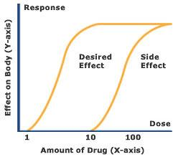
dose-response relationship

Slide 15
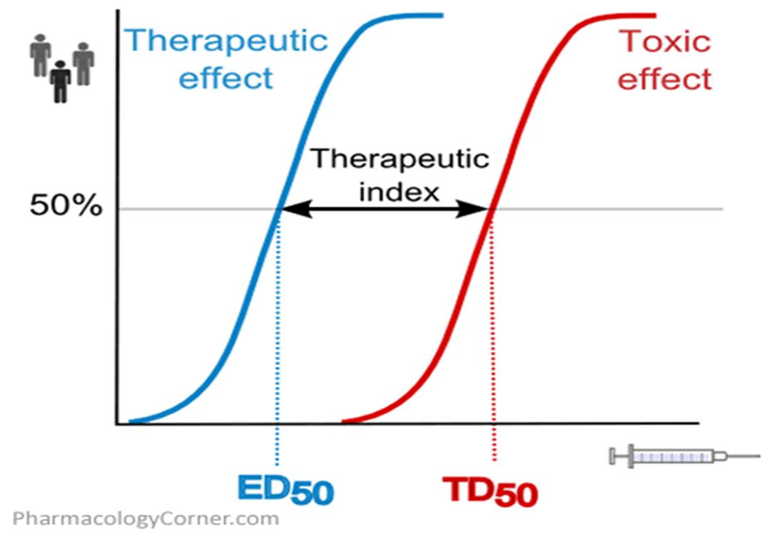
 LD50 values are the standard for
comparison of acute toxicity
between chemical compounds and
between species
 TD50 – Median Toxic Dose
 ED50 – Median Effective Dose
 LC50 – Median Lethal
Concentration

Slide 16
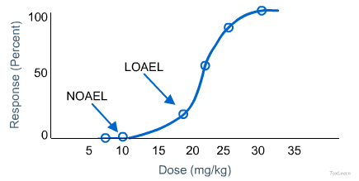
Dose-Response Curve?
 NOAEL Value – No Observed Adverse Effect Level, The highest dose of a chemical that, in a given toxicity test, causes no observable effect in test animals
 The NOAEL for the most sensitive test species and the most sensitive indicator of toxicity is usually employed for regulatory purposes
LOAEL Value – Lowest Observed Adverse Effect Level, The lowest dose of a chemical that, in a given toxicity test, does cause an observable effect in test animals

Slide 17
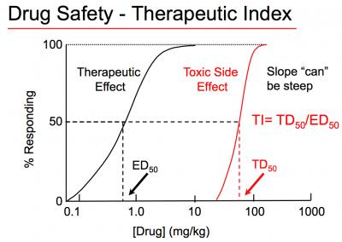
what Can Be Learned From A Dose-Response Curve

Slide 18
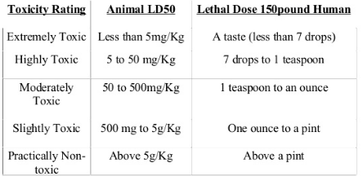
TOXICITY RATING FOR HUMANS (70 KG BODY WEIGHT)

