Slide 1
Appendicitis
Assistant lecturer :
Noor Wafaa Hashim

Slide 2
Epidemiology
Commonest cause of an acute abdomen and surgical admission in the UK.
Approximately one in seven people will have an appendicectomy.
It most commonly occurs between 10 and 20 years; it is rare under 3 years of age.

Slide 3
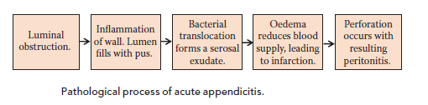
Pathophysiology
It usually occurs when the appendix is obstructed by a faecolith or foreign body in the lumen bacterial proliferation and invasion………….thrombosis…...perforation

Slide 4
Clinical features
Abdominal pain
Initially vague, colicky central abdominal pain.
right iliac fossa (RIF) pain
Usually accompanied by a low-grade fever, nausea, vomiting and anorexia.

Slide 5
Abdominal examination
Tenderness over McBurney’s point is the usual feature.
There may also be signs of peritoneal inflammation, including:
Guarding, tenderness on percussion, pain on coughing or other movement.
Signs of generalised peritonitis may develop as the illness progresses with abdominal rigidity

Slide 6
Rovsing’s sign: Pain is felt in the RIF when pressure is applied to the LIF.
There must also be RIF tenderness for this sign to be positive.
Psoas sign: The patient keeps his or her hip in flexion to relieve his or her pain.
The appendix is anatomically adjacent to the psoas muscle, which is involved in hip flexion.
PR examination may reveal tenderness anterolaterally on the right.

Slide 7
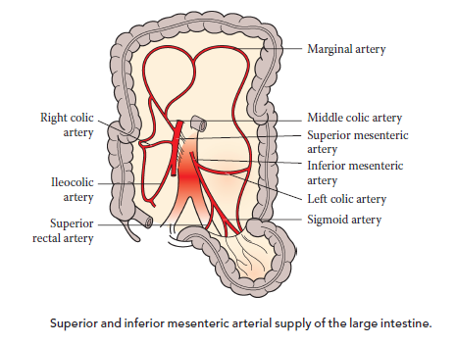

Slide 8
Diagnosis
The performance of a full blood count (FBC) can be useful to determine whether or not the patient has a leucocytosis.
A urinalysis to exclude urinary tract infection.
A pregnancy test in women of child-bearing age is mandatory to rule out an ectopic pregnancy.
An ultrasound scan (USS) in women can be useful where the diagnosis of appendicitis is in doubt to exclude tubo-ovarian pathology as the cause of RIF pain.

Slide 9
A computed tomography (CT) scan can be useful to confirm the diagnosis, especially in the elderly where a caecal tumour (colonic cancer)may be causative, or in the obese where examination is difficult.
Diagnostic laparoscopy allows immediate treatment if appendicitis is confirmed.
Urea and electrolytes (U&E) should also be performed to assess hydration status.

Slide 10
Management
Patients are often dehydrated at presentation and so require fluid resuscitation. IV fluids should be continued whilst the patient remains starved for theatre=NPO
Open appendicectomy
Laparoscopic appendicectomy

Slide 11
Open appendicectomy
Usually performed in children.
A Lanz incision is used for the best cosmetic result.
If the appendix is found to be perforated or gangrenous, then peritoneal lavage is performed to remove any pus or contamination.
Most patients can be discharged on the second or third day post-operatively

Slide 12
Laparoscopic appendicectomy
Improves diagnostic accuracy and minimises negative appendicectomy rates.
It is indicated in patients who are unwell but there is question as to the diagnosis, and is particularly indicated in young women.
It is useful in the obese where wound infections are more common and laparoscopic procedures have lower wound infection rates

Slide 13
Advantages of laparoscopic appendectomy
May shorten hospital stay .
Faster return to normal activities.
Less post-operative pain.
May result in quicker return to bowel function.
Better cosmetic results.

Slide 14
Initial Managment
The initial management of an appendix abscess is conservative with IV fluids, antibiotics and observation. They may require radiological drainage.
If there is deterioration, or frank perforation, surgery may still be required.

Slide 15
Complications
Abscess formation
peritonitis.
Wound problems, including infection or haematoma.

Slide 16
Intestinal obstruction due to adhesion formation within the abdomen.
Patients with a perforated appendix may occasionally need admission to intensive treatment unit (ITU).

Slide 17
Appendicitis during Pregnancy
Appendicitis is the most common non-gynecologic surgical emergency during pregnancy.
It must be suspected in any pregnant woman with abdominal pain.
Operation is indicated in pregnant patient as soon as the diagnosis of appendicitis is suspected.

