Slide 1
Antihypertensive drugs
Done by:
Assistant. lec. Shaymaa Hasan Abbas

Slide 2
Diuretics

Slide 3
Thiazides and related diuretics
- Thiazides and related compounds are moderately potent diuretics; they inhibit sodium reabsorption at the beginning of the distal convoluted tubule.
Thiazides are used to relieve oedema due to chronic heart failure and, in lower doses, to reduce blood pressure.
.
They act within 1 to 2 hours of oral administration and most have a duration of action of to 24 hours; they are usually administered early in the day so that the diuresis does not interfere with sleep
- In the management of hypertension a low dose of a thiazide
produces a maximal or near-maximal blood pressure with lowering effect, with very little biochemical disturbance.
- Higher doses cause more marked changes in plasma potassium, sodium, uric acid, glucose, and lipids, with little advantage in blood pressure control

Slide 4
Thiazides and related diuretics
-Chlortalidone and indapamide are the preferred diuretics in the management of hypertension. Thiazides also have a role in chronic heart failure.
Bendroflumethiazide can be used for mild or moderate heart failure; it is licensed for the treatment of hypertension but is no longer considered the first-line diuretic for this indication,
although patients with stable and controlled blood pressure currently taking bendroflumethiazide can continue treatment

Slide 5
Thiazides and related diuretics
Chlortalidone, a thiazide-related compound, has a longer
duration of action than the thiazides and may be given on
alternate days to control oedema. It is also useful if acute
retention is liable to be precipitated by a more rapid diuresis
or if patients dislike the altered pattern of micturition caused
by other diuretics.
Chlortalidone can also be used under close supervision for the treatment of ascites due to cirrhosis in stable patients.
Xipamide and indapamide are chemically related to chlortalidone.
Indapamide is claimed to lower blood pressure with less metabolic disturbance, particularly less aggravation of diabetes mellitus.

Slide 6
Thiazides and related diuretics
Metolazone is particularly effective when combined with a loop diuretic (even in renal failure); profound diuresis can occur and the patient should therefore be monitored carefully.
The thiazide diuretics benzthiazide, clopamide,
hydrochlorothiazide, and hydroflumethiazide do not offer
any significant advantage over other thiazides and related
diuretics.

Slide 7
Chlortalidone
(Chlorthalidone)
INDICATIONS AND DOSE
Hypertension
▶ BY MOUTH
Adult: 25 mg daily, dose to be taken in the morning, then increased if necessary to 50 mg daily

Slide 8
Chlortalidone
INTERACTIONS → Appendix 1: thiazide diuretics
SIDE-EFFECTS
▶ Common or very common
Appetite decreased . Erectile dysfunction . gastrointestinal discomfort. hyperglycaemia .rash. eosinophilia . glycosuria . hepatic disorders . Nephritis . paraesthesia . Pulmonary oedema .respiratory disorder. vomiting
BREAST FEEDING The amount present in milk is too small to be harmful. Large doses may suppress lactation.
MEDICINAL FORMS There can be variation in the licensing of
different medicines containing the same drug. Forms available
from special-order manufacturers include: oral suspension

Slide 9
Chlortalidone
Tablet
▶ Chlortalidone (Non-proprietary)
Chlortalidone 25 mg tablets, Chlortalidone 50 mg Combinations available: Triamterene with chlortalidone

Slide 10
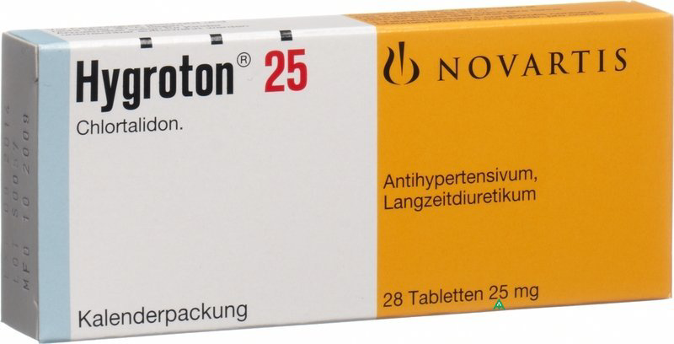
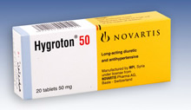
Onset 1-2 hr.
Duration 12-24 hr.
(In the morning)

Slide 11
Hydrochlorothiazide
IMPORTANT SAFETY INFORMATION
MHRA/CHM ADVICE: HYDROCHLOROTHIAZIDE: RISK OF NON-
MELANOMA SKIN CANCER, PARTICULARLY IN LONG-TERM USE
(NOVEMBER 2018)
The MHRA advises healthcare a professionals to:
.inform patients taking hydrochlorothiazide-
containing products of the cumulative, dose-dependent increased risk of non-melanoma skin cancer, particularly in long-term use, and advise
patients to regularly check for and report any new or changed skin lesions or moles;

Slide 12
Hydrochlorothiazide
.-advise patients to limit exposure to sunlight and UV
rays and use adequate sun protection;
. -reconsider the use of hydrochlorothiazide in patients
who have had previous skin cancer;
. -examine all suspicious moles or skin lesions
(potentially including histological examination of
biopsies).

Slide 13
Hydrochlorothiazide
l MEDICINAL FORMS Forms available from special-order
manufacturers include: tablet, oral suspension, oral solution
Combinations available:
Enalapril with hydrochlorothiazide,
Irbesartan with hydrochlorothiazide
Lisinoprilwith hydrochlorothiazide, . Losartan with
hydrochlorothiazide, Olmesartan with amlodipine and
hydrochlorothiazide, Olmesartan with
hydrochlorothiazid,e, Quinapril with
hydrochlorothiazide, Telmisartan with
hydrochlorothiazide, Timolol with amiloride and
hydrochlorothiazide, Valsartan with
hydrochlorothiazide,

Slide 14
loop diuretics
- Loop diuretics inhibit reabsorption from the ascending limb of the loop of Henlé in the renal tubule and are powerful diuretics.
- Loop diuretics are used in pulmonary oedema due to left-
ventricular failure; intravenous administration produces
relief of breathlessness and reduces pre-load sooner than
would be expected from the time of onset of diuresis.
-Loop diuretics are also used in patients with chronic heart failure.
- Diuretic-resistant oedema (except lymphoedema and
oedema due to peripheral venous stasis or calcium-channel
blockers) can be treated with a loop diuretic combined with a
thiazide or related diuretic (e.g. bendroflumethiazide or
metolazone).

Slide 15
loop diuretics
- If necessary, a loop diuretic can be added to antihypertensive treatment to achieve better control of blood pressure in those with resistant hypertension, or in patients with impaired renal function or heart failure.
- Loop diuretics can exacerbate diabetes (but- hyperglycaemia is less likely than with thiazides) and gout. If there is an enlarged prostate, urinary retention can occur, although this is less likely if small doses and less potent diuretics are used initially.

Slide 16
loop diuretics
-Furosemide and bumetanide are similar in activity; both act within 1 hour of oral administration and diuresis is complete within 6 hours so that, if necessary, can be given twice in one day without interfering with sleep
-Following intravenous administration furosemide has a peak
effect within 30 minutes. The diuresis associated with these
drugs is dose related.
Torasemide has properties similar to those of
furosemide and bumetanide, and is indicated for oedema
and for hypertension.

Slide 17
loop diuretics
CONTRA-INDICATIONS Anuria . comatose and precomatose
states associated with liver cirrhosis .renal failure due to
nephrotoxic or hepatotoxic drugs . severe hypokalaemia . severe hyponatraemia
CAUTIONS Can exacerbate diabetes (but hyperglycaemia less likely than with thiazides). can excacerbate gout. hypotension should be corrected before initiation of treatment. hypovolaemia should be corrected before initiation of treatment. urinary retention can occur in prostatic hyperplasia

Slide 18
loop diuretics
CAUTIONS, FURTHER INFORMATION
▶ Elderly
Lower initial doses of diuretics should be used in the elderly because they are particularly susceptible to the side-effects. The dose should then be adjusted according to renal function. Diuretics should not be use continuously on a long-term basis to treat simple gravitational oedema (which will usually respond to increased movement, raising the legs, and support stockings)
▶ Potassium loss:Hypokalaemia
can occur with both thiazide and loop diuretics. The risk of hypokalaemia depends on the duration of action as well as the potency and is thus greater with thiazides than with an equipotent dose of a loop diuretic

Slide 19
loop diuretics
- Hypokalaemia is dangerous in severe cardiovascular
disease and in patients also being treated with cardiac
glycosides. Often the use of potassium-sparing diuretics
avoids the need to take potassium supplements.
-In hepatic failure, hypokalaemia caused by diuretics can precipitate encephalopathy, particularly in alcoholic cirrhosis.
▶ Urinary retention
If there is an enlarged prostate, urinary
retention can occur, although this is less likely if small
doses and less potent diuretics are used initially; an
adequate urinary output should be established before
initiating treatment.

Slide 20
loop diuretics
SIDE-EFFECTS
▶ Common or very common
Dizziness .electrolyte imbalance . fatigue . headache . metabolic alkalosis . muscle spasms . nausea
▶ ▶ Frequency not known Deafness
(more common in renal impairment). leucopenia . paraesthesia .rash .
HEPATIC IMPAIRMENT Hypokalaemia induced by loop diuretics may precipitate hepatic encephalopathy and coma—potassium-sparing diuretics can be used to prevent this. Diuretics can increase the risk of hypomagnesaemia in alcoholic cirrhosis, leading to arrhythmias.

Slide 21
loop diuretics
RENAL IMPAIRMENT High doses or rapid intravenous administration can cause tinnitus and deafness
Dose adjustments: High doses of loop diuretics may
occasionally be needed in renal impairment.
MONITORING REQUIREMENTS Monitor electrolytes during
treatment.

Slide 22
furosemide
INDICATIONS AND DOSE
Resistant hypertension
▶ BY MOUTH
▶ Adult: 40–80 mg daily
INITIALLY BY INTRAMUSCULAR INJECTION, OR BY SLOW
INTRAVENOUS INJECTION, OR BY INTRAVENOUS INFUSION
Adult: Initially 20–50 mg, then (by intramuscular injection or by intravenous injection or by intravenous infusion) increased in steps of 20 mg every 2 hours if required, doses greater than 50 mg given by
intravenous infusion only; maximum 1.5 g per day
CAUTIONS Hepatorenal syndrome . hypoproteinaemia may
reduce diuretic effect and increase risk of side-effects
INTERACTIONS → Appendix 1: loop diuretics

Slide 23
furosemide
SIDE-EFFECTS
GENERAL SIDE-EFFECTS
Agranulocytosis . aplastic anaemia . auditory disorder more common with rapid intravenous administration, and in renal impairment). diabetes mellitus . eosinophilia . fever. gout. haemolytic anaemia . hepatic encephalopathy . malaise . mucosal reaction . nephritis tubulointerstitial . pancreatitis acute . shock . skin eruption .tetany . vasculitis
SPECIFIC SIDE-EFFECTS
With oral use Acute kidney injury . hepatic disorders . metabolic acidosis . psychiatric disorder. urinary disorders
With parenteral use Acute urinary retention . cholestasis
PREGNANCY Furosemide should not be used to treat gestational hypertension because of the maternal hypovolaemia associated with this condition.
BREAST FEEDING Amount too small to be harmful. May inhibit lactation.

Slide 24
furosemide
DIRECTIONS FOR ADMINISTRATION Intravenous
administration rate should not usually exceed 4
mg/minute however single doses of up to 80 mg may be
administered more rapidly; a lower rate of infusion may be
necessary in renal impairment. For intravenous infusion
(Lasix ®), give continuously in Sodium chloride 0.9%;
infusion pH must be above 5.5; glucose solutions are
unsuitable.
MEDICINAL FORMS There can be variation in the licensing of
different medicines containing the same drug. Forms available
from special-order manufacturers include: oral suspension, oral
solution

Slide 25
furosemide
Tablet
▶ Furosemide (Non-proprietary)
Furosemide 20 mg Furosemide 20mg tablets
Furosemide 40 mg Furosemide 40mg tablets
Furosemide 500 mg Furosemide 500mg tablets
Solution for injection
Furosemide 20mg/2ml solution for injection ampoules
▶ Furosemide (Non-proprietary)
Furosemide 10 mg per 1 ml Furosemide 250mg/25ml solution for
injection ampoules |
Furosemide 50mg/5ml solution for injection ampoules

Slide 26
furosemide
Oral solution
EXCIPIENTS: May contain Alcohol
Furosemide 4 mg per 1 ml Furosemide 20mg/5ml oral solution
sugar free sugar-free |
Furosemide 8 mg per 1 ml Furosemide 40mg/5ml oral solution
Furosemide 10 mg per 1 ml Furosemide 50mg/5ml oral solution

Slide 27
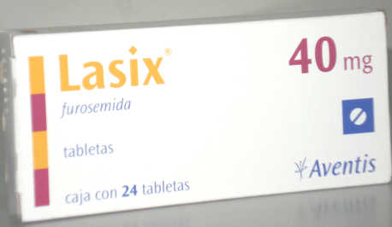
Oral; Act within 1 hr.
Inj.; Act within 30 min.
Complete action within 6 hr.
Can be given twice daily.

Slide 28
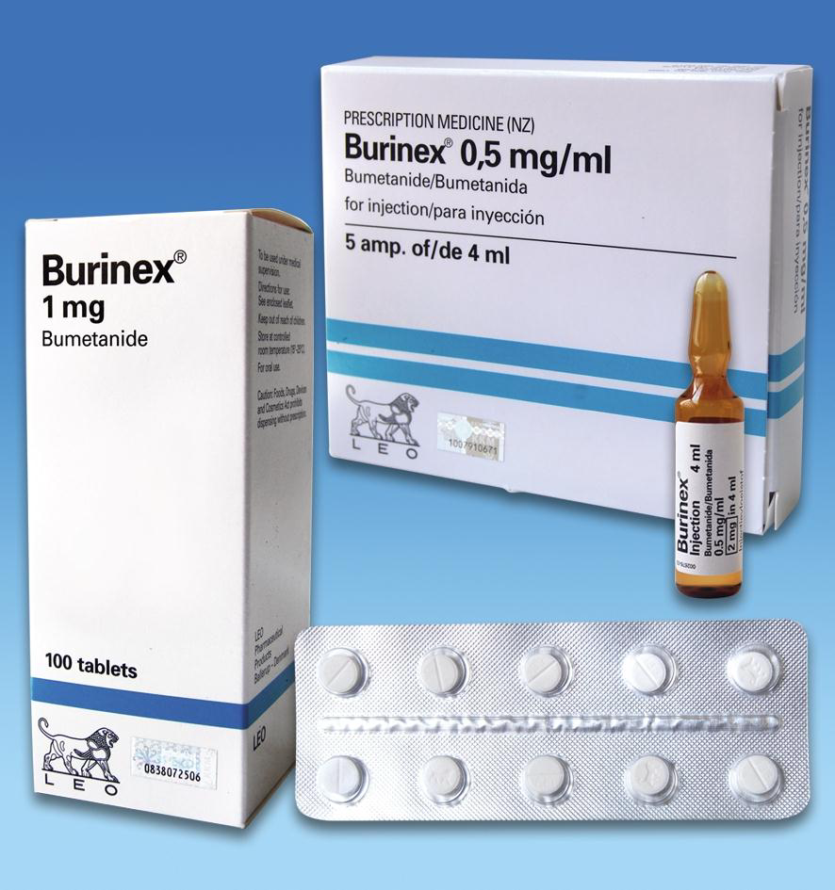

Slide 29
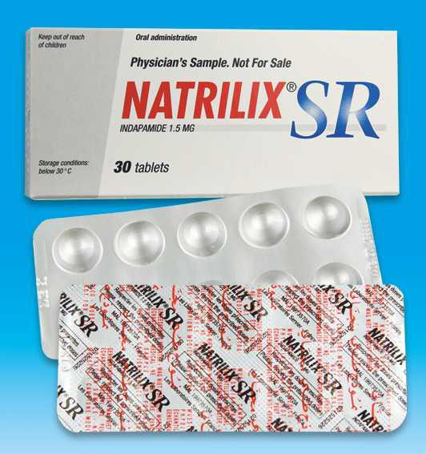
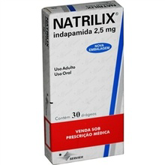

Slide 30
Potassium-sparing diuretics and aldosterone antagonists
- Amiloride hydrochloride and triamterene on their own are weak diuretics. They cause retention of potassium and are therefore given with thiazide or loop diuretics as a more effective alternative to potassium supplements.
-Potassium supplements must not be given with potassium-
sparing diuretics. Administration of a potassium sparing
diuretic to a patient receiving an ACE inhibitor or an
angiotensin-II receptor antagonist can also cause severe
hyperkalaemia.

Slide 31
Potassium-sparing diuretics and aldosterone antagonists
Spironolactone potentiates thiazide or loop diuretics by antagonising aldosterone; it is a potassium-sparing diuretic.
- Spironolactone is of value in the treatment of oedema and ascites caused by cirrhosis of the liver;
Low doses of spironolactone are beneficial in moderate to severe heart failure and when used in resistant hypertension [unlicense
indication].
Spironolactone is also used in primary hyperaldosteronism (Conn’s syndrome).
It is given before surgery or if surgery is not appropriate, in the lowest effective dose for maintenance

Slide 32
Potassium-sparing diuretics and aldosterone antagonists
Eplerenone is licensed for use as an adjunct in left ventricular dysfunction with evidence of heart failure after myocardial infarction; it is also licensed as an adjunct in chronic mild heart failure with left ventricular systolic dysfunction.
- Potassium supplements must not be given with aldosterone antagonists
-Potassium-sparing diuretics with other diuretics Although it is preferable to prescribe thiazides and potassium-sparing diuretics separately, the use of fixed combinations may be justified if compliance is a problem.
- Potassium-sparing diuretics are not usually necessary in the routine treatment of hypertension, unless hypokalaemia develops

Slide 33
Spironolactone
INDICATIONS AND DOSE
Resistant hypertension (adjunct)
▶ BY MOUTH
▶ Adult: 25 mg once daily

Slide 34
Spironolactone
UNLICENSED USE Resistant hypertension (adjunct)
unlicensed indication.
CONTRA-INDICATIONS: Addison’s disease . anuria . hyperkalaemia
CAUTIONS Acute porphyrias . elderly . potential
metabolic products carcinogenic in rodents
INTERACTIONS → Appendix 1: aldosterone antagonists
SIDE-EFFECTS : Acidosis hyperchloraemic . acute kidney
injury . agranulocytosis . alopecia . breast neoplasm benign
. breast pain . confusion . dizziness . electrolyte imbalance .
gastrointestinal disorder . gynaecomastia . hepatic
function abnormal . hyperkalaemia (discontinue) .
hypertrichosis . leg cramps . leucopenia . libido disorder .
malaise . menstrual disorder . nausea . severe cutaneous
adverse reactions (SCARs) . skin reactions .thrombocytopenia

Slide 35
Spironolactone
PREGNANCY Use only if potential benefit outweighs risk—feminisation of male fetus in animal studies.
BREAST FEEDING Metabolites present in milk, but amount probably too small to be harmful.
RENAL IMPAIRMENT Avoid in acute renal insufficiency or severe impairment.
Monitoring : Monitor plasma-potassium concentration
(high risk of hyperkalaemia in renal impairment).
MONITORING REQUIREMENTS Monitor electrolytes— discontinue if hyperkalaemia occurs (in severe heart failure
monitor potassium and creatinine 1 week after initiation
and after any dose increase, monthly for first 3 months,
then every 3 months for 1 year, and then every 6 months).
MEDICINAL FORMS There can be variation in the licensing of different medicines containing the same drug. Forms available from special-order manufacturers include: oral suspension, oral solution

Slide 36
Tablet
CAUTIONARY AND ADVISORY LABELS 21
▶ Spironolactone (Non-proprietary)
Spironolactone 25 mg Spironolactone 25mg tablets |
Spironolactone 50 mg Spironolactone 50mg tablets |
Spironolactone 100 mg Spironolactone 100mg tablets |
▶ Aldactone (Pfizer Ltd)
Spironolactone 25 mg Aldactone 25mg tablets
Spironolactone 50 mg Aldactone 50mg tablets
Spironolactone 100 mg Aldactone 100mg tablets

Slide 37
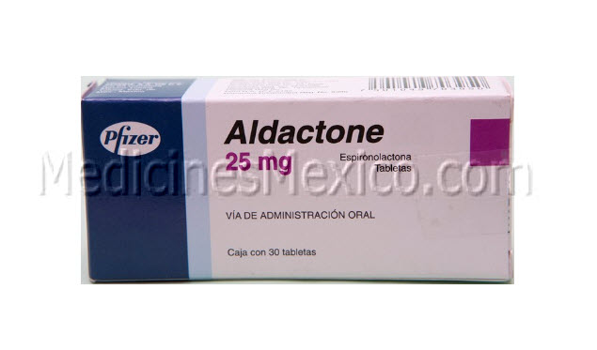
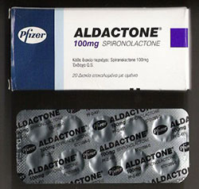
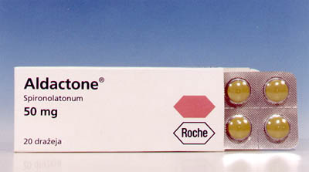

Slide 38
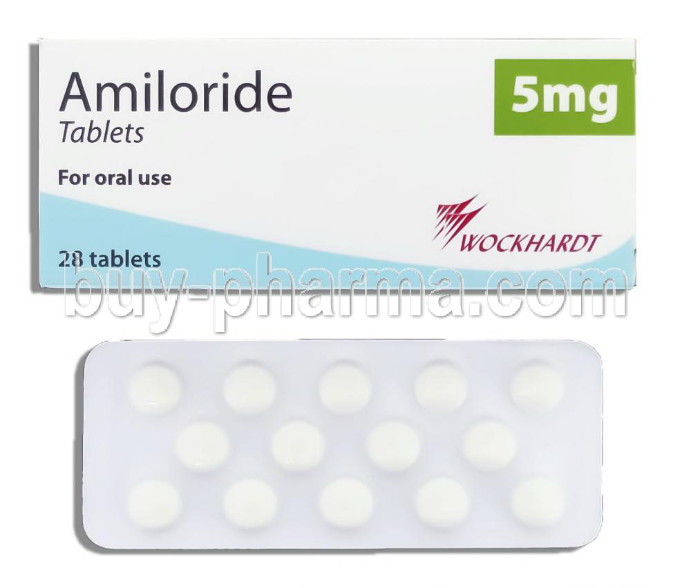

Slide 39
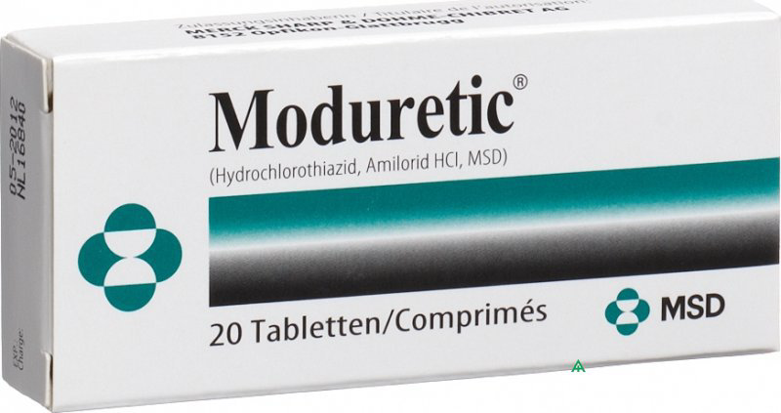

Slide 40
Other diuretics
Mannitol is an osmotic diuretic that can be used to treat cerebral oedema and raised intra-ocular pressure.
Mercurial diuretics are effective but are now almost never
used because of their nephrotoxicity.
The carbonic anhydrase inhibitor acetazolamide is
a weak diuretic and is little used for its diuretic effect. It is
used for prophylaxis against mountain sickness [unlicensed
indication] but is not a substitute for acclimatisation.
Eye drops of dorzolamide and brinzolamide
inhibit the formation of aqueous humour and are used in
glaucoma.

Slide 41
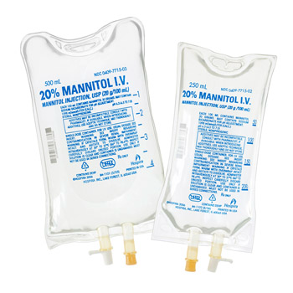

Slide 42
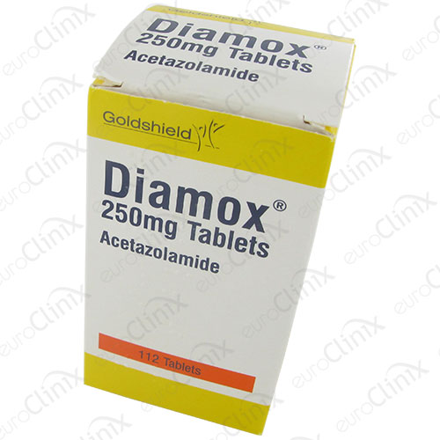
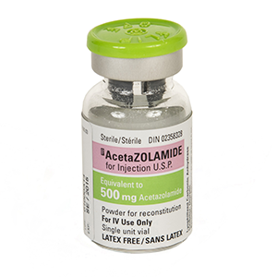

Slide 43
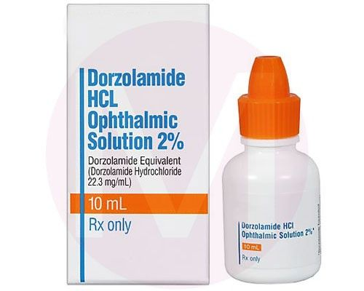

Slide 44
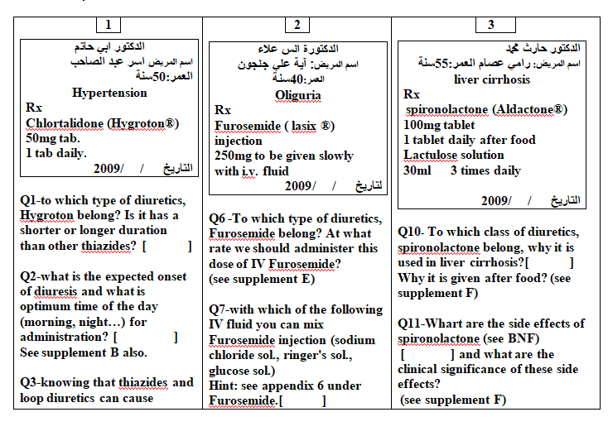

Slide 45
