Slide 1
Introduction cases
Done by
: Assistant lecturer
Lubab Tarek Nafea

Slide 2
Pre-operative care case
SC is a 30-year-old woman who is due to undergo surgery for severe Crohn’s disease. She has been admitted to the surgical ward for nutritional care prior to her surgery. On examination SC is 165 cm in height and weighs 50 kg. SC takes the following regular medications:
_ Mesalazine 500 mg tds
_ Paracetamol 1 g q.d.s. p.r.n.
_ Azathioprine 100 mg o.d.
_ Prednisolone 20 mg o.m.
_ Calcichew-D3 Forte ii o.d.
_ Alendronic acid 70 mg once a week
_ Ranitidine 150 mg b.d.
_ Ensure Plus 1 carton three times a day
_ Phenytoin 100 mg t.d.s.
_ Sodium valproate MR 200 mg b.d.
Prior to her admission, SC was prescribed Ensure Plus cartons / times/day + her usual diet. However, despite the additional nutrition provided by the Ensure Plus, SC has failed to gain sufficient weight. The surgical team caring for SC has decided they need to increase her nutritional intake and plan to commence tube feeding. SC has developed a sore throat and painful mouth due to oral thrush and she is unable to swallow her medication. SC’s medications will now need to be administered via an NG tube.

Slide 3
Questions:
1/ What approach should the pharmacist have in decision-making about SC’s regular medications?
A systematic approach should be taken. The pharmacist should consider the following:
•Is the drug needed at all?
•Can the drug be administered via any other route?
Does the drug come in a suitable formulation for administering via a tube?

Slide 4
2/ List and rationalize the medication SC will need to continue while she has an NG tube inserted?
•Medicines used to control life-threatening conditions should be continued.
•Phenytoin and sodium valproate – SC’s anti-epilepsy medicines will need to continue.
•Prednisolone – The stress of surgery causes an increase in plasma adrenocorticotrophic hormone and cortisol concentrations. Cortisol secretion can rise from 30 mg/day to 50 mg/day following minor surgery and 150 mg/day following major surgery. However, an abrupt withdrawal after a prolonged period may lead to acute adrenal insufficiency, hypotension or shock. Thus it is important to continue SC’s corticosteroid therapy and additional intravenous hydrocortisone may be administered peri-operatively.
•Paracetamol – As this is being taken as required, a judgment would have to take by the clinician whether SC still requires the medication. SC’s pain score would need to be assessed.
•Azathioprine and mesalazine will be withheld prior to the procedure. These medications are not used to control a life-threatening condition and her surgery may remove the need for these medicines.
•Alendronic acid and Calcichew D3 Forte can be withheld prior to the procedure as they are for osteoporosis prophylaxis.
•Ranitidine is being used as prophylaxis against steroid-induced gastric or duodenal ulcers. The clinician will need to decide if this needs to continue based on patients previous medical history.

Slide 5
3/ For each medication, state how you can administer that drug via an NG tube?
•Phenytoin – suspension preparation available.
•Sodium valproate – liquid preparation available.
•Prednisolone – dispersible tablets available.
•Paracetamol – dispersible tablets and liquid preparation are available.
•Ranitidine – effervescent and liquid preparations available

Slide 6
4/Will any of the drug doses need to be changed due to a formulation change?
There is a difference in bioequivalence between capsules and phenytoin suspension. A 100-mg phenytoin capsule is equivalent to 90 mg of the suspension preparation.
5/Are there any significant drug–nutrition interactions and how would you manage them?
Enteral feed reduces phenytoin absorption by 75%. The pharmacist can recommend the phenytoin to be given as a single dose, if possible. The enteral feeds should be stopped 2 hours prior to and for 2 hours after the dose. The NG tube should be ‘flushed’ with 20–50 mL of sterile water before feeds and medication. Phenytoin levels must be monitored as this drug has a narrow therapeutic index.

Slide 7
6 /If there is no suitable preparation, can the nurses crush tablets or open capsules?
Crushing tablets and opening capsules should be considered as a last resort as there is a risk to the person administering the medicines. By crushing tablets you are breaking the product license of that drug. This route would then make this an unlicensed preparation. Modified-release or slow-release preparations are designed to release the medication over a period of time. Crushing these preparations results in the whole dose being immediately available for absorption. At the least, this will cause an alteration in the patient’s drug levels and at the worst it may result in an overdose. To overcome this, some medications which are soluble can be given more frequently to maintain a steady drug level.
For example, dipyridamole 200 mg MR can be changed to 100 mg q.d.s. to have the same effect.

Slide 8
7/ In what post-operative situations is the use of parenteral nutrition indicated?
For short-term feeding (less than 14 days) NICE (2006) recommends parenteral feeding via a peripheral venous catheter for those patients who do not need central access. A GTN patch can be applied above the peripheral venous catheter site to promote vasodilatation of the vein for those patients who have narrow veins. Some TPN is unsuitable for peripheral administration due to the nitrogen and glucose concentration; these must go through a central venous catheter.
9/The team caring for SC decide to start her on parenteral nutrition at half of her daily requirements. Why is this?
As SC has eaten little for more than 5 days, she is at risk of refeeding syndrome. NICE (2006) recommend that parental nutrition should be introduced at no more than 50% of the requirements for the first 2 days for those at risk of refeeding syndrome.

Slide 9
10/ What is re-feeding syndrome?
Refeeding syndrome is defined by Crook et al. (2001) as ‘severe electrolyte and fluid shifts associated with metabolic abnormalities in malnourished patients undergoing refeeding, whether orally, enterally or parenterally’.In a starved patient, the secretion of insulin is decreased in response to the low carbohydrate intake. Catabolised fats and protein are used for energy. This results in an intracellular loss of electrolytes, in particular phosphates. When the patient starts to feed, a sudden shift from fat to carbohydrate metabolism occurs and secretion of insulin increases. This stimulates cellular uptake of magnesium, phosphate and potassium, which can lead to hypophosphatemia, hypokalemia, hypomagnesaemia and fluid balance abnormalities. These abnormalities can lead to the clinical features of refeeding syndrome which include cardiac failure, respiratory failure, rhabdomyolysis, arrhythmias and seizures.

Slide 10
11/ As SC will be ‘nil by mouth’ postoperatively, her medication will have to be administered intravenously. What advice will you give the nurse on the administration of the drugs?
•Phenytoin i.v. 100 mg t.d.s. – Inject slowly undiluted and directly into a large vein through a large-gauge needle or i.v. catheter). Maximum rate: 50 mg/min.
•Sodium valproate i.v. 200 mg b.d. – To reconstitute, inject the solvent provided (4 mL) into the vial, allow to dissolve and extract the appropriate dose. Due to displacement of solvent by sodium valproate the concentration of reconstituted sodium valproate is 95 mg/mL. Give as a slow intravenous injection over 3–5 minutes.
•Paracetamol 1000 mg i.v. – Infuse over 15 minutes.
•Prednisolone 20 mg is changed to hydrocortisone 100 mg t.d.s. i.v. bolus: over at least 30 seconds. Manufacturer recommends over 1–10 minutes

Slide 11
P0st –operative care
History
You are called to the ward at 3 a.m., to see a 20-year-old man with persistent vomiting. He had an emergency laparotomy 3 days previously. The doctor on call earlier had prescribed anti-emetics for the patient, without carrying out a full assessment. The patient is extremely distressed and the nurse in charge is concerned about his sudden deterioration. You retrieve the operation note and find the patient had undergone a ‘normal’ laparotomy for trauma. The small and large bowel was both examined carefully and no injury was found. He had made a good recovery and had been moved onto free fluids earlier in the day. There was no nasogastric tube left after the operation, and the urinary catheter had been removed.
Examination
The patient is rolling around in the bed having just vomited. His blood pressure is 120/75 mmHg and pulse rate 110/min. He has a midline incision covered with a dry dressing. The abdomen is distended and tympanic. On palpation, he is tender around the incision only. There are no bowel sounds on auscultation.

Slide 12
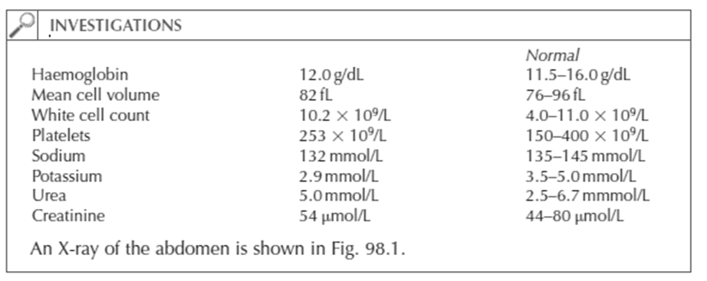
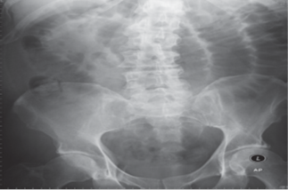

Slide 13
Questions
• What is shown on the abdominal X-ray?
• What are the most common causes?
• What is the most likely cause in this patient?
• How would you manage the patient?

Slide 14
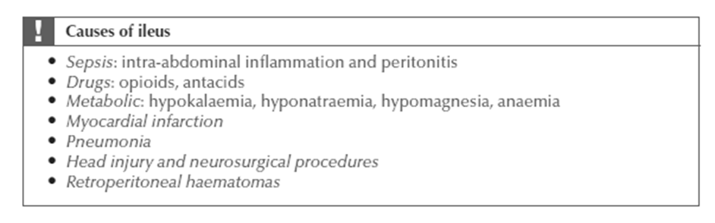
Answers:
When assessing a postoperative patient on the ward it is important to read the operation note as well as making a physical assessment. Unexpected findings or difficulties during the procedure should be documented, and this may aid your clinical decision making. This patient has a postoperative paralytic ileus. An ileus is a normal physiological event after abdominal surgery. It usually resolves spontaneously within 2–3 days of the procedure. Paralytic ileus is defined as ileus of the intestine persisting for more than 3 days after surgery. His bowels had not returned to normal function by day 3 and he had started free fluids that morning. This resulted in vomiting and abdominal discomfort. A nasogastric tube should be placed to decompress the bowel, and a urinary catheter inserted to monitor his urine output. Non-steroidal anti-inflammatory drugs (NSAIDs) can be used for pain relief, rather than opiates, as these will not affect bowel motility. The most common cause of an ileus is an intra-abdominal operation. Other factors can prolong an ileus and should be looked for and corrected if possible. This patient has hypokalemia which should be corrected.

