Slide 1
Introduction to Economic Evaluation
Dr. Haider Raheem Mohammad

Slide 2
Some basics
Those who plan, provide, receive, or pay for health services face an incessant barrage of questions such as the following.
◆ Should clinicians check the blood pressure of each adult who walks into their offices?
◆ Should planners launch a scoliosis screening programme in secondary schools?
◆ Should individuals be encouraged to request annual check-ups?
◆ Should local health departments free scarce nursing personnel from well-baby clinics so that they can carry out home visits on lapsed hypertensives?
◆ Should hospital administrators purchase each and every piece of new diagnostic equipment?
◆ Should a new, expensive drug be listed on the formulary?

Slide 3
Some basics
These are examples of general, recurring questions about who should do what to whom, with what health care resources, and with what relation to other health services.
Since the effects of choosing one course of action over another will not only have effects on health, but also on health care resources as well as other effects outside health care, informing health care decisions requires consideration of costs and benefits. For this reason, this type of evaluation is most commonly referred to as economic evaluation.

Slide 4
The features of economic evaluation
Economic evaluation, regardless of the activities (including health services) to which it is applied, has two features.
First, it deals with both the inputs and outputs, which can be described as the costs and consequences, of alternative courses of action. Few of us would be prepared to pay a specific price for a package whose contents were unknown. Conversely, few of us would accept a package, even if its contents were known and desired, until we knew the specific price being asked. In both cases, it is the linkage of costs (what must be given up) and consequences (the overall benefits expected to be received) that allows us to reach our decision.

Slide 5
The features of economic evaluation
Second, economic evaluation concerns itself with choices. Resources are limited, and our consequent inability to produce all desired outputs (including efficacious therapies), necessitates that choices must, and will, be made in all areas of human activity.
These two characteristics of economic evaluation lead us to define economic evaluation as the comparative analysis of alternative courses of action in terms of both their costs and consequences. Therefore, the basic tasks of any economic evaluation are to identify, measure, value, and compare the costs and consequences of the alternatives being considered.

Slide 6
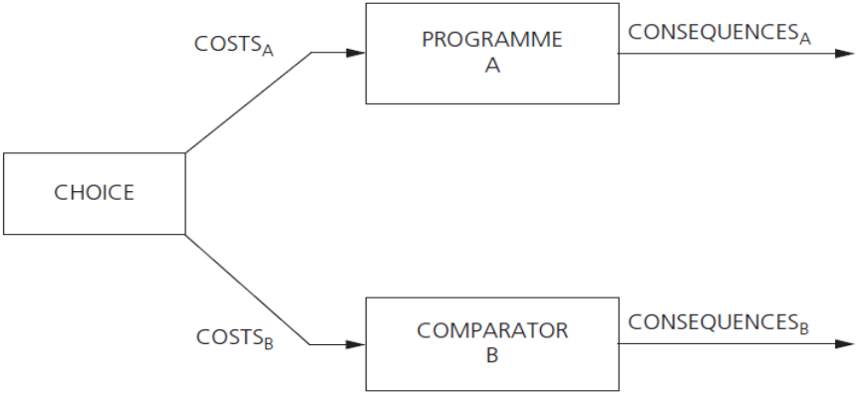
Fig. 1.1 Economic evaluation always involves a comparative analysis of alternative courses of action.

Slide 7
The features of economic evaluation
Figure 1.1 illustrates that an economic evaluation is usually formulated in terms of a choice between competing alternatives. Here we consider a choice between two alternatives, A and B. The comparator to Programme A, the programme of interest, does not have to be an active treatment. It could be doing nothing. Even when two active treatments are being compared, it may still be important to consider the baseline of doing nothing, or a low-cost option. This is because the comparator (Programme B) may itself be inefficient. (It is important that the evaluation considers all relevant alternatives).
However, the general rule when assessing programmes A and B is that the difference in costs is compared with the difference in consequences, in an incremental analysis.

Slide 8
The features of economic evaluation
However, not all of the studies measuring costs constitute economic evaluations. The large literature on cost of illness, or burden of illness, falls into this category. These studies describe the cost of disease to society but are not full economic evaluations because alternatives are not compared.
Some studies do compare alternatives but just consider costs. An example of such a study is that by Lowson et al. (1981) on the comparative costs of three methods of providing long-term oxygen therapy in the home: oxygen cylinders, liquid oxygen, and the oxygen concentrator (a machine that extracts oxygen from air). Such studies are called cost analyses. The authors argued that a cost analysis was sufficient as the relative effectiveness of the three methods was not a contentious issue. However, a full economic evaluation would explicitly consider the relative consequences of the alternatives and compare them with the relative costs.

Slide 9
Do all economic evaluations use the same techniques?
The identification of various types of costs and their subsequent measurement in monetary units is similar across most economic evaluations; however, the nature of the consequences stemming from the alternatives being examined may differ considerably.

Slide 10
1: cost-effectiveness analysis
Suppose that our interest is the prolongation of life after renal failure and that we are comparing the costs and consequences of hospital dialysis with kidney transplantation. In this case the outcome of interest—life-years gained—is common to both programmes; however, the programmes may have differential success in achieving this outcome, as well as differential costs. Consequently, we would not automatically lean towards the least-cost programme unless, of course, it also resulted in a greater prolongation of life. In comparing these alternatives, we would normally calculate this prolongation and estimate incremental cost per unit of effect (that is, the extra cost per life-year gained of the more effective and more costly option).

Slide 11
1: cost-effectiveness analysis
Such analyses, in which costs are related to a single, common effect that may differ in magnitude between the alternative programmes, are usually referred to as cost-effectiveness analyses (CEAs). Note that the results of such comparisons may be stated either in terms of incremental cost per unit of effect, as in this example, or in terms of effects per unit of cost (life-years gained per dollar spent).
It is sometimes argued that if the two or more alternatives under consideration achieve the given outcome to the same extent, a cost-minimization analysis (CMA) can be performed. However, it is not appropriate to view CMA as a form of full economic evaluation.

Slide 12
The death of cost-minimization analysis?
Economic evaluations are sometimes referred to in the literature as cost-minimization analyses (CMAs). Typically this is used to describe the situation where the consequences of two or more treatments or programmes are broadly equivalent, so the difference between them reduces to a comparison of costs.

Slide 13
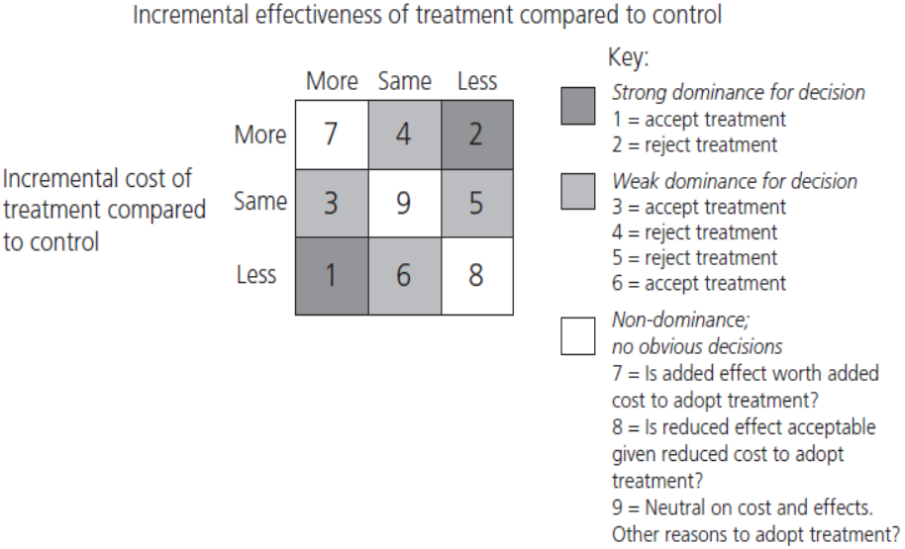
Fig. 1.2 The death of cost-minimization analysis?.

Slide 14
The death of cost-minimization analysis?
It can be seen from Figure 1.2 that there are nine possible outcomes when one therapy is being compared with another. In two of the cases (boxes 4 and 6) it might be argued that the choice between the treatment and control depends on cost because the effectiveness of the two therapies is the same.
However, Briggs and O’Brien (2001) point out that, because of the uncertainty around the estimates of costs and effects, the results of a given study rarely fit neatly into one of the nine squares shown in the diagram. Also, because of this uncertainty, CMA is not a unique study design that can be determined in advance.
The only possible application of CMA is in situations where a prior view has been taken, based on previous research or professional opinion, that the two options are equivalent in terms of effectiveness. It is likely only to be justifiable in situations where the two therapies embody a near-identical technology (e.g. drugs of the same pharmacological class).

Slide 15
2: cost–utility analysis
Another term you might encounter in the economic evaluation literature is cost–utility analysis (CUA) (NICE 2013). These studies are essentially a variant of cost-effectiveness and are often referred to as such. The only difference is that they use, for the consequences, a generic measure of health gain. As we will argue later, this offers the potential to compare programmes in different areas of health care, such as treatments for heart disease and cancer, and to assess the opportunity cost (on the budget) of adopting programmes.

Slide 16
2: cost–utility analysis
The estimation of preferences for health states is viewed as a particularly useful technique because it allows for health-related quality-of-life adjustments to a given set of treatment outcomes, while simultaneously providing a generic outcome measure for comparison of costs and outcomes in different programmes. The generic outcome, usually expressed as quality adjusted life-years (QALYs), is arrived at in each case by adjusting the length of time affected through the health outcome by the preference weight (on a scale of 0 to 1) of the resulting level of health status.

Slide 17
QALYs gained from an intervention
In the conventional approach to QALYs the quality-adjustment weight for each health state is multiplied by the time in the state and then summed to calculate the number of QALYs. The advantage of the QALY as a measure of health output is that it can simultaneously capture gains from reduced morbidity (quality gains) and reduced mortality (quantity gains) and integrate these into a single measure.

Slide 18
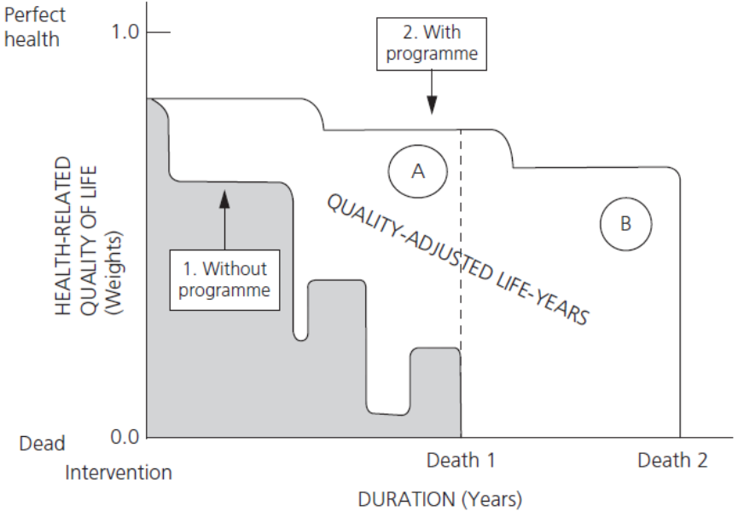
Fig. 1.3 QALYs gained from an intervention.

Slide 19
QALYs gained from an intervention
A simple example is displayed in Figure 1.3, in which outcomes are assumed to occur with certainty. Without the health intervention an individual’s health-related quality of life would deteriorate according to the lower curve and the individual would die at time Death 1. With the health intervention the individual would deteriorate more slowly, live longer, and die at time Death 2. The area between the two curves is the number of QALYs gained by the intervention. For instruction purposes the area can be divided into two parts, A and B, as shown. Then part A is the amount of QALY gained due to quality improvements (i.e. the quality gain during time that the person would have otherwise been alive anyhow), and part B is the amount of QALY gained due to quantity improvements (i.e. the amount of life extension, but adjusted by the quality of that life extension).

Slide 20
3: cost–benefit analysis
Is there a form of economic evaluation that can address whether it is worthwhile expanding the budget?
One approach would be to broaden the concept of value and to express the consequences of an intervention in monetary terms in order to facilitate comparison to programme costs. This, of course, requires us to translate effects such as disability days avoided, life-years gained, medical complications avoided, or QALYs gained, into a monetary value that can be interpreted alongside costs. This type of analysis is called cost–benefit analysis (CBA) and has a long track record in areas of economic analysis outside health such as transport and environment. The results of such analyses might be stated either in the form of a ratio of costs to benefits, or as a simple sum (possibly negative) representing the net benefit (loss) of one programme over another.

Slide 21
Use of economic evaluation in health care decision-making
Over the past 20 years, two factors have led to an increased prominence of economic evaluation within health care decision-making. First, increasing pressures on health care budgets have led to a shift in focus from merely assessing clinical effectiveness, to one on assessing both clinical effectiveness and cost-effectiveness. Secondly, decision-making processes have emerged in several jurisdictions that enable the results of economic evaluations to be used as an integral part of funding, reimbursement, or coverage, decisions.

Slide 22
Use of economic evaluation in health care decision-making
In 1991 the Commonwealth of Australia announced that, from January 1993, economic analyses would be required in submissions to the Pharmaceutical Benefits Advisory Committee, the body that advises the minister on the listing of drugs on the national formulary of publicly subsidized drugs, the Pharmaceutical Benefits Schedule (PBS).
Since that time, this policy has become fairly widespread, with approximately half the countries in the European Union, plus Canada and New Zealand, requesting economic analyses of pharmaceuticals, and sometimes other health technologies, to varying degrees. In the last 5 years several payers in the United States and countries in Latin America and Asia have also expressed an interest in receiving economic data.

Slide 23
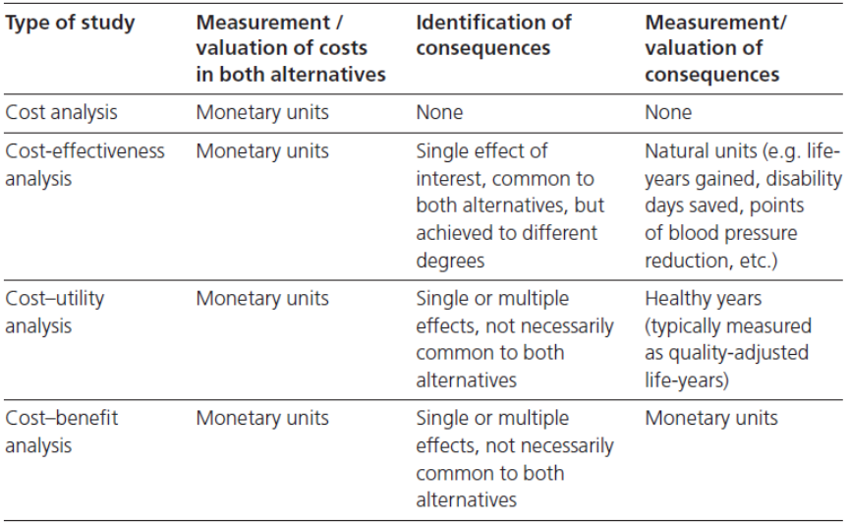
Table 1.1 Measurement of costs and consequences in economic evaluation

Slide 24
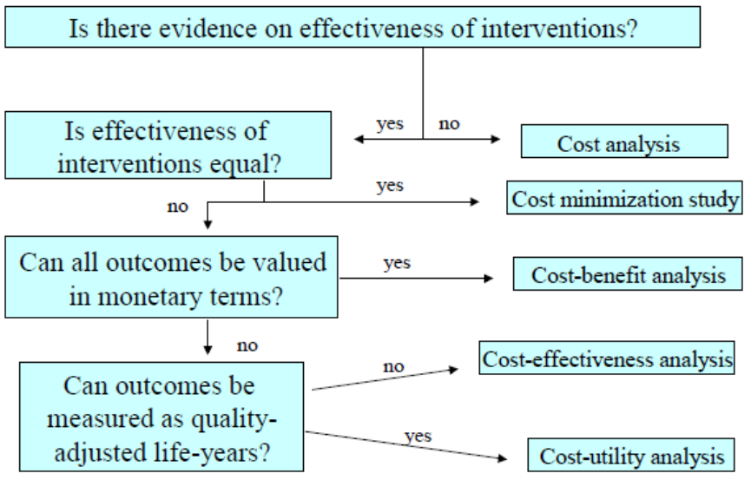
Figure 1.4 Types of Economic evaluation

