Slide 1
INFRARED SPECTROSCOPY
Assist.Prof. Dr.Ayad MR Raauf
2nd Semester
College of Pharmacy,
Dept. of pharmaceutical chemistry
(M Sc. Students)

Slide 2
Emission
Fluorimetry
Flame photometer
Absorption
NMR
Spectroscopy
IR
UV

Slide 3
Electromagnetic Spectrum
Frequency, ν in Hz
~10¹⁹
~10¹⁷
~10¹⁵
~10¹³
~10¹⁰
~10⁵
Wavelength, λ
~.0001 nm
~0.01 nm
10 nm
1000 nm
0.01 cm
100 m
Energy (kcal/mol)
> 300
300-30
300-30
~10⁻⁴
~10⁻⁶
γ-rays
X-rays
UV
IR
Microwave
Radio
nuclear excitation (PET) | core electron excitation (X-ray cryst.) | electronic excitation (π to π*) | molecular vibration | molecular rotation | Nuclear Magnetic Resonance NMR (MRI)
Visible

Slide 5
CONTENTS
1. INTRODUCTION
2. THEORY-MOLECULAR VIBRATION
3. INSTRUMENTATION
4. Infrared Group Analysis

Slide 6
1. Introduction
IR spectroscopy is an useful tool to identify functional groups in organic molecules .
IR spectrum is an important record which gives sufficient information about the structure of a compound and also determine the functional group.
Spectroscopy is the study of the interaction of matter with the electromagnetic spectrum.
Electromagnetic radiation displays the properties of both particles and waves.
2. The particle component is called a photon.
3. The energy (E) component of a photon is proportional to the frequency.
Where h is Planck’s constant and ν is the frequency in Hertz (cycles per second)
E = hν
= c / λ
E = hc / λ
C, is speed of light (constant)
λ, is wavelength in cm

Slide 7
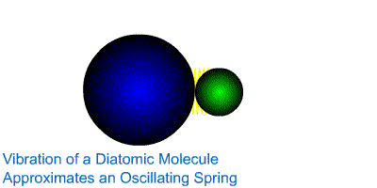
2. THEORY-MOLECULAR VIBRATION
1. IR spectroscopy is a result of molecular vibrational transitions that occur when light interacts with matter Molecules are always vibrating.

Slide 8
2. When a wave of infrared light encounters this oscillating EM field generated by the oscillating dipole of the same frequency, the two waves couple, and IR light is absorbed
3. The coupled wave now vibrates with twice the amplitude
IR beam from spectrometer
“coupled” wave
EM oscillating wave
from bond vibration

Slide 9
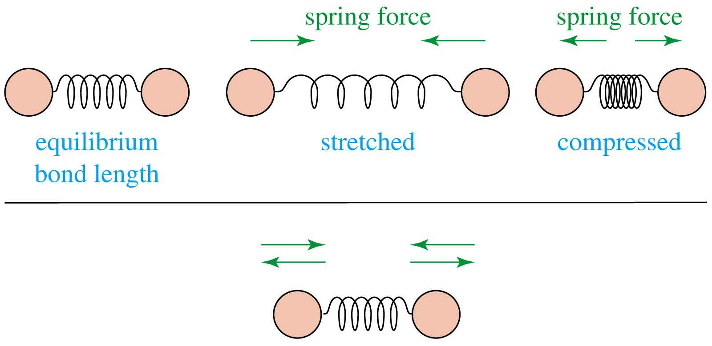
Molecular Vibrations
Covalent bonds vibrate at only certain allowable frequencies.

Slide 10
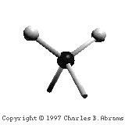
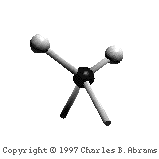
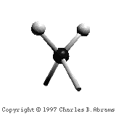
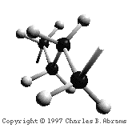
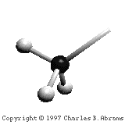
4. There are two types of bond vibration:
Stretch – Vibration or oscillation along the line of the bond
Bend – Vibration or oscillation not along the line of the bond
H
H
C
C
H
H
symmetric
asymmetric
H
H
H
H
C
C
C
C
C
C
C
C
H
H
H
H
scissor
rock
twist
wag
in plane
out of plane

Slide 11
5. The absorption of IR radiations can be expressed either in terms of wavelength(λ) or in wave number (ṽ).
Relationship between wavelength(λ) and wave number (ṽ ).
ṽ= 1/ λ
ṽ in cm⁻¹

Slide 12
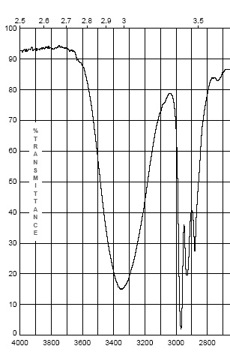
6. The IR Spectrum
a. Each stretching and bending vibration occurs with a characteristic frequency as the atoms and charges involved are different for different bonds
The y-axis on an IR spectrum is in units of % transmittance
In regions where the EM field of an osc. bond interacts with IR light of the same ν– transmittance is low (light is absorbed)
In regions where no osc. bond is interacting with IR light, transmittance nears 100%

Slide 13
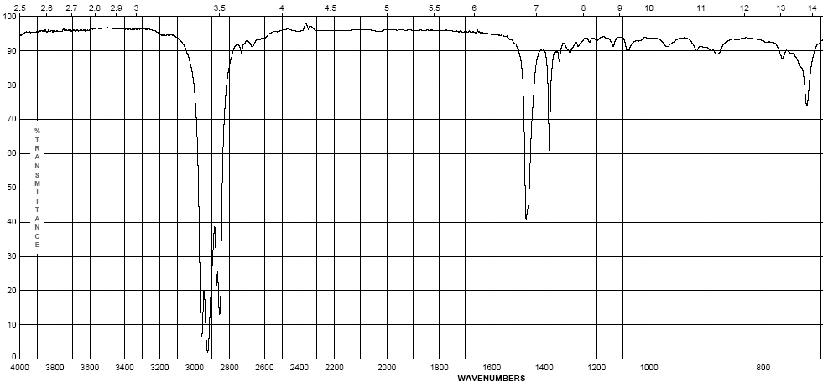
b. The x-axis of the IR spectrum is in units of wavenumbers, ṽ, which
is the number of waves per centimeter in units of cm⁻¹
c. IR spectra are observed for the mid-infrared: 600-4000 cm⁻¹

Slide 14
d. It is important to make note of peak intensities to show the effect of these factors:
Strong (s) – peak is tall, transmittance is low (0-90 %)
Medium (m) – peak is mid-height (75-35%)
Weak (w) – peak is short, transmittance is high (90-75%)
* Broad (br) – if the Gaussian distribution is abnormally broad

Slide 15
3. Instrumentation
• IR radiation source
• Wavelength selector (Monochromator)
• Sample Holder or cell
• Detector
• Recorder
Handling of samples in IR
• Sampling techniques in IR depend on whether the sample is a
Gas
- Gas cell
Liquid
- Thin film
Solid
- KBr Pellet - few mg sample + 0.2g dry KBr ground compressed at very high pressure.
- Mull - suspend ground solid in oil of similar refractive index (Nujol, perfluorocarbon),

Slide 16
4. Infrared Group Analysis
General : The four primary regions of the IR spectrum
Bonds to H
Triple bonds
Double bonds
Single Bonds
O-H N-H C-H | C≡C C≡N | C=O C=N C=C | Fingerprint Region C-C C-N C-O
4000 cm⁻¹
2700 cm⁻¹
2000 cm⁻¹
1600 cm⁻¹
600 cm⁻¹

Slide 17
Octane
Alkanes – combination of C-C and C-H bonds
C-C stretches and bends 1360-1470 cm⁻¹
CH₂-CH₂ bond 1450-1470 cm⁻¹
CH₂-CH₃ bond 1360-1390 cm⁻¹
sp³ C-H between 2800-3000 cm⁻¹
(w – s)
(m)

Slide 18
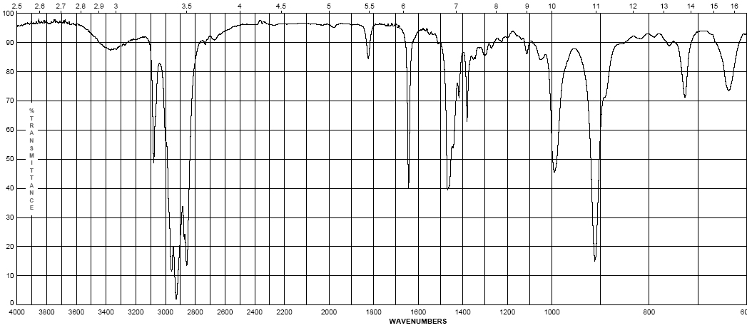
1-Octene
Alkenes – addition of the C=C and vinyl C-H bonds
C=C stretch at 1620-1680 cm⁻¹ weaker as substitution increases
vinyl C-H stretch occurs at 3000-3100 cm⁻¹
The difference between alkane, alkene or alkyne C-H is important! If the band is slightly above 3000 it is vinyl sp² C-H or alkynyl sp C-H if it is below it is alkyl sp³ C-H
(w – m)
(w – m)

Slide 19
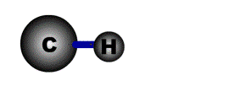
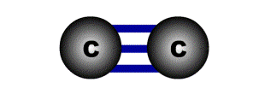
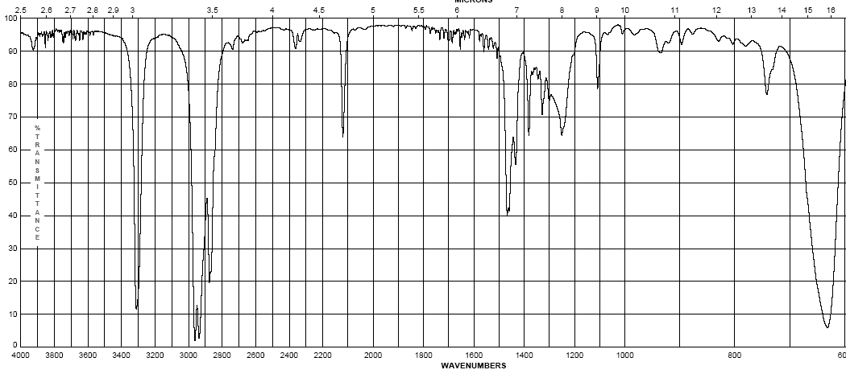
1-Octyne
Alkynes – addition of the C=C and vinyl C-H bonds
C≡C stretch 2100-2260 cm⁻¹; strength depends on asymmetry of bond, strongest for terminal alkynes, weakest for symmetrical internal alkynes
C-H for terminal alkynes occurs at 3200-3300 cm⁻¹
Internal alkynes ( R-C≡C-R ) would not have this band!
(w-m)
(m – s)

Slide 20
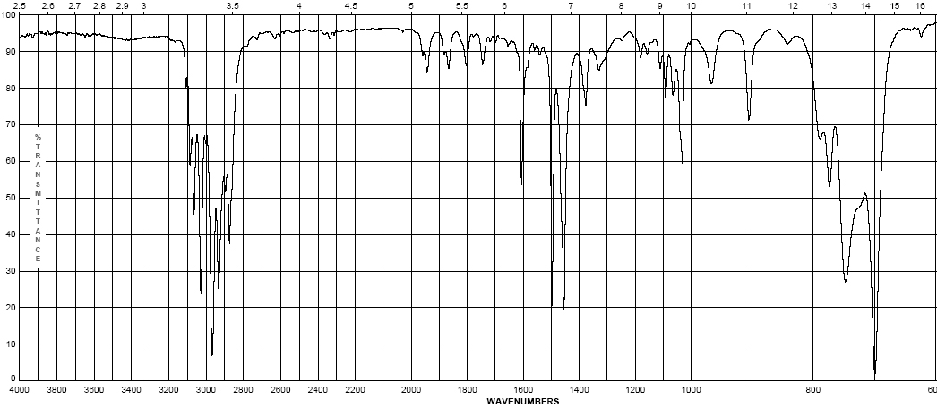
Ethyl benzene
Aromatics
Due to the delocalization of e⁻ in the ring, C-C bond order is 1.5, the stretching frequency for these bonds is slightly lower in energy than normal C=C
These show up as a pair of sharp bands, 1500 & 1600 cm⁻¹, (lower frequency band is stronger)
C-H bonds off the ring show up similar to vinyl C-H at 3000-3100 cm⁻¹
(w – m)
(w – m)

Slide 21
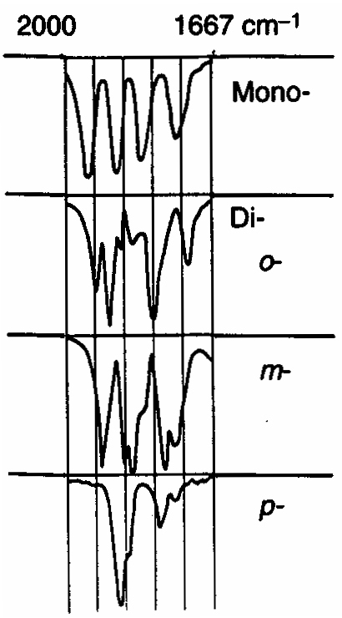
Aromatics
If the region between 1667-2000 cm⁻¹ (w) is free of interference (C=O stretching frequency is in this region) a weak grouping of peaks is observed for aromatic systems
Analysis of this region, called the overtone of bending region, can lead to a determination of the substitution pattern on the aromatic ring
Monosubstituted
1,2 disubstituted (ortho or o-)
1,2 disubstituted (meta or m-)
1,4 disubstituted (para or p-)

Slide 22
Unsaturated Systems – substitution patterns
The substitution of aromatics and alkenes can also be discerned through the out-of-plane bending vibration region
However, other peaks often are apparent in this region. These peaks should only be used for reinforcement of what is known or for hypothesizing as to the functional pattern.

Slide 23
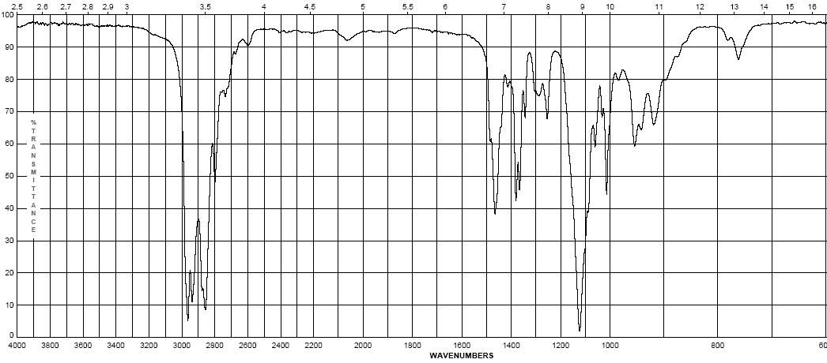
Diisopropyl ether
Ethers – addition of the C-O-C asymmetric band
Show a strong band for the antisymmetric C-O-C stretch at 1050-1150 cm⁻¹
Otherwise, dominated by the hydrocarbon component of the rest of the molecule
(s)

Slide 24
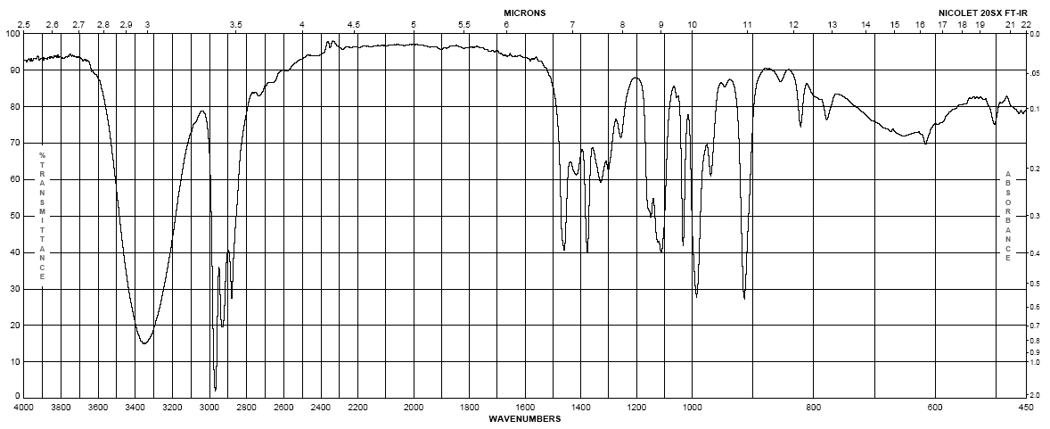
1-butanol
Alcohols
Strong, broad O-H stretch from 3200-3400 cm⁻¹
Like ethers, C-O stretch from 1050-1260 cm⁻¹
Band position changes depending on the alcohols substitution: 1° 1075-1000; 2° 1075-1150; 3° 1100-1200; phenol 1180-1260
The shape is due to the presence of hydrogen bonding
(m– s)
br
(s)

Slide 25
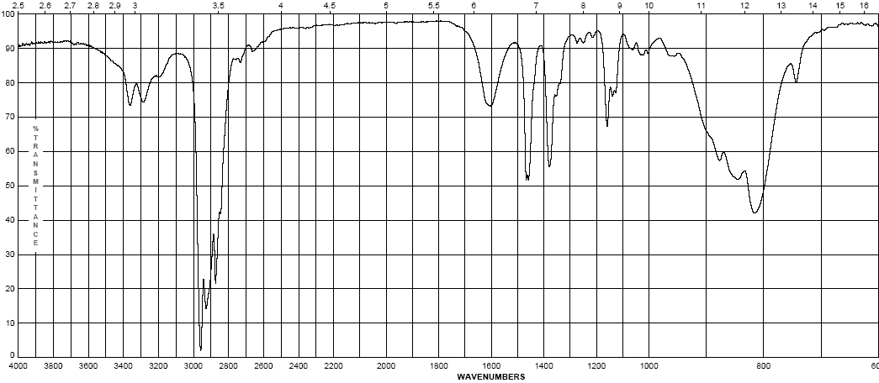
2-aminopentane
Amines - Primary
Shows the –N-H stretch for NH₂ as a doublet between 3200-3500 cm⁻¹ (symmetric and anti-symmetric modes)
-NH₂ has deformation band from 1590-1650 cm⁻¹
Additionally there is a “wag” band at 780-820 cm⁻¹ that is not diagnostic
(w)
(w)

Slide 26
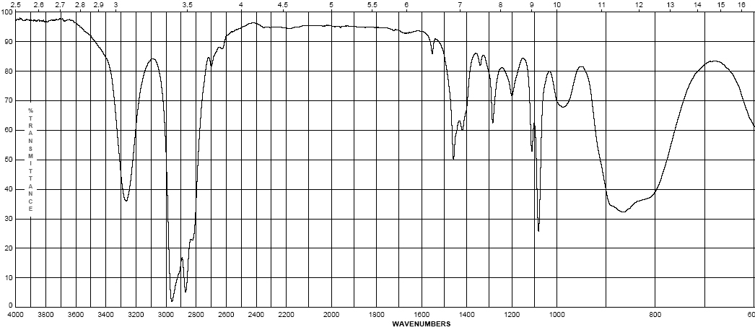
pyrrolidine
Amines – Secondary
N-H band for R₂N-H occurs at 3200-3500 cm⁻¹ as a single sharp peak weaker than –O-H
Tertiary amines (R₃N) have no N-H bond and will not have a band in this region
(w – m)

Slide 27
Pause and Review
Inspect the bonds to H region (2700 – 4000 cm⁻¹)
Peaks from 2850-3000 are simply sp³ C-H in most organic molecules
Above 3000 cm⁻¹ Learn shapes, not wavenumbers!:
V-shape peak
-N—H bond for 2º amine (R₂N—H)
Broad U-shape peak
-O—H bond
W-shape peak
-N—H bond for 1º amine (RNH₂)
Sharp spike
-C≡C—H bond
3000 cm⁻¹
Small peak shouldered just above 3000 cm⁻¹ C=C—H or Ph—H

Slide 28
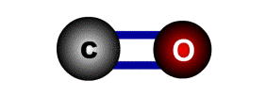
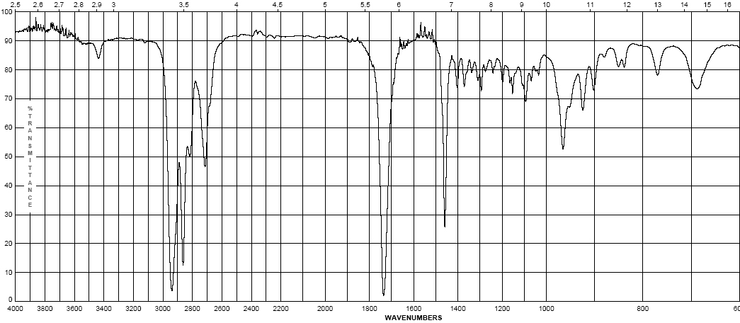
Cyclohexyl carboxaldehyde
Aldehydes
C=O (carbonyl) stretch from 1720-1740 cm⁻¹
Band is sensitive to conjugation, as are all carbonyls (upcoming slide)
A highly unique sp² C-H stretch appears as a doublet, 2720 & 2820 cm⁻¹ called a “Fermi doublet”
(w-m)
(s)

Slide 29
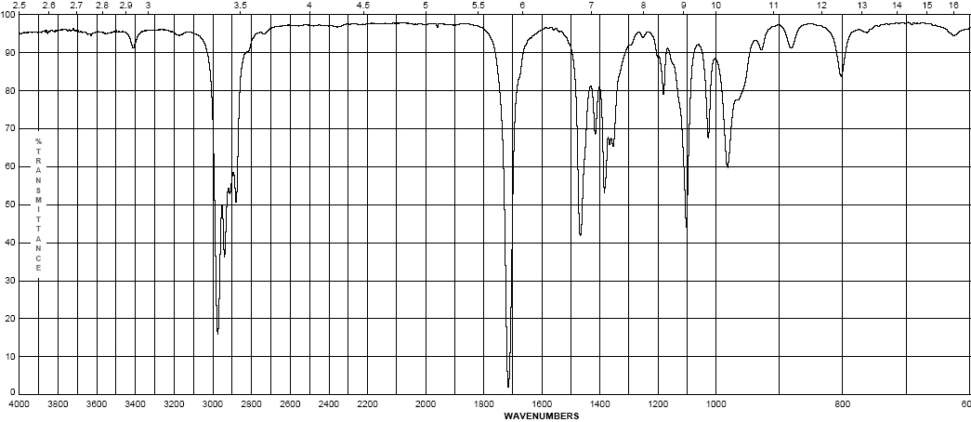
3-methyl-2-pentanone
Ketones
Simplest of the carbonyl compounds as far as IR spectrum – carbonyl only
C=O stretch occurs at 1705-1725 cm⁻¹
(s)

Slide 30
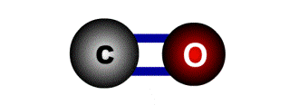
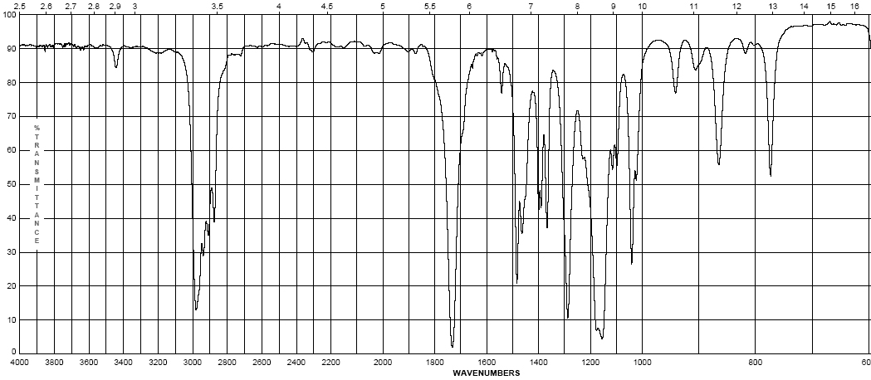
Ethyl pivalate
Esters
C=O stretch at 1735-1750 cm⁻¹
Strong band for C-O at a higher frequency than ethers or alcohols at 1150-1250 cm⁻¹
(s)
(s)

Slide 31
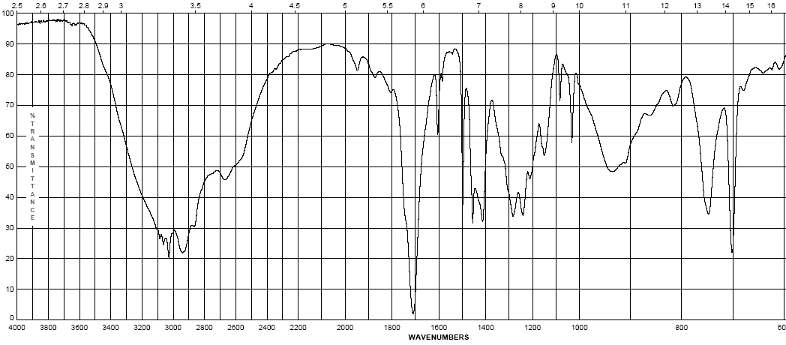
4-phenylbutyric acid
Carboxylic Acids:
Gives the messiest of IR spectra
C=O band occurs between 1700-1725 cm⁻¹
The highly dissociated O-H bond has a broad band from 2400-3500 cm⁻¹ covering up to half the IR spectrum in some cases
(w – m)
br
(s)
(s)

Slide 32
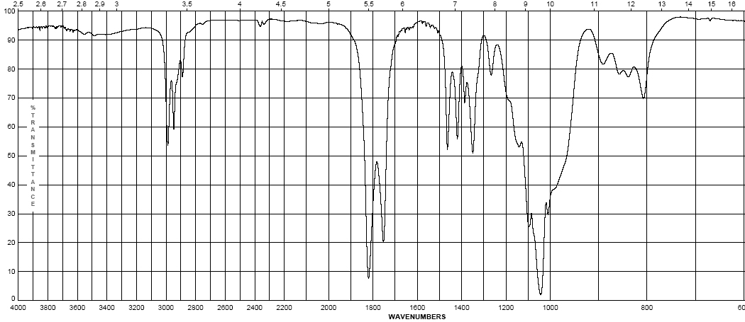
Propionic anhydride
Acid anhydrides
Coupling of the anhydride though the ether oxygen splits the carbonyl band into two with a separation of 70 cm⁻¹
Bands are at 1740-1770 cm-1 and 1810-1840 cm⁻¹
Mixed mode C-O stretch at 1000-1100 cm⁻¹
(s)
(s)

Slide 33
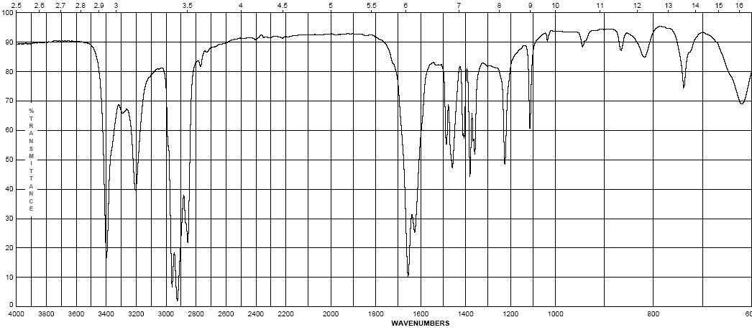
pivalamide
Amides
Display features of amines and carbonyl compounds
C=O stretch at 1640-1680 cm⁻¹
If the amide is primary (-NH₂) the N-H stretch occurs from 3200-3500 cm⁻¹ as a doublet
If the amide is secondary (-NHR) the N-H stretch occurs at 3200-3500 cm⁻¹ as a sharp singlet
(m – s)
(s)

Slide 34
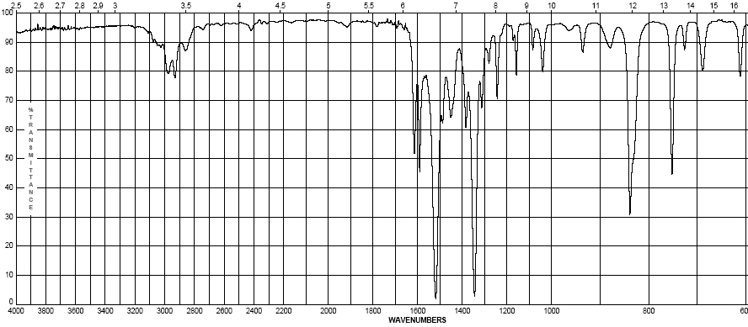
2-nitropropane
Nitro group (-NO₂)
Proper Lewis structure gives a bond order of 1.5 from nitrogen to each oxygen
Two bands are seen (symmetric and asymmetric) at 1300-1380 cm⁻¹ and 1500-1570 cm⁻¹
This group is a strong resonance withdrawing group and is itself vulnerable to resonance effects
(s)
(s)

Slide 35
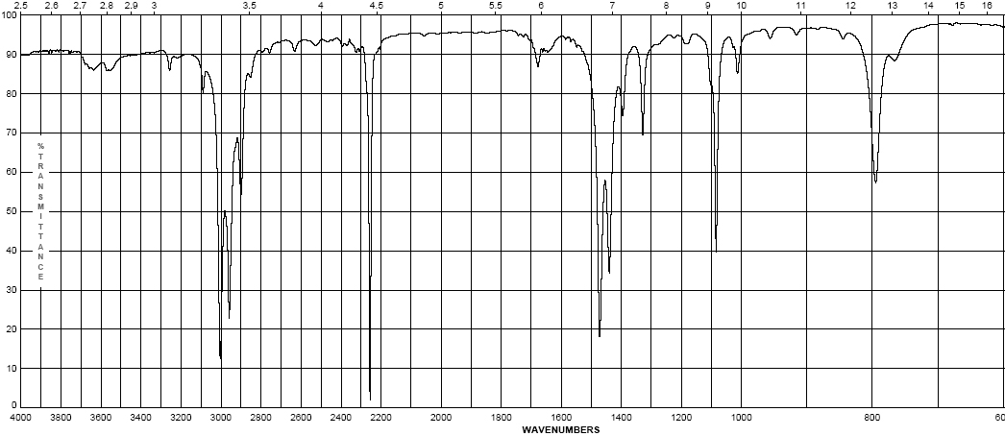
propionitrile
Nitriles (the cyano- or –C≡N group)
Principle group is the carbon nitrogen triple bond at 2100-2280 cm⁻¹
This peak is usually much more intense than that of the alkyne due to the electronegativity difference between carbon and nitrogen
(s)

Slide 36
Effects on IR bands
Conjugation – by resonance, conjugation lowers the energy of a double or triple bond. The effect of this is readily observed in the IR spectrum:
Conjugation will lower the observed IR band for a carbonyl from 20-40 cm⁻¹ provided conjugation gives a strong resonance contributor
Inductive effects are usually small, unless coupled with a resonance contributor (note –CH₃ and –Cl above)

Slide 37
Effects on IR bands
Steric effects – usually not important in IR spectroscopy, unless they reduce the strength of a bond (usually π) by interfering with proper orbital overlap:
Here the methyl group in the structure at the right causes the carbonyl group to be slightly out of plane, interfering with resonance
Strain effects – changes in bond angle forced by the constraints of a ring will cause a slight change in hybridization, and therefore, bond strength
As bond angle decreases, carbon becomes more electronegative, as well as less sp² hybridized (bond angle < 120°)

Slide 38
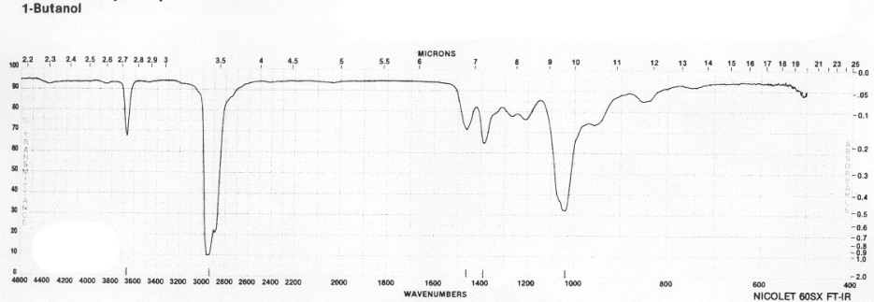
Effects on IR bands
Hydrogen bonding
Hydrogen bonding causes a broadening in the band due to the creation of a continuum of bond energies associated with it
In the solution phase these effects are readily apparent; in the gas phase where these effects disappear or in lieu of steric effects, the band appears as sharp as all other IR bands:
Gas phase spectrum of
1-butanol
Steric hindrance to H-bonding
in a di-tert-butylphenol
H-bonding can interact with other functional groups to lower frequencies

