Slide 1
Epithelial Tissues
By
Dr. Fitua Al-Saedi

Slide 2
Histology
The study of animal tissues is called histology.
Tissue Definition
A tissue is a group of cells and their extracellular matrix that share the same embryonic origin and perform a similar function.
The human body is composed of four main types of tissues :
1. Epithelial tissues
2. Connective tissues
3. Muscular tissues
4. Nervous tissues

Slide 3
Epithelial Tissues
Epithelial tissues are essentially large sheets of cells covering the internal and external surfaces of the body.
Epithelia arise from all of the 3 primary germ layers: ectoderm (outer layer; e.g. skin & surface of sense organs), mesoderm (middle layer; e.g. lining of body cavities), and endoderm (inner layer; e.g. internal linings of gastrointestinal & respiratory tracts).

Slide 4
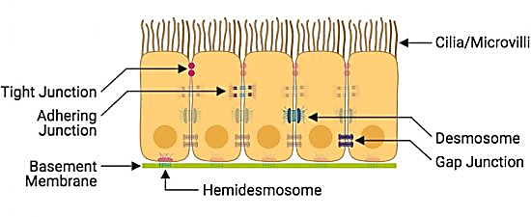
General characteristics of epithelial cells and tissues:
Polar: Epithelial cells have structurally- and functionally-distinct apical and basal surfaces. The apical surface faces the external environment or lumen while the basal surface faces the basement membrane.
Closely-connected continuous sheets: Epithelial cells typically fit closely together, forming continuous sheets of tissue. The lateral surfaces of these cells interact through junctional complexes (adhering junctions, tight junctions, and desmosomes) and gap junctions

Slide 5
General characteristics of epithelial cells and tissues:
Avascular: Epithelial tissue does not contain blood vessels, with few exceptions (e.g. stria vascularis of inner ear).
Supported by connective tissue: Epithelia rely on support from underlying connective tissue, facilitated by a layer of extracellular matrix called a basement membrane.

Slide 6
Types of epithelial tissues
Two main types of epithelial tissues:
A- Covering or lining epithelium
B- Glandular epithelium

Slide 7

A. Covering or lining epithelium
They are classified according to the number of structural layers into :
Simple epithelium
Is an epithelial tissue made up of only one layer of epithelial cells. These cells are in direct contact with the basement membrane
Stratified epithelium
This type of epithelial is composed of more than one layer of epithelial cells. The basal layer is the only one that is in contact with the basal lamina

Slide 8
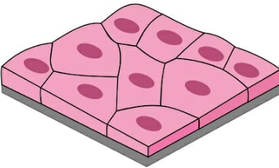
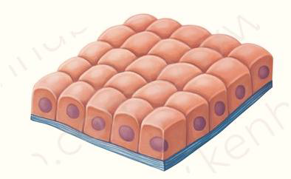
1. Simple epithelium includes:
a. Simple squamous epithelium:
This type of tissues is found in the following parts in the body:
➢ lining the inside of the blood vessels [called: endothelium]
➢ lining the inside of the lung cavities [mesothelium]
➢ lining the inside of the mouth and esophagus
b. Simple cuboidal epithelium:
This type of tissues is found in the following parts in the body:
➢ lining the tubules within the kidney
➢ lining the ducts of many glands

Slide 9
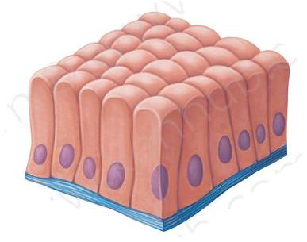
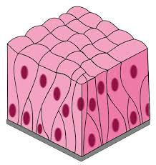
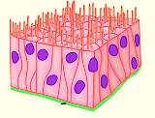
1- Simple epithelium includes:
c. Simple columnar epithelium:
This type of tissues is lining the stomach and the intestines
d. Pseudostratified epithelium:
It consists of many types of cells arranged in different levels and therefore it gives this tissue a pseudostratified shape.
Non-ciliated pseudostratified columnar epithelia are located in the membranous part of male vas deferens, while ciliated type of this tissue is found in the trachea.

Slide 10
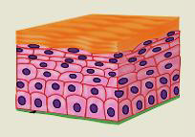
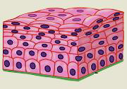

2- Stratified epithelium:
This type of epithelium consists of many cell layers.
a. Stratified squamous epithelium:
There are two types of this tissue:
1- Keratinized which is found in the skin (epidermis).
2- Non-keratinized which found in the mouth and vagina.
b. Stratified cuboidal epithelium:
This type is found in the ducts of the glands.

Slide 11
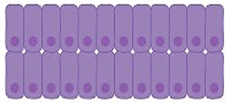
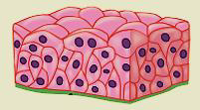
2- Stratified epithelium:
c. Stratified columnar epithelium:
This type is found in the in conjunctiva
d. Transitional epithelium:
This type is found only in the urinary system.

Slide 12
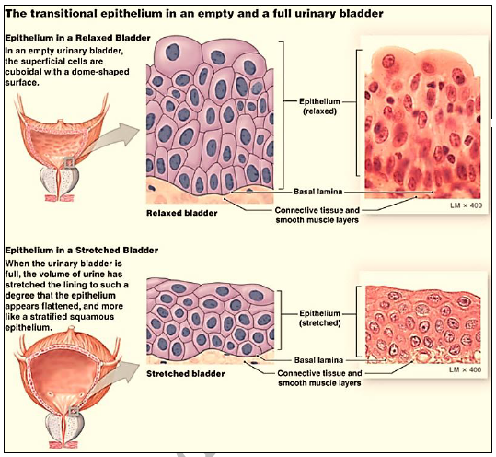

Slide 13
B-Glandular epithelium (the glands):
Some epithelial cells may be specialized to perform a secretory
function.
Comprised of organized collections of secretory epithelial cells, glands (also called glandular epithelia) are broadly divided into two categories:
endocrine (without ducts) & exocrine (with ducts).
Endocrine Glands release their secretions—called hormones—directly into
the bloodstream for distribution to target tissues with specialized receptors.
Examples include the pituitary gland, the ovaries & testes, and the pancreas
Exocrine Glands release their secretions into a lumen through an epithelial-lined tube called a duct
Examples include salivary glands & sweat glands

Slide 14
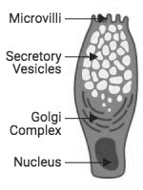
~~~ Exocrine Glands
While most exocrine glands are multicellular, goblet cells are the only example of unicellular exocrine glands in mammals. They can be found in the epithelium lining of the intestines.
These specialized epithelial cells secrete mucus are typically found in simple and pseudostratified columnar membranes
Goblet cell

Slide 15
Function of epithelial tissues
Protection
Epithelia provide a layer of protection for all underlying tissues from toxins, pathogens, etc.
e.g. stratified squamous keratinized epithelium of the skin
Absorption and/or Secretion
Depending on the location, some epithelia are involved in absorption or secretion
e.g. simple cuboidal epithelium of the choroid plexus
Motility
Some epithelia have motile cilia on their apical surface that move in coordinated waves to move particles (e.g. mucus)
e.g. ciliated pseudostratified columnar epithelium of the trachea
Sensation
e.g. stratified squamous non-keratinized epithelium of the cornea

Slide 16
Thank you for your attention

