Slide 1
NMR Spectroscopy
Interpretation of NMR spectrum II

Slide 2
Nuclear Magnetic Resonance Spectroscopy
¹H NMR—Number of Signals
The number of NMR signals equals the number of different types of protons in a compound.
Protons in different environments give different NMR signals.
Protons that occupy identical electronic environments are called chemically equivalent
Equivalent protons give the same NMR signal.

Slide 3
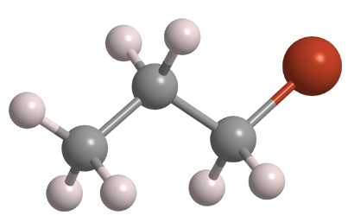
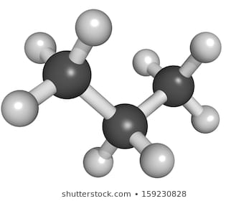
Nuclear Magnetic Resonance Spectroscopy
¹H NMR—Number of Signals
CH₃-CH₂-CH₂-Br
CH₃-CH₂-CH₃
b
a
c
a
a
b
Equivalent protons
Three signals
Two signals

Slide 4
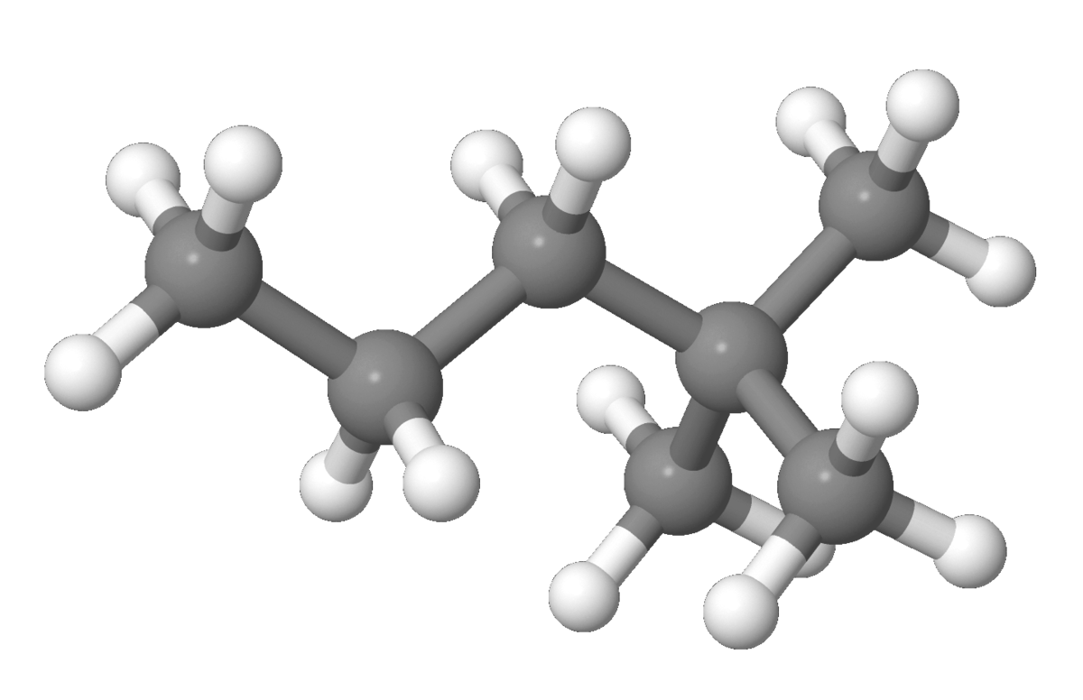
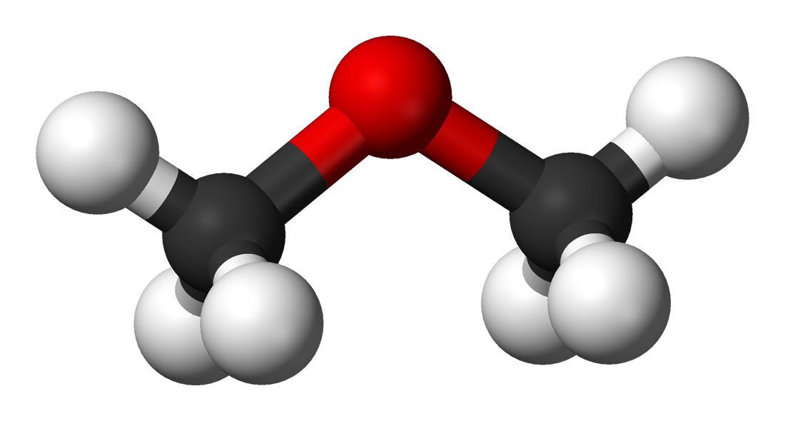
Nuclear Magnetic Resonance Spectroscopy
¹H NMR—Number of Signals
CH₃-O-CH₃
C(CH₃)₃-CH₂-CH₂-CH₃
b
a
a
a
c
d
a
a
One signal
Four signals

Slide 5
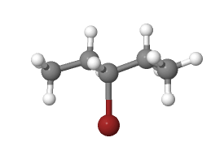
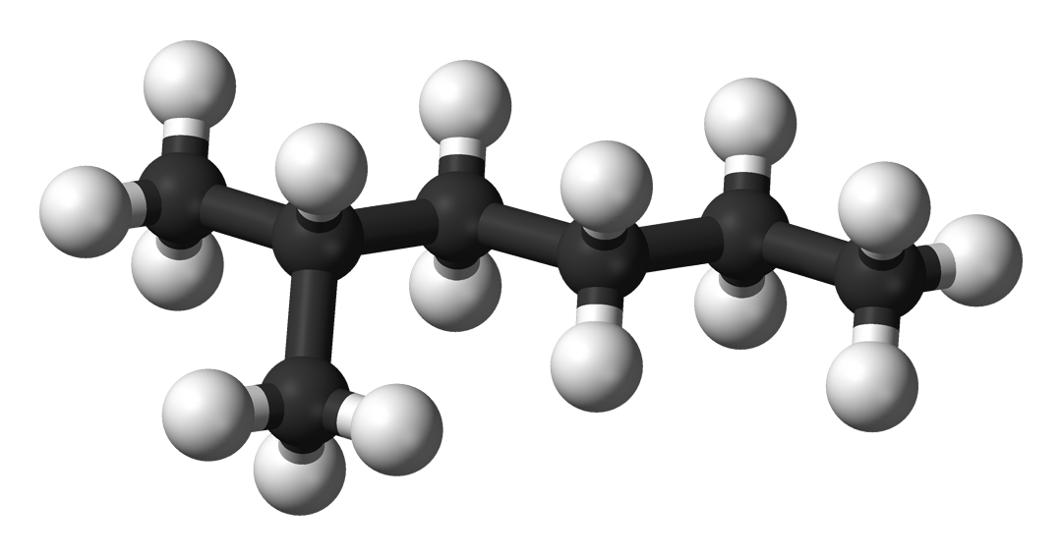
Nuclear Magnetic Resonance Spectroscopy
¹H NMR—Number of Signals
CH₃-CH2-CH(Br)-CH2-CH₃
CH(CH₃)₂-CH₂-CH₂-CH₂-CH₃
b
b
b
a
c
e
f
a
a
a
c
a
d
Three signals
Six signals

Slide 6
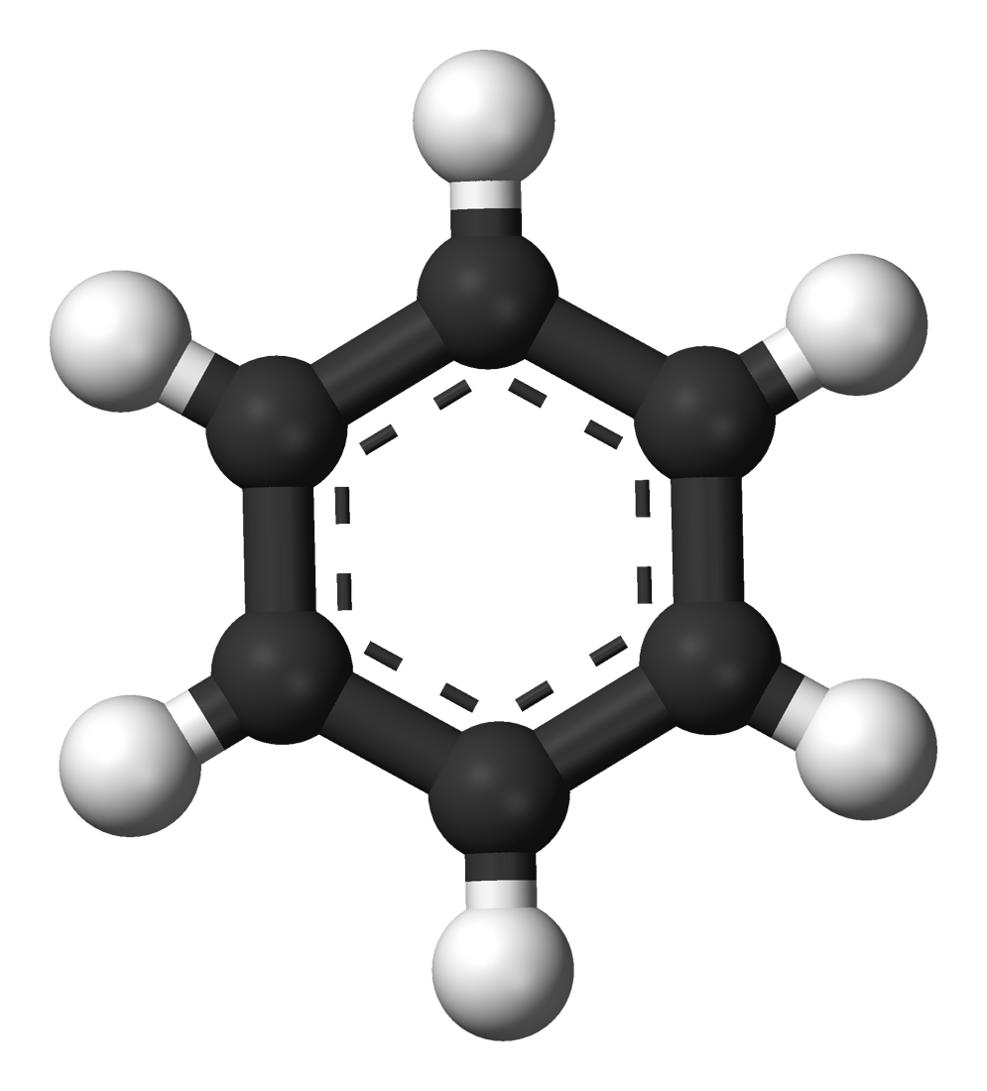
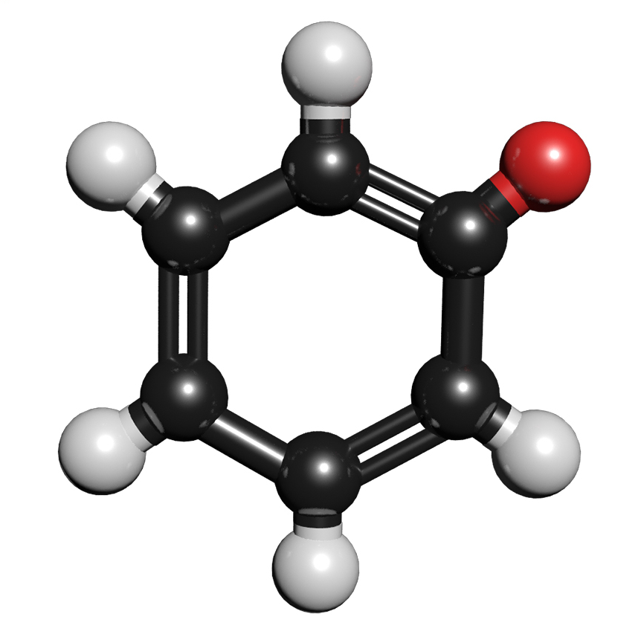
Nuclear Magnetic Resonance Spectroscopy
¹H NMR—Number of Signals
C₆H₆
C₆H₅Br
a
a
b
a
a
a
c
a
a
a
b
One signal
Three signals

Slide 7
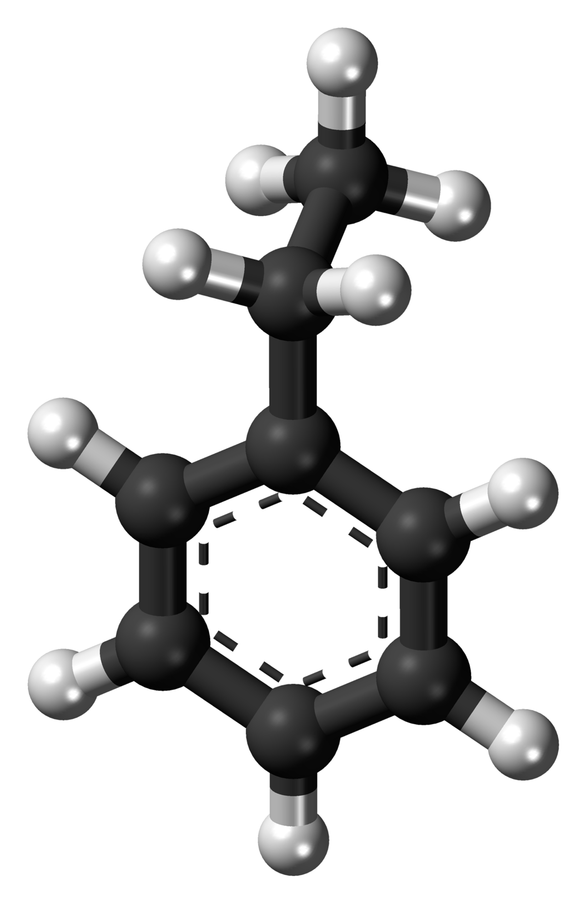
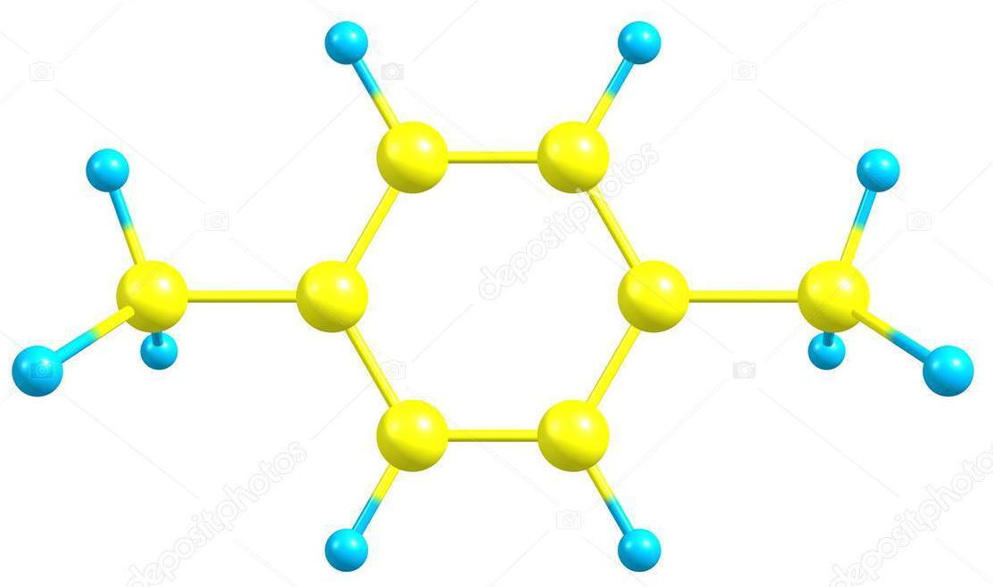
Nuclear Magnetic Resonance Spectroscopy
¹H NMR—Number of Signals
C₆H₄(CH₃)₂
C₆H₅CH₂CH₃
e
b
b
a
a
d
a
a
b
b
b
b
c
Symmetric
Two signals
Five signals

Slide 8
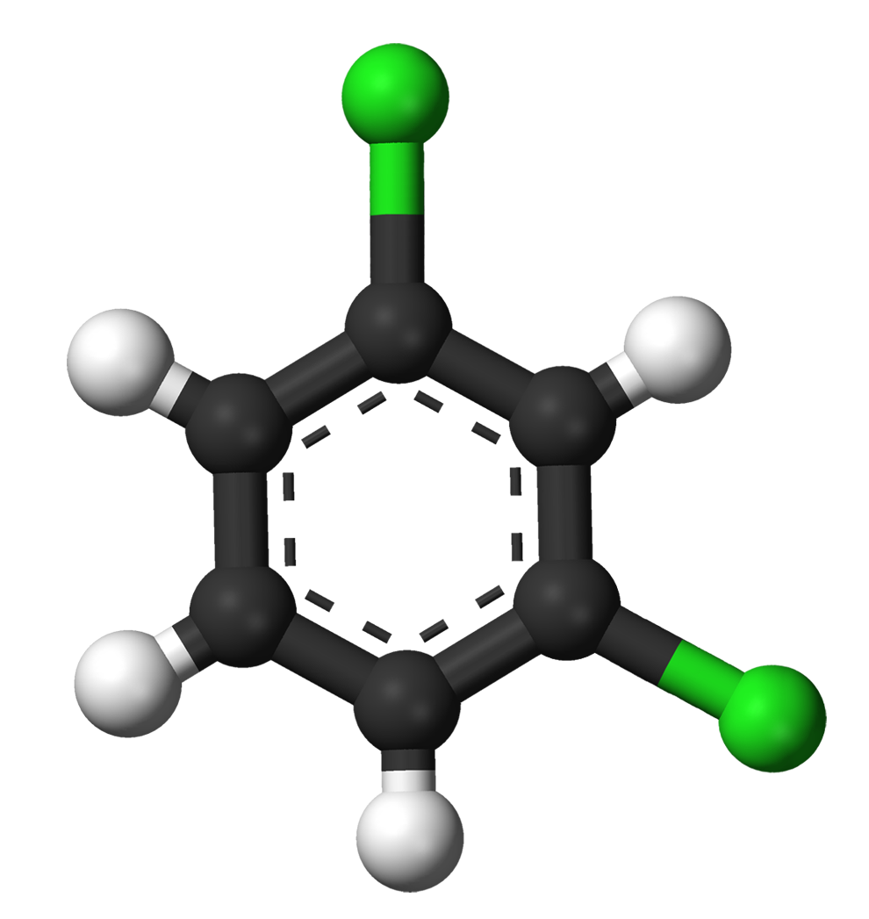
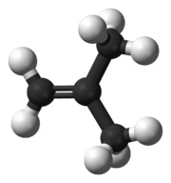
Nuclear Magnetic Resonance Spectroscopy
¹H NMR—Number of Signals
C₆H₄Cl₂
CH₂=C(CH₃)₂
(=) means no free rotation
b
a
a
b
c
b
b
a
cis
Symmetric
Three signals
trans
Two signals

Slide 9
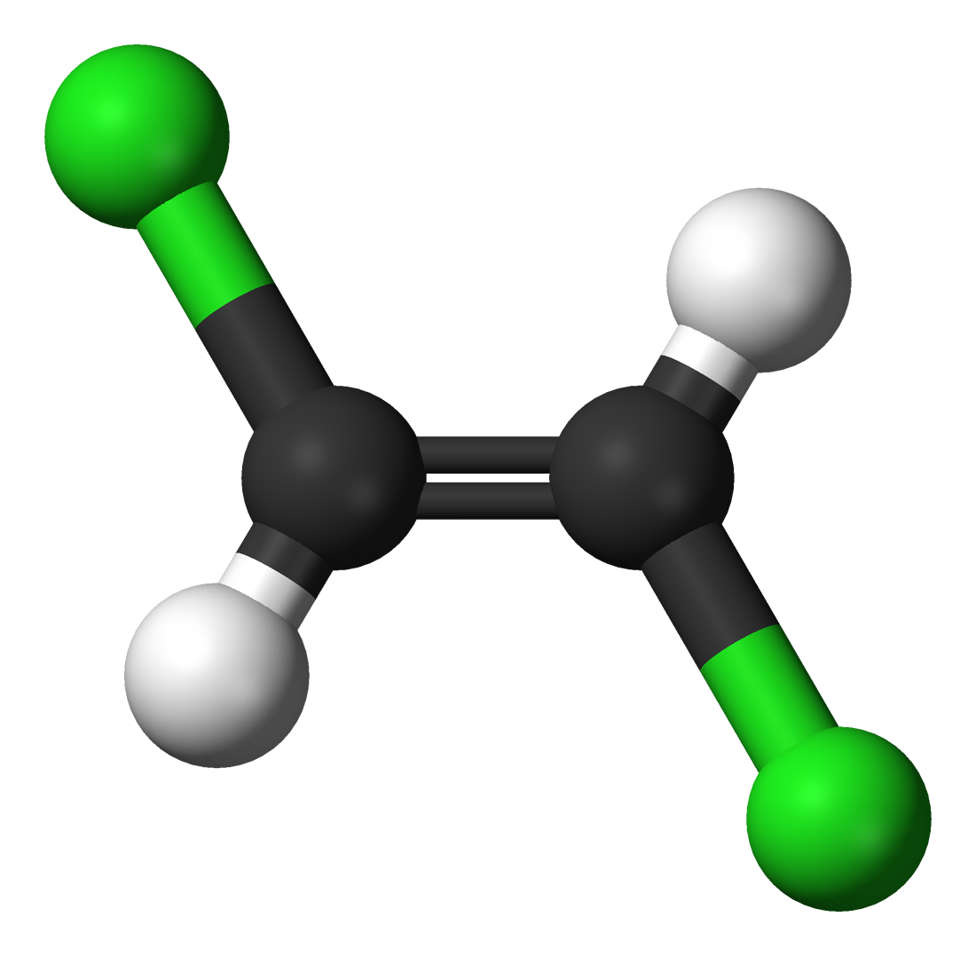
Nuclear Magnetic Resonance Spectroscopy
¹H NMR—Number of Signals
CHCl=CHCl
CH₂=C(CH₃)₂
(=) means no free rotation
a
a
b
a
b
a
cis
Symmetric
One signal
trans
Two signals

Slide 10
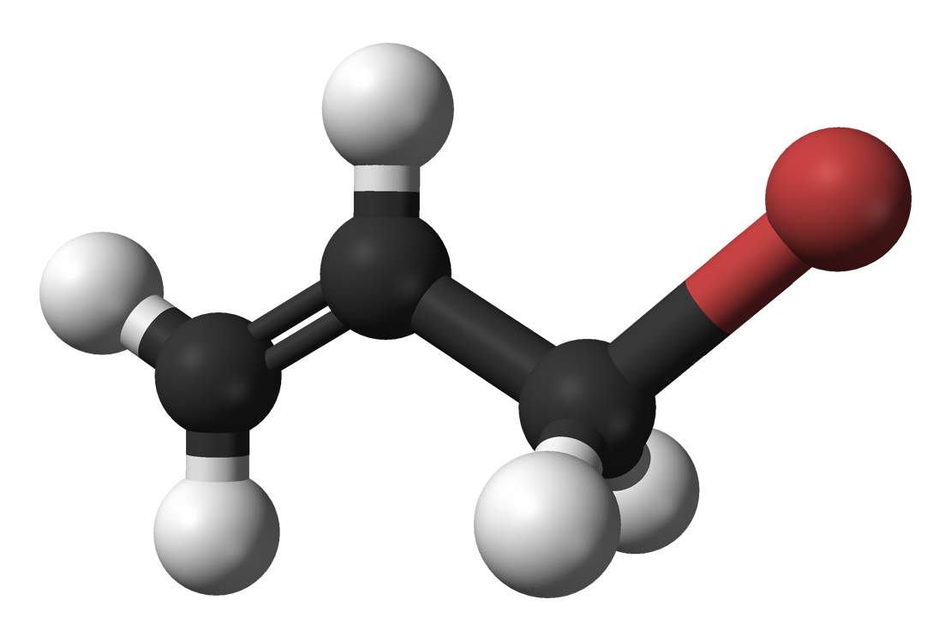
Nuclear Magnetic Resonance Spectroscopy
¹H NMR—Number of Signals
CH₂=CH(CH₂Br)
c
(=) means no free rotation
b
H_{a} Cis to (–CH₂Br)
H_{a} Trans to H_{c}
H_{b} Cis to H_{c}
H_{b} Trans to (–CH₂Br)
d
a
Four signals

Slide 11
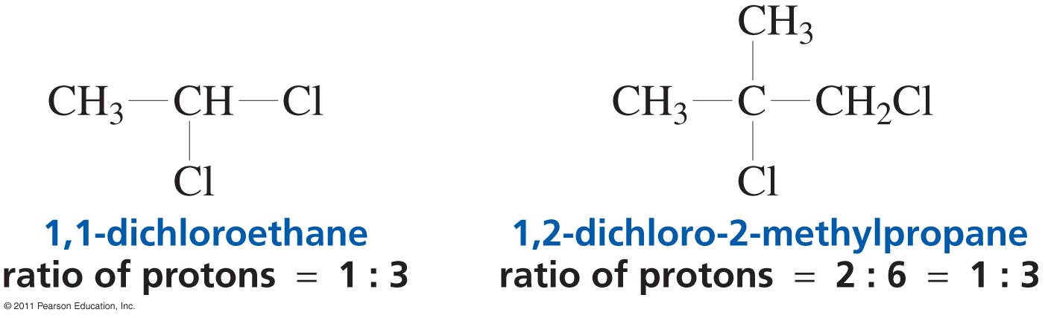
Nuclear Magnetic Resonance Spectroscopy
¹H NMR—Intensity of signals (Integration)
Integration is the measurement of peak areas on the NMR spectrum.
It corresponds to the amount of energy absorbed or released by all nuclei participating in chemical shift during the nuclear spin flip process.
It is used to determine the ratio of hydrogens that correspond to the signal
It is proportional to relative number of equivalent protons

Slide 12
Nuclear Magnetic Resonance Spectroscopy
¹H NMR—Intensity of signals (Integration)
3H
3H
2H
2H
(multiply by 2) 2 3 2 3

Slide 13
Nuclear Magnetic Resonance Spectroscopy
¹H NMR—Spin-spin splitting (Multiplicity)
The absorption of a proton can split into multiple peaks called a multiplet
Multiple absorptions are caused by the interaction (coupling) of the spins of nearby nuclei
Tiny magnetic fields produced by one nucleus affects the magnetic field felt by neighbouring nuclei
If protons align with the applied field the effective field felt by neighbouring protons is slightly larger
If protons align against the applied field the effective field felt by neighbouring protons is slightly smaller

Slide 14
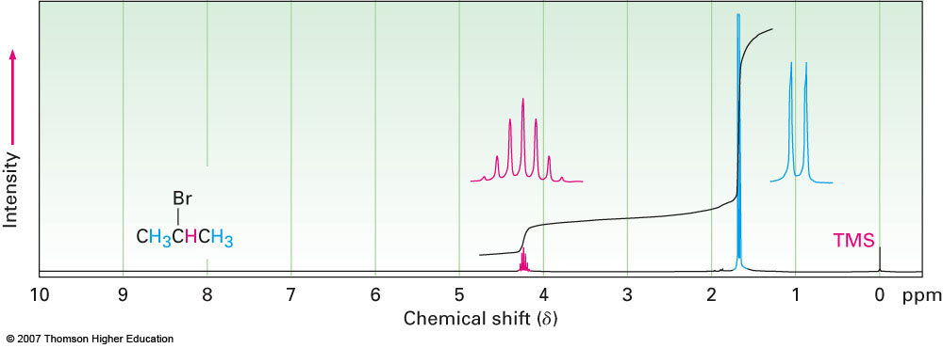
Nuclear Magnetic Resonance Spectroscopy
¹H NMR—Multiplicity
n + 1 rule
The NMR absorption of a proton which has n equivalent neighbouring protons will be split into n + 1 peaks.
In the ¹H NMR spectrum of 2-bromopropane the –CH₃ proton signal at 1.71 ppm is split into a doublet, and the –CHBr proton signal at 4.28 ppm is split into a septet

Slide 15
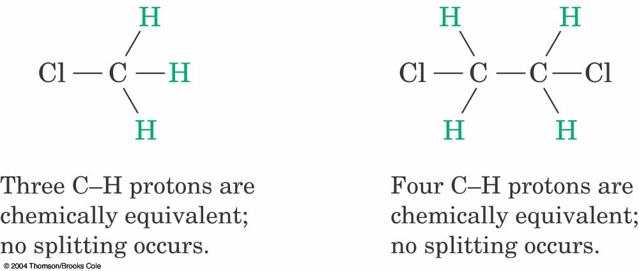
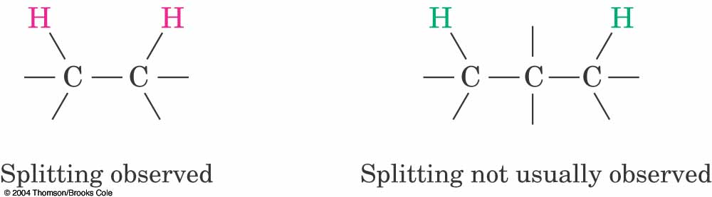
Nuclear Magnetic Resonance Spectroscopy
¹H NMR—Multiplicity (Rules for Spin-Spin Splitting)
Equivalent protons do not split each other
Protons that are farther than two carbon atoms apart do not split each other

Slide 16
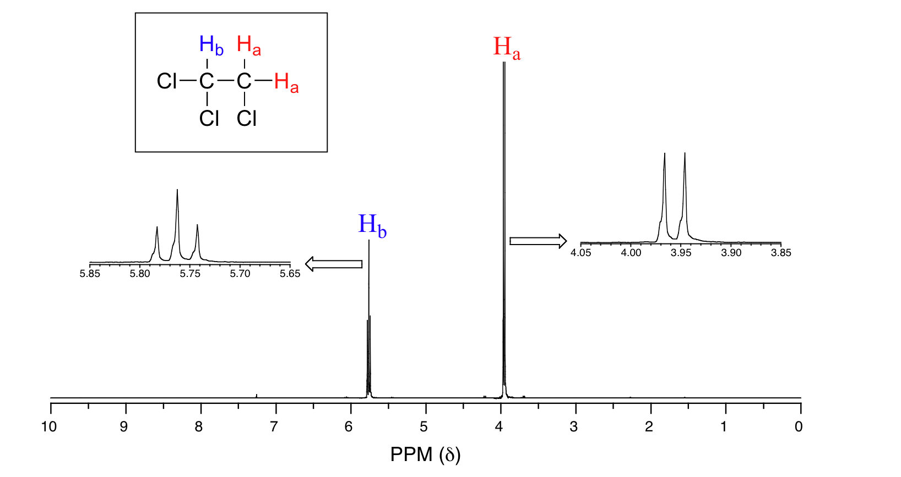
Nuclear Magnetic Resonance Spectroscopy
¹H NMR—Multiplicity (Rules for Spin-Spin Splitting)

Slide 17
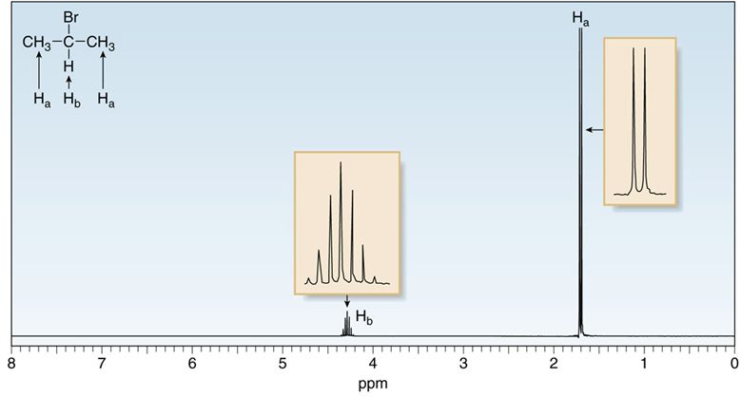
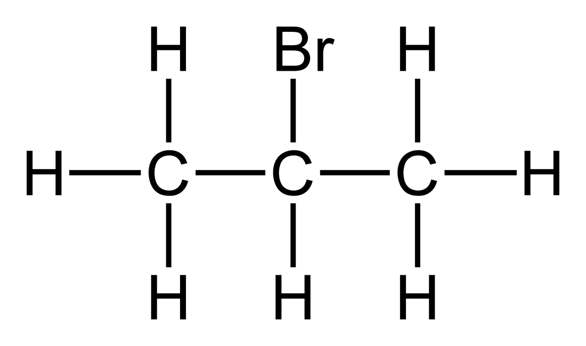
Nuclear Magnetic Resonance Spectroscopy
¹H NMR—Multiplicity (Rules for Spin-Spin Splitting)
a
b
a

Slide 18
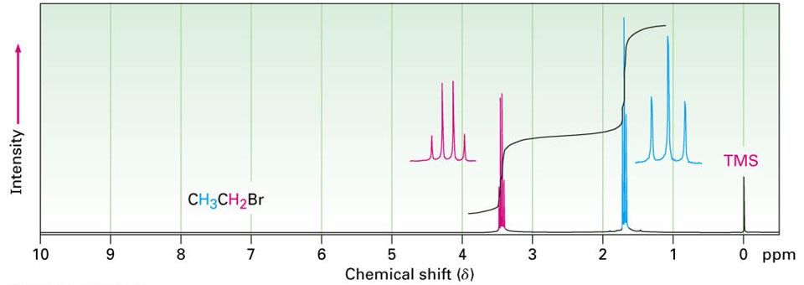
Nuclear Magnetic Resonance Spectroscopy
¹H NMR—Multiplicity (Rules for Spin-Spin Splitting)
CH₃-CH₂-Br

Slide 19
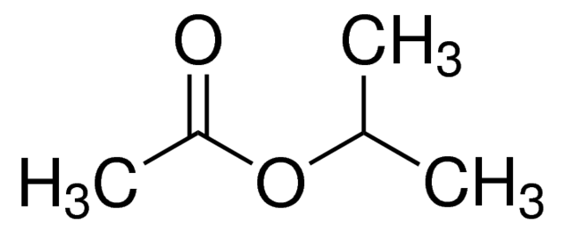
Drawing the expected ¹H NMR spectrum of a compound
a
No. of signals = 3
Position of signals (chemical shift values)
H_{c} (0.9 ppm) + carbonyl group (1.0 ppm) = 1.9 ppm
H_{b} (1.7 ppm) + oxygen atom (3.0 ppm) = 4.7 ppm
H_{a} (0.9 ppm) + distant oxygen atom (0.6 ppm) = 1.5 ppm
Integration and multiplicity:
H_{c} = 3H (singlet)
H_{b} = 1H (septat)
Ha = 6H (doublet)
b
a
c
3H
6H
1H

Slide 20
Using ¹H-NMR spectroscopy to distinguish between compounds
a
a
d
I
II
I
II
d
b
Four signals each
b
c
c
a
a
d
I
II
b
d
b
c
c

