Slide 1
NMR Spectroscopy
Interpretation of NMR spectrum

Slide 2
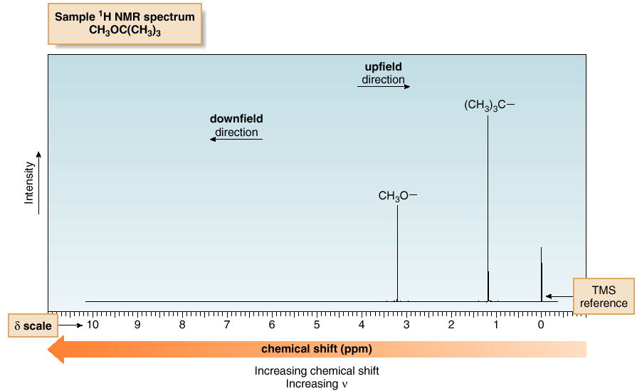
Nuclear Magnetic Resonance Spectroscopy
¹H NMR—The Spectrum
An NMR spectrum is a plot of the intensity of a peak against its chemical shift, measured in parts per million (ppm).

Slide 3
Nuclear Magnetic Resonance Spectroscopy
¹H NMR—The Spectrum
NMR absorptions generally appear as sharp peaks.
Increasing chemical shift is plotted from left to right.
Most protons absorb between 0-10 ppm.
The terms “upfield” and “downfield” describe the relative location of peaks. Upfield means to the right. Downfield means to the left.
NMR absorptions are measured relative to the position of a reference peak at 0 ppm on the δ scale due to tetramethylsilane (TMS).
TMS is a volatile inert compound that gives a single peak upfield from typical NMR absorptions.

Slide 4
Nuclear Magnetic Resonance Spectroscopy
Features of ¹H NMR spectrum
Four different features of a ¹H NMR spectrum provide information about a compound’s structure:
  Position of signals
  Number of signals
  Intensity of signals.
  Spin-spin splitting of signals.

Slide 5
Magnetic Shielding
If all protons absorbed the same amount of energy in a given magnetic field, not much information could be obtained.
But protons are surrounded by electrons that shield them from the external field.
Circulating electrons create an induced magnetic field that opposes the external magnetic field.

Slide 6
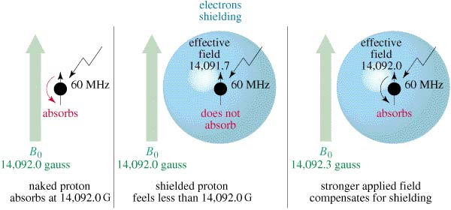
Shielded Protons
Magnetic field strength must be increased for a shielded proton to flip at the same frequency.

Slide 7
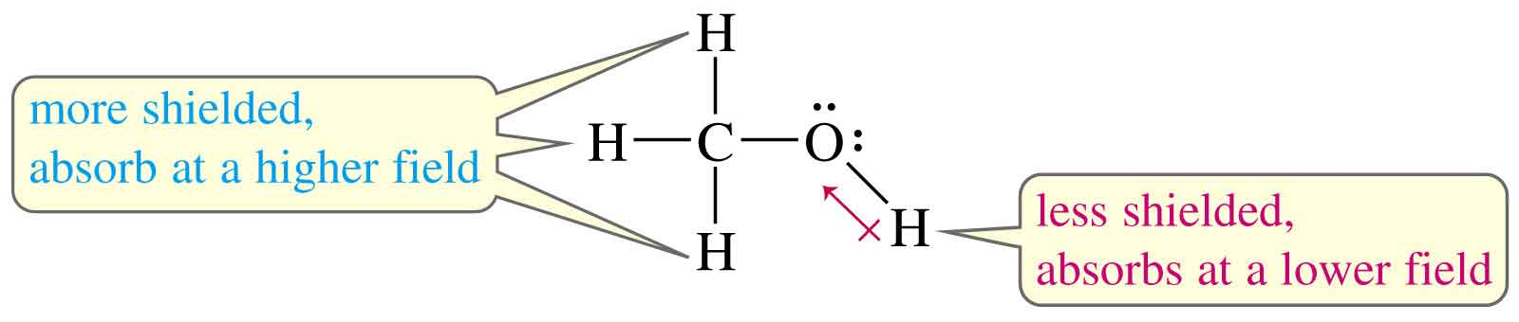
Protons in a Molecule
Depending on their chemical environment, protons in a molecule are shielded by different amounts.

Slide 8
Electron drawing
Electron drawing
(a) (b)
CH₃-CH₂-Br
(a)
(b)
(c)
CH3-CH2-O-CH2-Br
Electron rich
shielded
(low frequency)
Electron poor
deshielded
(high frequency)
Electron rich
shielded
(low frequency)
Electron poor
more deshielded
(high frequency)
Shielding:
nucleus feels weak magnetic field
Reduced energy gap ∆E
Lower frequency needed to achieve resonance
Electron dense (rich) means upfield chemical shift
Deshielding:
nucleus feels strong magnetic field
Increased energy gap ∆E
Higher frequency needed to achieve resonance
Electron dense (poor) means downfield chemical shift
The shifts in the positions of NMR signals resulting from the Shielding/Deshielding by the Electrons is called as "CHEMICAL SHIFTS"

Slide 9
Factors affecting chemical shift
Chlorine "deshields" the proton, that is, it takes valence electron density away from carbon, which in turn takes more density from hydrogen deshielding the proton.
Factors affecting chemical shift
Electronegativity inductive effect
Anisotrophic effect
Hydrogen bonding
Vanderwaal’s deshielding
Electronegative element
Dependence of the chemical shift of CH₃X on the element X
Compound CH₃X | CH₃F | CH₃OH | CH₃Cl | CH₃Br | CH₃I | CH₄ | (CH₃)₄Si
Element X | F | O | Cl | Br | I | H | Si
EN | 4.0 | 3.5 | 3.1 | 2.8 | 2.5 | 2.1 | 1.8
Chemical shift | 4.3 | 3.40 | 3.1 | 2.7 | 2.2 | 1.0 | 0
Most deshielded
Deshielding increases with EN of atom X
TMS
The chemical shift of a C—H bond increases with increasing alkyl substitution.
RCH₂-H R₂CH-H R₃C-H
0.9 ppm 1.3 ppm 1.7 ppm
Increasing alkyl substitution, increasing chemical shift

Slide 10
Factors affecting chemical shift
Substitution effects on chemical shift
The effect increases with greater numbers of electronegative atoms
Factors affecting chemical shift
Electronegativity inductive effect
Anisotrophic effect
Hydrogen bonding
Vanderwaal’s deshielding
CH₄ | CH₃Cl | CH₂Cl₂ | CHCl₃
1.0 | 3.1 | 5.3 | 7.3
The effect decreases with increasing distance from the electronegative atom. The effect completely vanished at the fourth bond from the electronegative atom
-CH2-Br | -CH2-CH2-Br | X-CH2-CH2-CH2-Br
3.3 | 1.7 | 1.3
1.6 ppm
0.9 ppm
3.3 ppm
The effect of absence of electronegative atoms
Methyl Methylene Methine
0.9 ppm 1.2 ppm 1.7 ppm

Slide 11
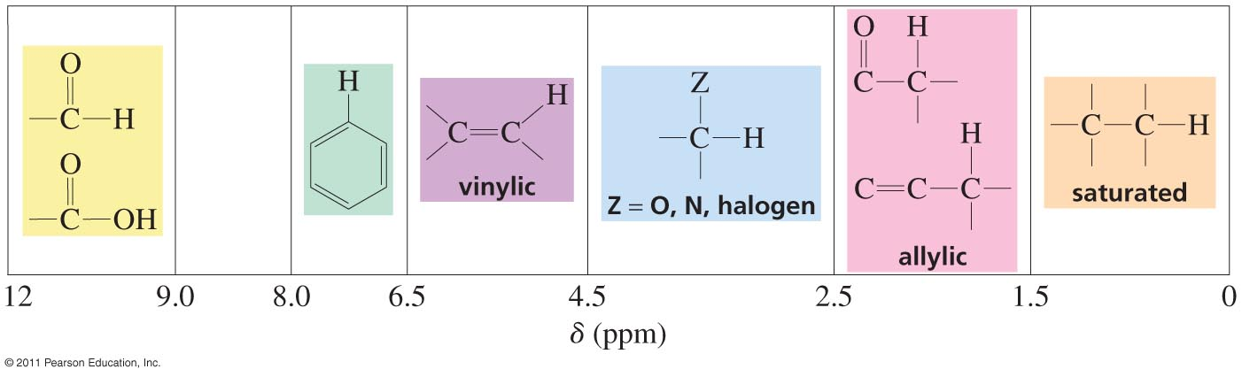
Factors affecting chemical shift
Factors affecting chemical shift
Electronegativity inductive effect
Anisotrophic effect
Hydrogen bonding
Vanderwaal’s deshielding
Characteristic Values of Chemical Shifts
It is possible to predict the chemical shifts for the protons in a wide variety of compounds, including alcohols, ethers, ketones, esters, and carboxylic acids.

Slide 12
Factors affecting chemical shift
Factors affecting chemical shift
Electronegativity inductive effect
Anisotrophic effect
Hydrogen bonding
Vanderwaal’s deshielding
Effects on neighbouring functional groups on chemical shift

Slide 13
Factors affecting chemical shift
Factors affecting chemical shift
Electronegativity inductive effect
Anisotrophic effect
Hydrogen bonding
Vanderwaal’s deshielding
The opposite of isotropy which means uniformity in all directions.
So, anisotropy is non -uniformity.
Now for different compounds this anisotropy is different as different distribution of electrons around nuclei. These compounds are:
Alkene
Alkyne
Benzene
Others

Slide 14
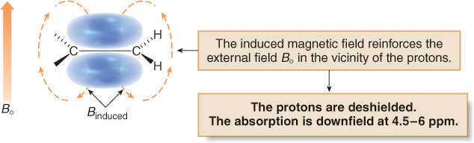
Factors affecting chemical shift
Factors affecting chemical shift
Electronegativity inductive effect
Anisotrophic effect
Hydrogen bonding
Vanderwaal’s deshielding
Alkene
protons adjacent to alkene (C=C-H) are deshielded by anisotropy effect, so, chemical shift will be induced.

Slide 15
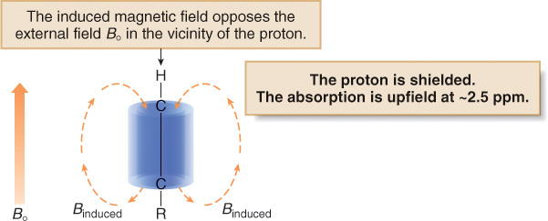
Factors affecting chemical shift
Alkyne
All groups in a molecule having π electrons generate secondary anisotropic field.
In alkynes (C≡C),the system will shields the proton, thus
causing decrease in chemical shift of alkynes.
Also the proton next to the alkynes carbon experience the anisotropic effect towards shielded side.
Factors affecting chemical shift
Electronegativity inductive effect
Anisotrophic effect
Hydrogen bonding
Vanderwaal’s deshielding

Slide 16
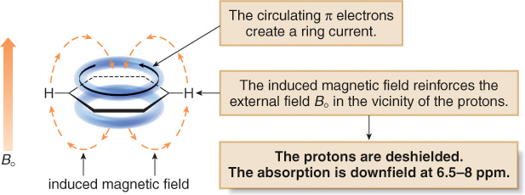
Factors affecting chemical shift
Benzene
In a magnetic field, the six π electrons in benzene circulate around the ring creating a ring current.
The magnetic field induced by these moving electrons reinforces the applied magnetic field in the vicinity of the protons.
The protons thus feel a stronger magnetic field and a higher frequency is needed for resonance. Thus they are deshielded and absorb downfield.
Factors affecting chemical shift
Electronegativity inductive effect
Anisotrophic effect
Hydrogen bonding
Vanderwaal’s deshielding

Slide 17
Factors affecting chemical shift
Others
Factors affecting chemical shift
Electronegativity inductive effect
Anisotrophic effect
Hydrogen bonding
Vanderwaal’s deshielding

Slide 18
Factors affecting chemical shift
Factors affecting chemical shift
Electronegativity inductive effect
Anisotrophic effect
Hydrogen bonding
Vanderwaal’s deshielding
Hydrogen bonding (HB) effect
The chemical shift depends on how much HB is taking place (observed in high conc. solutions.
HB lengthens the O-H bonds and reduces the valence electron density around the proton, so, it is deshielded and shifted downfield in the NMR spectrum.
Alcohols vary in chemical shift from 0.5 ppm (free OH) to about 5.0 ppm (lots of HB).

Slide 19
Factors affecting chemical shift
Factors affecting chemical shift
Electronegativity inductive effect
Anisotrophic effect
Hydrogen bonding
Vanderwaal’s deshielding
Vanderwaal's Dishielding
In overcrowded molecules, it is possible that some protons may be occupying sterically hindered position.
Electronegative cloud of bulky groups (hindering groups) will tend to repell the electron cloud surrounding proton.
Thus, such a proton will be deshielded and will resonate a slightly higher values of δ (chemical shift) than expected in the absence of this effect

