Slide 1
NMR Spectroscopy
Introduction

Slide 2
Introduction to NMR Spectroscopy
Nuclear magnetic resonance spectroscopy is a powerful analytical technique used to characterize organic molecules by identifying carbon-hydrogen frameworks within molecules.
Two common types of NMR spectroscopy are used to characterize organic structure: ¹H NMR is used to determine the type and number of H atoms in a molecule; ¹³C NMR is used to determine the type of carbon atoms in the molecule.
The source of energy in NMR is radio waves which have long wavelengths, and thus low energy and frequency.
When low-energy radio waves interact with a molecule, they can change the nuclear spins of some elements, including ¹H and ¹³C.

Slide 3
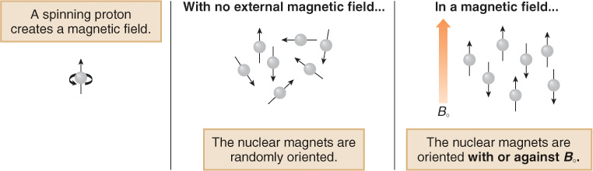
Introduction to NMR Spectroscopy
When a charged particle such as a proton spins on its axis, it creates a magnetic field. Thus, the nucleus can be considered to be a tiny bar magnet.
Normally, these tiny bar magnets are randomly oriented in space. However, in the presence of a magnetic field B₀, they are oriented with or against this applied field. More nuclei are oriented with the applied field because this arrangement is lower in energy.
The energy difference between these two states is very small (<0.1 cal).

Slide 4
NMR Active Nuclei
Most elements possess at least one NMR active nucleus, but many of them several (i.e.,¹¹⁵Sn, ¹¹⁷Sn and ¹¹⁹Sn, ⁹⁵Mo and ⁹⁷Mo, etc.).
In order for an atom to be NMR active:
Odd number of neutrons or protons. If it is even, the spin quantum number will be zero. Both ¹²C and ¹⁶O will not be observable, but ¹³C, ¹H and ¹⁷O are NMR active nuclei.
The spin quantum number (I) must not equal zero, i.e, I = (½). Nuclei with a spin quantum number larger than I= (½) often show broad lines because of their quadrupole moment

Slide 5
NMR Active Nuclei
There is a significant difference in abundance in these NMR active nuclei and the sensitivity of these experiments differs quite a bit as well.
Nucleus | Spin Quantum Number, I | Protons | Neutrons | Natural Abundance | Magnetogyric ratio, g (10⁷ rad T⁻¹s⁻¹) | NMR Active
¹H | ½ | 1 | 0 | 99.985 % | 26.7519 | YES
²H | 1 | 1 | 1 | 0.015 % | 4.1066 | YES
³H | ½ | 1 | 2 | trace | 28.535 | YES
¹²C | 0 | 6 | 6 | 98.89 % |  | NO ☹
¹³C | ½ | 6 | 7 | 1.11 % | 6.7283 | YES
¹⁴N | 1 | 7 | 7 | 99.6 % | 1.934 | YES
¹⁵N | ½ | 7 | 8 | 0.37 % | -2.712 | YES
¹⁶O | 0 | 8 | 8 | 99.76 % |  | NO ☹
¹⁷O | ⁵∕₂ | 8 | 9 | 0.04 % | -3.62808 | YES
¹⁹F | ½ | 9 | 10 | 100 % | 25.181 | YES
³¹P | ½ | 15 | 16 | 100 % | 10.841 | YES

Slide 6
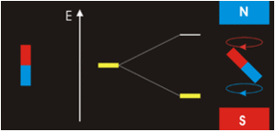
Physical Background of NMR Spectroscopy I
Energy
m_{I}= -½
ΔE= f(γB_{o})= hν
m_{I}= +½
Increased magnetic field B_{o}
The principle behind NMR is that many nuclei have spin and all nuclei are electrically charged. If an external magnetic field is applied, an energy transfer is possible between the base energy to a higher energy level (generally a single energy gap). The energy transfer takes place at a wavelength that corresponds to radio frequencies and when the spin returns to its base level, energy is emitted at the same frequency. The signal that matches this transfer is measured in many ways and processed in order to yield an NMR spectrum for the nucleus concerned.

Slide 7
β
aligned against the field
ENERGY
ΔΕ = hν
α
aligned with the field
A spinning nucleus such as ¹H behaves as a spinning charge and generates a magnetic field. It can be likened to a bar magnet. When it is placed in an externally applied field it can align with, or against, the field. The energy difference between the two states (DE) depends on the applied field.

Slide 8
Physical Background of NMR Spectroscopy II
A resonance phenomenon occurs when the aligned nuclei interact with the applied field and are forced to change their spin orientation
The energy, which is absorbed, is equal to energy difference DE between the two spin states. This resonance energy is about 10⁻⁶ kJ/mol (the radio-frequency)
The stronger the applied field, the greater energy difference between the spin states (DE) becomes, which allows distinguishing even between very similar atoms
  The NMR spectrometers with stronger magnetic fields provide better resolution
60 MHz
600 MHz

Slide 9
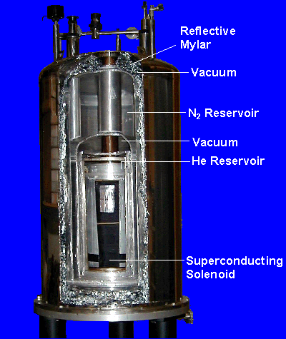
Physical Background of NMR Spectroscopy II
The strength of the magnetic field determines the range of frequencies that must be used.
Most spectrometers employ three chambers to achieve this low temperature;
The innermost chamber contains liquid helium, (b.p 4.3K).
Surrounding by a chamber of liquid nitrogen (b.p 77) K).
The third and outermost chamber is a vacuum that minimizes heat transfer from the environment.
Any heat developed in the system is transferred from the liquid helium to the liquid nitrogen. In this way, the innermost chamber can be maintained at 4 degrees above absolute zero. This extremely cold environment enables the use of superconductors that generate the large magnetic fields required in NMR spectroscopy.

Slide 10
Physical Background of NMR Spectroscopy III
The exact resonance frequency of a certain nucleus depends on the environment of the nucleus. The effective magnetic field is a result of the applied magnetic field and the changes that are induced by the environment
The changes are often summarized into a shielding constant, σ.
  The larger the shielding constant and the smaller the effective field,
  the higher the applied field has to be in order for the nucleus to resonate
  as constant frequency (=shift to lower d-values in the ¹H-NMR spectrum)
  If a constant magnetic field is applied, the resonance frequency will decrease with increasing shielding
In ¹H-NMR spectroscopy, the diamagnetic and neighboring effects are the most important contributions because only s-orbitals are important
In ¹³C-NMR, the paramagnetic term becomes more significant because of the involvement of p-electrons

Slide 11
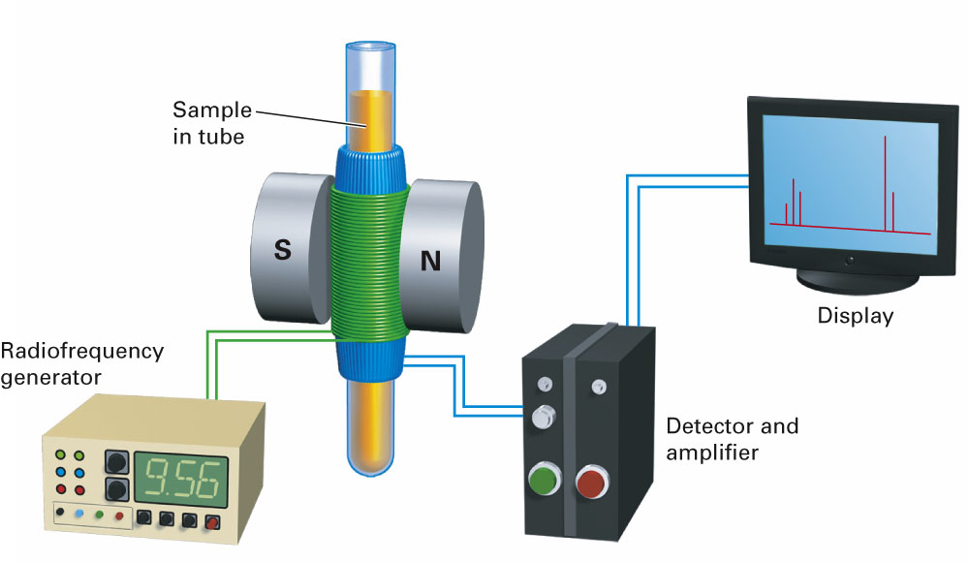
An intense, homogeneous and stable magnetic field (magnet + shim)
A “probe” which enables the coils used to excite and detect the signal to be placed close to the sample
High-power RF transmitter/s capable of delivering short pulses (RF source + RF Amplifier)
A sensitive receiver to amplify the NMR signals (RF Detector)
A Digitizer to convert the NMR signals into a form which can be stored in computer memory
A “pulse programmer” to produce precisely timed pulses and delays
A computer to control everything and to process the data
Notes:
To optimize the sensitivity this coil needs to be (1) as close as possible to the sample; (2) tuned to resonant at the Larmor frequency of the nuclei being detected and (3) matched to maximize power transfer between the probe and the transmitter and receiver.

Slide 12
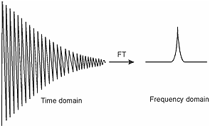
Type of NMR Spectroscopy
Continuous wave NMR Spectroscopy
Varying the frequency of radiation at constant magnetic field
and measuring the absorption of radiation by the different nucle
FT NMR Spectroscopy (better resolution and sensitivity)
In FT-NMR all nuclei are excited at the same time by a radio frequency pulse.
Radio frequency pulse : if the radiation is emitted as a very short pulse. A short radio frequency pulse contains many frequencies in a broad band around υ₀ .
Notes:
To optimize the sensitivity this coil needs to be (1) as close as possible to the sample; (2) tuned to resonant at the Larmor frequency of the nuclei being detected and (3) matched to maximize power transfer between the probe and the transmitter and receiver.

Slide 13
Solvents in NMR spectroscopy
If the solvent itself has protons, the spectrum will be overwhelmed with signals from the solvent, rendering it unreadable.
As a result, solvents without protons must be used. Although there are several solvents that lack protons, such as CCl₄, these solvents do not dissolve all compounds. In practice, deuterated solvents are generally used.
The deuterium atoms are invisible to the NMR spectrometer, why???
Ans. A 300-MHz spectrometer will use a pulse that consists only of frequencies between 300,000,000 and 300,005,000 Hz. The frequencies required for deuterium resonance do not fall in this range.
Notes:
To optimize the sensitivity this coil needs to be (1) as close as possible to the sample; (2) tuned to resonant at the Larmor frequency of the nuclei being detected and (3) matched to maximize power transfer between the probe and the transmitter and receiver.

Slide 14
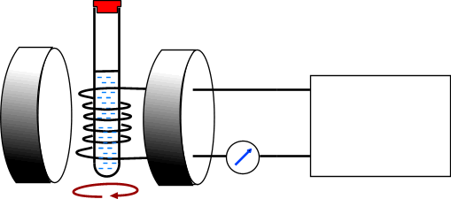
NMR SPECTROMETERS
The sample is spun round in the field of a large electromagnet and a radio-frequency (RF) field is applied. The magnetic field is increased and the excitation or “flipping” of nuclei from one orientation to another is detected as an induced voltage resulting from the absorption of energy from the RF field.
By observing the field strength at which protons absorb energy, one can deduce something about the structure of a molecule.
An NMR spectrum is the plot of the induced voltage against the sweep of the field. The area under a peak is proportional to the number of nuclei “flipping”
Not all hydrogen nuclei absorb energy at the same field strength at a given frequency; the field strength required depends on the environment of the hydrogen.
RADIOFREQUENCY
OSCILLATOR

Slide 15
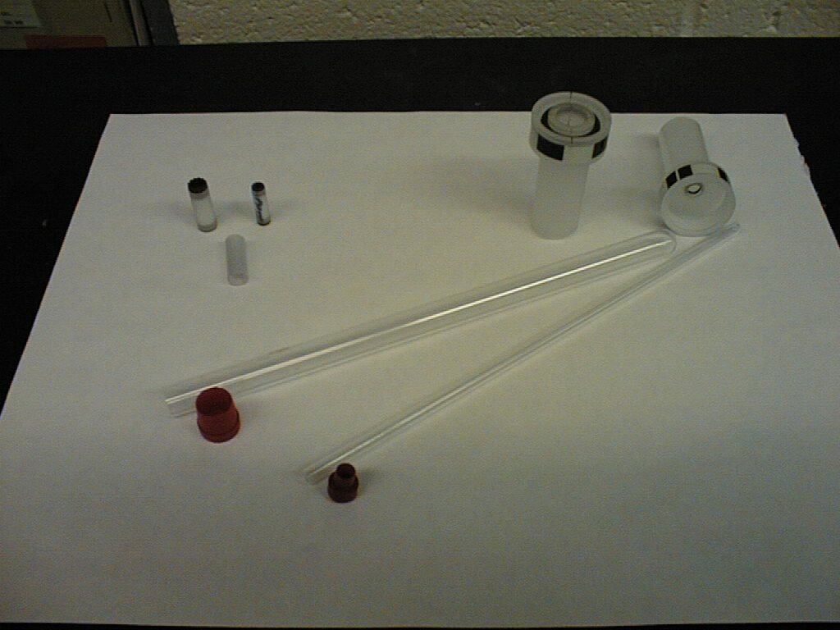
Types of NMR Tubes
Solution NMR
Sample Tube
Spinners
Solid State Sample Rotors
NMR Sample Tubes with Caps

Slide 16
NMR Sample Preparation
5 mm
Use clean + dry NMR tubes and caps
(tubes can be re-used, caps should not!)
0.5 ml deuterated solvent
(i.e. CDCl₃ ,C₆D₆ , acetone-d₆ ,etc.)
substrate requirements for routine spectra:
10 mg for proton NMR
100 mg for carbon-13 NMR
min. filling height of tube: 2 inches (5 cm)
Cleaning of tubes:
1. rinse with solvent you were using
2. rinse with acetone
3. dry in (vacuum-)oven at low temperature
3
6
6

Slide 17
NMR Sample Preparation
Precipitate
Two phases
Clean clear solution
Not enough solvent
Suspension or opaque solution
Concentration gradient
GOOD!
B a d S a m p l e s !

Slide 18
Interpretation of NMR spectra
The spectrum produced by 1H NMR spectroscopy is generally rich with information that can be interpreted to determine a molecular structure:
number of different signals in the spectrum
position of the signals (chemical shift)
intensity of the signals
splitting pattern of the signals
Obtaining spectra
a liquid sample is placed in a tube which spins in a magnetic field
solids are dissolved in solvents which won’t affect the spectrum - CCl₄, CDCl₃
TMS, tetramethylsilane, (CH₃)₄Si, is added to provide a reference signal
when the spectrum has been run, it can be integrated to find the relative peak areas
spectrometers are now linked to computers to analyse data and store information

Slide 19
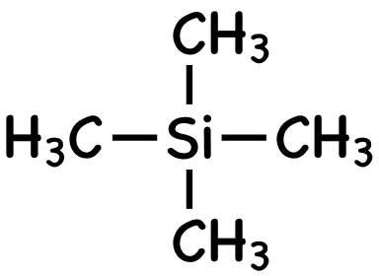
Tetramethylsilane TMS (provides the reference signal)
The molecule contains four methyl groups attached to a silicon atom in a tetrahedral arrangement. All the hydrogen atoms are chemically equivalent.
non-toxic liquid - SAFE TO USE
inert - DOESN’T REACT WITH COMPOUND BEING ANALYSED
has a low boiling point - CAN BE DISTILLED OFF AND USED AGAIN
all the hydrogen atoms are chemically equivalent - PRODUCES A SINGLE PEAK
twelve hydrogens so it produces an intense peak - DON’T NEED TO USE MUCH
signal is outside the range shown by most protons - WON’T OBSCURE MAIN SIGNALS
given the chemical shift of d = 0
the position of all other signals is measured relative to TMS

