Slide 1
ANTHRAQUINONE GLYCOSIDES
Pharmacognosy
3rd Class, 1st Semester
Lab.4

Slide 2
Introduction
Anthraquinone and related glycosides are organic compounds found in some plants and have a stimulant cathartics effect which exert their action by increasing the tone of the smooth muscle in the wall of the colon and stimulate the secretion of the water and electrolytes into the large intestine.
After the oral administration, the Anthraquinone glycosides are hydrolyzed in the colon by the action of enzymes of the micro flora, to the pharmacologically active free aglycone which usually produce their effect in 8-12 hour after administration, these agents are indicated for constipation in patient who do not respond to milder drugs and for bowel evacuation before investigation procedures or surgery.

Slide 3
Stimulant laxative are habit –forming so the long term use may result in laxative dependence and loss of the normal bowel function and become lazy so for this reason its better just to eat foods with lots of fiber and drink water, fresh juices that will cleanse system.
The glycoside of anthranols and anthrones which is reduced anthraquinone derivatives elicit a more drastic reaction than do other anthraquinone, and cause discomfort and gripping action.
The drugs mostly used are, cascara, frangula, casanthranol and senna. The aloe and rhubarb are not recommended due to their irritating action, which increase the chance for gripping effect.
The Anthraquinone hydrolyzed to give aglycone, which are
Di, Tri or Tetra- hydroxyanthraquinone.
Also there are anthrone,dianthrone and oxanthrone.

Slide 4
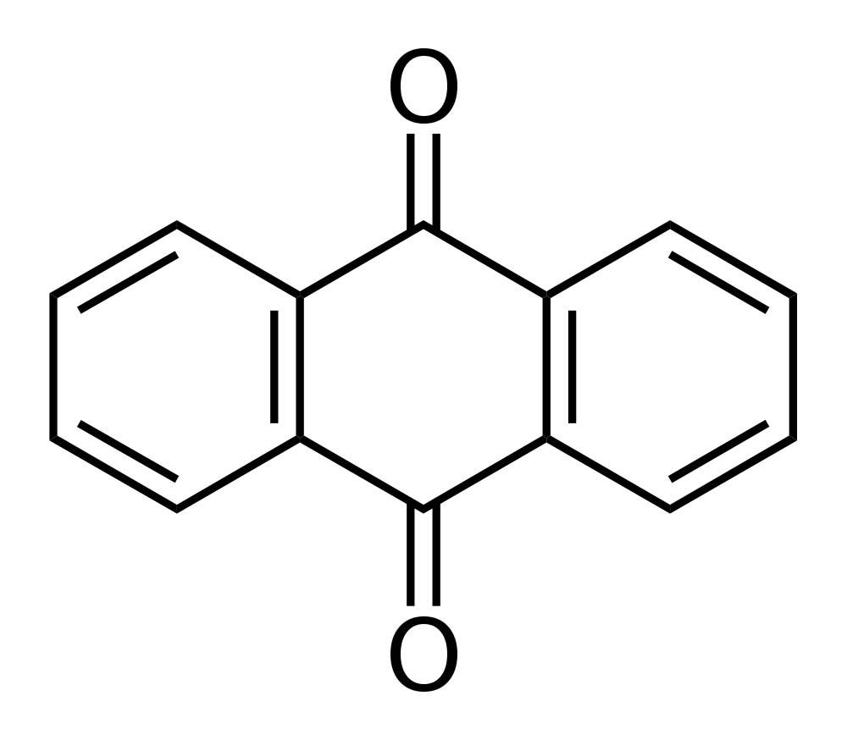
General Anthraquinone Structure

Slide 5
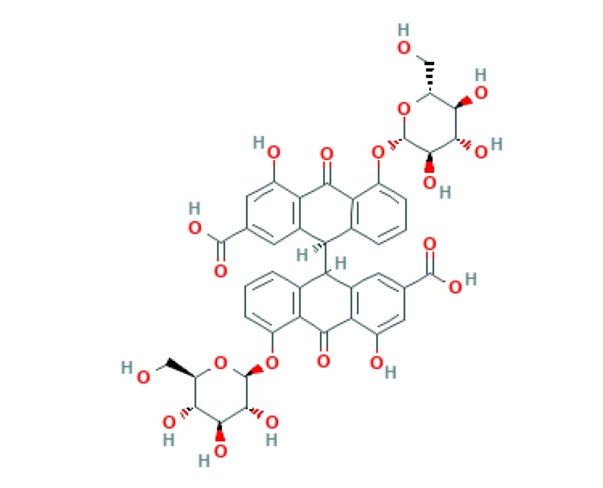

Slide 6
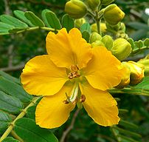
Senna Plant

Slide 7
Extraction OF Anthraquinone glycosides (Senna)
Place 0.5 gm of powdered drug in a beaker
Add 50 ml of water
  Boil gently for 15 minutes, cool and centrifuge or can use filter
Place the filtrate in separatory funnel and extract by shaking with two quantities of
(2*30 ml) chloroform
Obtain two layers
(Aqueous & Organic )

Slide 8
Aqueous Layer
Fraction B
Organic Layer
concentrate to about 1ml
Placed in small flask and evaporate carefully almost to dryness on a rotary evaporator
  The other part is place in a 250 ml round bottom flask
  Adding to it 3.5 of ferric chloride solution (60%w/v).
  Reflux for 20 minutes
  Add 2ml of concentrated HCL acid , continue heating for further 20 minutes , shaking the flask occasionally to dissolve as possible of the precipitate, and allow cooling.
  Place the hydrolysate in a separatory funnel and extract with two quantities of (2*30ml) chloroform
Fraction A
Fraction C
Concentrate the bulked chloroform extracts to about 3ml

Slide 9
Discussion
The chloroform layer will contain the free aglycone (fraction B) , while the aqueous layer will contain the glycoside as a whole , since sugar is water soluble (fraction A) .
The use of ferric chloride and HCL and reflux is to break the C-C bond in the dimmer, which is very strong bond so need strong conditions.

Slide 10
Identification by chromatography by the use of T.L.C technique
The stationary phase = silica gel G
The mobile phase = n-propanol : ethyl acetate: water (40: 40:30)
Spray reagent =alcoholic KOH (5%w/v)
(For better result spray first with 25 %( w/v) nitric acid then heat in the oven, after that spray with KOH reagent. This step is done to intensity the color of the spots.)

Slide 11
Procedure
Prepare the solvent system and place it in the glass tank, leave it for 45minutes before use.
Apply the sample fraction A, B, C, each sample with standard on the separated plate.
Place the three plate in the tank and allow the mobile phase to rise to about two –third the plates then after drying at room temperature, spray first with 25%nitric acid solution and heat for 10 minutes at 110 c .
Allow to cool, and then spray with 5% w/v alcoholic KOH solution.
Detect the spots formed and calculate the Rf value.

Slide 12
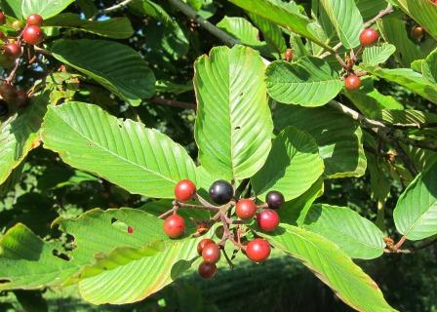
Thank You

