Slide 1
Reactions of aldehydes and Ketones
Nucleophilic addition reaction
Reaction at the α carbon

Slide 2
Aldehydes & ketones, reactions:
Oxidation
Reduction
Nucleophilic addition reaction
Addition of cyanide
Addition of derivatives of ammonia
Addition of alcohols
Cannizzaro reaction
Addition of Grignard reagents
4. Reaction at the α carbon
Alpha-halogenation of ketones
Addition of carbanions

Slide 3
Oxidation
Aldehydes are readily oxidized to yield carboxylic acids; but ketones are generally inert toward oxidation.
Many oxidizing agents, including KMnO_{4,} CrO₃ in aqueous acid and hot HNO₃, convert aldehydes into carboxylic acids.
Oxidation of an aldehyde can be carried out using a solution of silver oxide (Ag₂O) in aqueous ammonia, the so-called Tollen's reagent. Oxidation of aldehyde is accompanied by reduction of silver ion to free silver (in the form of a mirror under the proper conditions).
Methyl ketones:
Oxidation of ketones required breaking of C–C bond next to the carbonyl group and takes place only under vigorous conditions, except for methyl ketones which oxidized smoothly by mean of hypohalite (NaOX) to form Haloform (Haloform reaction).
Yellow ppt

Slide 4
2) Reduction:
To alcohols: aldehyde can bre reduced to 1° alcohol , and ketone to 2° alcohol , either by catalytic hydrogenation or by use reducing agent [Sodium borohydride (NaBH₄) or Lithium aluminium hydride (LiAlH₄) followed by protonation].

Slide 5
To hydrocarbons
Clemmensen reduction: The Clemmensen reduction is most commonly used to convert acylbenzenes (from Friedel-Crafts acylation) to alkylbenzenes
Wolff–Kishner reduction: The ketone or aldehyde is converted to its alkane, which is heated with Hydrazine (NH₂NH₂), and strong base such as KOH.
Summary:

Slide 6
3) Nucleophilic addition reaction.
Addition of cyanide: Treatment of an aldehyde or ketone with NaCN and a strong acid such as HCl adds HCN across the carbon–oxygen π bond, forming a cyanohydrin.

Slide 7
II. Addition of Alcohols (Acetal Formation): Aldehydes and ketones react with two equivalents of alcohol to form acetals. In an acetal, the carbonyl carbon from the aldehyde or ketone is now singly bonded to two OR" (alkoxy) groups.

Slide 8
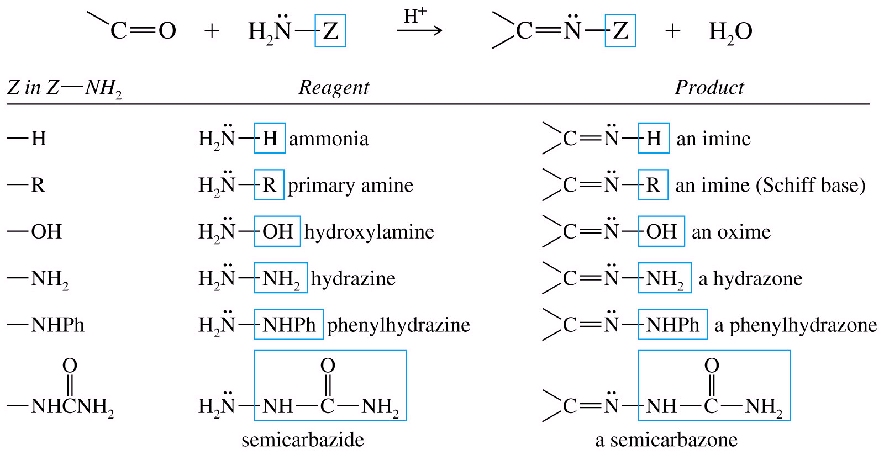
III. Addition of derivatives of ammonia (formation of imine): Treatment of an aldehyde or ketone with a 1° amine affords an imine (also called a Schiff base). Nucleophilic attack of the 1° amine on the carbonyl group forms an unstable carbinolamine, which loses water to form an imine. The overall reaction results in replacement of C=O by C=NR.

Slide 10
IV. Cannizzaro reaction. (self oxidation/reduction) : In the presence of concentrated alkali, aldehydes containing no α-hydrogen undergo self-oxidation and reduction to yield a mixture of an alcohol and a salt of a carboxylic acid. This reaction is known as the Cannizzaro reaction.
Crossed Cannizzaro reaction: If two different aldehydes with no α-hydrogen undergo Cannizzaro reaction yield a mixture of products. This reaction is called crossed Cannizzaro reaction.
Formaldehyde is the most easily oxidized aldehyde. When mixed with another aldehyde that doesn’t have any alpha-hydrogens and conc. NaOH, all of the formaldehyde is oxidized and all of the other aldehyde is reduced.

Slide 11
V. Addition of Grignard reagents: The addition of Grignard reagents to aldehydes and ketones yields alcohols. The organic group, transferred with a pair of electrons from magnesium to carbonyl carbon, is a powerful nucleophile.
Synthesis of alcohols, used to build larger molecules from smaller organic compounds.

Slide 12
or

Slide 13
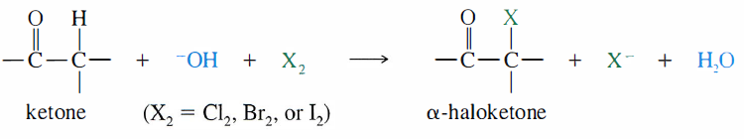
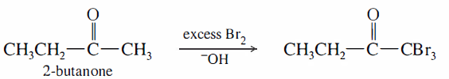
4) Reaction at the α carbon
Alpha-halogenation of ketones: When a ketone is treated with a halogen and base, an α-halogenation reaction occurs.

Slide 14
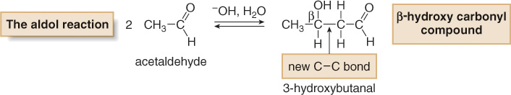
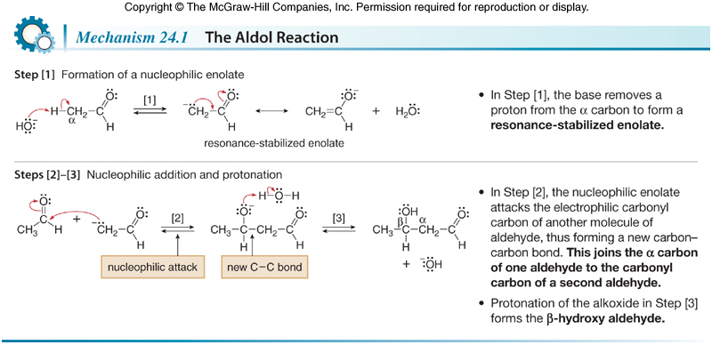
Addition of carbanions :
Aldol condensation: Under the influence of or, two molecules of an aldehyde or a ketone, which, may combine to form a β-Hydroxy aldehyde or β-Hydroxy ketone. This reaction is called the Aldol condensation.

Slide 15
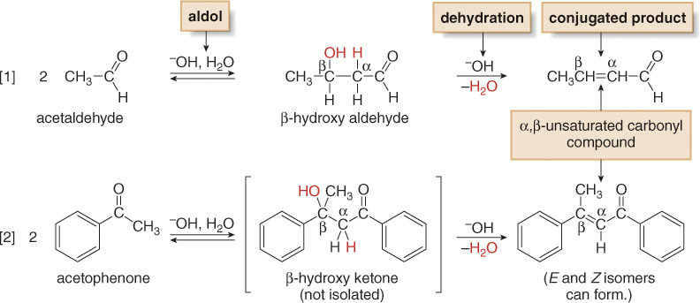
The Aldol Reaction—Dehydration of the Aldol Product
Under the basic reaction conditions, the initial aldol product is often not isolated. Instead, it loses the elements of H₂O from the α and β carbons to form an α,β-unsaturated carbonyl compound.

Slide 16
If aldehyde or ketone does not contain an α-hydrogen, a simple Aldol condensation cannot take place.

Slide 17
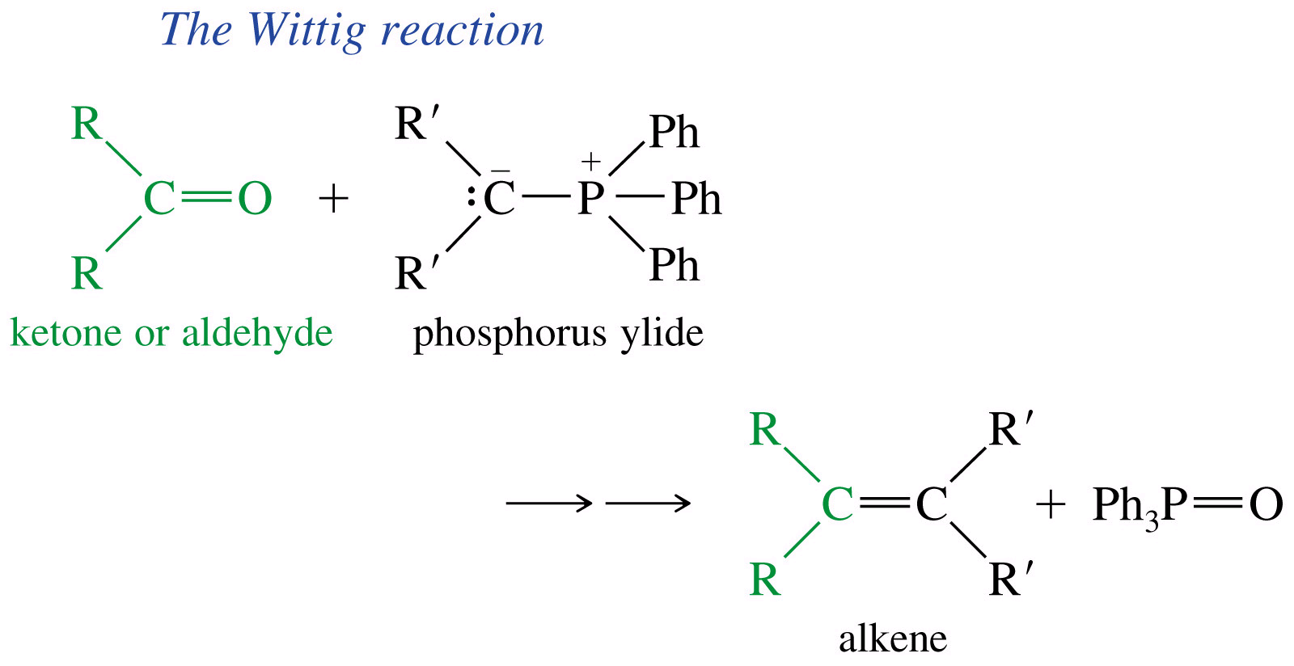
Wittig Reaction (C=O into C=C ): The synthesis of an alkene from the reaction of an aldehyde or ketone and a triphenylphosphonium ylide (Wittig reagent).

Slide 18
