Slide 1

Medical Microbiology
Enterobacteriaceae
Lab. 9

Slide 2
Enterobacteriaceae
Enterobacteriaceae includes many genera;
Escherichia , Salmonella , Shigella , Enterobacter ,
Serratia , Proteus ,and others are short gram negative rods , non-sporing , facultative an aerobes , catalase positive , oxidase negative .
Enterobacteriaceae members are commonly found in the human intestine , either as commensals or as pathogens.

Slide 3
Some tests are used in rapid identification system ;
The production of indole from tryptophan
Triple sugar iron test
Culture on differential media contain special dyes and carbohydrates
MacConkey agar
Eosin Methylene Blue agar(EMB) distinguish lactose fermenting from non lactose fermenting colonies.

Slide 4
Identification characters
Lactose fermenter bacteria
Non-Lactose fermenter bacteria

Slide 5
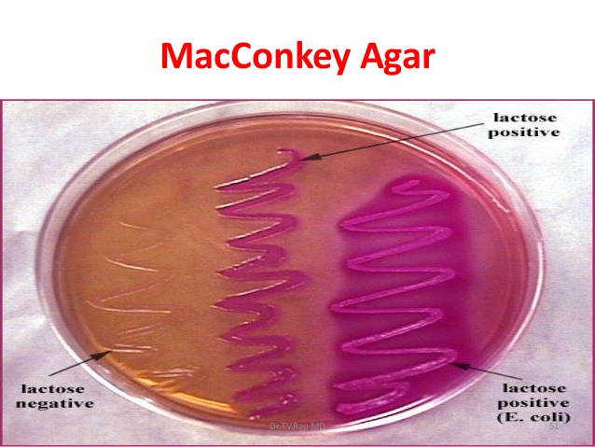
Escherichia coli
MacConkey agar ( pink colored)-lactose fermenter

Slide 6
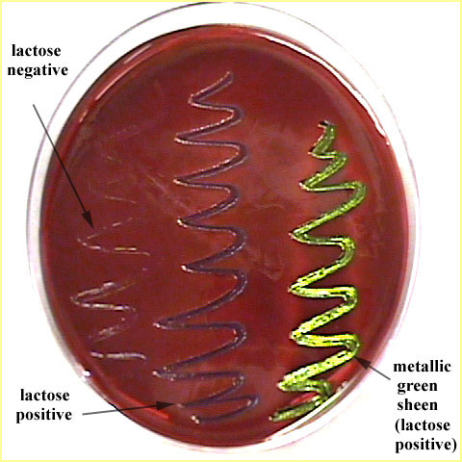
EMB agar (green metalic sheen )

Slide 7
Enterobacter aerogenes
No green metalic sheen on EMB agar .
Often motile .
More viscous colonies .

Slide 8
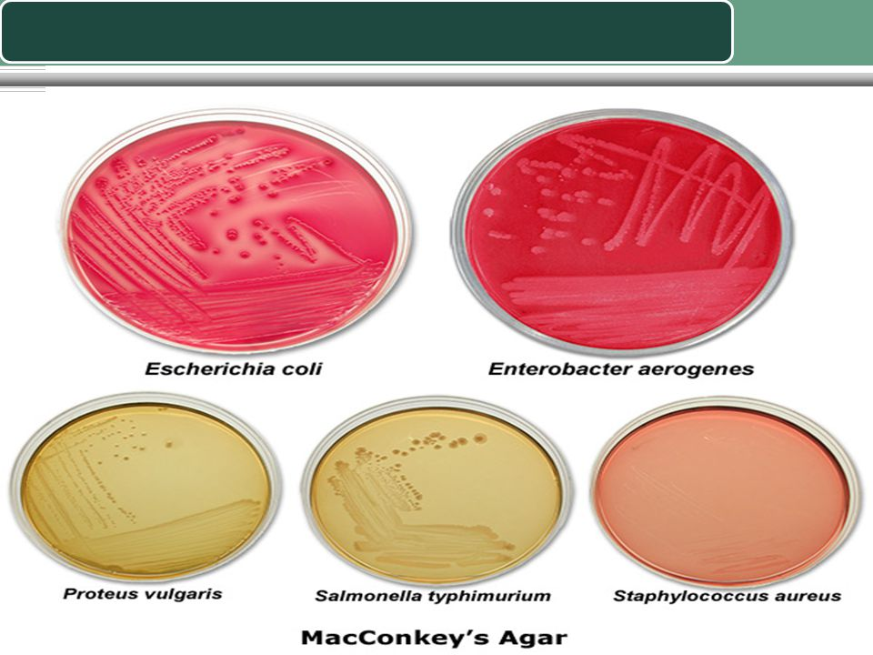
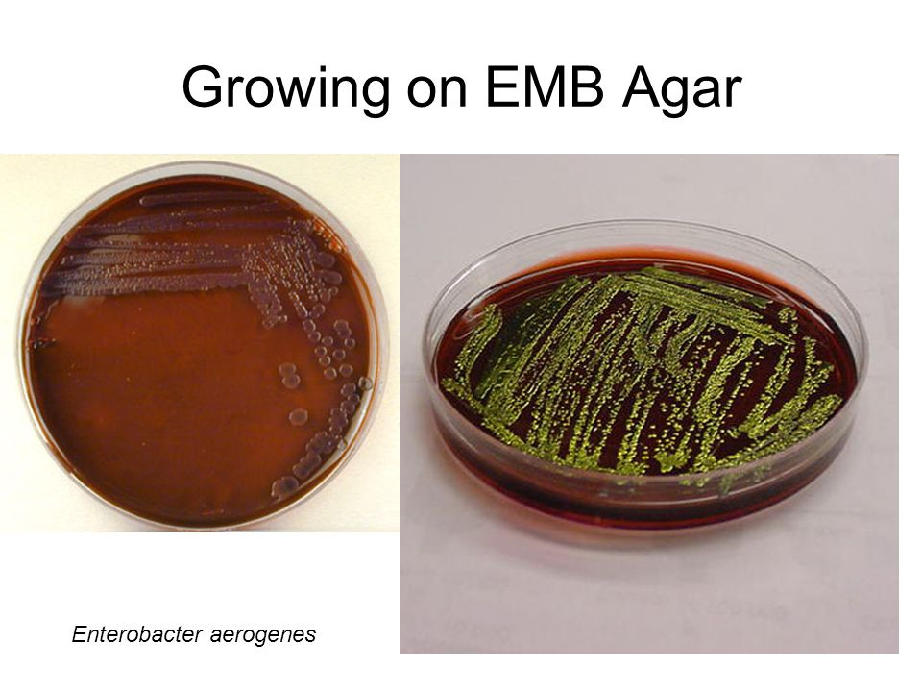
MacConkey agar
EMB agar

Slide 9
Klebsiella pneumoniae
Pink to purple colonies on MacConkey agar
No green metallic sheen on EMB agar .
Non- motile .
Very viscous mucoid colonies .

Slide 10
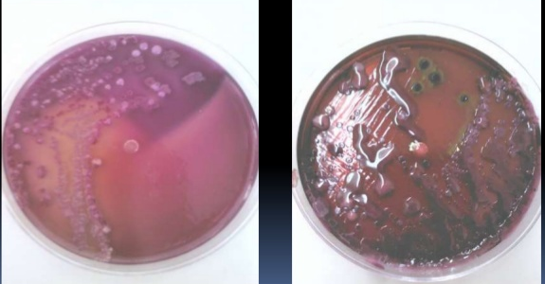


Klebsiella pneumoniae

Slide 11
Shigella sp.
Non-motile pale colonies on SS agar .
TSI: K/A , H2S(-)
Salmonella sp.
Motile black colonies on SS agar .
TSI: K/A , H2S(+)

Slide 12
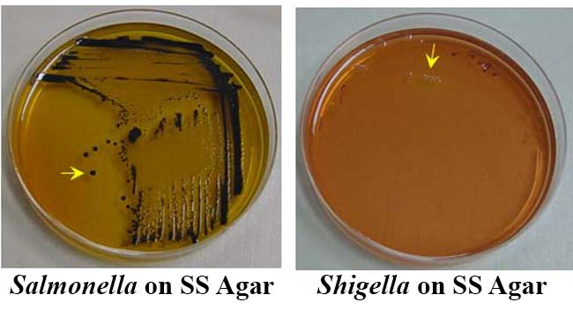

Slide 13
Proteus sp.
Motiler.
Swarming on agar.
Fishy odor.
Urease production

Slide 14
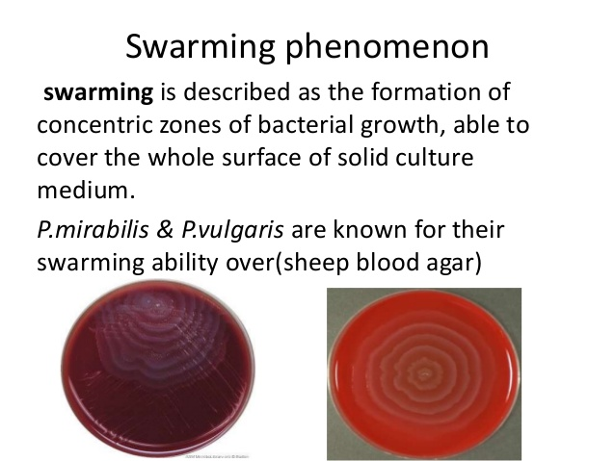

Slide 15
