Slide 1
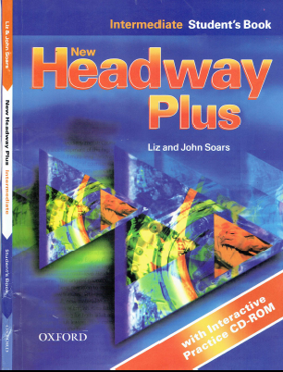
Class Reference book
English Language
For 3rd Year Students
College Pharmacy
Al-Mustansiriyah University
Chapter Five
Reading and Speaking

