Slide 1
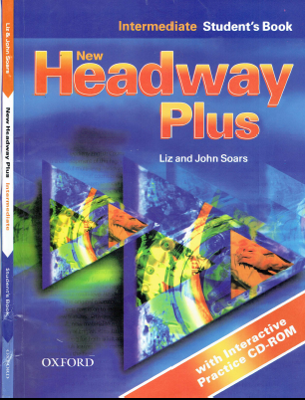
Class Reference book
English Language
For 3rd Year Students
College Pharmacy
Al-Mustansiriyah University
Chapter Six
Dr. Hiba Ali Hasan

Slide 2
Introduction like
6.1. What…….like?
6.2. How….?
6.3. How….? or What ……like?
6.4. Verb +-ing or infinitive
6.5. Relative Clauses.
6.6. Participles.

