Slide 1
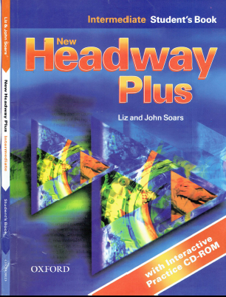
Class Reference book
English Language
For 3rd Year Students
College Pharmacy
Al-Mustansiriyah University
Chapter Five
Dr. Hiba Ali Hasan

Slide 2
Future Tense
Will / going to and present Continuous

Slide 4
Future tense

