Slide 1
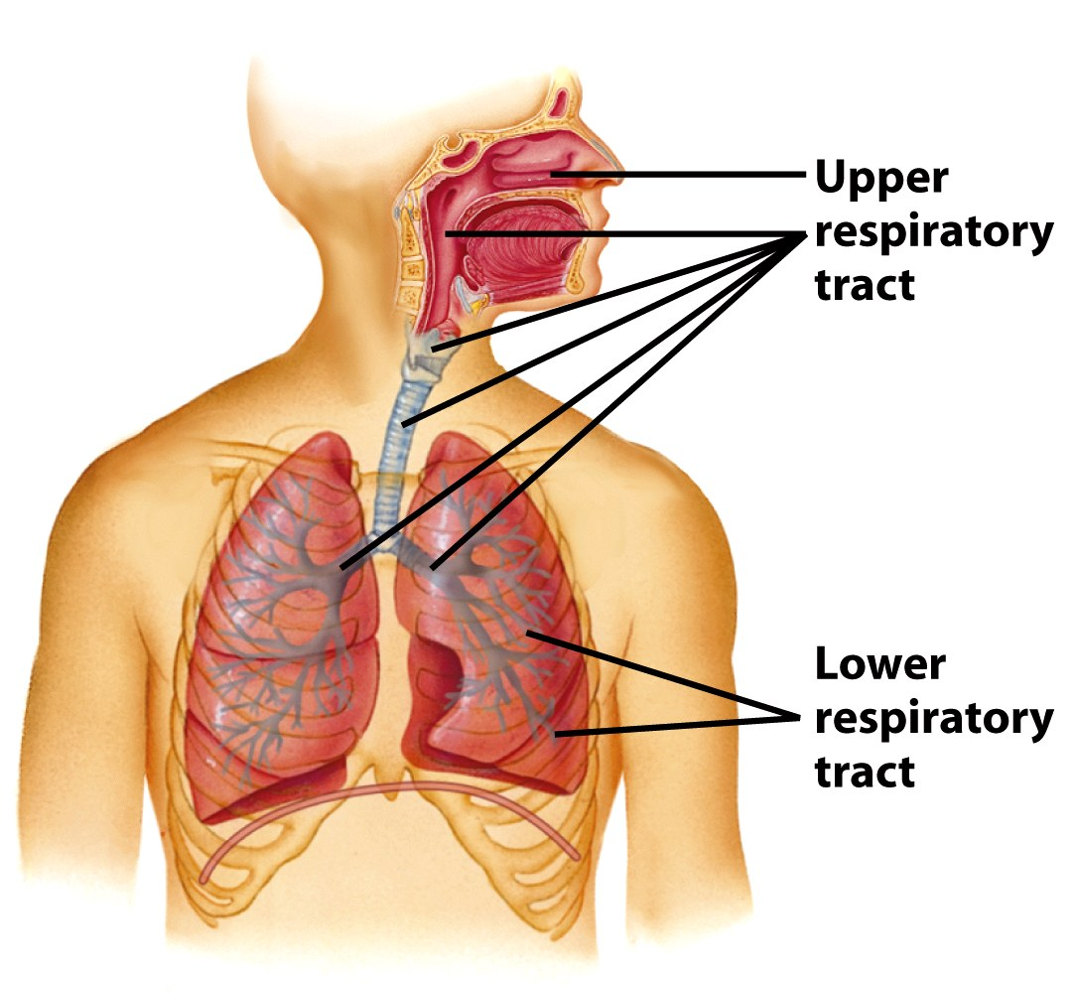
Respiratory Tract Infection
Dr.Suzan Yousif

Slide 2
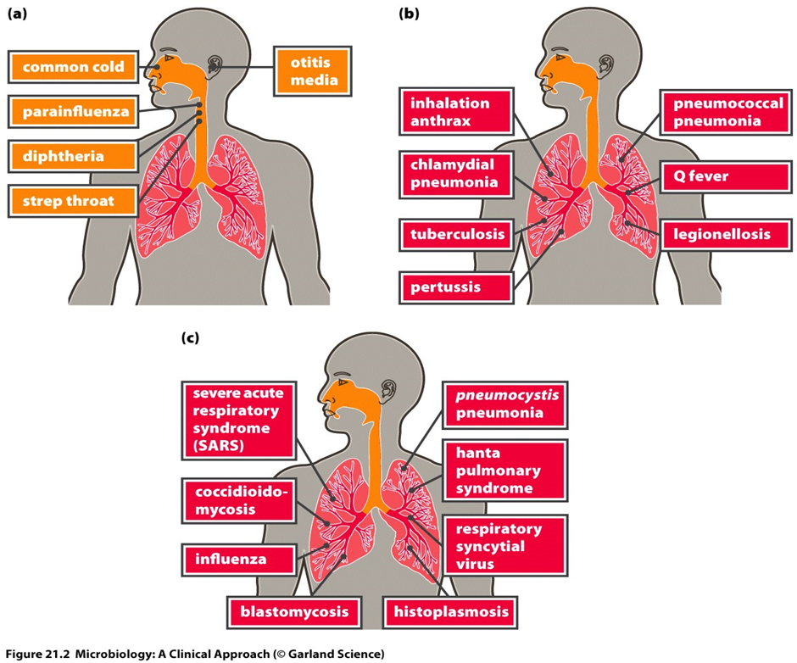
Infections of the respiratory tract are acquired mainly by the inhalation of pathogenic organisms.
PATHOGENS OF THE RESPIRATORY SYSTEM

Slide 3
Infective Agents
The infective agents that cause respiratory infections include viruses, bacteria, rickettsia and fungi.
The spread of infection from the respiratory tract may lead to the invasion of other organs of the body. Bacterial meningitis is often secondary to a primary focus in the respiratory tract, for example infections due to Streptococcus pneumoniae, Haemophilus influenzae or Mycobacterium tuberculosis.
The pathogens vary in their ability to survive in the environment. Some are capable of surviving for long periods in dust, especially in a dark, warm, moist environment, protected from the lethal effects of ultraviolet rays of sunshine. For example, M. tuberculosis can survive for long periods in dried sputum.
Humans are the reservoir of most of these infections but some have a reservoir in lower animals, for example plague in rodents.
Carriers play an important role in the epidemiology of some of these infections, for example in meningococcal infection carriers represent the major part of the reservoir.

Slide 4
Transmission
There are three main mechanisms for the transmission of air-borne infections – droplets, droplet nuclei and dust.
Droplets: These are particles that are ejected by coughing, talking, sneezing, laughing and spitting. They may contain food debris and micro-organisms enveloped in saliva or secretions of the upper respiratory tract. Being heavy, droplets tend to settle rapidly. The transmission of infection by this route can only take place over a very short distance. Because of their relatively large size, droplets are not readily inhaled into the lower respiratory tract.
Droplet nuclei: These are produced by the evaporation of droplets before they settle. The small dried nuclei are buoyant and are rapidly dispersed. The droplet nuclei are also usually small enough to pass through the bronchioles into the alveoli of the lungs.
Dust: Dust-borne infections are important in relation to organisms that persist in dust for long periods and dust can act as the reservoir for some of them. The organisms may be derived from sputum, or from settled droplets.
Other mechanisms: Streptococci or staphylococci may also be derived from skin and infected wounds.
Notes:
Buoyantقابلة للطفو
Dispersed تتشتت

Slide 5
Host
Non-specific defences
A number of non-specific factors protect the respiratory tract of man. These include mechanical factors such as the mucous membrane, which traps small particles on its sticky secretions and cleans them out by the action of its ciliated epithelium. In addition, the respiratory tract is also guarded by various reflex acts such as coughing and sneezing which are provoked by foreign bodies or accumulated secretions. Mucoid secretions which contain lysozyme and some biochemical constituents of tissues have antimicrobial action.
Immunity
Specific immunity may be acquired by previous spontaneous infection or by artificial immunization. For some of the infections, a single attack confers life-long immunity (e.g. measles) but in other cases, because there are many different antigenic strains of the pathogen, repeated attacks may occur (e.g. influenza).

Slide 6
Control Of Air-borne Infections
The main principles involved in the control of respiratory infections are outlined under three headings infective agent, the mode of transmission and host factors.
Infective agent
■ Elimination of human and animal reservoirs.
■ Disinfection of floors and the elimination of dust.
Mode of transmission
■ Air hygiene: good ventilation; air disinfection with ultraviolet light (in special cases).
■ Avoid overcrowding. Bedrooms of dwelling houses and public halls.
■ Personal hygiene. Avoid coughing, sneezing, spitting or talking directly at the face of other persons. Face masks should be worn by persons with respiratory infections to limit contamination of the environment.
Host
■ Specific immunization: active immunization (e.g. measles, whooping cough, influenza); passive immunization in special cases (e.g. gamma globulin for the prevention of measles).
■ Chemoprophylaxis (e.g. isoniazid in selected cases for the prevention of tuberculosis).

Slide 7
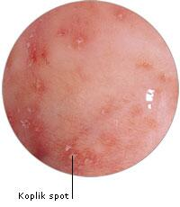
Viral Infections
Measles
Measles is an acute communicable disease which presents with fever, signs of inflammation of the respiratory tract (coryza, cough), and a characteristic skin rash. The presence of punctate lesions (Koplik’s spots) on the buccal mucosa may assist diagnosis in the early prodromal phase.
Deaths occur mainly from complications such as secondary bacterial infection, with bronchopneumonia and skin sepsis. Post-measles encephalitis occurs in a few cases.
The incubation period is usually about 10 days, at which stage the patient presents with the prodromal features of fever and coryza. The skin rash usually appears 3–4 days after the onset of symptoms.
The aetiological agent is the measles virus.
Epidemiology
Measles is a familiar childhood infection in most parts of the world. Until recent years there were a few isolated communities in which the infection was unknown, but the disease is endemic in virtually all parts of the world.
RESERVOIR AND TRANSMISSION
Humans are the reservoir of infection. Transmission is by droplets or by contact with sick children or with freshly contaminated articles such as toys or handkerchiefs.
Notes:
Coryza زكام

Slide 8
Control
Isolation of children who have measles is of limited value in the control of the infection because the disease is highly infectious in the prodromal coryzal phase before the characteristic rash appears. Thus, often by the time a diagnosis of measles is made or even suspected, a number of contacts would have been exposed to infection.
ACTIVE IMMUNIZATION
The best means of reducing the incidence of measles is by having an immune population. Children should be vaccinated at 8 months, with one dose of live attenuated measles virus vaccine.
The protection conferred appears to be durable (12 years). During shipment and storage, prior to reconstitution, freeze-dried measles vaccine must be kept at a temperature between 2 and 8°C and must be protected from light.
PASSIVE IMMUNIZATION
Measles infection may be prevented or modified by artificial passive immunization using immune gamma globulin. If the gamma globulin (0.25 ml/kg) is given early, within 3 days of exposure, the infection will be prevented; if a smaller dose (0.05 ml/kg) is given 4–6 days after exposure, the infection may be modified, the child presenting with a mild infection which confers lasting immunity. Since passive immunity by itself gives only transient protection, it is more desirable to achieve a modified attack rather than complete suppression of the infection unless the presence of some other serious condition in the child absolutely contraindicates even a mild attack.

Slide 9
Rubella or German measles
Is an acute viral infection which presents with fever, mild upper respiratory symptoms, a morbiliform or scarlatiniform rash and lymphadenopathy usually affecting postauricular, postcervical and suboccipital lymph nodes.
The illness is almost always mild, but infection with rubella during the first trimester of pregnancy is associated with a high risk (up to 20%) of congenital abnormalities in the baby.
The incubation period is 2–3 weeks. The aetiological agent is the rubella virus.
Epidemiology
Rubella has a worldwide distribution. Humans are the reservoir of infection which is spread from person to person by droplets or by contact, direct or through contamination of fomites. Infection results in lifelong immunity.
Infection during early pregnancy may cause such abnormalities as cataract, deaf mutism and congenital heart disease in the baby.
Control
The main interest is to prevent the infection of women who are in the early stages of pregnancy, and thus avoid the risk of rubella-induced foetal injury. One practical approach is the deliberate exposure of prepubertal girls to infection with rubella or vaccinating them with a single dose of vaccine. Pregnant women should avoid exposure to rubella, especially during the first 4 months of pregnancy; those who have been in contact with the disease should be protected with human immunoglobulin.
Notes:
Morbiliform طفح حصبي
Scarlatiniform قرمزي الشكل
Postauricularخلف صيوان الاذن

Slide 10
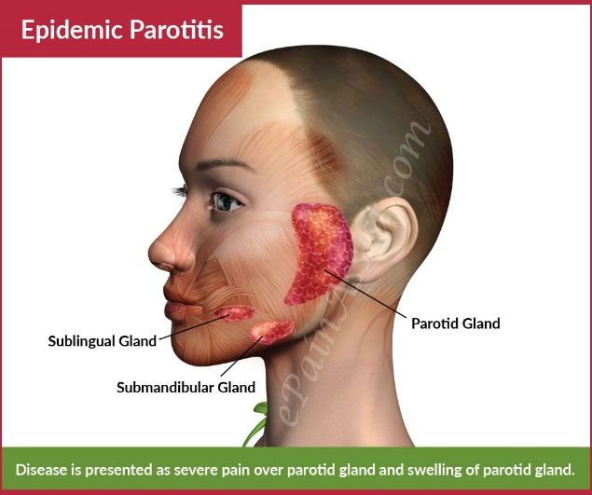
MUMPS
This is an acute viral infection which typically affects salivary glands, especially the parotids, but may also involve the submandibular or the sublingual salivary glands. Pancreatitis, orchitis, inflammation of the ovaries or meningo-encephalitis may complicate the infection; some of the complications occasionally occur in the absence of obvious clinical symptoms or signs of salivary gland infection.
The incubation period varies from 2 to 4 weeks; usually it is about 21 weeks.
The infectious agent is the mumps virus.
Epidemiology
Mumps has a worldwide distribution.
RESERVOIR
Humans are the reservoir of infection. The virus is present in the saliva of infected persons; it may be isolated as early as 1 week before clinical signs occur, and it may persist for 9 days after the onset of signs. Healthy carriers, who remain asymptomatic throughout the infection, may also transmit the infection. The source of infection therefore, includes sick patients, incubatory (‘precocious’) carriers and healthy carriers.
TRANSMISSION
The infection is transmitted by droplets or by contact, directly or indirectly, through fomites.

Slide 11
HOST FACTORS
One infection, whether clinical or subclinical, confers lifelong immunity.
Artificial active immunization with live or inactivated vaccine provides protection for a limited period of a few years.
Control
INDIVIDUAL
-The sick patient should be isolated, if possible, during the infectious phase;
- Strict hygienic measures should be observed in the cleansing of spoons, cups and other utensils handled by the patient, and also in the disposal of his or her soiled handkerchiefs and other linen.
VACCINATION
A live mumps virus vaccine is available. Vaccination is of value in protecting susceptible young persons in residential institutions in which epidemics occur frequently. It has proved very effective in controlling mumps in the USA. Acombined vaccine for measles, mumps and rubella is available (MMR). Fears for the use of this vaccine seem unjustified on present evidence.

Slide 12
INFLUENZA
This is an acute respiratory infection that is characterized by systemic manifestations – fever, headache, malaise and muscle pains, and by local manifestations of coryza, sore throat and cough. Secondary bacterial pneumonia is an important complication.
The case fatality rate is low but deaths tend to occur in debilitated persons, those with underlying cardiac, respiratory or renal disease, and in the elderly.
The incubation period is usually 1–3 days.
There are three main types of the influenza virus – influenza A, B and C; A and B types consist of several serological strains.
An important feature of the epidemiology of influenza is the periodic emergence of new antigenically distinct strains which account for massive pandemics.
Most epidemic strains belong to type A. They have been recovered from various types of animals and birds which may well act as important sources of new strains showing major antigenic changes (antigenic shift). Pandemics may originate where there is close contact between humans and animals.
Sporadic cases and limited outbreaks occur annually throughout the world and are the result of progressive, minor antigenic change (antigenic drift).

Slide 13
Epidemiology
Massive epidemics of influenza periodically sweep throughout the world with attack rates as high as 50% in some countries. The pandemic may first appear in a specific focus (Asiatic ‘flu, Hong Kong ‘flu) from which it spreads from continent to continent. Rapid air travel has facilitated the global dissemination of this infection.
RESERVOIR AND TRANSMISSION
Humans are the reservoir of infection of human strains of the influenza virus. The infection is transmitted by droplets, and also by contact, both direct and indirect, through the handling of contaminated articles.
HOST FACTORS
All age groups are susceptible, but if the particular strain causing an epidemic is antigenically related to the cause of an earlier epidemic, the older age group with persisting antibodies may be less susceptible. Deaths occur mostly in cases with some underlying debilitating disease.
Control
Active immunization with inactivated influenza virus protects against infection with that specific strain. Polyvalent vaccines are also available but they are only effective if they contain the antigens of the particular strain causing the epidemic. Sometimes, it may be possible to prepare vaccine from strains that are isolated early in the epidemic for use in other areas or countries which have not been affected. Based on serological surveys and antigenic analysis WHO recommends vaccine formulations on a year to year basis. The vaccine is especially recommended for the elderly and other vulnerable groups, for example, chronic lung disease.

Slide 14
Acute Upper Respiratory Tract Infection
Acute infection of the upper respiratory tract is a common but mainly benign disease. The most typical manifestation, ‘the common cold’, presents with coryza, irritation of the throat, lacrimation and mild constitutional upset. Local complications may occur with secondary bacterial infection and involvement of the para nasal sinuses and the middle ear. Infection may spread to the larynx, trachea and bronchi.
The incubation period is from 1 to 3 days.
These symptoms can be induced by infection with various viral agents, including the rhinoviruses, certain enteroviruses, influenza, para-influenza, adenoviruses, reoviruses and the respiratory syncitial virus. Superinfection with various bacteria may determine the clinical picture in the later stages of the illness.
Epidemiology
Humans are the reservoir of these infections. Transmission is by air-borne spread, or by contact both direct and indirect (contaminated toys, handkerchiefs, etc.).
All age groups are susceptible but the manifestations and complications tend to be severe in young children.
Repeated attacks are very common.
Epidemics occur commonly in households, offices, schools and in other groups having close contact.
Control
No specific control measures are available. Infected persons should avoid contact with others. The exposure of young persons to infected persons should be avoided if possible.

Slide 15
INFECTIOUS MONONUCLEOSIS
This is an acute febrile illness which is characterized by lymphadenopathy (‘glandular fever’), splenomegaly, sore throat and lymphocytosis. A skin rash and small mucosal lesions may be present. Occasionally, jaundice and rarely meningoencephalitis may occur.
The incubation period is from about 4 days to 2 weeks.
The causative agent is the Epstein–Barr virus, which is also associated with Burkitt’s lymphoma.
Epidemiology
Isolated cases and epidemics of the disease have been reported from most parts of the world.
Humans are presumed to be the reservoir of infection, with saliva being regarded as the most likely source of infection.
Transmission may be air-borne or by person to person occurring in closed institutions for young adults; there is some suggestion that kissing may be an important route.
Infection occurs mostly in children and young adults. It is uncommon in developing countries.
Control
No satisfactory control measures are available.
Notes:
Febrileمحموم

Slide 16
coronavirus
A coronavirus is a kind of common virus that causes an infection in nose, sinuses, or upper throat. Most coronaviruses aren't dangerous.
But In early 2020, after a December 2019 outbreak in China, the World Health Organization (WHO) identified a new type, 2019 novel coronavirus (2019-nCoV), which can be fatal. The organization named the disease it causes COVID-19.
The outbreak quickly moved from China around the world. It spreads the same way other coronaviruses do: through person-to-person contact.
Symptoms can show up anywhere from 2 to 14 days after exposure. Early on, they're a lot like the common cold:
Fever
Cough
Shortness of breath

Slide 17
Infections range from mild to serious. The virus can turn deadly if it leads to pneumonia, respiratory failure, or septic shock. Those most at risk of death are the elderly and people with weakened immune systems.
Coronaviruses were first identified in the 1960s. They get their name from their crown-like shape. Sometimes, but not often, a coronavirus can infect both animals and humans.
Most coronaviruses spread the same way other cold-causing viruses do: through infected people coughing and sneezing, by touching an infected person's hands or face, or by touching things such as doorknobs that infected people have touched.
Almost everyone gets a coronavirus infection at least once in their life, most likely as a young child. In the United States, coronaviruses are more common in the fall and winter, but anyone can come down with a coronavirus infection at any time.

Slide 18
Control and prevention

