Slide 1
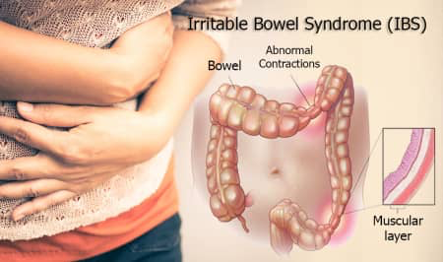

Slide 2
Definition
It is a chronic functional bowel disorder in which abdominal pain is associated with intermittent diarrhoea, sometimes alternating with constipation and a feeling of abdominal distension
The cause is unknown
It often seems to be triggered by stress, and many IBS sufferers have symptoms of anxiety and depression.
Some sufferers may have food intolerance that triggers their symptoms.

Slide 4
Aggravating factors
Stress
Caffeine
The sweeteners sorbitol and fructose
Other foods that have been implicated are milk and dairy products,chocolate, onions, garlic, chives and leeks.

Slide 5
When to refer
Children
Older person with no previous history of IBS
Pregnant women
Blood in stools
Unexplained weight loss
Caution in patients aged over 55 years with changed bowel habit
Symptoms/signs of bowel obstruction
Unresponsive to appropriate treatment

Slide 6
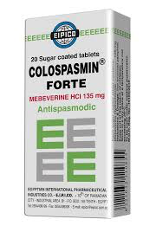
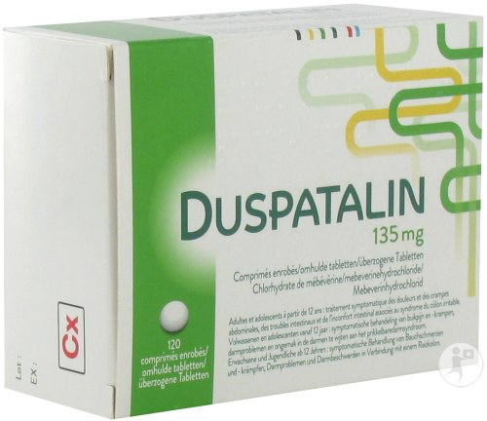
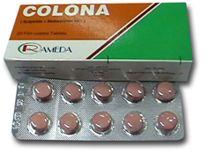
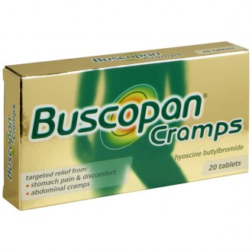
Management
Antispasmodics
Smooth muscle relaxants alverine citrate, peppermint and mebeverine and the antimuscarinic hyoscine are used.

Slide 7
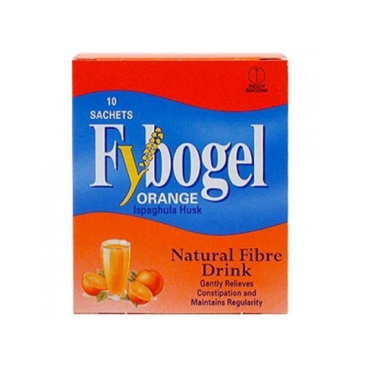
Bulking agents
Bran, which is an insoluble fibre, is no longer recommended in IBS
Oats are more soluble than wheat bran and can be better tolerated.
Bulking agents such as ispaghula husk containing soluble fibre can some help patients.

Slide 8
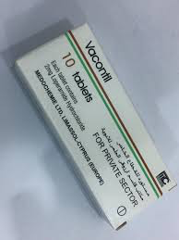
Antidiarrhoeals
Use of OTC antidiarrhoeals such as loperamide is appropriate only on an occasional, short-term basis to reduce diarrhoea or urgency of defaecation.

Slide 9
Diet and nutrition should be assessed for people with IBS and the following general advice given:
■ Have regular meals and take time to eat
■ Avoid missing meals or leaving long gaps between eating
■ Drink at least eight cups of fluid per day
■ Restrict tea and coffee to three cups per day
■ Reduce intake of alcohol and fizzy drinks

Slide 10
■ It may be helpful to limit intake of high-fibre food
■ Reduce intake of ‘resistant starch.
■ Limit fresh fruit to three portions per day (a portion should be ∼80 g)
■ People with diarrhoea should avoid sorbitol
■ People with wind and bloating may find it helpful to eat oats.

Slide 11
Other things that can improve IBS
Exercise
Complementary therapies.. traditional acupuncture, reflexology, aromatherapy or homoeopathy.

