Slide 2
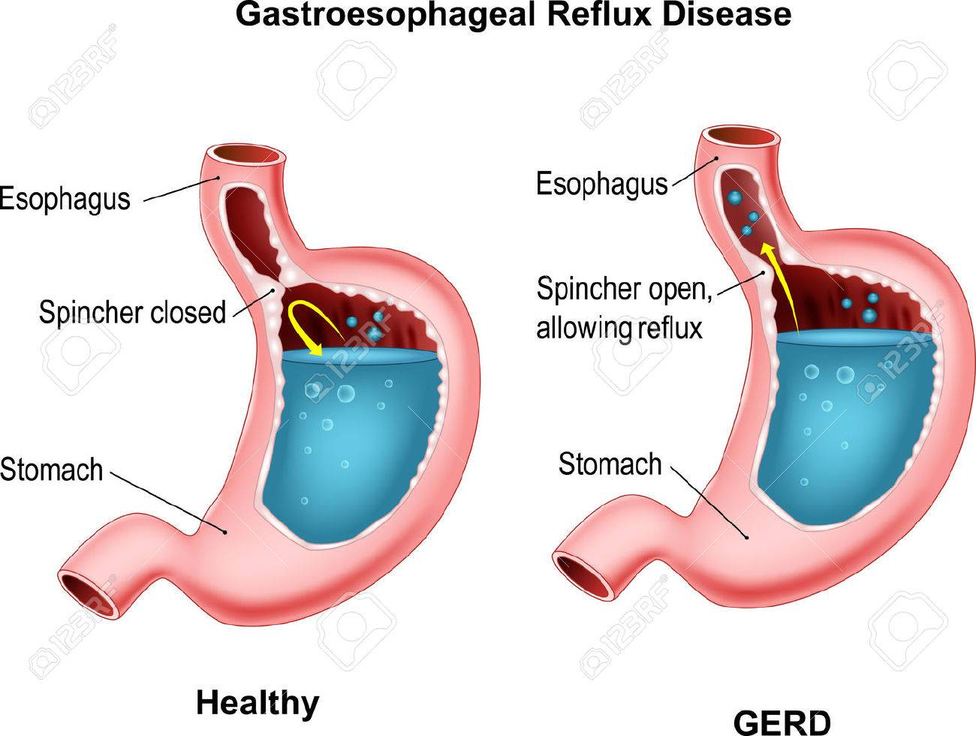

Slide 3
What you need to know
Age
The symptoms of reflux and oesophagitis occur more commonly in patients aged over 55 years.
Children with symptoms of heartburn should therefore be referred to their doctor.

Slide 4
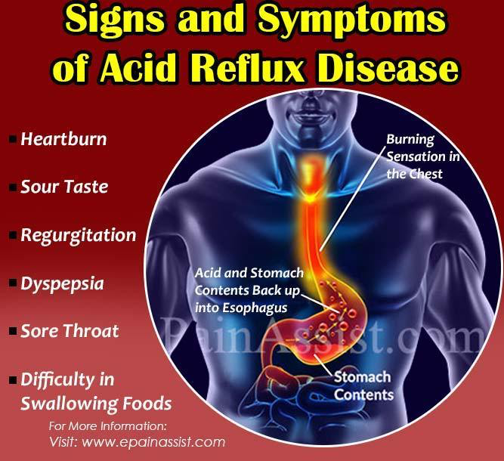

Slide 5
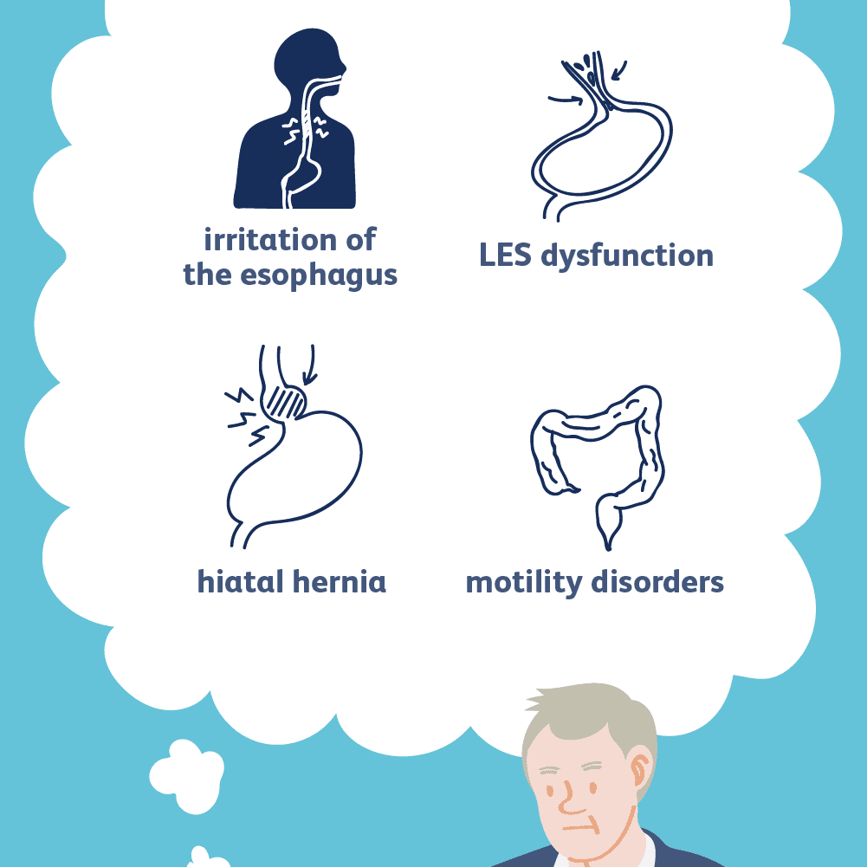

Slide 6
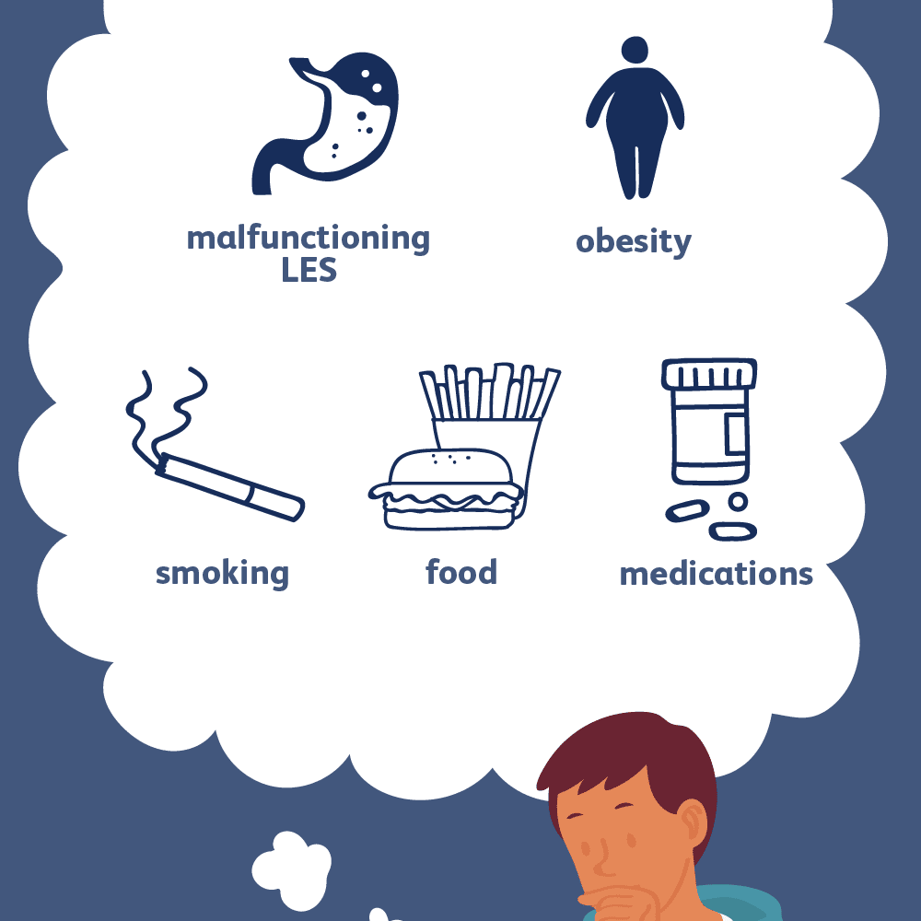
Associated factors

Slide 7
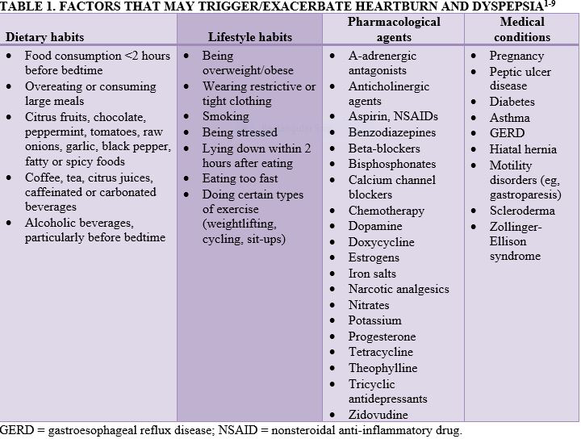

Slide 8
When to refer
Failure to respond to antacids
Related to prescribed medication
Pain radiating to arms
Difficulty in swallowing
Regurgitation
Long duration
Increasing severity
Children

Slide 9
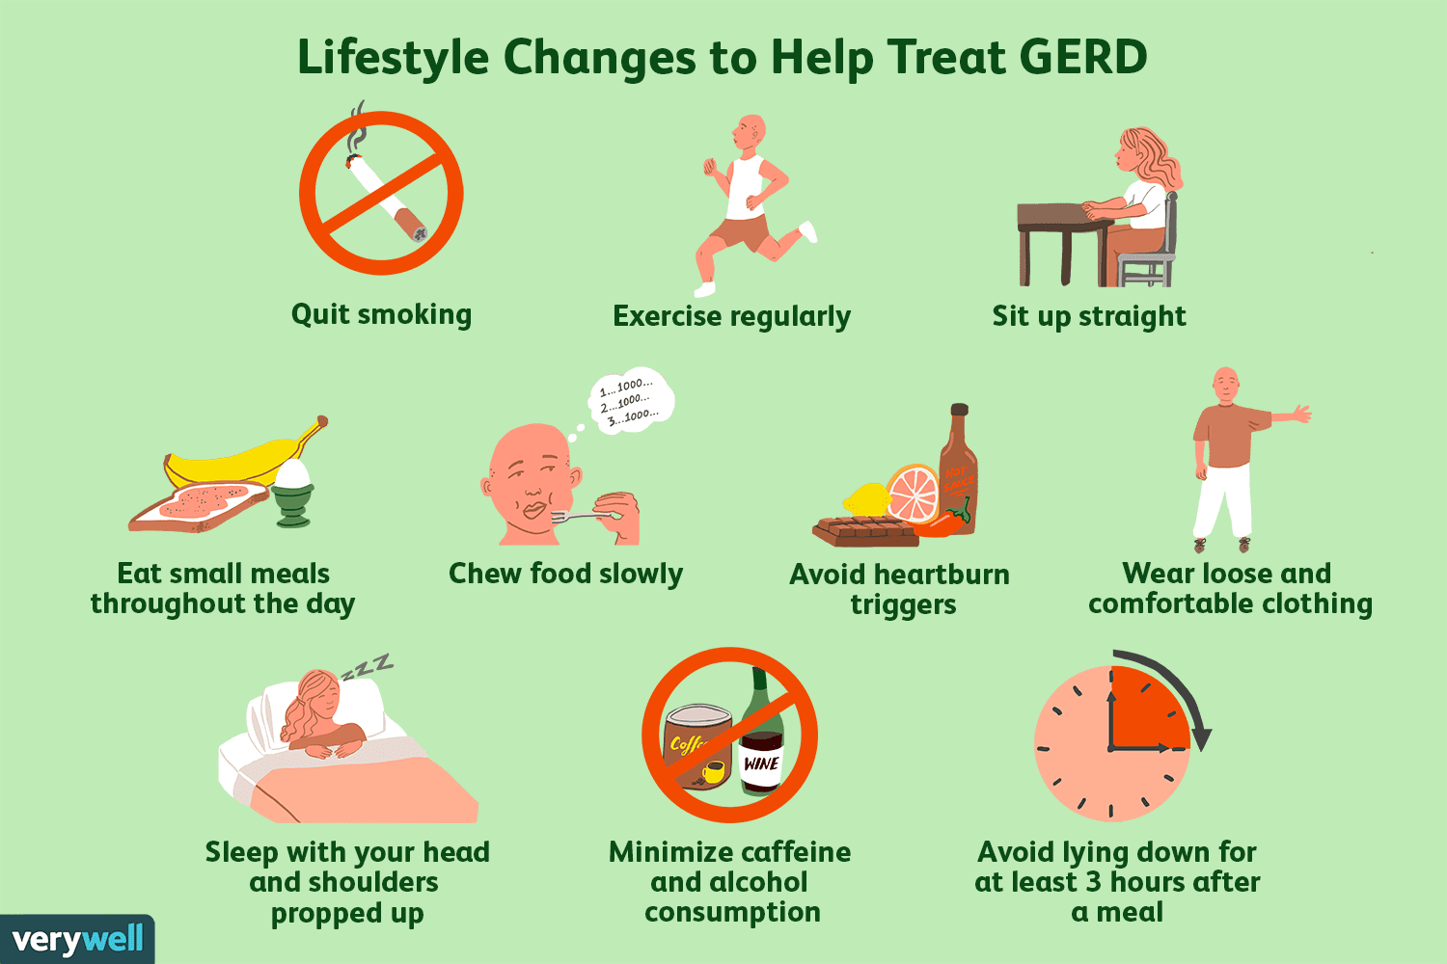
Non-pharmacological management

Slide 10
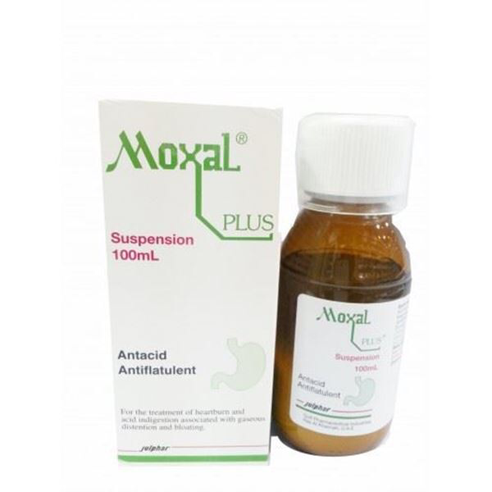
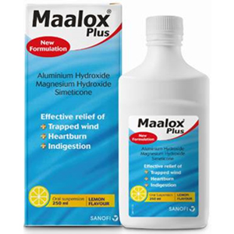
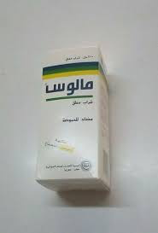
Pharmacological management
Pharmacological management
Antacid
Calcium-, aluminum-, and magnesium-based products are available OTC in a variety of formulations (capsules, tablets, chewable tablets, and suspensions).

Slide 11
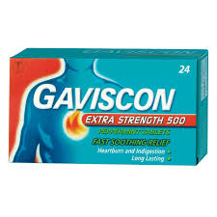
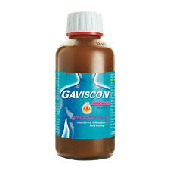
Alginates
contain the antirefluxant alginic acid, which forms a viscous layer on top of gastric contents to act as a barrier to reflux.

Slide 12
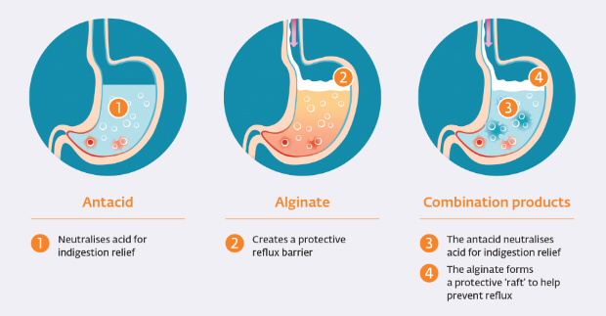
Antacid

Slide 13
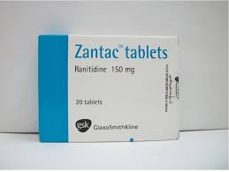
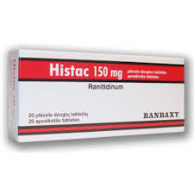
H2 antagonists (ranitidine)
inadults andchildren over 16
Ranitidine is licensed for OTC use in a dose of 75 mg with a maximum daily dose of 300 mg. It can be used for up to 2 weeks

Slide 14
Mechanism of H2 receptor blocker

Slide 15
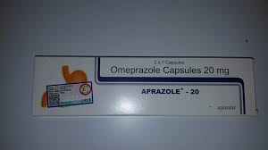
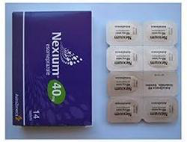
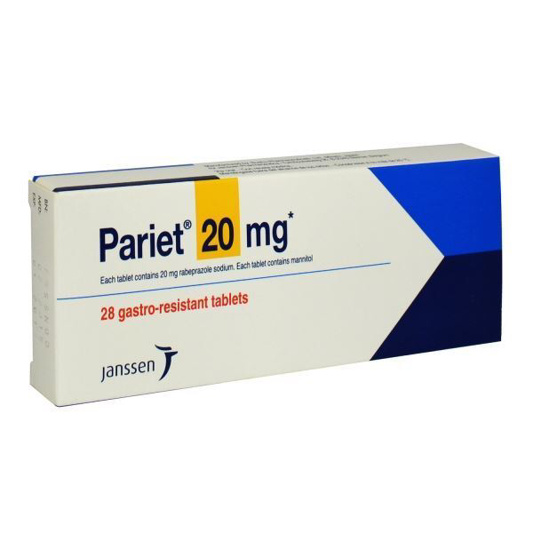
Proton pump inhibitors
Omeprazole and rabeprazole are licensed OTC as 10 mg tablets and esomeprazole and pantoprazole as 20 mg tablets,

Slide 16
Mechanism of proton pump inhibitor

Slide 17
