Slide 1
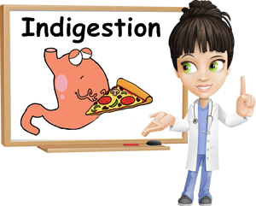

Slide 2
Definition
Indigestion (dyspepsia) is upper abdominal discomfort or pain that may be described as a burning sensation, heaviness or an ache.

Slide 3
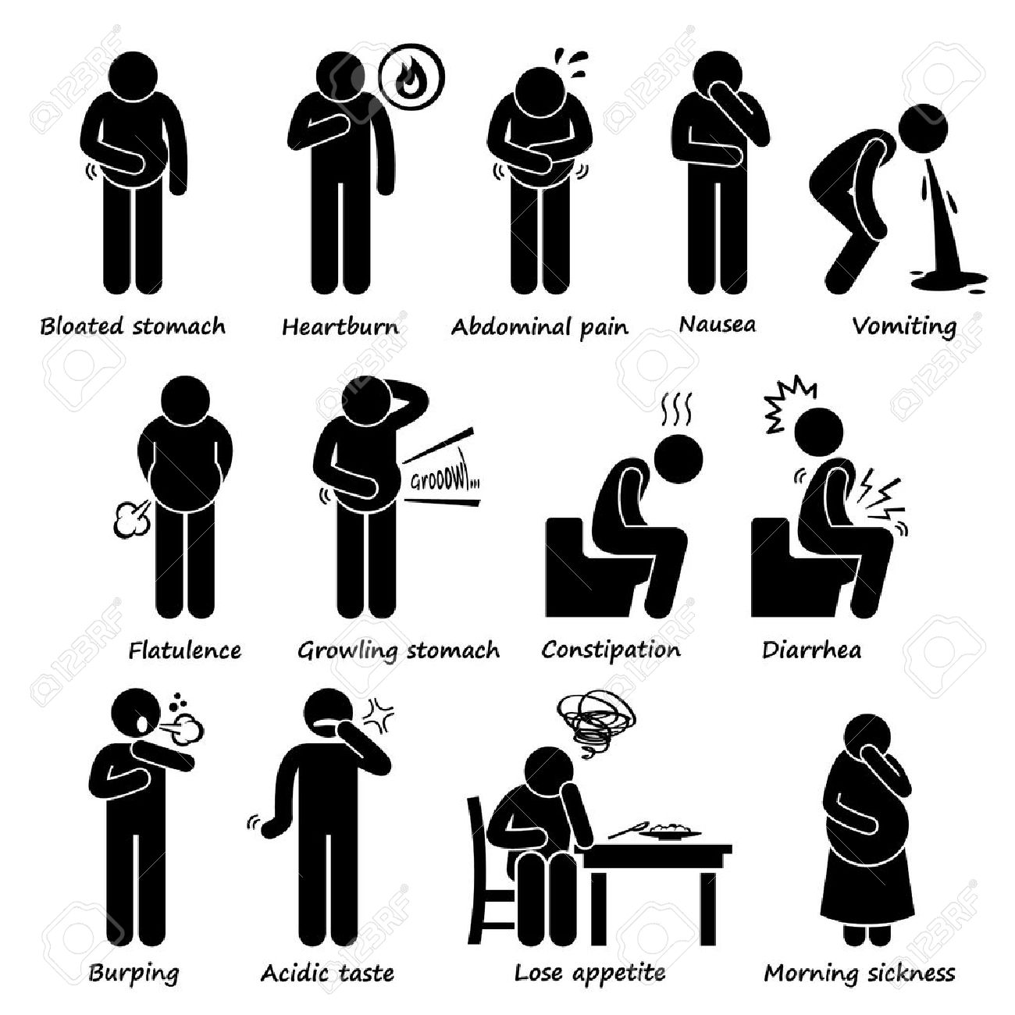
What you need to know..symptoms

Slide 4
2.Age
Children
Older than 55 years old
Risk of gastric cancer

Slide 5
Alarm symptoms and indigestion:Reasons for referral
Age over 55 years, if symptoms develop for first time.
Symptoms are persistent (longer than 5 days) or recurrent.
Pain is severe.
Blood in vomit or stool.
Pain gets worse on effort.

Slide 6
Persistent nausea or vomiting.
Treatment has failed.
Adverse drug reaction is suspected.
Associated weight loss.
Children.

Slide 7
Management
Antacids
are best taken about 1 hr after a meal because the rate of gastric emptying has then slowed and the antacid will therefore remain in the stomach for longer.
Taken at this time antacids may act for up to 3 h compared with only 30 min–1 h if taken before meals

Slide 8
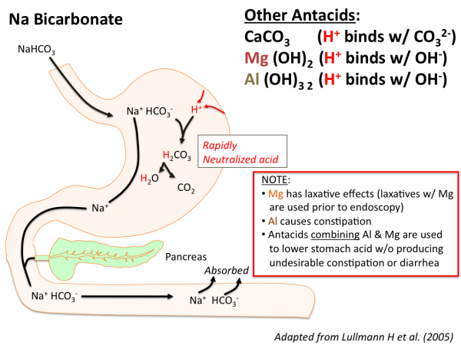

Slide 9
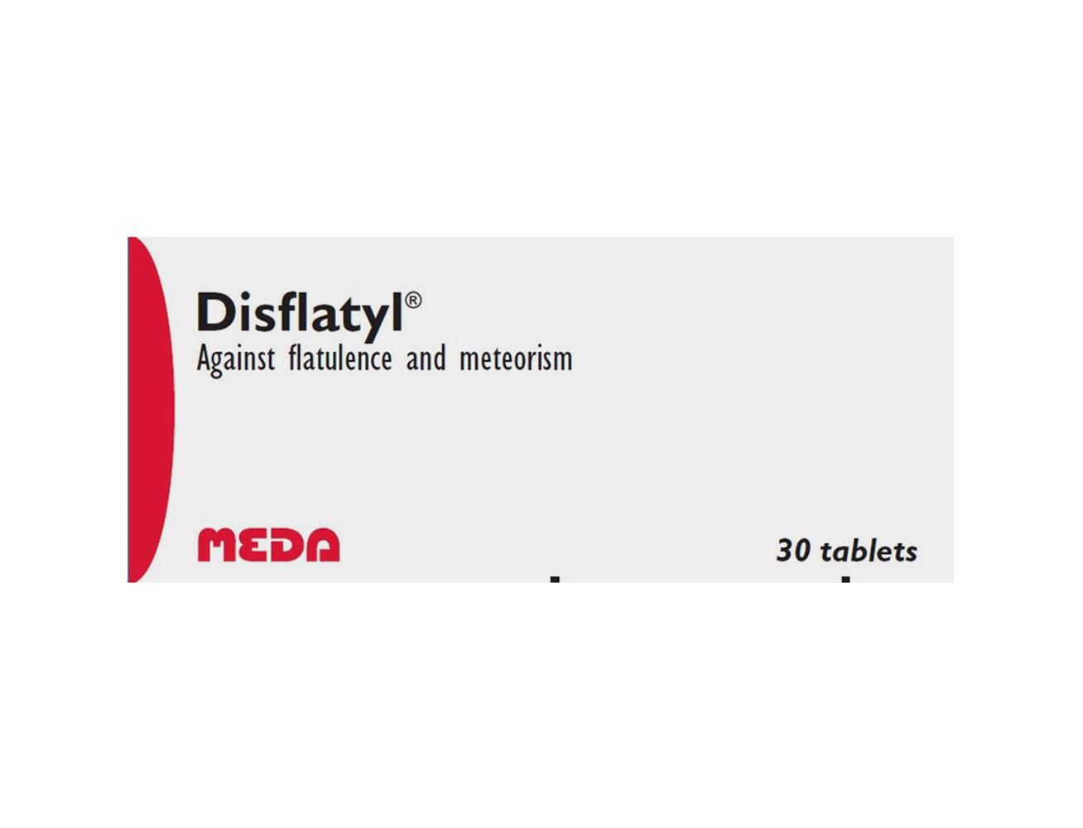
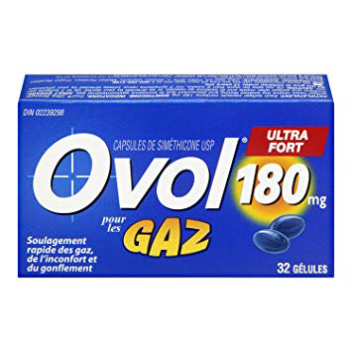
Dimeticone (dimethicone)
it reduces surface tension and allows easier elimination of gas from the gut by passing flatus or eructation (belching)

Slide 10
Interactions with antacids
Antacids may reduce the absorption of some antibiotics and antifungals
Sodium bicarbonate may increase the excretion of lithium and lower the plasma level
decrease in iron absorption if iron is taken at the same time.

Slide 11
Ranitidine can be used for the short-term treatment of dyspepsia and heartburn.
Treatment with ranitidine is limited to a maximum of 2 weeks.

Slide 12


