Slide 1
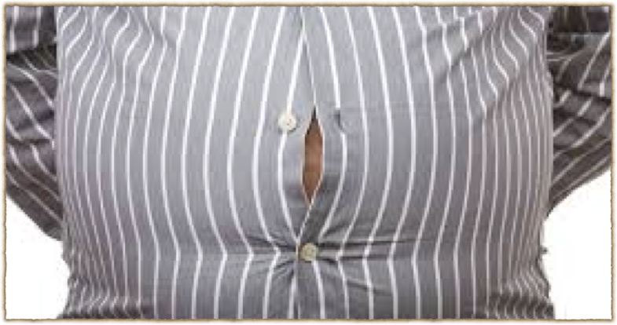
Obesity

Slide 2

Classification
Normal: BMI 18.5–24.9 kg/m2
3. Overweight: BMI 25.0–29.9 kg/m2
4. Obesity a. Class I: BMI 30.0–34.9 kg/m2
b. Class II: BMI 35.0–39.9 kg/m2
c. Class III: BMI 40 kg/m2 or greater

Slide 3
Nonpharmacologic therapy
1. Increased physical activity: 200–300 minutes per week
2.Dietary options
a.Striveforatleasta500-kcal/day deficit.
b. 1200–1800 kcal/day for women
c. 1500–1800 kcal/day for men
3. Behavioral intervention
4. Surgery

Slide 4
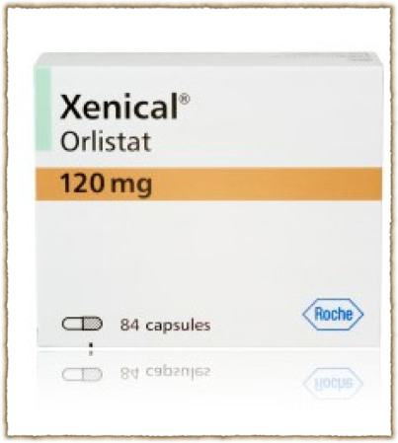
Orlistat
Reduced absorption of fat by inhibition of gastric and pancreatic lipases.
120 mg three times daily during or up to 1 hour after meals
Gastrointestinal (GI) tract S.e

Slide 5
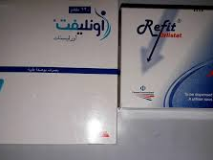

Slide 6
orlistat should not be supplied if there is renal/kidney disease,
thyroid disease or epilepsy.
Patients with chronic malabsorption syndrome and those with cholestasis
pregnancy and in women who are breastfeeding.

Slide 7
Referral to the Gp
Diabetes, patients with high cholesterol levels and hypertensive patient.
before starting orlistat many drugs need to be adjusted such as amiodarone, acarbose, ciclosporin and levothyroxine.
There is an increased risk of convulsions when orlistat is given with antiepileptics.
Patients with renal/kidney disease should consult their GP before us

