Slide 1
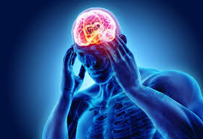
Headache

Slide 2

What you need to know
Age Adult, child
Duration
Nature and site of pain
Frequency and timing
Previous history Fits, faints, blackouts and migraine

Slide 3
Associated symptoms (Nausea, vomiting and photophobia )
Precipitating factors (Foods, alcohol, stress and hormonal)
Recent trauma or injury
Falls

Slide 4
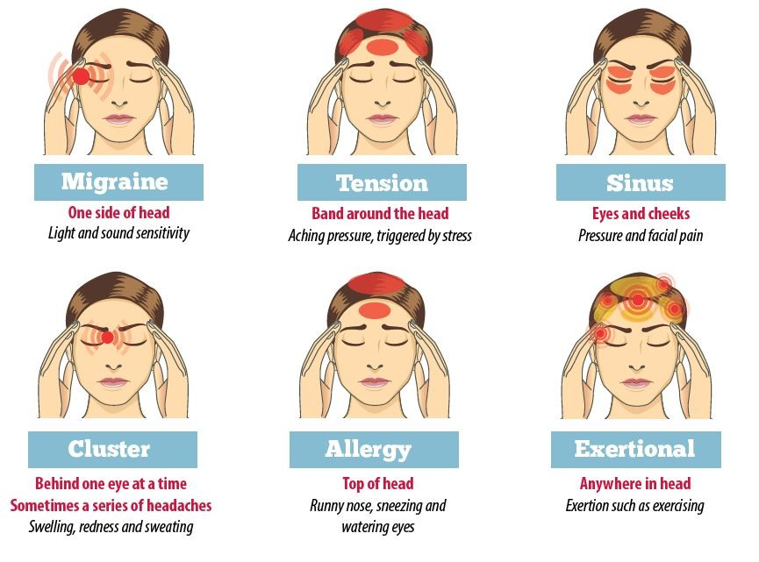

Slide 5
Migraine
There are two common types of migraine:
Migraine with aura is often associated with alterations in vision before an attack starts the so-called prodromal phase.
migraine without aura, there is no prodromal phase

Slide 6
Women who get migraine with aura, or particularly severe migraine without aura, should not take the combined contraceptive pill, patch or ring, because of an increased risk of stroke.

Slide 7
International Headache Society’s diagnostic pointers for migraine
Migraine without aura (common migraine)Headache has at least two of the following four characteristics
1.Unilateral location
2. Pulsating quality
3. Moderate or severe pain intensity
4. Aggravation by, or causing avoidance of, routine physical activity

Slide 8
During headache at least one of the following symptoms:
1. Nausea and/or vomiting
2. Photophobia (aversion to light) and phonophobia (aversion to noise)

Slide 9
Tension-type headache
These headaches are most often related to upset or stress.
recurrent episodes of headache that are usually bilateral and have a pressing or tightening quality (non-pulsating) that is mild to moderate in intensity.
is not aggravated by routine physical activity such as walking or climbing stairs and
is not associated with nausea or vomiting or photophobia or phonophobia

Slide 10
Medication overuse headache
Develops or worsens with frequent use of any drug treatment for pain in people who have tension-type headache or migraine.
It has also been identified in people taking analgesics for other painful conditions.
It is most commonly seen when triptans, opioids, ergots or combination analgesia have been taken for 10 days per month or more and is sometimes seen if paracetamol, aspirin or NSAID taken on 15 days per month or more.
The main treatment is stopping the analgesia, in tandem with careful support and encouragement. It may take 2 months to resolve.

Slide 11
Cluster headaches (migrainous neuralgia)
A typical pattern would be daily episodes of pain over 2–3 months, after which there is a remission for anything up to 2 years.
In typical cases the headache commonly wakes the person from sleep within 2 hr of going to sleep
Each episode of pain can last from 15 min to 3h,and the pain is usually experienced on one side of the head
It is often accompanied by a painful, watering eye and a watering or blocked nostril on the same side as the pain

Slide 12
Sinusitis
Sinusitis may complicate a respiratory viral infection (e.g. cold) or allergy (e.g. hay fever), which causes inflammation and swelling of the mucosal lining of the sinuses
The pain may be felt behind and around the eye, or over the cheek, with radiation over the forehead and often only one side is affected.
It is typically worse on bending forwards or lying down.

Slide 13
Temporal arteritis
usually occurs in people over the age of 60 when the arteries that run through the temples become inflamed.
However only about a half of patients have scalp tenderness, and these signs are not always present.
should be referred immediately as damage to the retinal blood supply can cause blindness
It is a curable disease,if diagnosis is made early.
Treatment usually involves high-dose oral corticosteroids.

Slide 14
When to refer
Headache associated with injury/trauma
Headache associated with high temperature (>38◦C)
Severe headache of more than 4 h duration
Suspected adverse drug reaction
Headache in children under 12 years
Severe occipital headache (across the back of the head)

Slide 15
Headache that is worse in the morning and then improves
Associated drowsiness, unsteadiness, visual disturbances or vomiting
Neck stiffness
Frequent migraines suggesting need for prophylactic treatment
Frequent and persistent headaches

Slide 16
If the headache does not respond to OTC analgesics within a day, referral is advisable.

Slide 17
Management

Slide 18
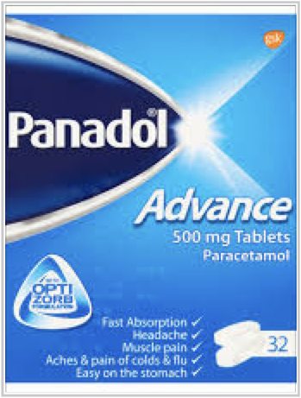
Paracetamol
Has analgesic and antipyretic effects but little or no anti inflammatory action.
It is less irritating to the stomach
can be given to children from 2 to 3 months old
effectiveness in the management of migraine is limited.
Can cause liver toxicity in overdose

Slide 19
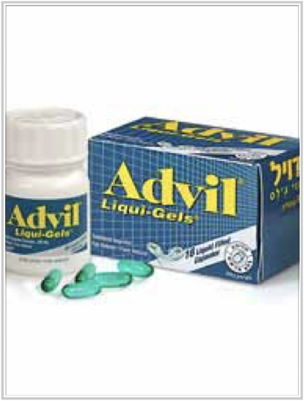
Ibuprofen
has analgesic, anti-inflammatory and antipyretic activities
causes less irritation and damage to the stomach than does aspirin.
Dose for analgesic activity is 200–400 mg and that for anti-inflammatory action 300–600 mg.

Slide 20

Ibuprofen
The maximum daily dose allowable for OTC use is 1200 mg
Ibuprofen tablets or capsules should not be given to children under 12 years.
Ibuprofen suspension 100 mg in 5 ml is available OTC

Slide 21
Ibuprofen, like other NSAIDs,can be irritating to the stomach,causing indigestion, nausea and diarrhoea
GI bleeding can also occur
This bleeding effect is reversible within 24 h of stopping the drug.
Ibuprofen seems to have little or no effect on whole blood clotting or prothrombin time,but it is still not advised for patients taking anticoagulant medication

Slide 22
best avoided in patients with congestive heart failure or renal impairment.
They should be avoided in pregnancy, particularly during the third trimester.
Breastfeeding mothers may safely take ibuprofen
Drug interaction with lithium.
NSAIDs are best avoided in aspirin-sensitive patients and should be used with caution in people with asthma.

Slide 23
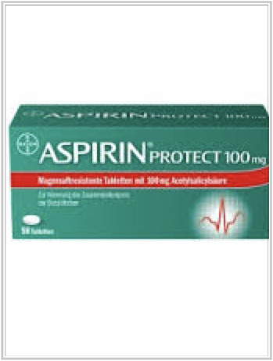
Aspirin
Aspirin is analgesic, antipyretic and also anti-inflammatory if given in doses of 600–900mg three to four times daily.
It should not be given to children under 16 years
It should not be used for gout or where there is history of gout.
Cause Gastric irritation
can cause GI bleeding and hypersensitivity
Not recommended during pregnancy

Slide 24
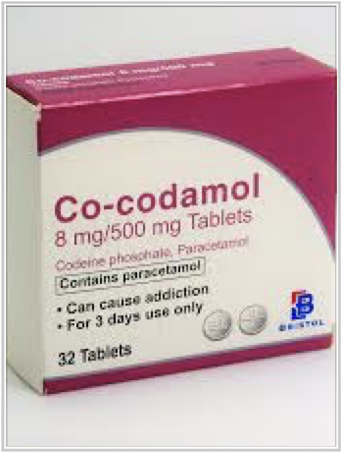
Codeine & Dihydrocodeine
narcotic analgesic
commonlyfoundincombination products with aspirin, paracetamol or both
Constipation is a well recognised side effect
should only be used in children over 12 years old
Codeine should also not be used by breastfeeding mothers

Slide 25
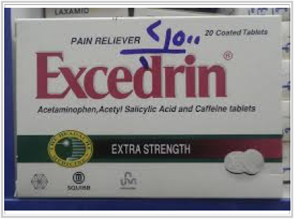
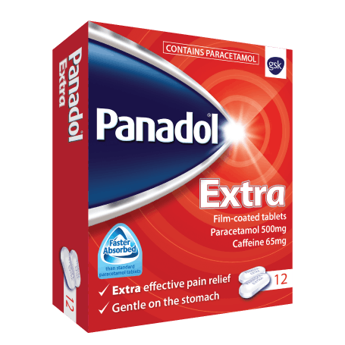
Caffeine
Is included in some combination analgesic products to produce wakefulness and increased mental activity.
Best avoided near bedtime because of their stimulant and diuretic effect.
Increases the effectiveness of analgesics

Slide 26
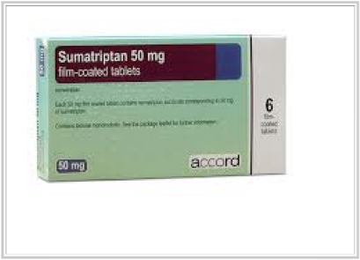
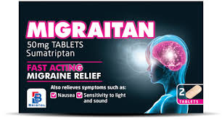
Sumatriptan
50 mg tablets can be used OTC for acute relief of migraine with or without aura
used by people aged between 18 and 65 years
A 50 mg tablet is taken as soon as possible after the migraine headache starts.

Slide 27
A second dose can be taken at least 2 h after the first if symptoms come back.
A second dose should be taken only if the headache responded to the first dose.

Slide 28
Caution
People with three or more of the following cardiovascular risk factors are not suitable for OTC sumatriptan:
men aged over 40 years
post-menopausal women
people with hypercholesterolemia
Regular smokers (10 or more daily)

Slide 29
obese people with body mass index of more than 30 kg/m2
those with diabetes; or those with a family history of early heart disease
either father or brother had a heart attack or angina before the age of 55 years or mother or sister had a heart attack or angina before the age of 65 years.

Slide 30
Contraindication
people with known hypertension
previous myocardial infarction
ischemic heart disease, peripheral vascular disease
coronary vasospasm/Prinzmetal’s angina, cardiac arrhythmias (including Wolff–Parkinson–White syndrome)
hepatic or renal impairment
epilepsy,a history of seizures and cerebrovascular accident or transient ischemic attack.

