Slide 1
Haemorrhoids
L.Dr. Abeer A. Rashid

Slide 2
They are swollen vascular cushions, which protrude into the anal canal (internal piles)
They may swell so much that they hang down outside the anus (external piles)

Slide 5
What you need to know
Duration and previous history
Symptoms Itching, burning, Soreness, Swelling, Pain, Blood in stools, Constipation ,Bowel habit, Pregnancy
Other symptoms ,Abdominal pain/vomiting, Weight loss, Medication

Slide 6
When to refer
Duration of longer than 3 weeks
Presence of blood in the stools
Significant pain
Change in bowel habit (persisting alteration from normal bowel habit)

Slide 7
Suspected drug-induced constipation
Associated abdominal pain/vomiting
Malaise, fever or weight loss

Slide 8
Treatment timescale If symptoms have not improved after 1 week, patients should see their doctor.

Slide 9
Management
1. Local anaesthetics (e.g. benzocaine and lidocaine [lignocaine])

Slide 10
Skin protectors
zinc oxide and kaolin
Or White petroleum jelly

Slide 11
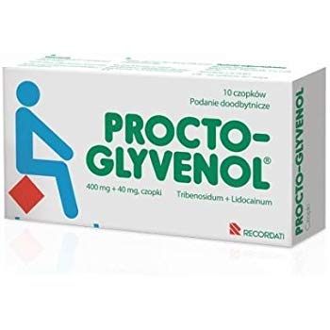
Topical steroids
Ointment and suppositories containing hydrocortisone

Slide 12
Astringents
zinc oxide, hamamelis (witch hazel) and bismuth salts

Slide 13
Antiseptics
Resorcinol

Slide 14
Counterirritants
Menthol and phenol

Slide 15
Shark liver oil/live yeast
Laxatives

Slide 16
How to use OTC products
Ointments and creams can be used for internal and external haemorrhoids and should be applied in the morning, at night and after each bowel movement.

Slide 17
Suppositories can be recommended for internal haemorrhoids
a suppository should be inserted in the morning, at night and after bowel movements. Insertion is easier if the patient is crouching or lying down.

